Slide 1
Improving Your Life with mpi4py
Or
How I Learned to Stop Worrying and Love Parallelization
Jacob Seiler

Slide 2
Overview
What is MPI?
When should I use MPI?
Examples!

Slide 3
What is MPI?
MPI stands for Messenger Passing Interface.
Provides a standard design for passing messages across multiple processors.
Black magic that makes your code run faster.
mpi4py provides bindings for using MPI in Python. Same underlying machinery but has a few extra perks (e.g., communicating arrays across processors).
Notes:
Can be physically one machine or in a supercomputer (separate discrete things).

Slide 4
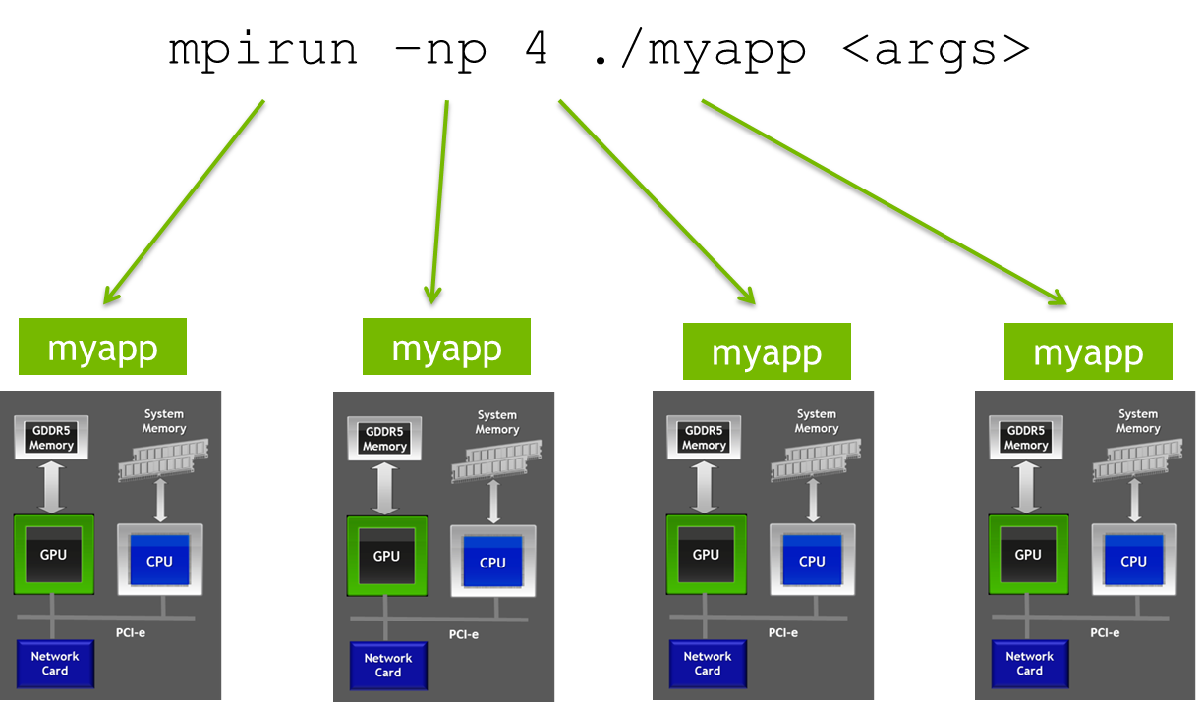
What is MPI?

Slide 5
When to use MPI?
Always.
When multiple, similar operations are being performed (look for “for” loops).
There are two broad classes of problems that can be solved with MPI:
Embarrassingly Parallel: In this case the operations are completely independent of each other. E.g., Running a program on 64 different initial conditions.
Communication Intensive: This class requires heavy communication between processors. E.g., N-body simulation where processors need to communicate their updated position at the end of each time step.

Slide 6
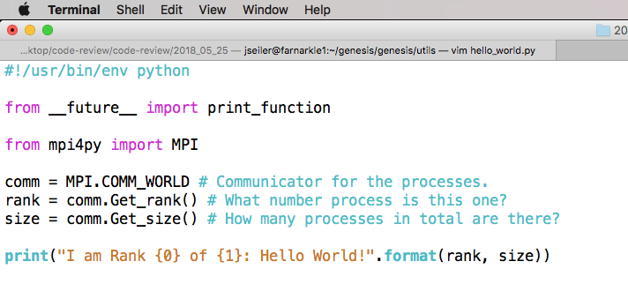
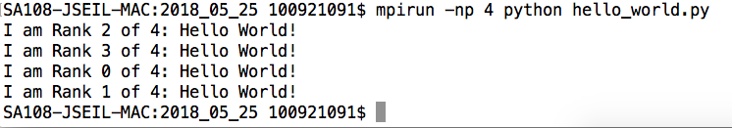
mpi4py: The Basics

Slide 7
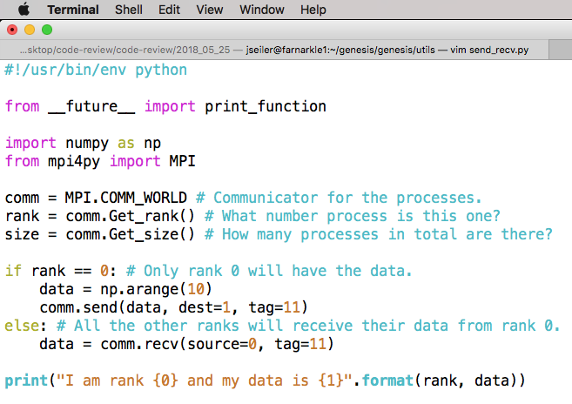
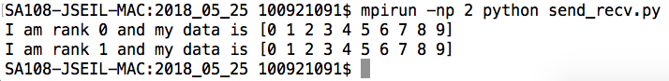
mpi4py: Send/Receive

Slide 8
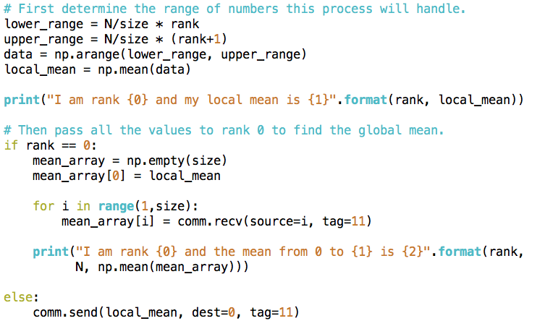
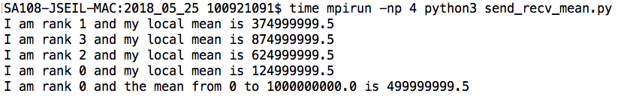
mpi4py: Send/Receive

Slide 9
mpi4py: Send/Receive
For N = 1e9:
Time on 1 Processor: 5.922s
Time on 4 Processors: 2.311s
If you did this for 1000 time steps, MPI would save you 1 hour!

Slide 10
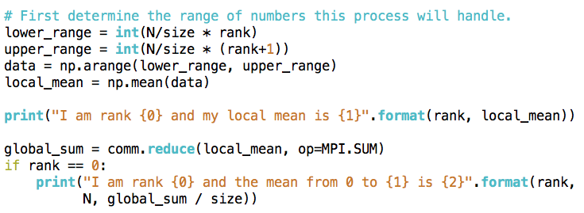
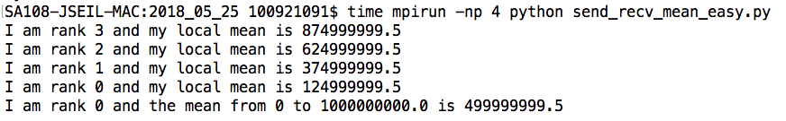
mpi4py: Send/Receive

Slide 11
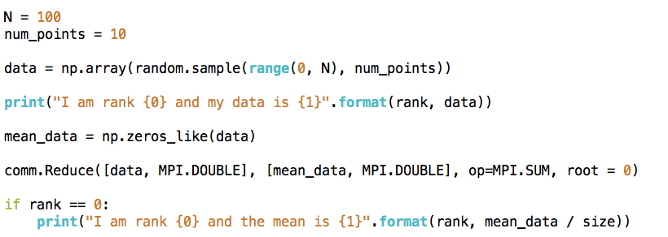
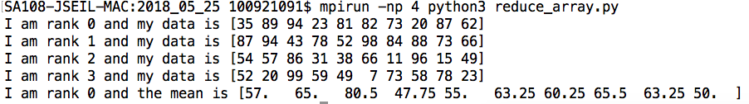
mpi4py: Send/Receive

