Slide 1

Running LLMs on OzSTAR

Slide 2
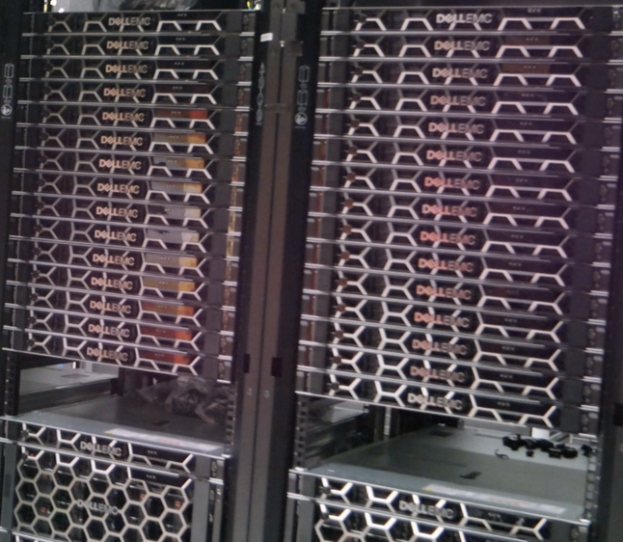
Resources
Read the OzSTAR docs: https://supercomputing.swin.edu.au/docs/
Each node on Ngarrgu Tindebeek has:
Dell PowerEdge XE8545 Server
2 x AMD EPYC 7543 2.8 GHz 32-core processors
4 x NVIDIA A100 80 GB GPUs
512 or 1024 GB DDR5 RAM
2 TB NVMe local SSD
P100s are also available in plenty (12GB VRAM) on old OzSTAR nodes

Slide 3

Limitations
On the supercomputer, everything has to be done in user space (no sudo, no choice of OS)
You have to wait for a job to run, or to get interactive access to a job node
Job nodes don’t have internet access - there’s a workaround!
You have to learn how to use Slurm
A few hoops to jump through!
With great power…

Slide 4
Modules
To access libraries and configure the compute environment, use the module system. See https://supercomputing.swin.edu.au/docs/2-ozstar/Modules.html and module help
In particular:
cuda/11.7.0 cudnn/8.4.1.50-cuda-11.7.0 cutensor/1.6.1.5-cuda-11.7.0
cuda/12.0.0 cudnn/8.8.0.121-cuda-12.0.0
cuda/12.4.0

Slide 5
Containers
You can run containerized code on OzSTAR, using apptainer (no docker).
This works:
apptainer run docker://ubuntu:latest
You can also build your own images, convert to SIF and run locally.
docker build -t myimage .
apptainer build ollama-webui.sif docker-daemon://myimage:latest
Or use apptainer’s build syntax natively.

Slide 6
Apptainer demo

Slide 7
Apptainer demo cont

Slide 8
LLM runners
There are various ways to run LLMs, popular choices include:
Ollama (https://ollama.com/)
Llama.cpp (https://github.com/ggerganov/llama.cpp)
Llamafile (https://github.com/Mozilla-Ocho/llamafile)
All of these will work on OzSTAR.

Slide 9
Using ollama
https://asciinema.org/a/n9Nsvat8qgFrr6iZ4QGIvvGzD

Slide 10
Accessing your model
You can forward a port from your local machine to OzSTAR to interact with your model easily.
For instance, for a model running on node gina302 using ollama on port 11434:
On your machine, run
ssh -N -L 11434:localhost:11434 -J nt gina302
Then access the model at localhost:11434

Slide 11
Internet access (e.g. to Huggingface)
Job nodes can get access to the internet via a proxy.
This is easiest for python script and others that respect environment variables:
export ALL_PROXY=socks5://localhost:5150
export HTTPS_PROXY=socks5://localhost:5150
Then run the proxy like this:
ssh -f -C -q -N -D 5150 tooarrana1
This sets up a proxy that routes traffic via the head node.
Your python installation might need to install pysocks and/or socks

Slide 12
Internet access 2
If the socks proxy isn’t enough, there is a way to route all traffic through the proxy transparently - it works, but it’s annoying.
The steps:
In your container or environment, make proxychains4 available.
E.g. apt install -y proxychains4
Add a file called proxychains.conf (in container, copy to /etc/proxychains.conf):
proxy_dns
[ProxyList]
socks5 127.0.0.1 5150
Preface any command you run with proxychains4 (or proxychains4 -f /path/to/proxychains.conf)

Slide 13
Example

