Slide 1


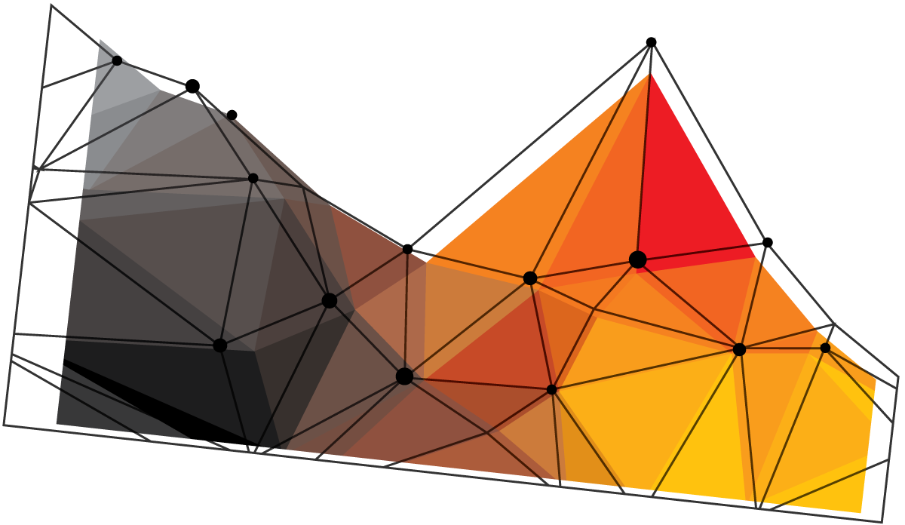
Hackathon 3.0
THE
SAVIOUR
ToulikDas
ChoudharyTushar .
TEXTBOOKS/e-BOOKS
IN A JIFFY

Slide 2

The project
WHAT IS THE PROJECT?
About
VR ON THE WEB IS PART OF THE FUTURE.
Being able to search an e-book or a textbook from the luxury of one’s place AND in Virtual Reality (VR).
It’s fun and intuitive.
00
01
10
11
Notes:
To change the image behind the Mock up.
Select the layer - > Right Click -> Send to Back -> Delete the image -> Drag & Drop your Own Picture -> Send to Back (again)

Slide 3

MOTIVE
JUST WHY?
Motive?
This helps students, like you and me.
And people who don’t want to purchase books.
00
WEBVR IS UNIVERSAL—JUST CODE ONCE
BUT are you stealing money from the authors?
Piracy—yes. Stealing—no.
We all know textbooks, especially Engineering and Medical can cause a hefty amount. Sure you can visit the library, but this project of ours might help out the lazy ones out there, hah.
01
10
11
Notes:
To change the image behind the Mock up.
Select the layer - > Right Click -> Send to Back -> Delete the image -> Drag & Drop your Own Picture -> Send to Back (again)

Slide 4
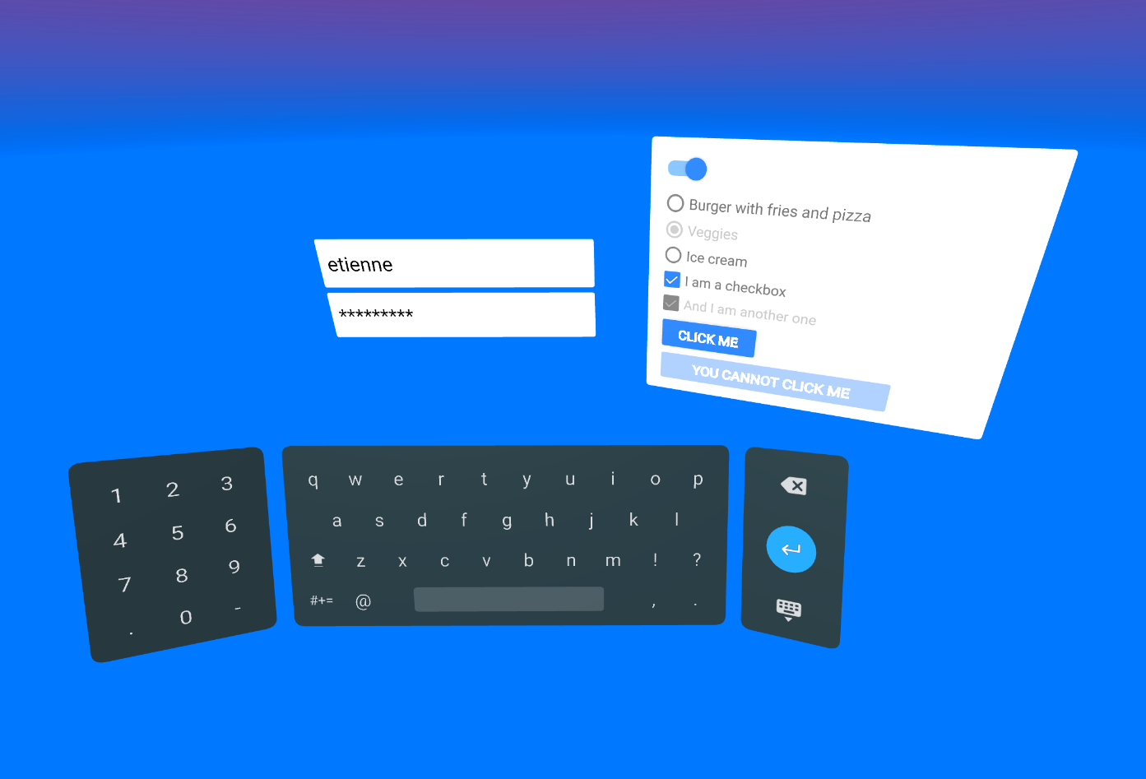


The-HOW
Part
This is the fun part. Sit back.
We’re going to implement this with WebVR. Using A-frame.
It would be following the Google Material Design Guideline.
00
IMPLEMENTATION?
#WebVRready
theFuture.
01
10
11
Using frame
A-frame is a web framework for building virtual reality (VR) experiences. A-Frame supports most VR headsets such as Vive, Rift, Windows Mixed Reality, Daydream, GearVR, Cardboard, Oculus Go, and can even be used for augmented reality.

Slide 5
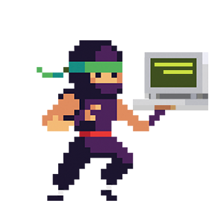
SOURCES
Books
libgen.io
b-ok.org
mobilism.org
sci-hub.tw
booksc.org
freebookspot.es
ebookee.org
00
Sources the prototype will fetch from.
Comics
getcomics.info
comicextra.com
readcomiconline.net
Courses
01
10
11
MIT Open Courseware
-ocw.mit.edu
Stanford University
-web.stanford.edu
UC Berkeley
-inst.eecs.Berkeley.edu

Slide 6


THANK YOU
Made with by Tushar and Toulik

