Slide 1
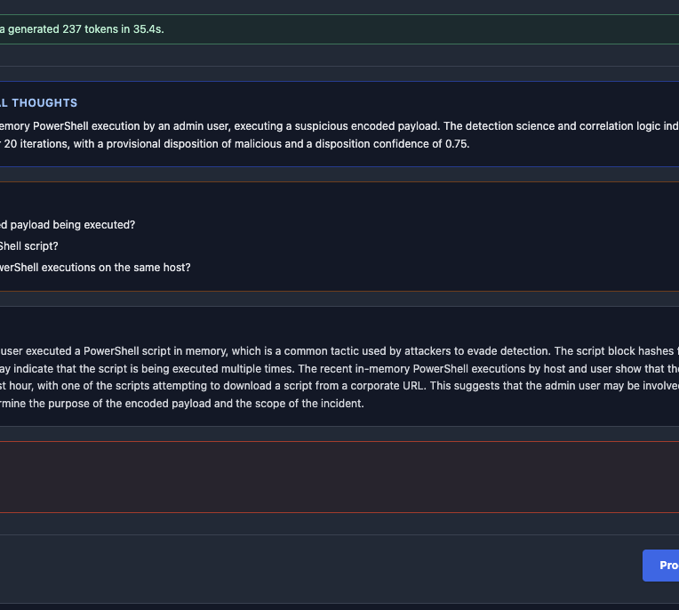
SOC PLATFORM
Evidence-driven
security investigations
From notable event to defensible closure with local AI, grounded SPL, and a durable evidence ledger.
LOCAL AI
AUDITABLE
ANALYST-GUIDED
Feature overview and demonstration guide
September 2026
Notes:
Open with the platform’s core promise: AI accelerates analysis, while the analyst controls evidence, inquiry resolution, and closure readiness.
Source: SOC Platform project and UI screenshots supplied by the project owner. Demo records are synthetic.

Slide 2
PLATFORM OVERVIEW
One workspace for the full investigation lifecycle
The application connects detection content, analyst evidence, local AI analysis, and structured closure.
Notables
Rule context
AI analysis
SPL follow-up
Evidence ledger
Closure
Cases and alerts
Detection logic
Ollama reasoning
Targeted searches
Durable findings
Defensible notes
Analyst control plane
01
Editable SPL
02
Explicit resolution
03
Persistent case state
Tune searches before running them in Splunk.
Mark whether evidence resolves a specific inquiry.
Resume locally without restarting the investigation.
SOC PLATFORM
02
Notes:
Walk left to right through the capability chain. Emphasize that the AI is grounded in case evidence and approved query cards rather than operating as an unbounded chatbot.
Source: SOC Platform project and UI screenshots supplied by the project owner. Demo records are synthetic.

Slide 3
OPERATOR WORKFLOW
Progress forward, create new phases only when needed
The analyst never has to jump backward to reopen an old phase.
1
2
3
4
5
Evidence
Initial
Follow-up
Verdict
Closure
Collect case facts
Form hypothesis
Resolve inquiries
Evaluate gates
Generate notes
Dynamic phase engine
If blockers remain, add Phase 3, Phase 4, or later rounds with only the searches still required.
Resolved inquiries leave the active list but remain available for audit and additional evidence.
SOC PLATFORM
03
Notes:
Describe the progression as a controlled investigation loop. Follow-up phases are created only when closure gates identify remaining work.
Source: SOC Platform project and UI screenshots supplied by the project owner. Demo records are synthetic.

Slide 4
CASE FOUNDATION
Start with a case, rule, and evidence package
The demonstration uses one synthetic PowerShell incident to exercise every workflow stage.
Seed evidence
TEST-POWERSHELL-1
PowerShell In-Memory Execution
2026-09-10 23:40:18 WIN-APP-042 admin.jlee
powershell.exe -NoP -NonI -W Hidden -Enc SQBFAFgA...
ParentImage: C:\Windows\System32\svchost.exe
Host
WIN-APP-042
User
admin.jlee
Process
powershell.exe
Parent
svchost.exe
Initial questions
1
What is the encoded payload’s purpose?
SYNTHETIC TEST CASE
2
Is the PowerShell script known or unknown?
Designed to validate workflow behavior without exposing production telemetry.
3
Are there other suspicious executions on the host?
SOC PLATFORM
04
Notes:
This is the sample case used throughout the deck. All timestamps, identities, URLs, hashes, and observations are synthetic demonstration data.
Source: SOC Platform project and UI screenshots supplied by the project owner. Demo records are synthetic.

Slide 5
FEATURE 1
Initial AI assessment turns raw evidence into a plan
Local Ollama analysis proposes a hypothesis, focused questions, investigative reasoning, and a preliminary verdict.
35s
analysis time
75%
confidence
3
open inquiries
SOC PLATFORM
05
Notes:
Show how the first analysis is structured for readability. The questions become the explicit targets for later SPL and closure gating.
Source: SOC Platform project and UI screenshots supplied by the project owner. Demo records are synthetic.

Slide 6
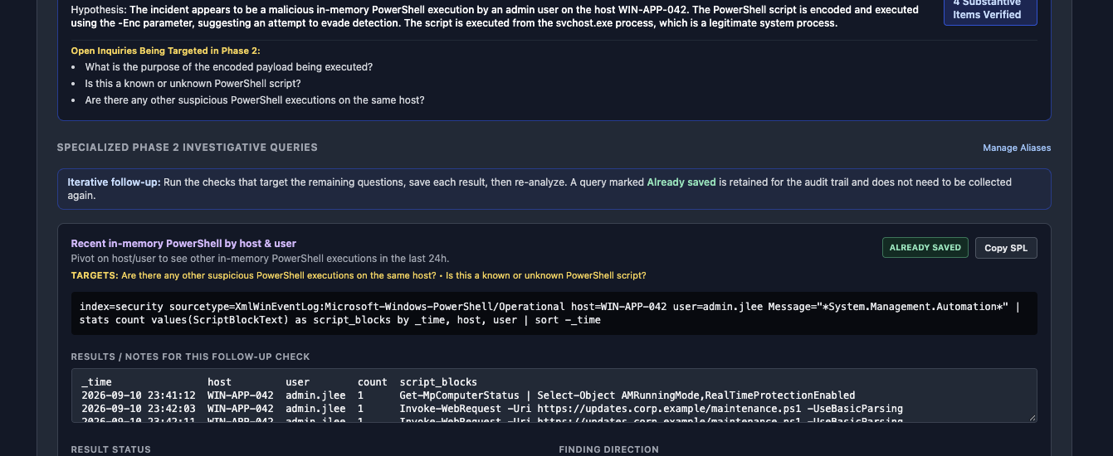
FEATURE 2
Grounded follow-up queries inherit the investigation context
Approved query cards target the exact questions that remain open and preserve previously saved results.
INHERITED HYPOTHESIS
QUESTION TARGETS
ALREADY SAVED
AUDIT TRAIL
SOC PLATFORM
06
Notes:
Point out that query generation is grounded in Phase 1 questions. Saved cards are retained and do not need to be collected again during a new analysis pass.
Source: SOC Platform project and UI screenshots supplied by the project owner. Demo records are synthetic.

Slide 7
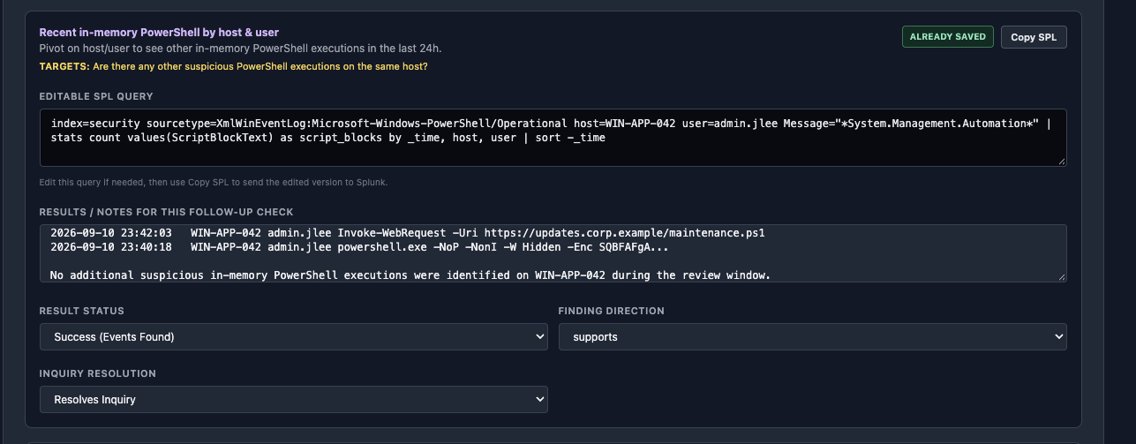
FEATURE 3
Analysts can edit SPL and classify every finding
The workflow records whether a search succeeded, whether it supports or refutes the hypothesis, and whether it resolves an inquiry.
EDIT
Adjust SPL before sending to Splunk
CLASSIFY
Success, failure, supports, or refutes
RESOLVE
Close a named investigative inquiry
SOC PLATFORM
07
Notes:
The analyst remains accountable for the search and its meaning. Editing avoids dead ends when field names or indexes differ across Splunk environments.
Source: SOC Platform project and UI screenshots supplied by the project owner. Demo records are synthetic.

Slide 8
DEMO EVIDENCE
Three targeted checks resolve the PowerShell case
Each record below is synthetic and intentionally mapped to one investigation question.
01
Payload context
Decoded command uses Net.WebClient.DownloadString and IEX against
https://updates.corp.example/payload.ps1
SUPPORTS
02
Recent activity
Maintenance script plus the encoded event. No additional suspicious
in-memory execution was identified in the review window.
REFUTES
03
Script hash
7f3a9c2e1b4d6a8f9c0e11223344556677889900 was absent from
the authorized baseline and known-good catalog.
SUPPORTS
SYNTHETIC DATA
Use these records to reproduce the demonstration without production telemetry.
SOC PLATFORM
08
Notes:
Present the three result sets in the same order as the original questions. The payload supports a malicious finding, the activity review narrows scope, and the hash confirms the script is not approved.
Source: SOC Platform project and UI screenshots supplied by the project owner. Demo records are synthetic.

Slide 9
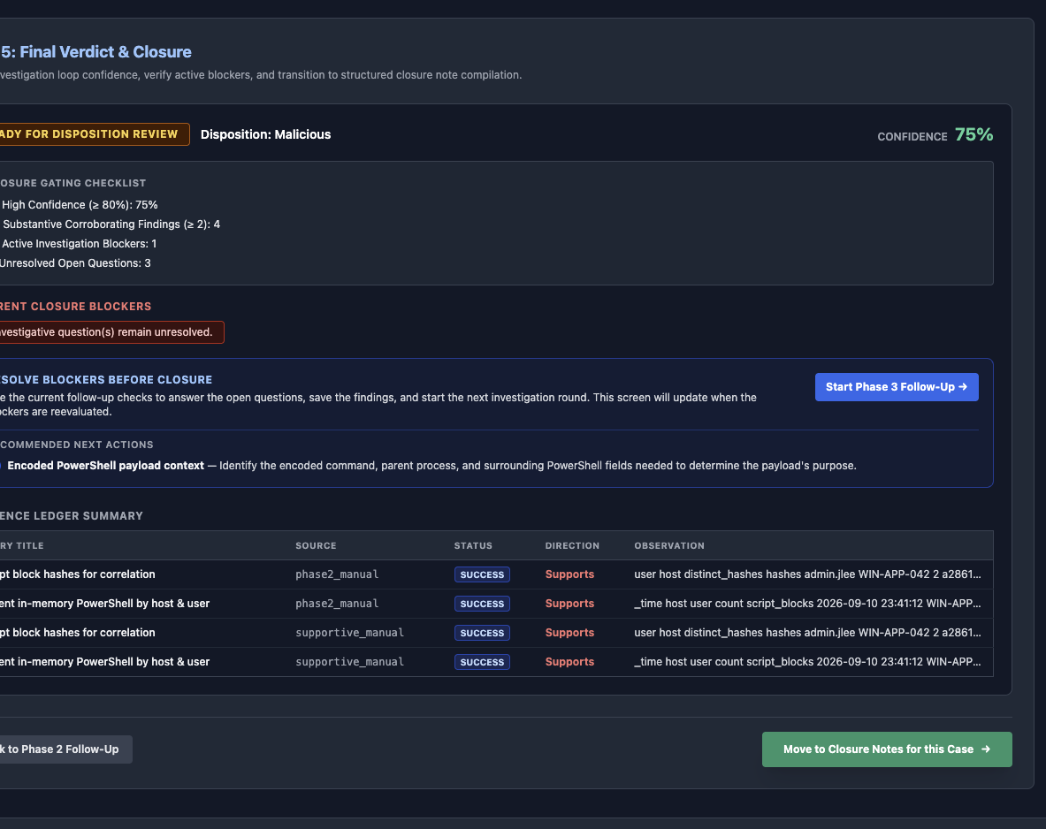
FEATURE 4
New investigation phases appear only when required
Closure blockers drive the next round. Completed phases stay preserved and visible.
PHASE 2
Broad follow-up
PHASE 3
Payload context
PHASE 4
Remaining inquiries
No forced restart. No duplicate collection.
SOC PLATFORM
09
Notes:
Use this slide to explain the key workflow change: the analyst moves forward into a new targeted phase instead of being sent backward to Phase 2.
Source: SOC Platform project and UI screenshots supplied by the project owner. Demo records are synthetic.

Slide 10
FEATURE 5
Resolved inquiries leave the active queue without losing history
The interface stays clean while additional evidence remains possible.
Active inquiry
Resolve
Resolved
More evidence
Visible in the current work queue
Select the named inquiry when saving evidence
Hidden from active work and retained for audit
Reopen a resolved item when more validation is needed
Analyst experience
Unresolved questions remain prominent. Resolved questions move to a collapsible section, keeping their evidence, status, source phase, and audit history intact.
Outcome: less clutter with no loss of investigative traceability.
SOC PLATFORM
10
Notes:
Explain that resolution changes the work queue, not the evidence record. This design supports both speed and defensibility.
Source: SOC Platform project and UI screenshots supplied by the project owner. Demo records are synthetic.

Slide 11
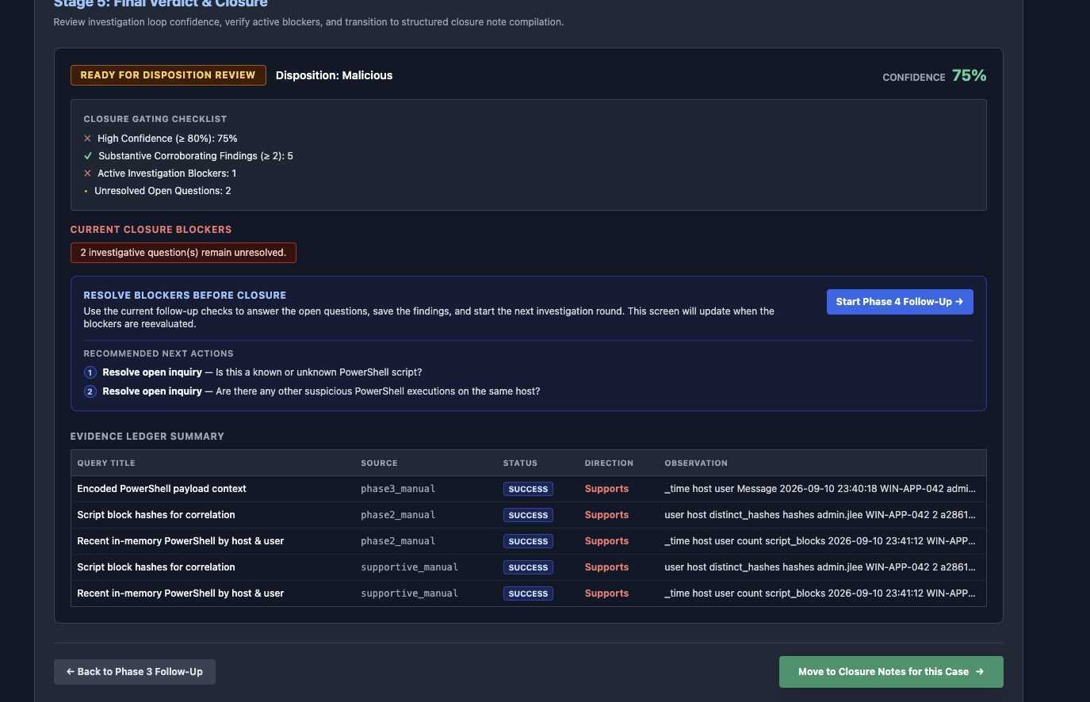
FEATURE 6
A durable evidence ledger preserves every investigation round
Phase-specific sources make the timeline understandable and support returning to a case later.
phase2_manual
Initial follow-up results
phase3_manual
Payload identification
phase4_manual
Final inquiry resolution
supportive_manual
Corroborating checks
Local PostgreSQL keeps case state, evidence, phase analyses, and closure records available across restarts.
SOC PLATFORM
11
Notes:
The evidence ledger is more than a result table. It preserves source phase, status, direction, observation, and the inquiry relationship.
Source: SOC Platform project and UI screenshots supplied by the project owner. Demo records are synthetic.

Slide 12
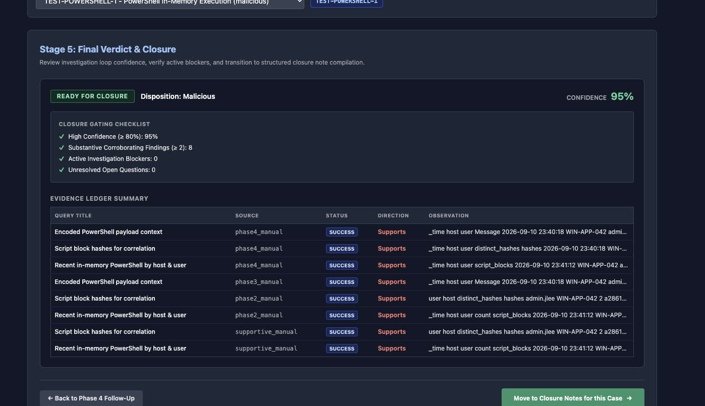
FEATURE 7
Closure readiness is evaluated with explicit gates
Confidence, corroboration, blockers, and unresolved questions remain visible before closure.
95%
confidence
8
substantive findings
0
active blockers
0
open questions
SOC PLATFORM
12
Notes:
The case reaches Ready for Closure only when every gate passes. In the test case, confidence rises to 95 percent and all three inquiries are resolved.
Source: SOC Platform project and UI screenshots supplied by the project owner. Demo records are synthetic.

Slide 13
FEATURE 8
Structured closure notes connect the case to the correct rule
The final step packages disposition, evidence, analyst reasoning, and rule context for handoff.
Closure note
What gets carried forward
CASE
TEST-POWERSHELL-1
✓
Selected detection rule
RULE
PowerShell In-Memory Execution
✓
Final disposition and confidence
Malicious
✓
Resolved inquiry trail
DISPOSITION
✓
Supporting and refuting evidence
CONFIDENCE
95%
✓
Structured analyst narrative
ANALYST SUMMARY
Encoded payload retrieved and executed unapproved content. Scope review found no additional suspicious executions.
ANALYST-REVIEWED OUTPUT
SOC PLATFORM
13
Notes:
Closure generation is tied to a populated rule list and the selected case. The generated note is structured for review and handoff, not treated as an autonomous final decision.
Source: SOC Platform project and UI screenshots supplied by the project owner. Demo records are synthetic.

Slide 14
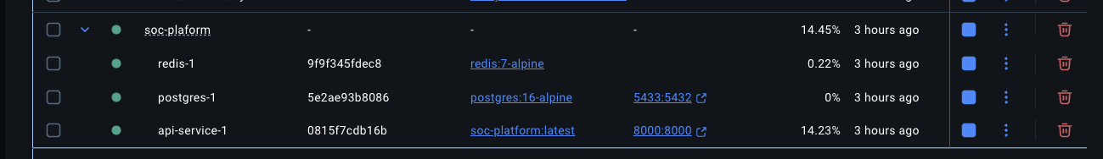
OPERATIONS
Local-first architecture keeps data under operator control
The same workflow can be tested on Linux or macOS and brought back to Windows.
Browser UI
FastAPI
PostgreSQL
Ollama
Splunk
Investigation workspace
Workflow and persistence APIs
Cases, evidence, analyses
Local llama3.1 analysis
Analyst-run SPL
Deployment choices
Docker Compose for portable setup
Native API restart script for rapid local testing
Database dump and import workflow for coworker handoff
Secrets stay local
Use .env and .pgpass for seamless restarts. Database passwords and dumps remain outside Git.
SOC PLATFORM
14
Notes:
Explain that the architecture supports a local testing loop and future Windows deployment. Do not expose credentials in Git or presentation materials.
Source: SOC Platform project and UI screenshots supplied by the project owner. Demo records are synthetic.

Slide 15
DEMONSTRATION RESULT
The test case moved from suspicion to closure-ready evidence
The workflow produced a measurable improvement in confidence and eliminated every investigation blocker.
75%
95%
3
0
8
Initial confidence
Final confidence
Questions opened
Questions remaining
Substantive findings
Suspicious encoded command
Targeted evidence collected
Scope narrowed
Inquiries resolved
Closure ready
Outcome
A malicious disposition supported by a transparent evidence trail, explicit analyst decisions, and reproducible search results.
SOC PLATFORM
15
Notes:
Use this as the executive summary of the demonstration. The important result is not only the 95 percent confidence, but also the visible path that produced it.
Source: SOC Platform project and UI screenshots supplied by the project owner. Demo records are synthetic.

Slide 16
PRESENTATION GUIDE
A concise live demo path for every major feature
Use the sample PowerShell case to tell one continuous story from intake to closure.
01
Open the case
02
Run initial analysis
Show notable details, rule context, and seed evidence.
Call out the hypothesis, three questions, and 75% verdict.
03
Collect follow-up evidence
04
Advance phases
Edit SPL, paste results, classify direction, resolve inquiries.
Demonstrate automatic Phase 3 or Phase 4 creation only when blocked.
05
Review the ledger
06
Close the case
Trace phase sources and saved observations across restarts.
Verify 95%, zero blockers, select the rule, and generate closure notes.
READY TO PRESENT
Repository: github.com/swinneyj/soc-plaform
SOC PLATFORM
16
Notes:
Use this slide as the speaker checklist. A complete demo should take about ten to fifteen minutes and should end with the evidence ledger and closure note rather than only the AI verdict.
Source: SOC Platform project and UI screenshots supplied by the project owner. Demo records are synthetic.

