Slide 1
GlucoTwin
A digital twin for Type 2 Diabetes that predicts glucose spikes 2 hours ahead, explains why, and simulates what would prevent them
Team GlucoTwin · Utkarsh Pal, Ayush Choubey
Birla Institute of Technology (BIT), Mesra
Happiest Health Digital Twin Challenge 2026
All data synthetic · research prototype, not a medical device
Notes:
GlucoTwin is a proof-of-concept digital twin of a type 2 diabetes patient. It fuses the health record with wearable streams, predicts a glucose spike two hours ahead, explains the prediction, and lets a doctor test what-if changes. Everything runs on synthetic data.

Slide 2
Between clinic visits, nobody sees the spike coming
100M+
90 days
288
people in India live with diabetes, most with type 2
between HbA1c tests: one number for a whole quarter
CGM readings a day that sit apart from the health record
The data exists, but it is split in two
The EHR explains who the patient is. Wearables show what their glucose is doing. Clinicians get either a lab value every three months or a raw CGM trace.
Neither tells them what is about to happen, or what would change it.
Notes:
India has over 100 million people with diabetes. Glucose swings with every meal, walk and short night of sleep, but the doctor sees a lab value every three months or a raw CGM trace. Neither predicts the next spike or says what would prevent it.

Slide 3
One twin per patient: predict, explain, simulate
1
2
3
Predict
Explain
Simulate
Probability that glucose will exceed 180 mg/dL in the next 2 hours, updated every 5 minutes
Top 3 reasons in plain English from SHAP, e.g. "Ate 105 g carbs, 10 min ago — raises risk"
What-if: a smaller meal, a 20-minute post-meal walk or a better night's sleep, as a new glucose curve and risk
Inputs fused per patient: static EHR (age, sex, BMI, HbA1c, diagnoses, metformin, lipids) + dynamic wearables (CGM every 5 min, steps, heart rate, sleep, meals)
Notes:
The twin does three things. It predicts the probability of crossing 180 in the next two hours. It explains why in plain English using SHAP. And it simulates interventions: a smaller meal, a walk after eating, or better sleep.

Slide 4
From synthetic records to a doctor's dashboard
Synthea EHR
src/ehr
src/wearable
src/features
1,171 synthetic patients, CSV
Adults with T2D or prediabetes → 238 patients
Physiological simulator: 14 days × 5 min CGM, HR, steps, meals, sleep
32 features + label, 948k rows
Streamlit dashboard
FastAPI
src/twin
src/model
Risk-sorted patients, CGM + risk band, reasons, what-if sliders → clinician
/patients, /predict, /whatif
Edit meal, walk or sleep → re-simulate 2 h → re-score
LightGBM, patient split, baseline, SHAP reasons
The twin reuses the same simulator and feature code as training, so what-if results are scored by the same model.
Notes:
The pipeline runs left to right, then back along the bottom. Synthea gives synthetic health records. Our simulator generates two weeks of 5-minute wearable data per patient, seeded from that record. Features feed a LightGBM model with SHAP explanations. The twin re-runs the simulator with changed inputs. FastAPI serves it, and the Streamlit dashboard is what the doctor sees.

Slide 5
Wearable simulator grounded in diabetes physiology
A1c
Baseline from HbA1c
M
Indian carb-heavy meals
eAG (mg/dL) = 28.7 × HbA1c − 46.7. Simulated mean tracks eAG (r = 0.945)
3 meals + optional snack. Peak 45–75 min, scaled by carbs × insulin resistance (BMI, HbA1c)
S
Steps lower glucose
Z
Poor sleep raises resistance
Effect lasts 1–3 h, strongest after meals. Heart rate rises with activity
Under 6 h or low efficiency → higher next-day insulin resistance
Rx
Metformin
~
Realistic noise
Blunts the meal rise by 15%
Physiological drift + CGM sensor noise, clipped to 40–400 mg/dL. Deterministic per seed
Notes:
Each patient's wearable data comes from a deterministic simulator seeded by their record. Baseline glucose comes from HbA1c with the standard eAG formula. Meals follow Indian carb-heavy patterns and their effect scales with insulin resistance. Walking lowers glucose, poor sleep raises next-day resistance, metformin blunts the rise.

Slide 6
LightGBM on 32 fused features, split by patient
Task | Will max glucose in (t, t+120 min] exceed 180 mg/dL?
Unit | (patient, 5-minute timestamp)
Features | Glucose now, 15/30/60-min lags, rate of change, rolling stats, carbs and steps in last 1–2 h, minutes since meal, heart rate, last night's sleep, time of day, static EHR
Model | LightGBM · 500 trees · learning rate 0.05 · 31 leaves
Baseline | Naive rule: current glucose > threshold (swept)
Explain | SHAP TreeExplainer, related features grouped into plain-English reasons
No leakage between patients
178
60
train patients
test patients
GroupShuffleSplit by patient, never by row, checked by a unit test. Evaluated on 227,025 test moments where glucose is still ≤ 180, so the model must predict an upcoming spike.
Notes:
Every 5-minute moment for every patient is a training example, labelled by whether glucose crosses 180 in the next two hours. We split by patient so the model is always tested on people it has never seen, and we evaluate only on moments where glucose is still below 180.

Slide 7
Unseen patients: far better than the naive rule
95%
of spike events alerted in advance (1,219 / 1,282)
95 min
median warning before glucose crosses 180
0.66
recall at 80% precision (baseline: 0.00)
Notes:
On sixty patients the model never saw, AUROC is 0.97 versus 0.55 for the naive glucose-threshold rule, and AUPRC is 0.84 versus 0.16. At an alert threshold chosen for 80% precision, 95% of spike events get an alert first, with a median of 95 minutes of warning. These numbers are on synthetic data, which I'll come back to.

Slide 8
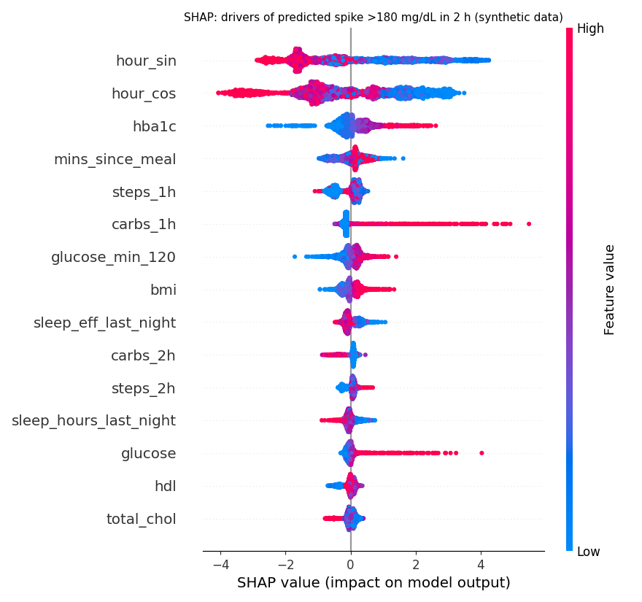
Every alert comes with reasons a clinician can check
Example reason shown on the dashboard
"Ate 105 g carbs, 10 min ago — raises risk"
Directions match physiology
More carbs, higher HbA1c and higher BMI raise risk
Recent walking and better sleep lower it
Top drivers: time of day, HbA1c, minutes since meal, steps and carbs in the last hour
Related SHAP features are grouped into the top 3 reasons per prediction
Notes:
SHAP shows why each prediction was made. The directions make sense: carbs, HbA1c and BMI push risk up, recent walking and good sleep push it down. On the dashboard we group these into three plain-English reasons.

Slide 9
A walk or a smaller lunch prevents the spike
Twin re-simulation of next 2 h | Spike prob. | Peak | Min > 180
As usual | 100% | 198 mg/dL | 40
20-minute post-meal walk | 36% | 173 mg/dL | 0
60 g lunch instead of 105 g | 0% | 160 mg/dL | 0
Walk and 60 g lunch | 0% | 137 mg/dL | 0
Demo patient be33d994
51-year-old woman with T2D, on metformin, BMI 29.3, hypertension
Slept 5.2 h, then ate a 105 g rice-heavy lunch at 13:15
Model risk at 13:25
98%
Across all 238 patients' lunches, a 20-minute walk lowers the simulated peak by 24 mg/dL on average and spike probability from 74% to 33%
Notes:
Here is the twin in action. Our demo patient slept badly and ate a 105-gram lunch; risk is 98%. The twin re-simulates the next two hours: a 20-minute walk cuts the spike probability to 36%, a 60-gram lunch to zero, and both together keep her peak at 137. Across all patients, a post-meal walk lowers the peak by 24 mg/dL on average.

Slide 10
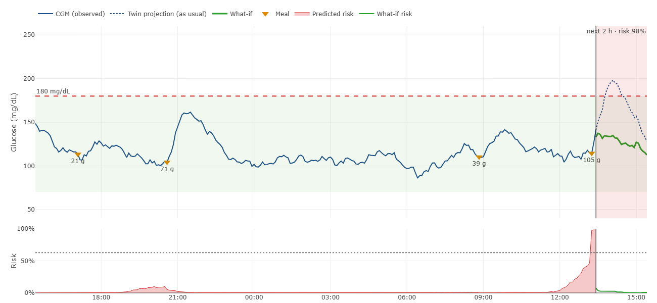
Dashboard: CGM, twin projection and what-if
Blue: observed CGM · Dotted: twin projection as usual (peaks at 198) · Green: what-if with walk + smaller lunch · Red band: predicted risk
Notes:
This is the dashboard chart for the same patient. The blue line is observed CGM, the dotted line is what the twin expects if nothing changes, and the green line is the what-if with a walk and a smaller lunch. The lower panel shows predicted risk rising after lunch.

Slide 11
Healthcare use case: triage now, coach with evidence
1
2
3
4
Rank
Understand
Test
Coach
Dashboard sorts all patients by current spike risk, so the care team sees who needs a nudge now
EHR card, 24 h CGM with risk band and the top 3 reasons for this patient
Move what-if sliders for meal carbs, a post-meal walk or sleep and see the new curve
Show the patient which change helps them most, using their own twin
Who benefits: diabetologists and diabetes educators managing many T2D patients between visits, and patients who get personalised, evidence-backed advice instead of generic rules.
Notes:
In practice: the care team opens the dashboard, sees patients ranked by risk, checks why a patient is flagged, tests changes on the twin, and shows the patient which change helps them most.

Slide 12
What these results do and do not show
!
The model partly learns our simulator
T
Time of day is too strong
Metrics show how well it recovers our physiology rules, not real-world accuracy. Validation on real CGM data is future work.
Everyone eats at similar times, so the clock alone reaches AUROC 0.935. Without time features: AUROC 0.927, AUPRC 0.68.
P
Population mismatch
W
Single-lever what-ifs
Synthea models a US population; HbA1c tops out at 7.5% (39 T2D, 199 prediabetes). Meals are Indian, demographics are not.
Meal composition (fibre, protein, GI), medication timing and stress are not modelled.
All data is synthetic (Synthea + our simulator): no real person's data, safe under DPDP Act 2023 and HIPAA. GlucoTwin is a research prototype, not a medical device.
Notes:
We want to be clear about limits. The model partly learns our own simulator, so these metrics are not real-world performance. Time of day is an over-strong signal. Synthea is a US population with a narrow HbA1c range. And the what-ifs are single levers. All data is synthetic, and this is not a medical device.

Slide 13
Next steps
From a convincing prototype to a validated twin
Validate on real T2D CGM datasets
Personal meal schedules to tame the time-of-day signal
Meal composition, medication timing and stress in the simulator
Consent, encryption, access control and audit logging
Clinician pilot of the dashboard
Thank you
Team GlucoTwin · BIT Mesra
github.com/swinter-ctrl/GlucoTwin_BITMesra
All data synthetic · research prototype, not a medical device · MIT License
Notes:
Next we want to validate on real CGM data, give each patient their own meal schedule, enrich the simulator, add the security a real deployment needs, and pilot the dashboard with clinicians. Thank you.

