Slide 1
Higher education system of IRELAND
Overview of structure, features, and opportunities
Created by Tancerev Andrew
594-2 group
1

Slide 2
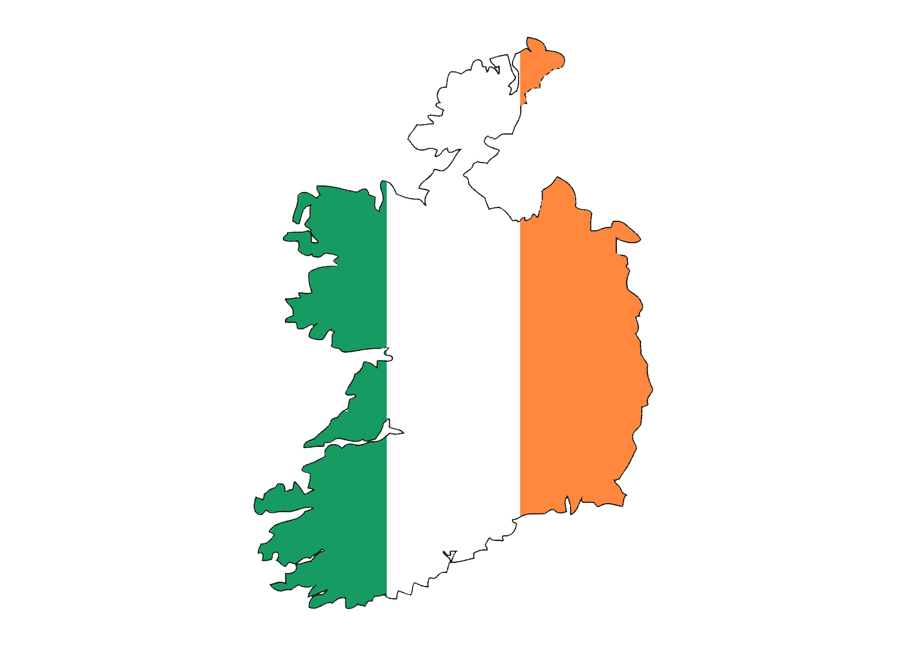
Introduction
Ireland is an island in Western Europe, near the United Kingdom.
People speak English and Irish (Gaelic).
The capital city is Dublin.
Ireland is famous for its music, dancing, and legends.
Ireland is known for its high-quality education system. It is a modern and innovative country that attracts students worldwide due to its global perspective and vibrant culture
2

Slide 3
Structure of Higher Education
Ireland’s higher education system consists of universities, technological institutes, and colleges.
Universities focus on research and advanced studies, while technological institutes emphasize practical skills and industry collaboration. Students can pursue undergraduate (bachelor’s), postgraduate (master’s), and doctoral (PhD) degrees. Additionally, there are private institutions offering specialized programs.
In Ireland, there are around 34 higher education institutions, including:
9 universities (e.g., Trinity College Dublin, University College Dublin).
11 technological universities and institutes (Technological Universities and Institutes of Technology).
14 other colleges, offering specialized education and training.
3

Slide 4
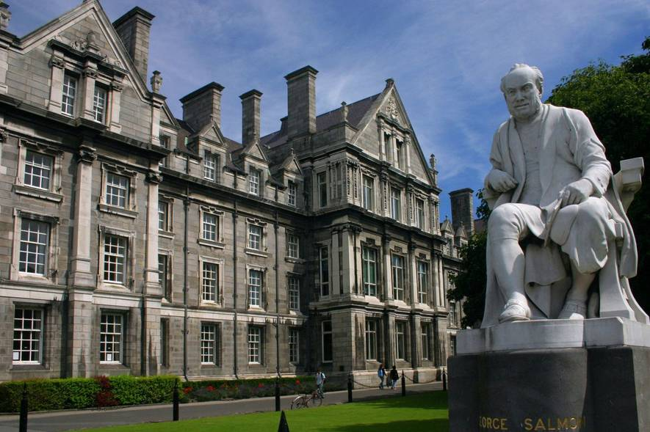
Not only universitates
Institutes of Technology
They offer applied programs in engineering, science, business and art. Focus on practical skills and innovation. Teacher Training Colleges (Colleges of Education)
Colleges of education
They specialize in teacher training for primary and secondary schools. A key role in the development of the educational system. Private business schools and IT schools
Private business and IT schools
Courses in management, entrepreneurship and technology. A modern approach to training, taking into account the needs of the labor market.
4

Slide 5

Tuition & Scholarships
The average cost for Russians is 15,000 EUR per year, the minimum price is 8000 EUR.
Refugees with an official status have the opportunity not to pay for their studies.
5

Slide 6
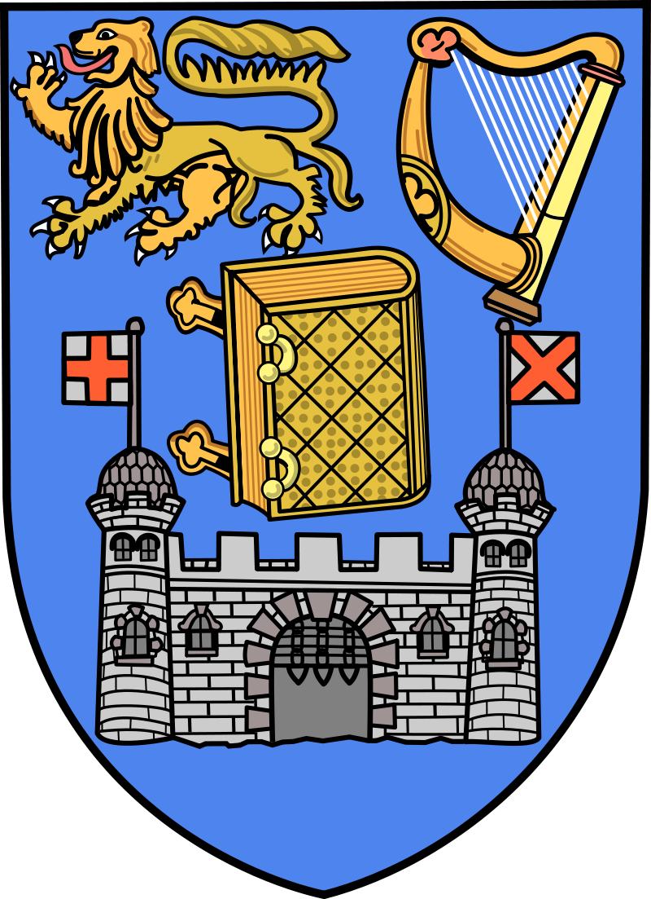

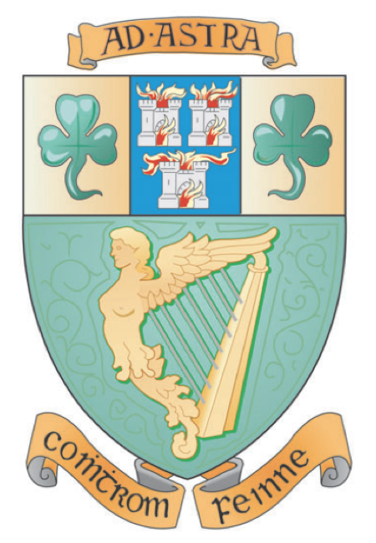
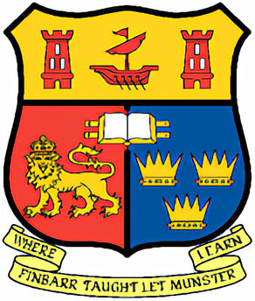

Universitates
There are 7 Higher education institutions in Ireland:
Trinity College Dublin (TCD)
University College Dublin (UCD)
University College Cork (UCC)
University of Limerick (UL)
Dublin City University (DCU)
National University of Ireland, Galway (NUIG)
Maynooth University (MU)
6

Slide 7

Admission to the university for Russians
Certificate of full secondary education
The application, written in the form of an essay
Diplomas, certificates
IELTS or TOEFL certificates
a certificate confirming solvency.
7

Slide 8
Advantages and disadvantages of studying in Ireland
Advantages
Disadvantages
The opportunity to receive a grant
The universality of the diploma
Part-time job
Ireland is security country
Sports and classes based on interests
It's hard to get in.
High tuition costs.
Cannot transfer from a Russian university to an Irish one.
8

Slide 9

Thanks for your attention
9

