Slide 1
Defuse the Bomb
JLZ

Slide 2
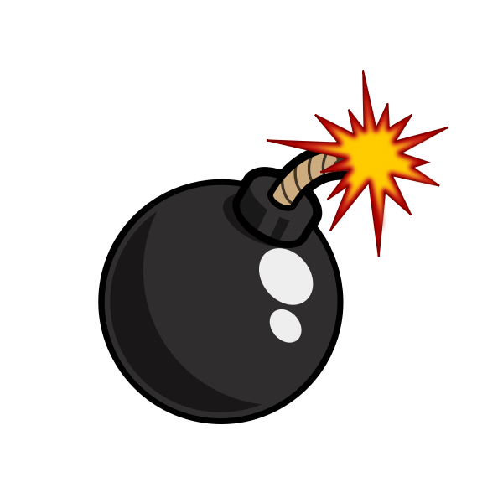
The Bomb
Four Unique Phases
Improved GUI
Immersive Audio

Slide 3
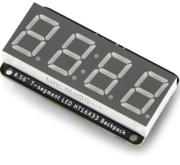
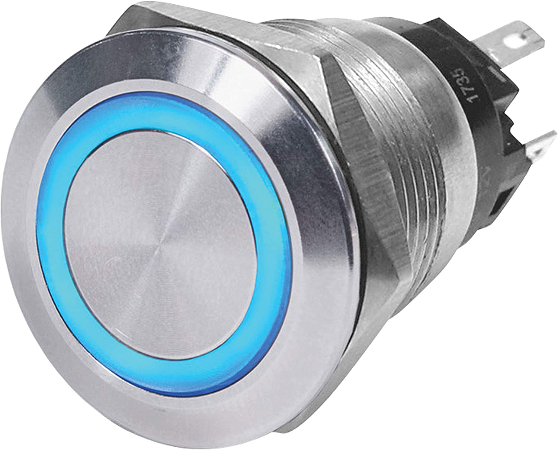
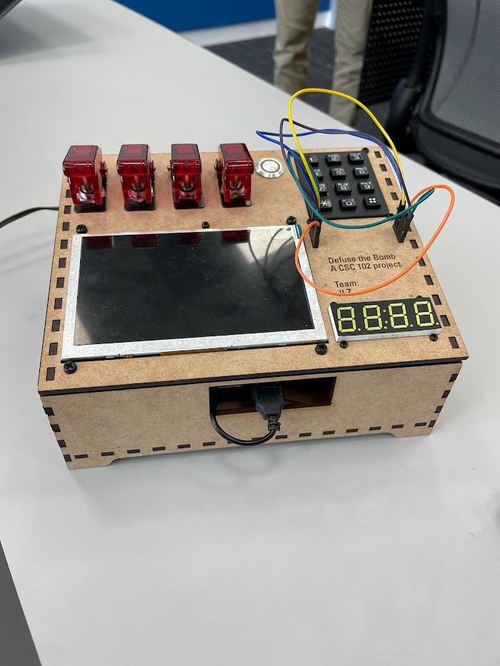
Button and Toggles Phase
Works in conjunction with the toggles phase and the clock
The player will press the button, causing the clock to pause
The player will then convert the number on the clock to binary and enter to diffuse the clock

Slide 4
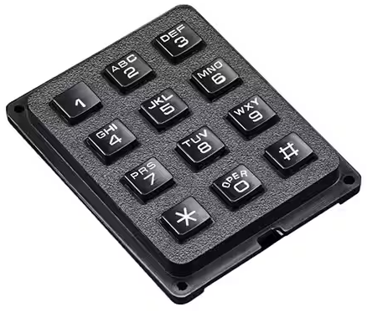
Keypad Phase
“Jump the 5”
Key word in boot up text
Player will find correct combo by “jumping the five” for each letter in the key word

Slide 5
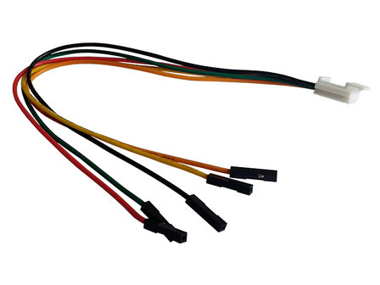
Wires Phase
Utilize the remaining strikes and reason to find the correct solution
Save this one for last and have a few strikes left!

Slide 6

Team Dynamics
Communication
Divided tasks
Set times outside of class to meet
Communicated schedules ahead of time
Goal Setting
Clearly laid out expectation of what we wanted to accomplish for each phase
Set deadlines for what we wanted to finish by different points of the project

Slide 7
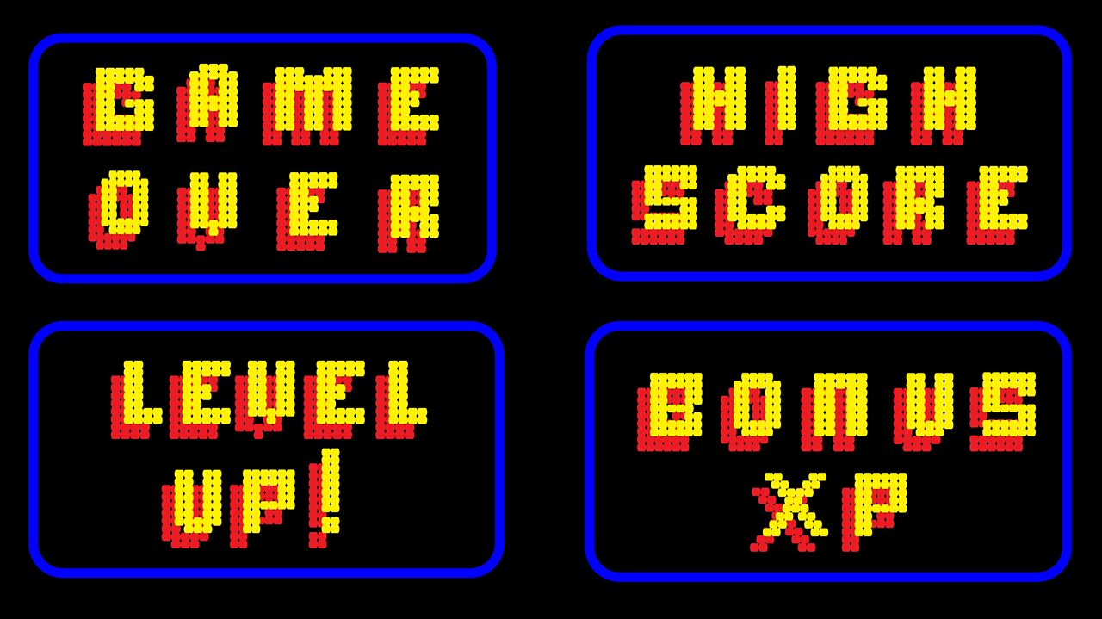
Future Development
Further develop the GUI
Add animations and graphics to create a more immersive experience
Multiple puzzles for each phase
Allows the user to play multiple times with a few different types of phases
Add a score component
Create a score system and allow players to set and improve a high score

Slide 8

Lessons Learned
Problem solving
Had to come up with a variety of creative solutions to implement certain elements of the project
Teamwork
Strengthened the skills required to work on a large project in a group
Python
Gained a better understanding of python threading and how to manage a large program with lots of code

Slide 9

Improvements and Suggestions
Allow the students to see how the code is developed earlier in the process
This would the students understand how to approach a large project
Add a couple options for hardware components
Allow the students to create a more personalized

Slide 10
Bomb Demonstration

