Slide 1
CUSTOMER PREDICTION
BA TECHNOLOGY, DATA, & INSIGHT

Slide 2
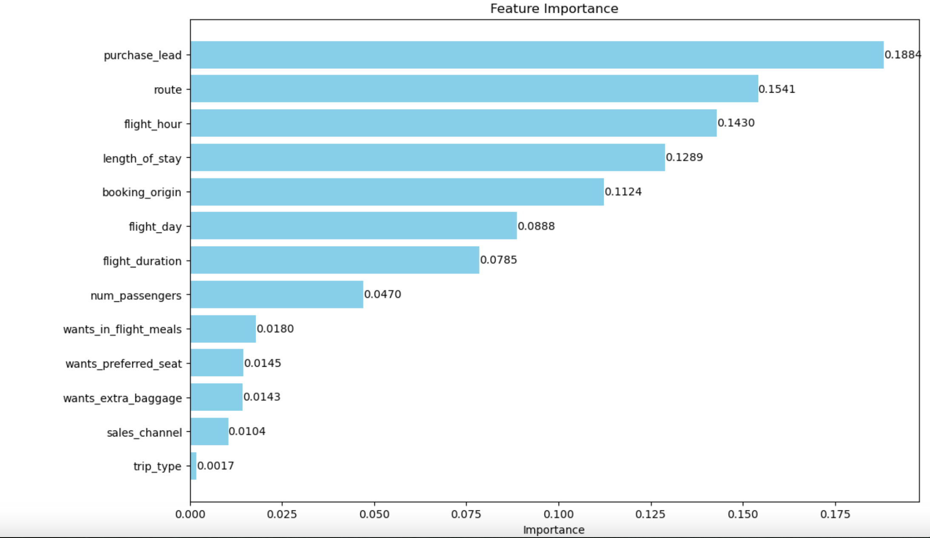
RESULTS
BA TECHNOLOGY, DATA, & INSIGHT
The most important variable in the model was purchase_lead, that is the time between purchase and departure.
Route, flight_hour and length_of_stay are also some other important features.
Acuuracy of the model:
Accuracy Score = 0.856
Precision Score = 0.824
Recall Score = 0.856
OOB Score = 0.8536
Hence our model has good accuracy.

