Slide 1
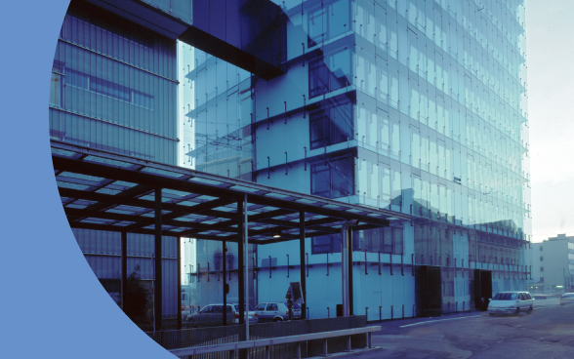
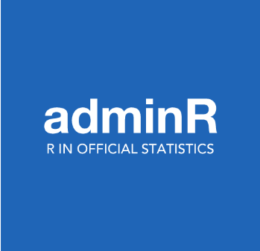

8 December 2022,
at the FSFO, Neuchâtel
Notes:
A warm welcome for everybody, including people following the meetUp with skype. Sorry, no food and drinks for you.
Before we start, I would first like to thank Andrea, Christop and Ronald for the support in setting up this meeting.
Thanks to Livio Lugano, the director of the Economy Division at the SFSO for supporting the idea of getting the meetUp at the SFSO and providing the funding for the drinks and food.
Special thanks to Athanassia Chalimourda from the Statistical Methods Section, Didier Staudenmann and all members of my section Sas well as the Data Analytics Tools Community who helped organizing this meetup.
Special thanks to the organizers of the adminR meetups: Andrea Schnell, Christoph Sax and Ronald Indergand

Slide 2
Programm
Welcome (Renger van Nieuwkoop, SFSO)
R at the SFSO (Renger van Nieuwkoop, SFSO)
R/Python-API to Access Public SFSO Data (Fabian Santi, SFSO)
Shiny Applications at VBZ, Yana Neuenschwander (VBZ)
Après-Meetup: Drinks and Food

Slide 3
Welcome and Information
All the presentations will be recorded and provided afterwards
Each presentation will take about 15min with some additional time for questions
Information on the building
Notes:
Information on the Building
Where are the toilets
FSO-Securiry intructions?
End Time of the meetup?

Slide 4
R at the Swiss FedeRal Statistical Office Infrastructure and Examples
Autumn
8.12.2022
RengeR van Nieuwkoop

Slide 5
R at the SFSO
Tools and Infrastructure

Slide 6
Tools at the SFSO
Main tool until now is SAS, Excel, and Oracle
Use of R, Python and GIT is steadily growing.
In January 2018, R and Python were classified as equivalent to SAS, by decision of the Executive Board
Most of the IT is centrally organised (Federal Office of Information, Technology, Systems, and Telecommunication, commonly referred to as «BIT»)
The IT-Section at the FSO
Notes:
Diese Unterhaltung wurde gespeichert. Sie wird bald auf der Registerkarte „Unterhaltungen“ in Skype for Business und im Outlook-Ordner „Aufgezeichnete Unterhaltungen“ angezeigt.

Slide 7
SAS at the FSO
More than 500 users, including 280 regular users
ca. 40’000 SAS programs in the production
Server installation from BIT (CPU 2700 MHz, 24 cores)
SAS Support (250% full-time equivalent), the SAS Competence Center.
Notes:
RAM??

Slide 8
R
> 100 active users, number of scripts in production > 1’000
Starting 2022: each employee can install R (4.0.4) and R Studio on their own work computer (16GB RAM) as well as install packages from CRAN.
Run R scripts via the Linux server (version 3.6.3, 2020, because of SAS)
Renku (up to 11CPUs, 104G Memory and 512G Disk space). Renku includes Jupyter notebooks with R and Python kernels are available as well as Rstudio and Gitlab for version control.
Notes:
Python around the same
R history until February 2022: old version AND old packages. Packages installed with ticket
Inhalt des Klammers hier: Plattform Renku, Server, faster laptops?

Slide 9
Goals
Establish these tools and find a good infrastructure solution

Slide 10




Data-Analytics Tools Community
The Data Analytics Tools Community is a group of internal experts that provide solutions related to data analytics tools consisting of consists of representatives from almost all divisions of the FSO
Goal:
Facilitation of the optimal use of data analytic tools at FSO through general knowledge transfer and support.
Support automation in data processing and promote re-use of existing processes.
Activities:
weekly meetings
workshops/presentations
courses
documentation (Confluence site)
Notes:
Kurse, JIRA tickets, external presentations (Austria, Netherlands), Colloquia, Courses,
no competence center
evtl. forum

Slide 11
R at the SFSO
Examples

Slide 12
Input-Output Tables
Before
ca. 1’400 files (1.4 Gb), ca. 600 Excel files with almost 5’000 worksheets, no version control
Excel/Matlab/Gams/R and Mac vs Windows.
Documentation partially outdated/lacking
No automation
Only for one year,
Months of work
Now
ca. 30 R-(Markdown)-Scripts, 60 Data files (350 Mb)
R, Oracle, GIT, GAMS
Rmarkdown for Documentation
80 - 90% automated
Multiple years3
ca. 1 – 2 weeks of work

Slide 13
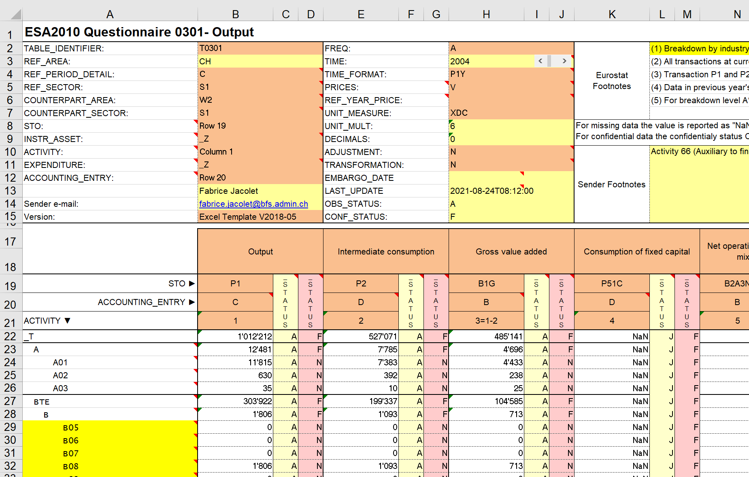
30 Excel files to Eurostat (Section SNA)
Before:
sometimes with up to 75 worksheets
copy-paste often the only option
effort enorm and error-prone
After:
Script: ca 300 lines of readable code
one-time effort: 1 day programming
Annual effort: < 5 minutes
Main work: Adjust file names ☺
Run script (3 minutes)
Notes:
People can focus on more interesting things than copy-paste

Slide 14
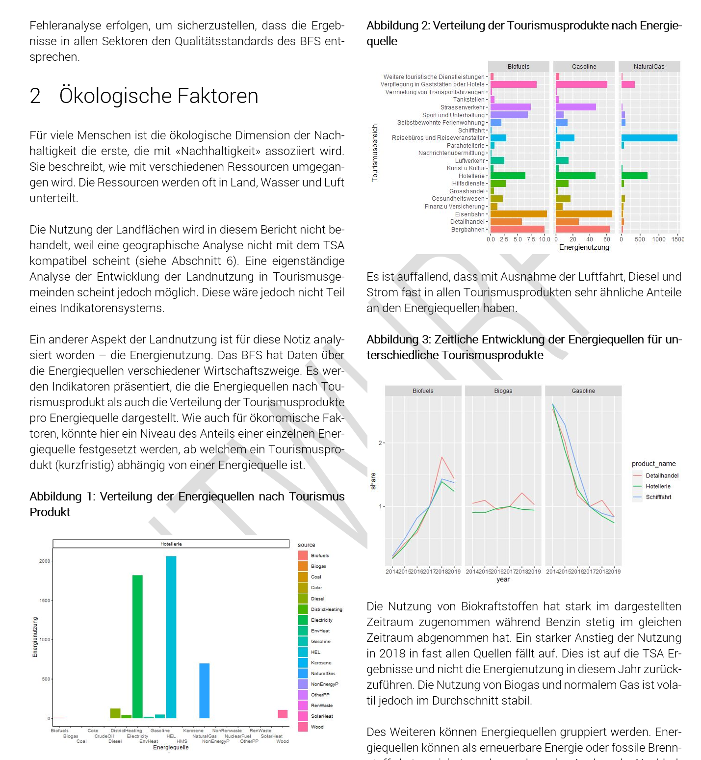
Other Examples
Creation of official BFS documents
Reading tables from PDF documents (instead of copy-paste)
Some innovative projects unsing Machine Learning in R and Python. E.g:
NOGAuto: prediction system for NOGA codes from German, French and Italian activity descriptions
ADELE: Arealstatistik DEep LEarning
ML-SoSi: Machine Learning Soziale Sicherheit
Imputation and optimization methods for FSO production systems
etc.
Notes:
Wir kämpfen darum DEEPL integrieren zu dürfen, aber es ist noch nicht geschehen.

Slide 15
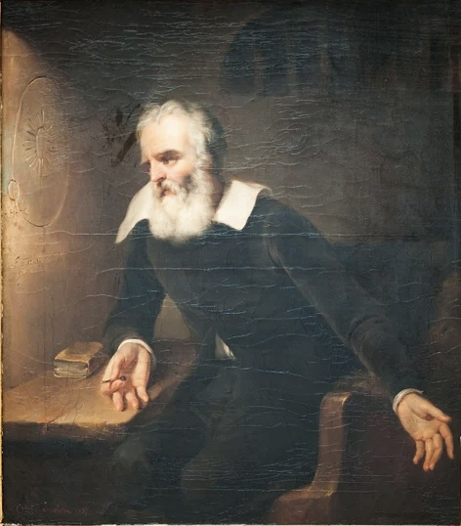
Conclusions
R is being used more and more at the SFSO and might become, together with Python one of the main tools in production
Eppur si muove! We are in the process of setting up:
the proper infrastructure, and
the support
We are eager to learn from your experience at your workplace!
Notes:
Wir kämpfen darum DEEPL integrieren zu dürfen, aber es ist noch nicht geschehen.

Slide 16

Questions/Discussions
We are particularly interested in the solutions for R at your departement

Slide 17
Reserve slides

Slide 18








Example: Input-Output Tables
10% automated
95% automated
Data collection
Import, calculations, checks
Documentation, publikation

Slide 19
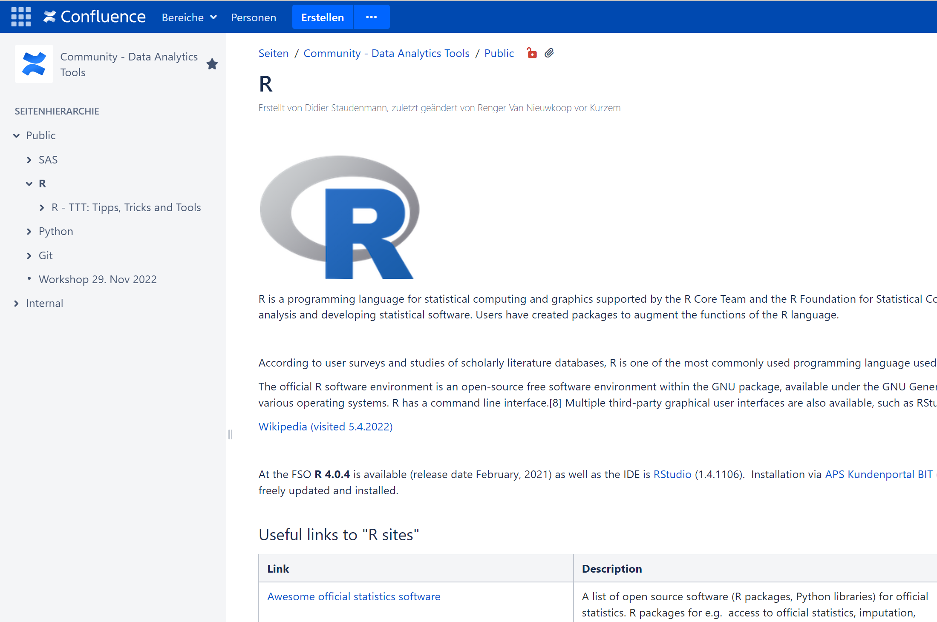
Confluence

