Slide 1
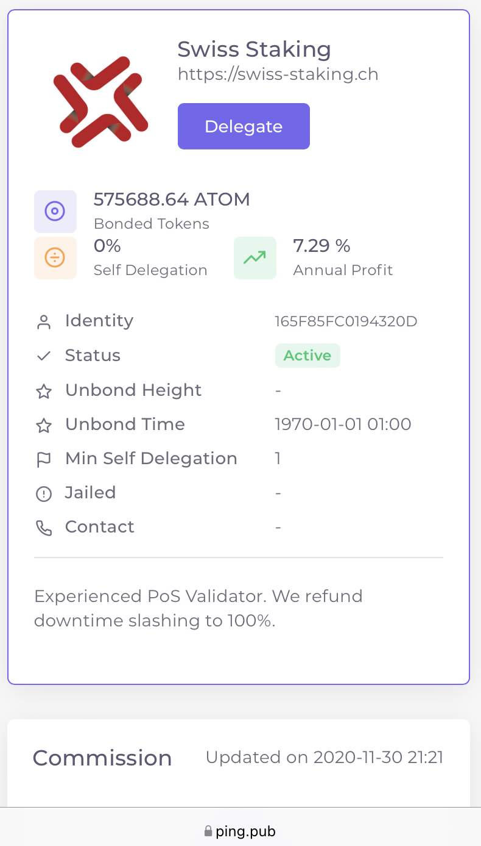




Slide 4

Interoperability
Governance
Scalability
Consensus

Slide 6


