Slide 1

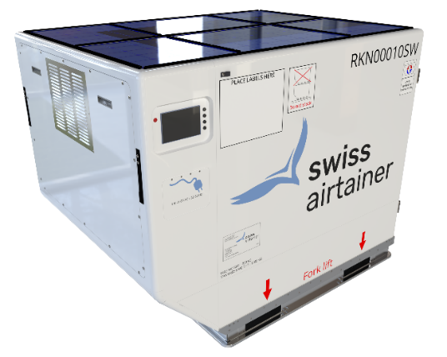
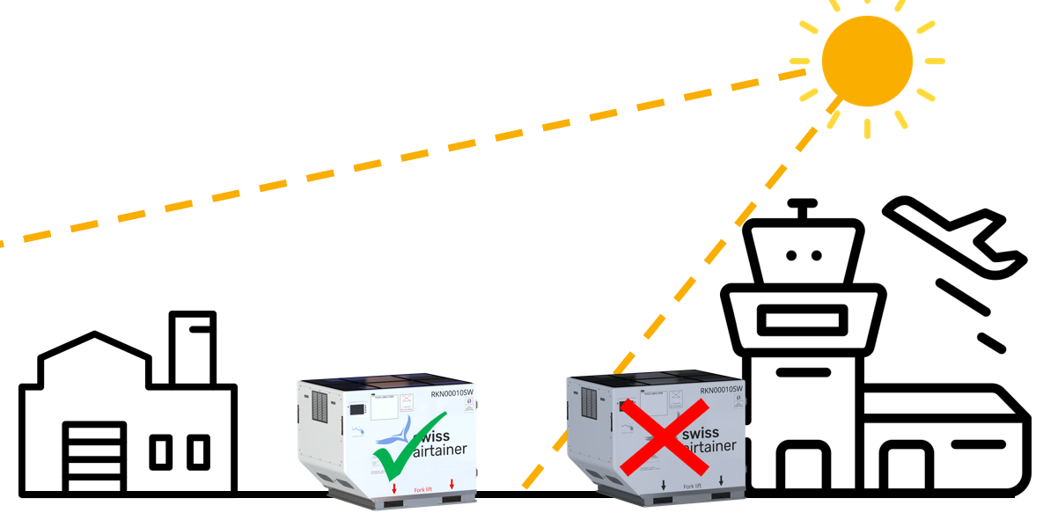

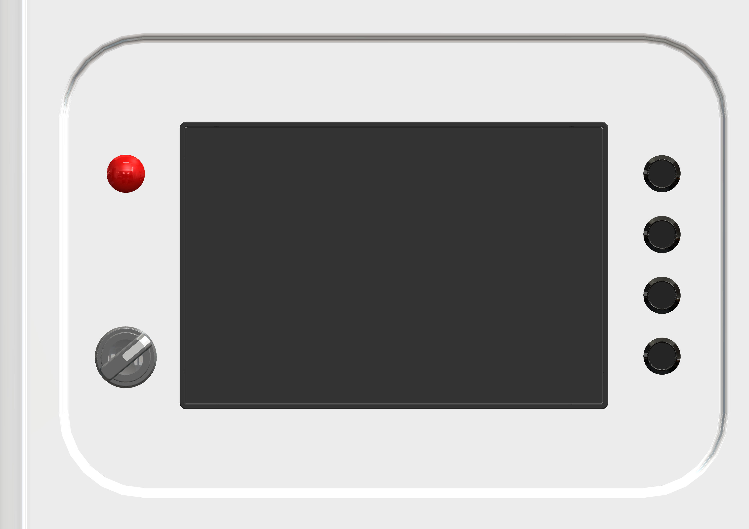
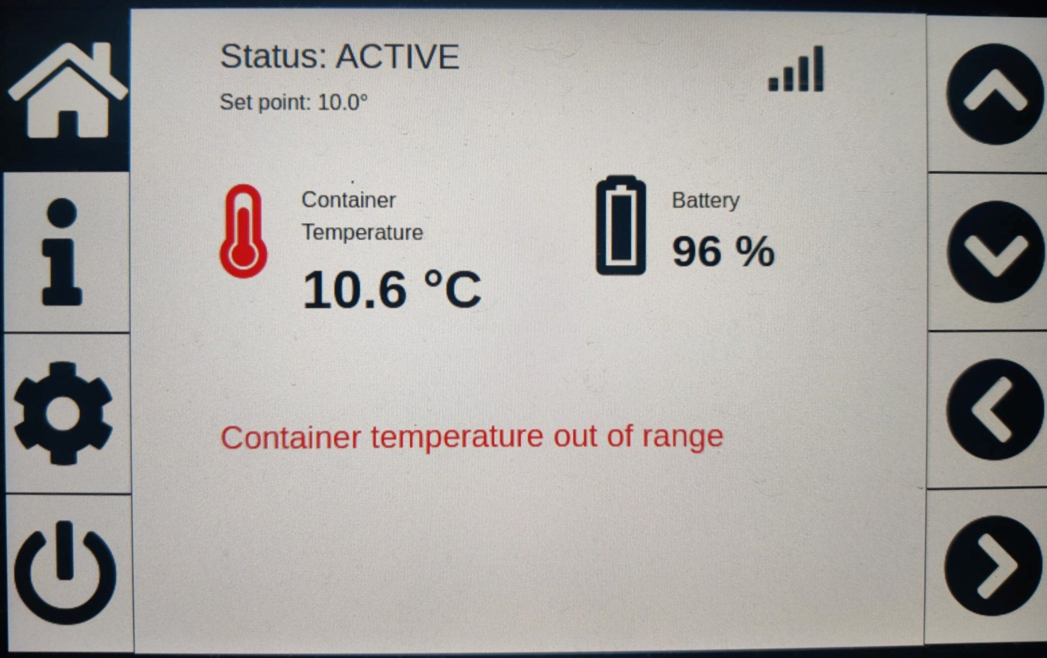
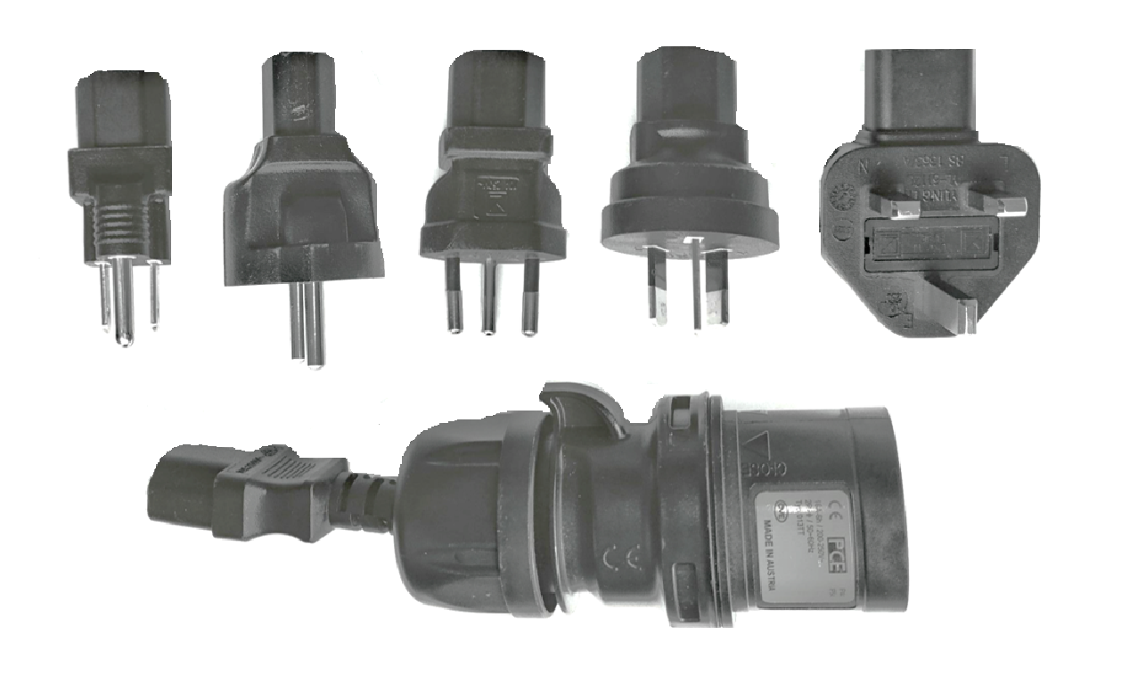



RKN Quick User Guide
0120-OT-C90d-002-B
Storage
Photovoltaic panels
Ensure direct exposure to the sun when outside.
Touch screen
User Manual
Cable box
WARNING!
Charging must never take place inside an airplane.
Charging must not take place in a damp, moist environment due to risk of electric shocks.
Check the cable for damages/abnormalities before using the cable and before connecting to an electric outlet.
Check that the cable is not connected to an electrical outlet before moving the container and place it back in the cable box with all 6 adapters.
CAUTION!
When charging, always pull out the entire cable (5 m) to avoid overheating and ensure the cable does not have loop or knots.
Charging
Touch screen
Status
Temperature
set point
Connectivity
Alarm LED
Control buttons
Control buttons
Menu buttons
Connectivity switch
Internal
temperature
Messages, alerts, alarms…
Battery status
Security Code
Add +1 to the displayed number (example: displayed 0123 → Code: 0124).
Temperature setting
Click on settings button
Click on unit to switch between °C and °F
Click on temperature set point
Enter the security code
Enter the temperature set point
Validate by pressing ✓
Turn on/off the container
Click on power button
A status message will show the current operational mode
Confirm the command by pressing ✓
Enter the security code

Slide 2
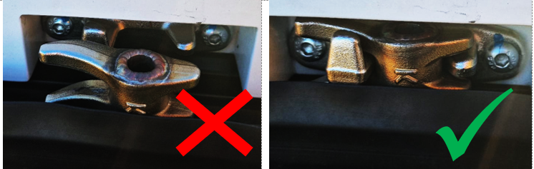
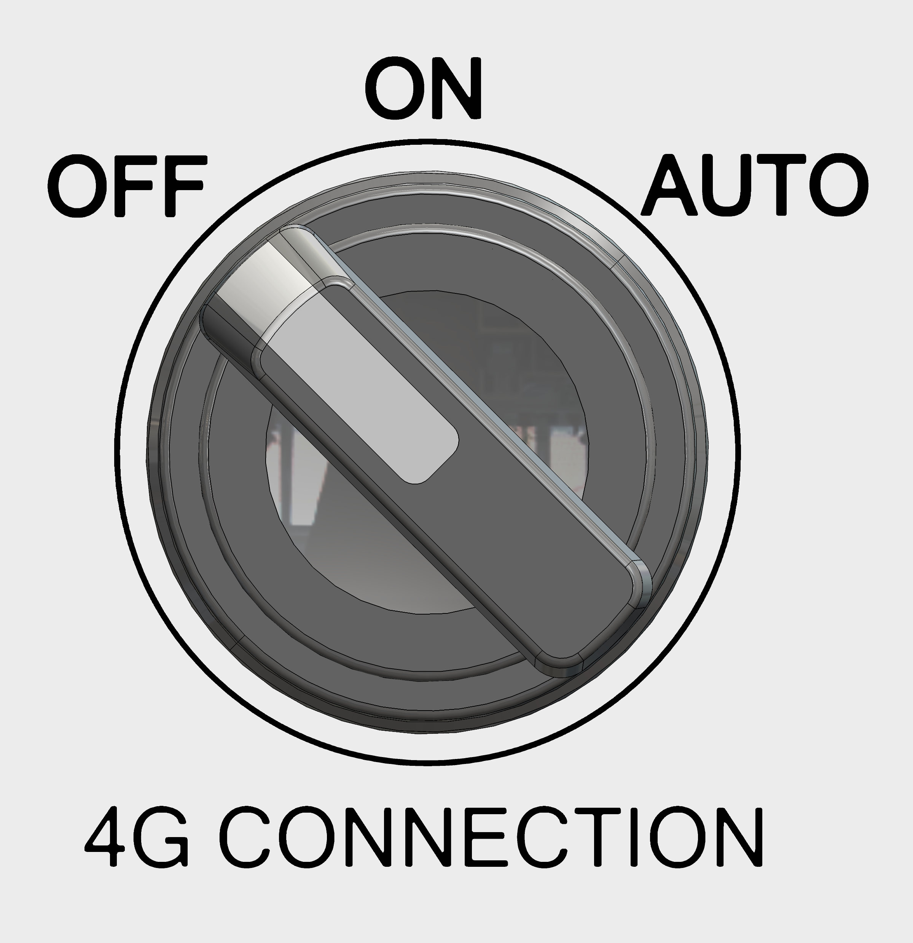
Before flight
Check that the battery level is 90 % or above.
Check that internal temperature equals the temperature set point.
Check that there is no alert or alarms.
Check that the alarm led is off.
Check that the door is properly closed.
WARNING!
When the door is closed, make sure the 2 cams hooks the keepers.
CAUTION!
The connectivity switch must be set to OFF before the container is loaded in the plane.
The connectivity switch must be set to ON when the container is unloaded from the plane.
Technical specification
Recharging electrical outlet | Grid: 100-240 VAC, 50-60 Hz Photovoltaic panels: 480 W
Maximum charging time | 4 hours
External dimensions (LxWxH) SAE AS36100 K4 | 1’985 x 1’534 x 1’621.5 mm (78.1 x 60.3 x 63.8 in)
Tare weight | 390 kg
Maximum load weight | 1’198 kg
Operational temperature range | -20 °C to 45 °C (-4 °F / 113 °F)
Storage temperature range | -25 °C to 50 °C (-13 °F to 122 °F)

