Slide 1


Slide 2


Slide 3

AzureAdDeployer 1.0

Slide 4
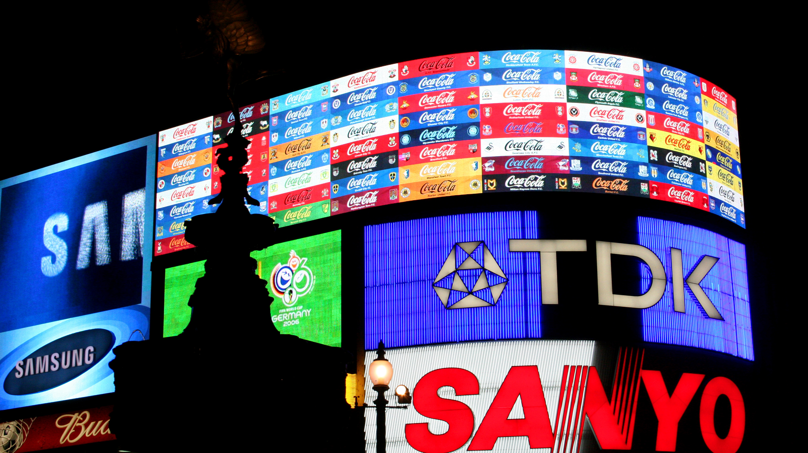

Slide 5
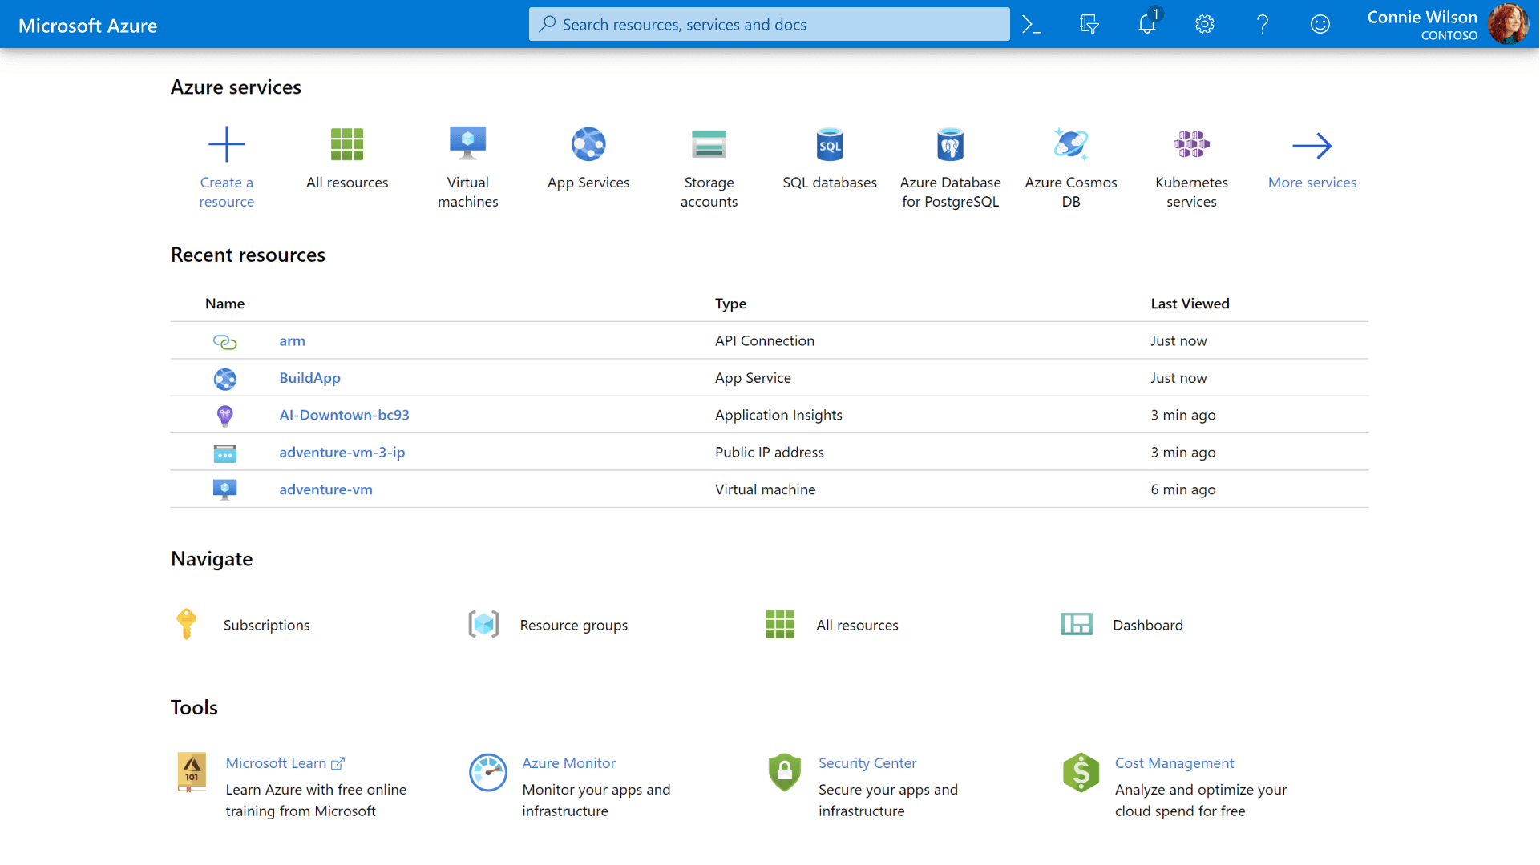

Slide 6
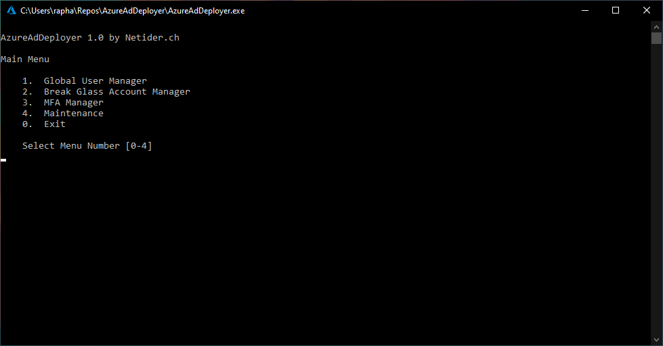

Slide 7
