Slide 1
CS Task 9
Software Engineering & Design

Slide 2
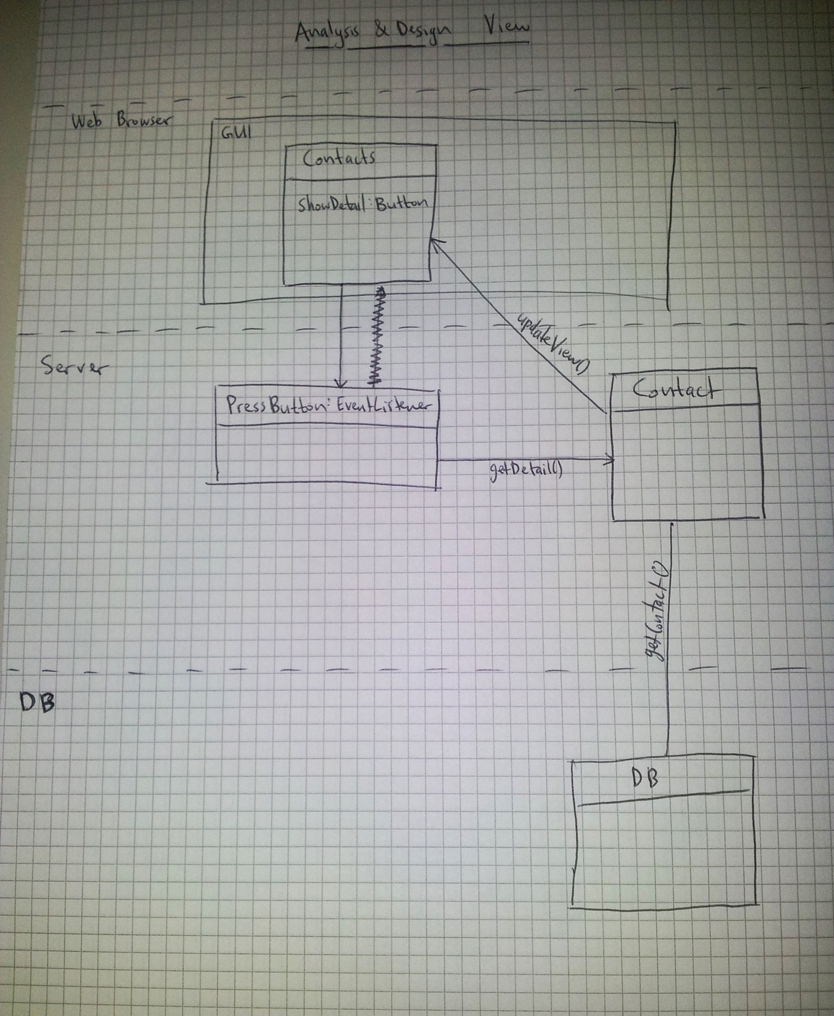
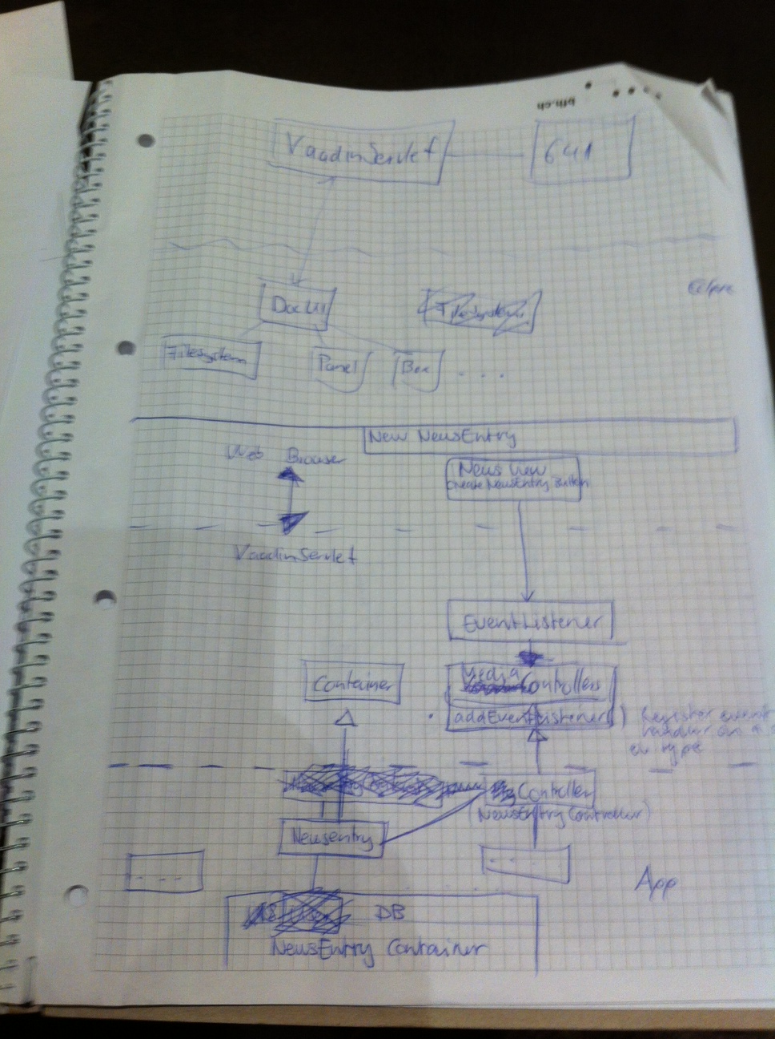
Drafts

Slide 3
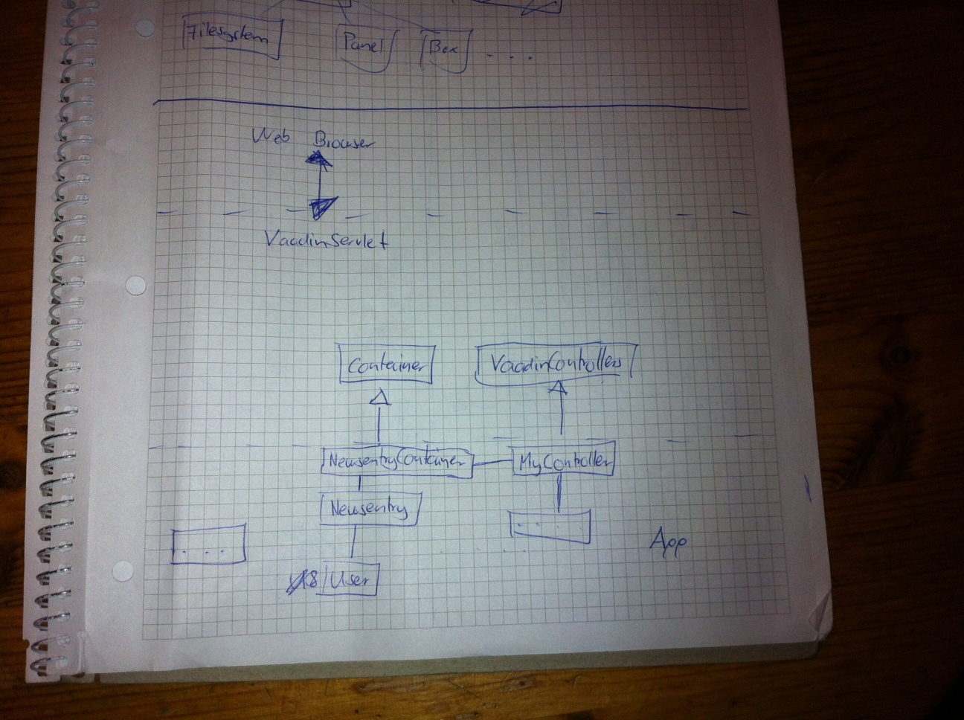
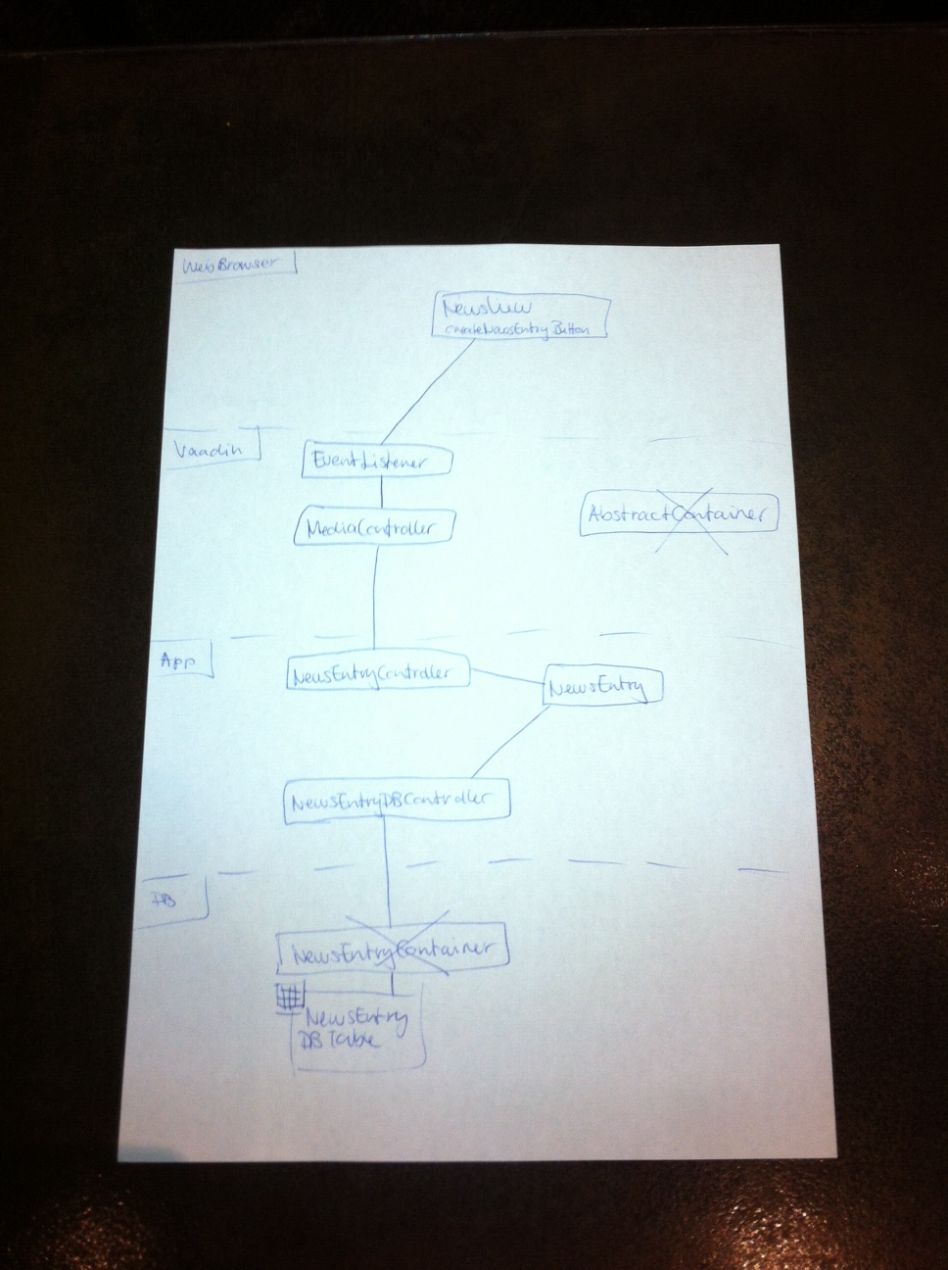
Drafts

Slide 4
Vaadin Components

Slide 5
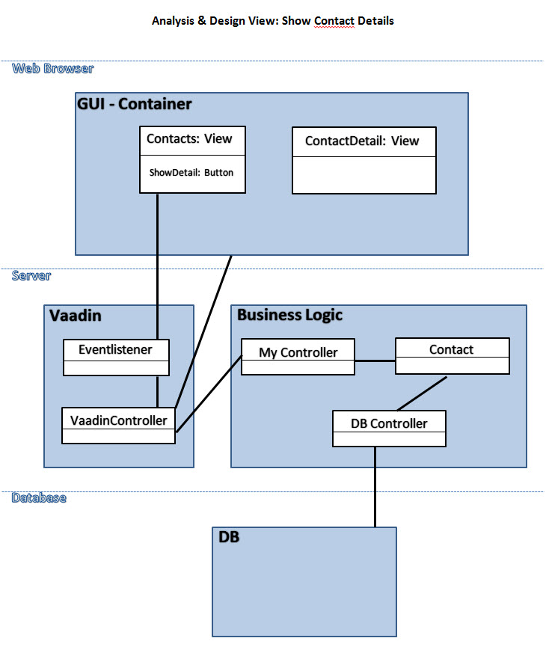
Show Contact

Slide 6
News Entry

Slide 7
CS Task 10
Software Engineering & Design

Slide 8
Scrum Setup

