Slide 1
CS Task 7
Domain Model and Sequence Diagram

Slide 2
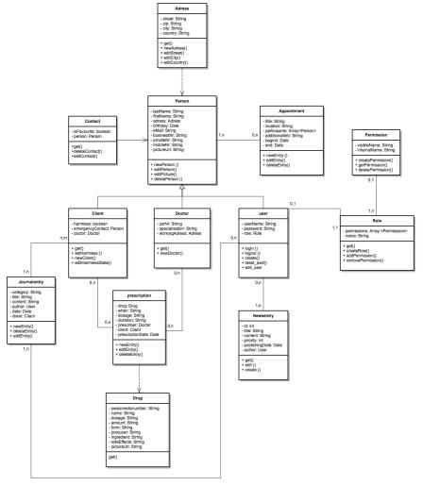
UML Domain Model (1)

Slide 3
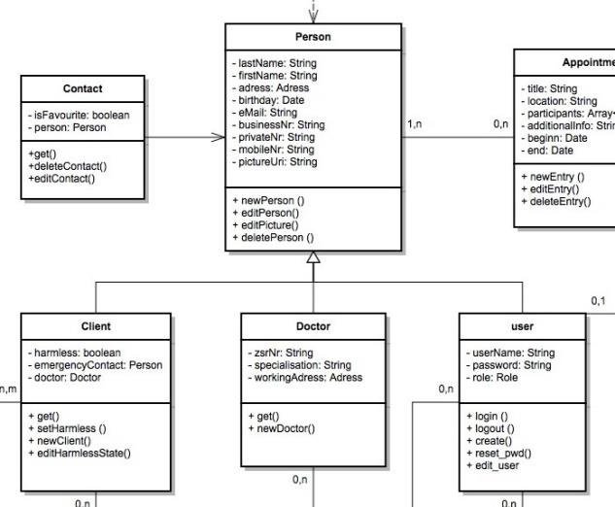
UML Domain Model (2)

Slide 4
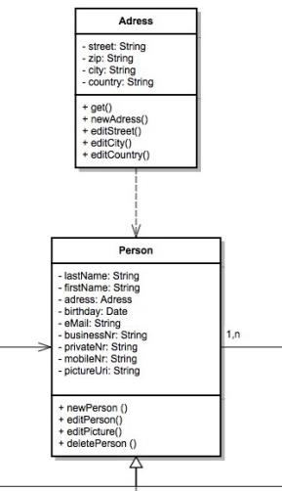
UML Domain Model (3)

Slide 5
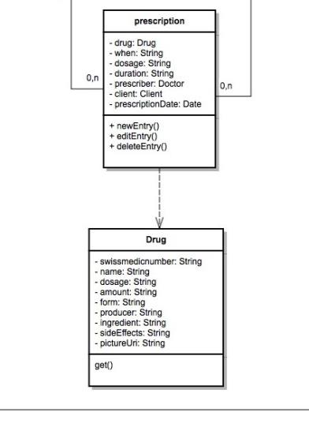
UML Domain Model (4)

Slide 6
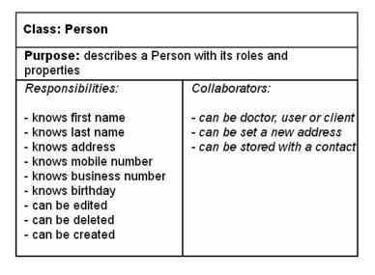
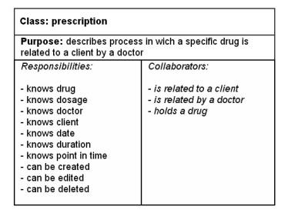
CRC-Cards

Slide 7
UML Sequence Diagrams
user updates some specific information
system alerts user about some specific event

Slide 8
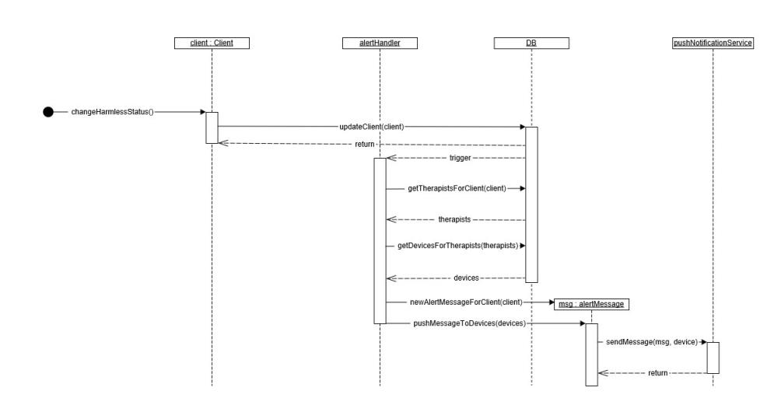

Slide 9
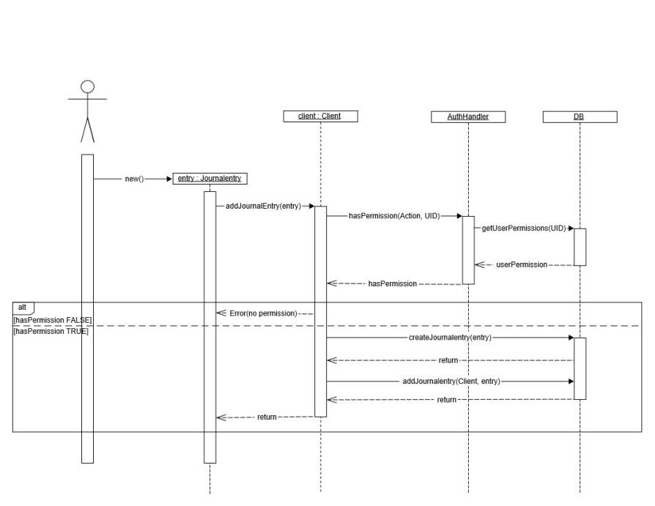

Slide 10
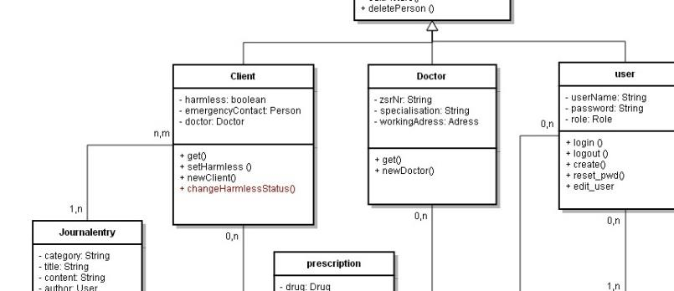
refined UML Domain Model (1)

Slide 11
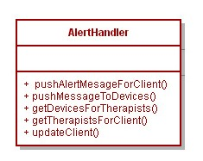
refined UML Domain Model (2)

