Slide 1

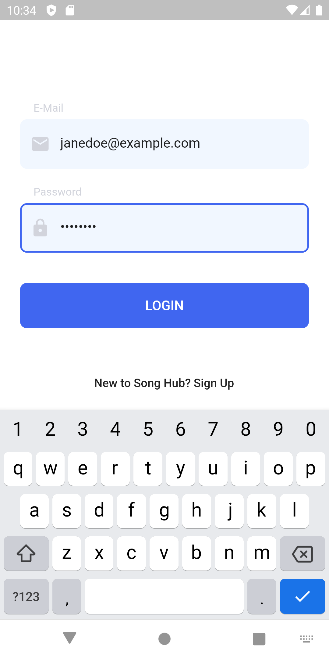
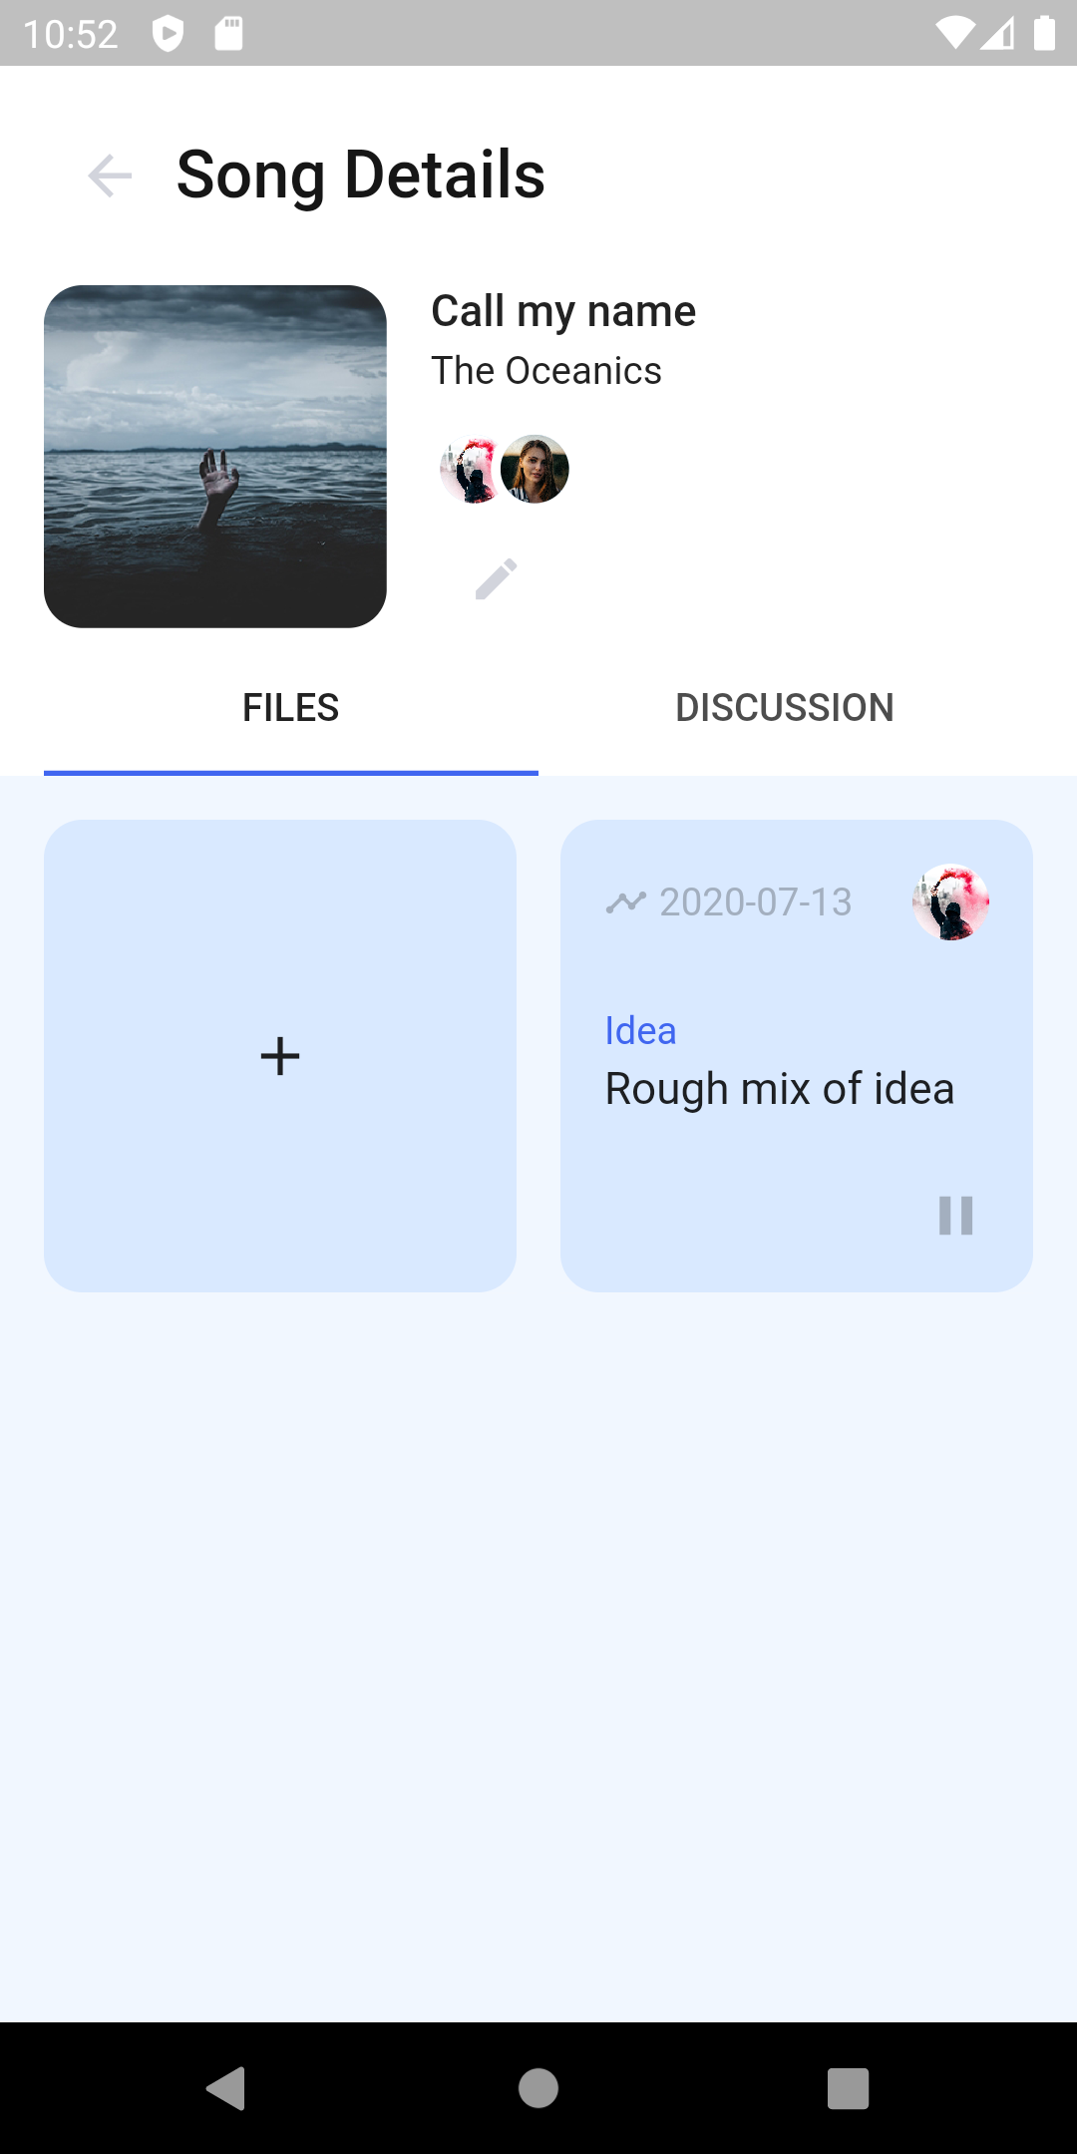

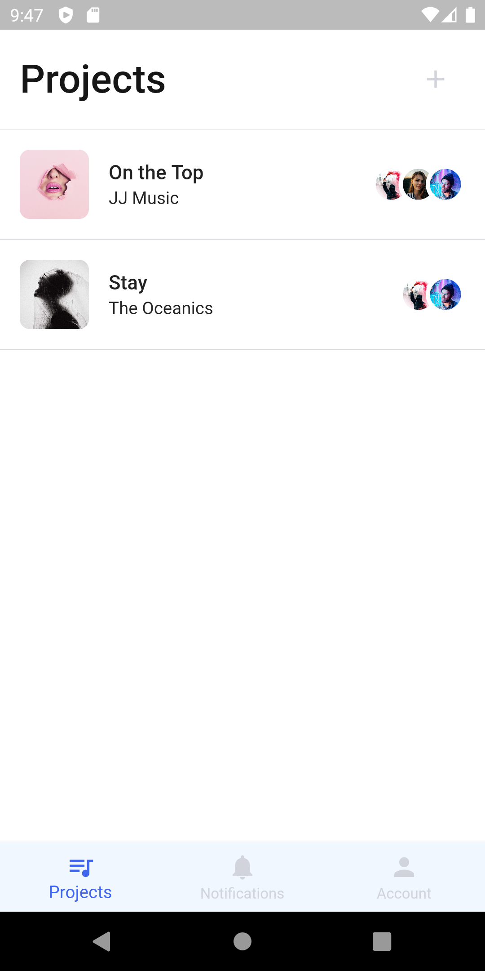
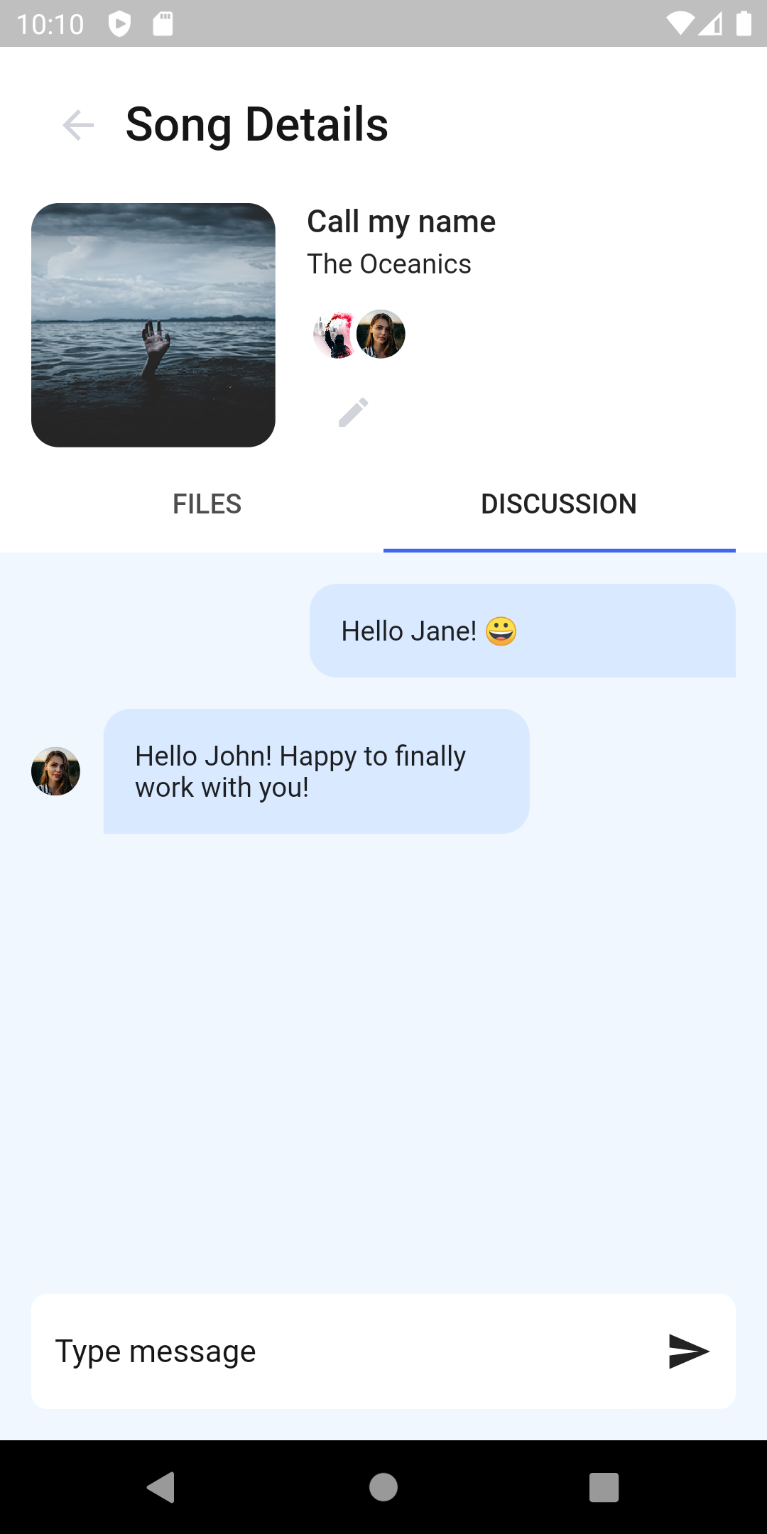
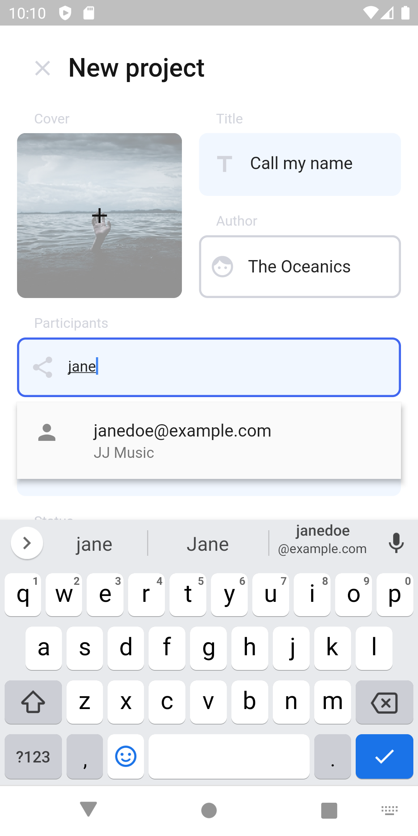

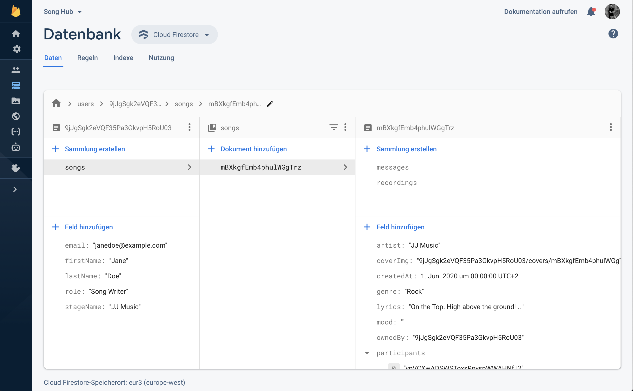
App Development (Informatik M.Sc.)
Song Hub
Pascal Schlaak, Tim Weise
Professional musicians usually create a lot of ideas and iterate on a big set of song projects with their partners. Often this creative process is unstructured and supported by various tools which leads to problems in communication. Song Hub is the first step towards such a musical project management tool.
Android
iOS
With the help of a competitive analysis we were able to identify current problems and take them into account in our solution. For our idea we developed a Flutter application that provides a management tool for mobile devices. Song Hub currently offers two main features: Song project versioning and song collaboration.
With versioning, both the producer and the song writer have a central place for storing audio files i.e. their different recordings for their projects as the songs progresses. This eliminates many problems that occur in actual project situations in which the exchange of the songs is based around email communication or traditional cloud storage providers.
Song collaboration feature a discussion area that is specific to a song project. The discussion area is designed to be used alongside with the recording versions so that one can always refer directly to a specific version in the creation process.
Since our complete backend infrastructure is hosted as a Backend as a Service on Google Firebase, we are able to guarantee high availability to our customers.
In the added screenshots you can see different parts of our app running on Android and iOS.
Android
iOS
Sign In
Project details and recording
Android
iOS
Android
iOS
Projects overview
Project discussion
Android
iOS
Add new project
Firestore backend

