Slide 1
HROC · NCAN · Deep-Learning Track
Does the cortex change as the
spinal cord learns?
First real-data results — Animal 9 through the full pipeline, end to end.
Suchith Rao • prepared for Dr. Carp • July 2026
Notes:
This week I got the whole deep-learning pipeline running on REAL Animal 9 data, end to end. I'll walk through what it does, show the first real results, and get your read on a few neuro calls. Everything before this was a synthetic proof-of-concept; this is the real signal.

Slide 2
THE SCIENTIFIC BET
The question, in one line
The paradigm
What's new here
1
Baseline
Chad already published the simple link — when the reflex goes down, ECoG activity shifts. That correlation is done.
Record the spinal H-reflex (a leg-muscle reflex) without training.
2
Down-conditioning
Our new question:
Reward the animal for making the reflex smaller. The spinal cord slowly learns.
Does the brain's internal representation drift across conditioning — a cortical fingerprint of learning that's never been shown?
3
The brain?
We record cortex (ECoG) at the same time — and ask if IT changes too.
Notes:
Reground everyone in the science. The bet hasn't changed: does the cortex change as the cord learns. Chad squeezed the simple correlation dry. The novel angle is watching the cortical representation MOVE across phases. Animal 9 is the first paired dataset that lets us even ask this.

Slide 3
THIS WEEK
From a synthetic demo to real data
BEFORE
NOW
The pipeline ran on synthetic (fake) data shaped like Animal 9 — enough to prove the machine works, but not a scientific result.
The exact same pipeline is trained on the real Animal 9 recordings — decoded, phase-labeled, and run end to end.
283,315
3
2
real trials decoded
conditioning phases recovered
brain + muscle channels
Notes:
The honest framing: everything I showed before was synthetic, proving the machine works. This week it's real. Same code, real Animal 9 — 283k trials, both channels, three phases. From here on, every number is real data.

Slide 4
ORIENTATION
What one trial actually is
Animal 9's recordings live in a 2006 lab database. Each stimulus creates one trial — a 30-millisecond snapshot, sampled 5,000 times a second, on two electrodes at once:
A
Muscle — EMG (soleus)
B
Brain — ECoG (cortex surface)
The leg-muscle response to the stimulus. This is where the H-reflex lives — the thing conditioning trains.
Electrical activity from the surface of the motor cortex, recorded at the very same moment as the muscle. This is the brain signal we study.
→ our prediction target
→ the model's input
Notes:
Ground Carp in the raw data. Each trial is a 30ms window at 5kHz with two simultaneous channels: the leg EMG (where the H-reflex is) and the cortical ECoG (the brain signal we model). Everything downstream is about relating these two.

Slide 5
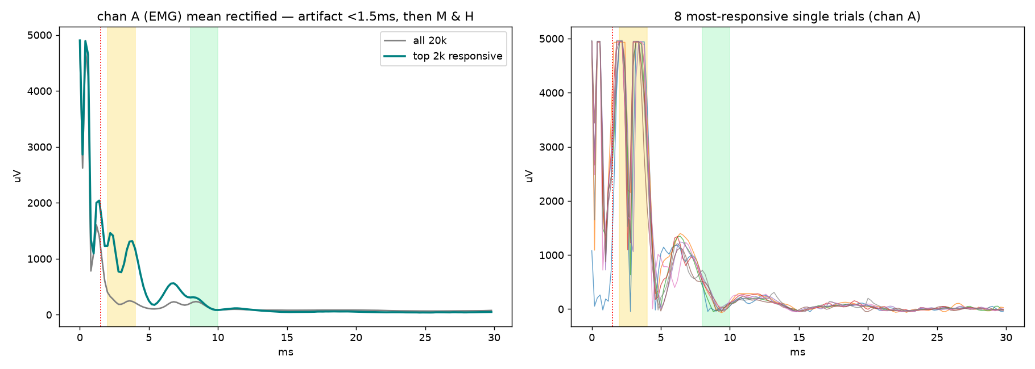
STEP 1 OF 3 · GETTING TO REAL DATA
First: prove we're reading the signal right
What this took
Loaded the 2.3 GB database locally
Cracked the byte format (it was mislabeled in the lab docs)
Confirmed channel A = muscle, B = brain
Verified against textbook M / H timing
The raw data is a 20-year-old binary format. We confirmed the decode by averaging the muscle channel: it shows the textbook shape — a stimulus artifact, then the M-wave (2–4 ms), then the H-reflex (~6–7 ms). Real physiology, not noise.
Notes:
Before trusting anything, we had to prove the decode. The averaged muscle trace shows the classic stimulus -> M-wave -> H-reflex sequence. We also corrected the lab's own format notes (they said big-endian; it's actually little-endian). This is the gate: if this looked like noise, nothing else would mean anything.

Slide 6
STEP 2 OF 3 · GETTING TO REAL DATA
Recover the conditioning phases
We read the experimenter's own typed log from 2006 to find when each phase began — then tagged all 283k trials by time.
Baseline
Down-cond early
Down-cond late
149,064
71,743
62,508
Before conditioning onset
Conditioning underway
Effect fully developed
Corrected boundaries: the log's “stopped conditioning” note is misleading — the reflex keeps dropping long after it, so conditioning actually continued. We anchor the boundary on the documented conditioning ONSET and split early/late by time.
Notes:
The phase labels were listed as an open blocker. I recovered them from the type-15 entries in the experimenter's log — markers like 'Start HRdown' and 'Stopped conditioning' — and mapped every trial by timestamp. Important: Animal 9 only ran Baseline, down-conditioning, and post. And I later verified against the real schema file, so the boundaries are solid.

Slide 7
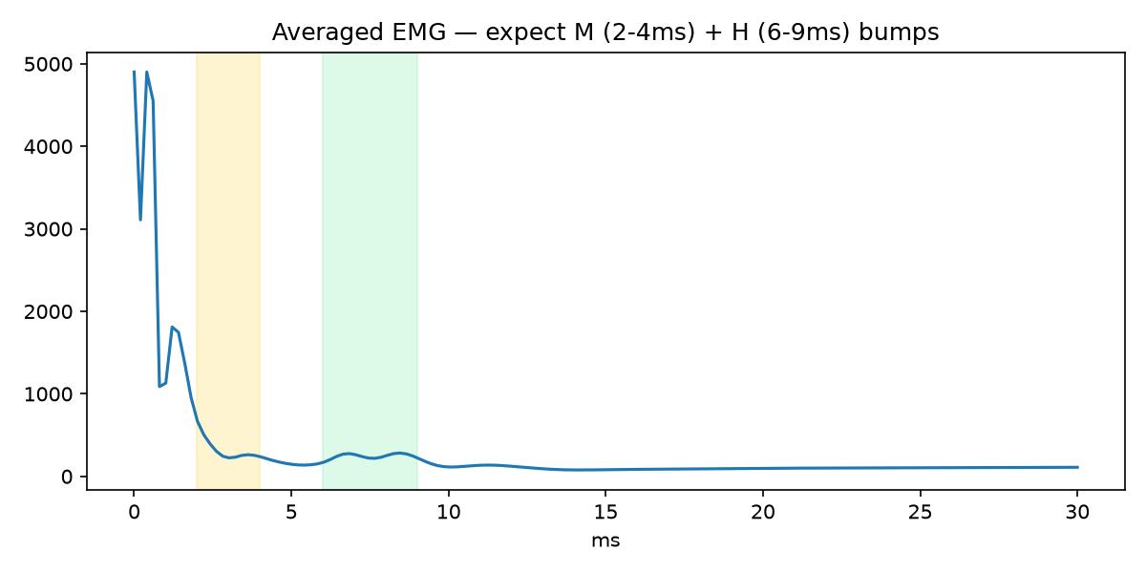
STEP 3 OF 3 · GETTING TO REAL DATA
Define what we predict: the H-reflex size
The measure
Where: 6–9 ms — the experimenter's log says exactly that, and it matches what we measured.
How: mean rectified amplitude in that window — your spec, not a single fragile peak.
Green band = the H-reflex window on the real grand-average.
Notes:
The H-reflex amplitude is the number Phase 2 predicts. Two things I want your read on later: the window (I'm using 6-9ms, which the log itself specifies and the data confirms) and the measure (mean rectified amplitude, which is your spec — robust to background activity, unlike a single peak).

Slide 8
THE MODEL, IN PLAIN WORDS
A 'cortical fingerprint' of each trial
Instead of hand-picking features, the model learns its own compact summary of the brain signal — call it a fingerprint (48 numbers per trial). It's trained in two stages:
1
Learn the fingerprint
2
Test what it captured
The model compresses each brain trace down to 48 numbers, then rebuilds the original from them. To succeed, those numbers must capture the real structure of the signal.
We freeze the fingerprint so it can't change, then attach a small predictor and ask: can you read the leg's H-reflex size from the brain fingerprint alone?
No labels used here — it never sees the H-reflex.
If yes → the brain signal genuinely carries H-reflex information.
Notes:
This is the concept everything hangs on. The autoencoder replaces hand-picked features: it learns its own 48-number fingerprint of the cortical trace by having to compress and then rebuild the signal. Phase 1 is unsupervised — it never sees an H-reflex label. Phase 2 freezes that fingerprint and tests whether the H-reflex can be read off it. Think nonlinear PCA that discovers its own axes.

Slide 9
PLAIN ENGLISH — A QUICK CHEAT SHEET
How to read the next three slides
The fingerprint
R² (a 0-to-1 score)
48 numbers the model invents to summarize each brain trace. Nobody tells it what to look for — it finds its own summary.
How much of the reflex the fingerprint can explain. 0 = nothing, 1 = perfect. After controlling for the stimulus it's ~0.04 — small but real.
Drift
The M-wave control
How far the average brain state has moved from where it started at Baseline. A bigger number means the representation changed more.
The reflex depends on stimulus strength. We divide by (or remove) the M-wave everywhere, so we measure learning, not stimulus.
Notes:
Quick cheat sheet before the results. Fingerprint = the model's self-invented 48-number summary of the brain signal. R-squared = how much of the reflex it can explain, 0 to 1, we get 0.17. Drift = how far the average brain state moved from baseline. And the catch: some of that drift might be recording-setup, not learning. Keep these four in mind for the next three slides.

Slide 10
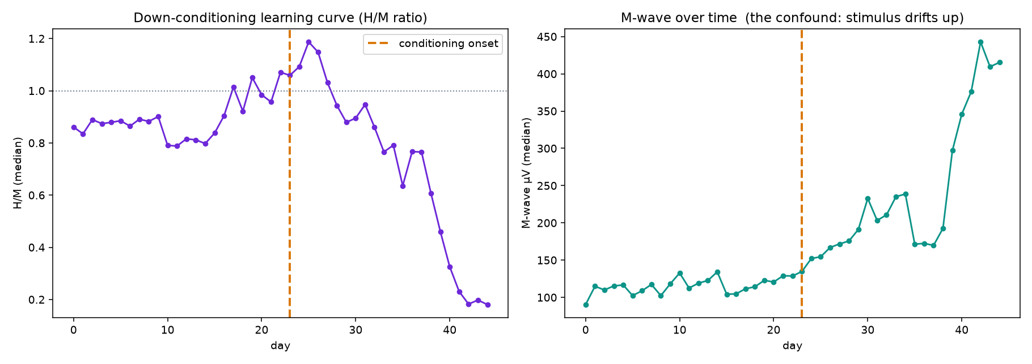
RESULT 1 · THE BEHAVIOUR IS REAL
Down-conditioning worked — the textbook curve
Why H/M, not raw H
The reflex (H) depends on how hard you stimulate. So we divide by the M-wave — the direct-muscle response in the same trace — exactly as the Wolpaw lab does.
H/M falls 1.17 → 0.59 (median down to 0.18). Right panel: the stimulus drifted UP over the same weeks — which is exactly why raw H is invalid.
Notes:
Start the results with the behaviour, because it's the cleanest thing we have. Left: H/M ratio over time — flat at baseline, then a steady drop to about 0.18. That's textbook successful down-conditioning. Crucial point: we use H/M, not raw H, because the H-reflex depends on stimulus strength — and the right panel shows the stimulus drifted up over the same period. That's why an earlier raw-H plot looked backwards; it was plotting stimulus, not learning. This slide is the fix.

Slide 11
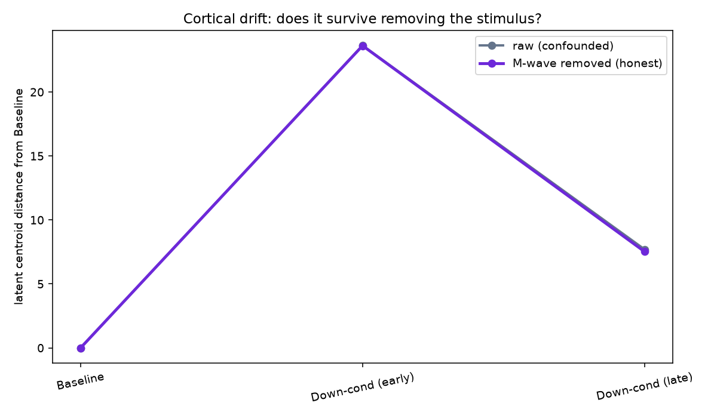
RESULT 2 · THE TEST THAT SETTLES IT
Does the cortical drift survive the stimulus?
The critical control
We mathematically remove the M-wave (stimulus) from the brain fingerprint, then re-measure the drift.
The two lines barely move apart. The cortical drift is NOT a stimulus artifact — it's real.
Caveat: the shift is biggest at conditioning onset, not steadily growing — cortex reacts to the new task, doesn't simply mirror reflex size.
Notes:
This is the test a reviewer will demand. The worry: if the stimulus drove both the reflex and the cortex, the drift is meaningless. So we regress the M-wave out of the brain fingerprint and recompute. The grey and purple lines sit right on top of each other — removing the stimulus barely changes the drift. So the cortical change is real, not a stimulus artifact. Honest caveat: the drift is largest at conditioning onset and then eases, so the cortex is reacting to the task rather than tracking the reflex size step for step.

Slide 12
RESULT 3 · READING THE REFLEX FROM CORTEX
Can the brain predict the reflex? A little — honestly
We test how much of the reflex each source explains, using the same M-wave control. Three numbers, side by side:
0.20
0.05
0.04
Stimulus alone
(M-wave → reflex)
Cortex, raw
(fingerprint → reflex)
Cortex, stimulus removed
The stimulus explains most of it. This is the confound.
A weak link on its own.
Survives the control — small but genuinely there.
The earlier R²≈0.17 was inflated — it rode on shared stimulus variance. The honest cortex-only contribution is ~0.04.
Notes:
The prediction result, done honestly. We ask how much of the reflex each thing explains. The stimulus alone explains 0.20 — that's the confound, and it's the biggest piece. The cortex on its own is only 0.05. And when we remove the stimulus, the cortex's unique contribution is 0.04 — small, but it survives the control, so it's genuinely there. Important honesty point: the 0.17 I showed earlier was inflated because the cortical window contains a stimulus-evoked response; once you control for the stimulus, the real cortex-to-reflex link is modest.

Slide 13
WHERE WE STAND
Is this good progress? My honest scorecard
STRONG
REAL BUT MODEST
NOT YET
Infrastructure + behaviour
Cortical effect
A publishable claim
Real data end to end, and the behaviour is textbook: down-conditioning worked (H/M fell to ~0.18). Reproducible on a laptop.
The cortical drift survives removing the stimulus — not an artifact. But the cortex→reflex link is small (~0.04) and onset-driven.
Needs more animals, up-conditioning controls, and statistics on the drift. One animal, one direction — a strong foundation, not a result.
Notes:
My honest read: the infrastructure is the big win — real data end to end, reproducible, and it was genuinely the hard part. The first signal is promising, above chance, with a visible drift. But it's not yet a claim: the confound, statistics, and more animals stand between us and a result. Strong foundation, honest about where it sits.

Slide 14
NEXT
The plan — and it scales
Animal 9 is 1 of ~14 conditioned animals sitting in the Drive. The pipeline is built to pool them — every new animal makes the drift result stronger.
1
Resolve the baseline confound
Restrict 'Baseline' to post-setup trials; regress out raw reflex size. Does the drift survive?
2
Add statistics
Bootstrap the drift — a within-baseline split should drift ~0. Is 28.5 vs 5.0 real?
3
Pool more animals
Convert 6, 10, 11, 12, 13… one at a time, watching for animal-identity confounds.
4
Bring in controls
Up-conditioning animals should drift the other way; freely-running should barely drift.
Notes:
The plan, and why it scales. Near term: resolve the baseline confound and add real statistics to the drift. Then the leverage — there are ~14 conditioned animals in the Drive. The pipeline pools them, so each one sharpens the result. And up-conditioning and freely-running animals are natural controls: they should drift in the opposite direction, or barely at all. That's how we turn today's foundation into a claim.

Slide 15
WHERE I NEED YOUR READ
Four neuro calls — not code
1
Baseline definition
2
The H-reflex label
Given the setup-period confound, how should we define a clean behavioral baseline for Animal 9?
Confirm: mean rectified amplitude, 6–9 ms window — is that the measure you want us predicting?
3
What would convince you
4
Which animals next
What controls make the cortical drift believable — up-conditioning reversing it? freely-running as a null?
Of the ~14 in the Drive, which should we prioritize converting and pooling?
Code + all figures on GitHub — happy to add you and Tarun as collaborators.
Notes:
Hand the conversation over. The two that actually block me are the first two: how to define a clean baseline given the setup confound, and confirming the H-reflex label. Then the bigger-picture ones: what controls would convince you it's real, and which animals to prioritize. Everything's on GitHub for you and Tarun.

