Slide 1
NCAN · WADSWORTH CENTER · SUMMER 2026
Can the brain tell us
how big the reflex will be?
Machine learning on 2.7 million trials of twenty-year-old neural recordings.
Suchith Rao · Tarun Senthil with Dr. Jonathan Carp and Teresa
Notes:
Thanks for having us. We're the machine-learning side of this project. Over the summer we took the archived paired EMG and ECoG recordings and asked one question: on any given trial, does the brain signal tell us anything about how big the reflex is going to be? I'll walk through what the data is, how we built the analysis, what we found — including one thing that didn't work — and where we think it goes.

Slide 2
WHAT WE'LL COVER
Roadmap
1
The question
what conditioning is, and what was already known
2
The data
one trial, six animals, and a broken decoder
3
How we built it
the model, the stack, the daily workflow
4
What we found
two results, one negative, and the controls
5
Where it goes
what we'd publish, and what it's useful for
Notes:
Five parts. What the question is and what was already known. What the data actually is. How we built the analysis, including the model and the workflow, since I gather that part is of interest. What we found, which includes one result that didn't survive. And where we think it goes from here.

Slide 3
PART 1 · THE QUESTION
What the animals are doing
1
2
3
The reflex
The training
The learning
A small shock to the leg nerve produces a reflex in the soleus muscle. Its size is what we measure.
The rat is rewarded whenever that reflex is bigger than a threshold — or smaller, depending on the group.
Over weeks the reflex shifts in the trained direction. A 20% change counts as success, and the change is in the spinal cord.
Already known: cortical activity influences reflex size (Boulay, Chen & Wolpaw, 2015). Our question: is it visible on a single trial, and does it change as the animal learns?
Notes:
For anyone not close to this work: a small shock to the leg nerve produces a reflex in the soleus. The rat is rewarded when that reflex is bigger, or smaller, than a threshold. Over weeks it shifts, and twenty percent counts as success. What's already known from Chad Boulay's paper is that cortical activity influences reflex size. Our question is whether you can see that on a single trial, and whether the relationship itself changes with learning.

Slide 4
PART 1 · THE QUESTION
Why bring machine learning to this
The usual approach
What we did instead
Decide in advance which features of the brain trace might matter — a peak here, a band of power there — then measure those.
Let a network learn its own compact description of each trace, with no labels and no assumptions, then test what that description can predict.
Whatever you didn't think of, you don't measure.
With 2.7 million trials, that is tractable.
The precedent
This mirrors what BrainBERT did for human intracranial recordings — learn a general representation of neural signal first, without labels, then use it for whatever downstream question you have. We use a much smaller model, because we have one channel and a 30 ms window rather than a whole electrode array.
Notes:
Why bring machine learning to this at all. The usual approach is to decide in advance which features of the trace might matter and measure those — but whatever you didn't think of, you don't measure. Instead we let a network learn its own description of each trace with no labels, then test what it can predict. The precedent is BrainBERT, out of MIT and used widely for human intracranial work: learn a general representation of neural signal first, then apply it downstream. Ours is a much smaller model because we have one channel and a thirty millisecond window rather than a full array.

Slide 5
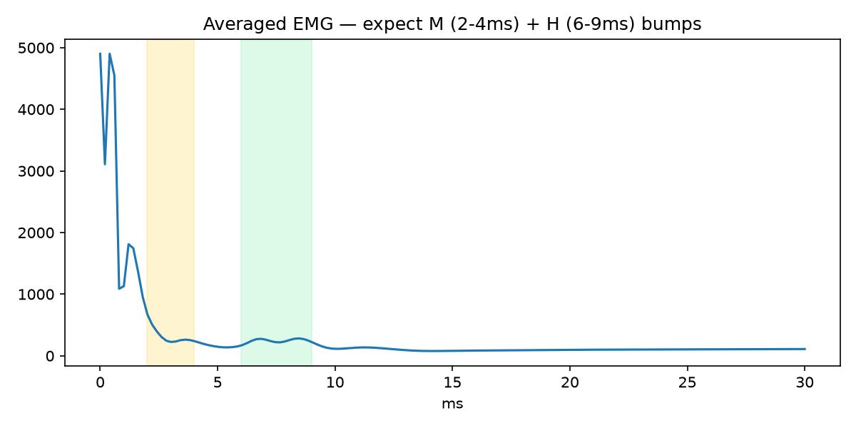
PART 2 · THE DATA
What a single trial looks like
Every shock produces one trial: a 30-millisecond window, two electrodes recorded at the same moment.
Reading the trace
The spike at zero
the stimulus itself — an electrical artifact
M-wave, 2–4 ms
the nerve firing the muscle directly
H-reflex, 6–9 ms
the signal that travelled to the spinal cord and back — this is what conditioning changes
Notes:
Orientation before anything else. Every shock gives one trial — thirty milliseconds at five kilohertz, two channels recorded simultaneously. The spike at zero is the stimulus artifact. The bump at two to four milliseconds is the M-wave, the nerve firing the muscle directly. The bump at six to nine is the H-reflex, which went down to the spinal cord and back. That's the one conditioning changes. This particular figure is the average of two hundred eighty thousand trials from one animal.

Slide 6
PART 2 · THE DATA
First problem: the archive would not decode
What we were given
What happened
What was wrong
2006 MySQL tables and a decoder script. The script documented the byte order as big-endian.
Decoded as documented, every trial came out as noise. No M-wave, no reflex, nothing.
The files are little-endian. One flag. Flip it and the physiology appears exactly where the experimenters' own notes said it would.
How we knew we had it right
Not because it looked plausible — because the M-wave and H-reflex landed at exactly the latencies the experimenter had typed into the log in 2006: “MR interval 2-4; HR interval 6-9”. The data confirmed the notes and the notes confirmed the data.
Notes:
First problem, and it took a while. We were given the tables and a decoder script that documented the byte order as big-endian. Decoded that way every trial is noise — no M-wave, no reflex. The files are actually little-endian. It's one flag. But the reason we trusted the fix wasn't that the output looked plausible; it's that the M-wave and H-reflex landed at exactly the latencies the experimenter had typed into the log back in 2006 — MR interval two to four, HR interval six to nine. The data confirmed the notes and the notes confirmed the data.

Slide 7
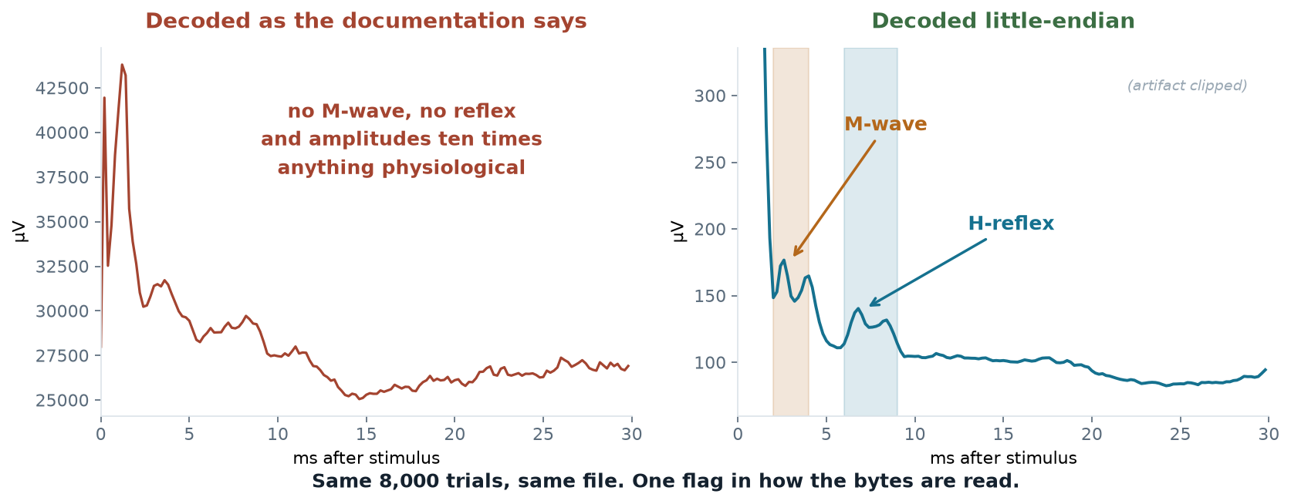
PART 2 · THE DATA
The same 8,000 trials, decoded two ways
This is real data, not an illustration. Left is what we got for the first two weeks. Right is the same file after flipping one flag.
Notes:
This is what it actually looked like. Left: decoded the way the documentation says, averaged over eight thousand trials. Amplitudes in the tens of thousands of microvolts, which is ten times anything physiological, and no structure at all. Right: the identical file with the byte order flipped. Stimulus artifact, then the M-wave in the orange band, then the H-reflex in the blue band. This is real data, not an illustration — and it's the moment the project actually started.

Slide 8
PART 2 · THE DATA
Six animals, 2.7 million trials
2.7M
6
3 / 3
45–210
trials decoded
animals
down / up
days each
Choosing which animals to download, without downloading them
The log files are a few hundred kilobytes; the signal data is four gigabytes an animal. The experimenter raises the reward threshold whenever the rat starts beating it, so the threshold history is a written record of how the animal was doing. We read only the logs, then downloaded signal data for the animals that had actually learned.
One animal excluded. A12's pre-stimulus cortical signal is 2.8 µV against 106–128 µV in the others — that electrode was dead.
Notes:
Six animals, three trained down and three up, forty-five to two hundred ten days each. Worth explaining how we chose them, because it saved us a lot of time. The log files are a few hundred kilobytes; the signal data is four gigabytes an animal. The experimenter raises the reward threshold whenever the rat starts beating it — so the threshold history is a written record of how the animal was doing. We read only the logs, then downloaded signal data for the ones that had learned. We also dropped animal twelve: its pre-stimulus cortical signal is under three microvolts against a hundred-plus in the others, so that electrode was dead.

Slide 9
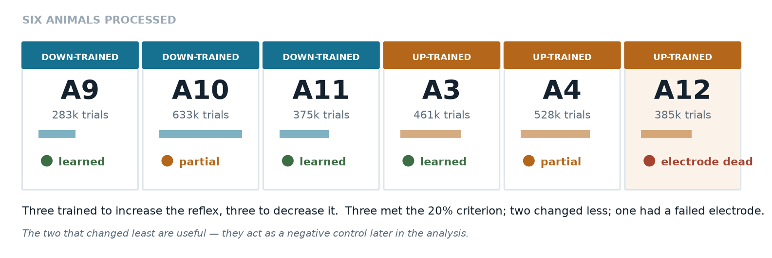
PART 2 · THE DATA
Who is in the study
Notes:
Here's the roster. Six animals, three trained to increase the reflex and three to decrease it, with trial counts from two hundred eighty thousand up to six hundred thirty thousand. Three met the twenty percent criterion. Two changed less than that — and those two turn out to be useful, because they act as a negative control later. One had a failed electrode and is excluded from anything cortical.

Slide 10
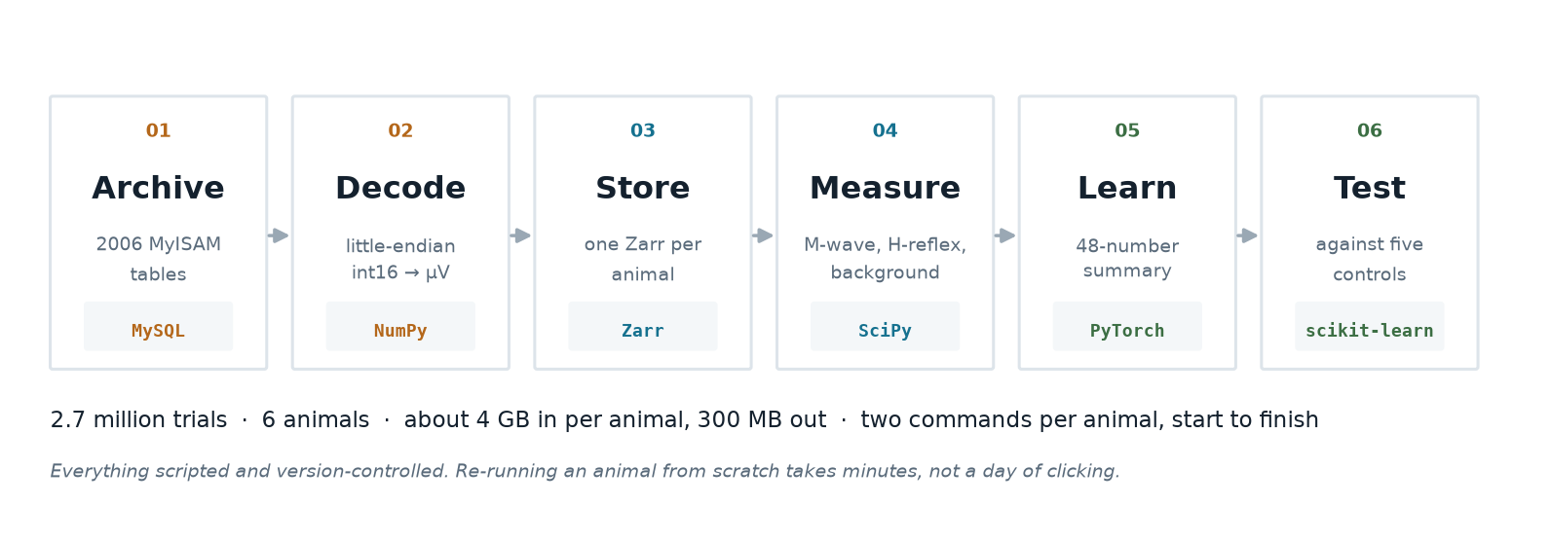
PART 3 · HOW WE BUILT IT
The pipeline, end to end
Notes:
This is the whole data flow. Recover the old tables into a local database. Decode each trial into two channels of microvolts. Store as Zarr, which is a chunked array format that lets us read two point seven million trials without loading them into memory. Measure the physiology. Learn the representation. Then test it against controls. Four gigabytes in per animal, about three hundred megabytes out, and once it's set up it's two commands per animal.

Slide 11
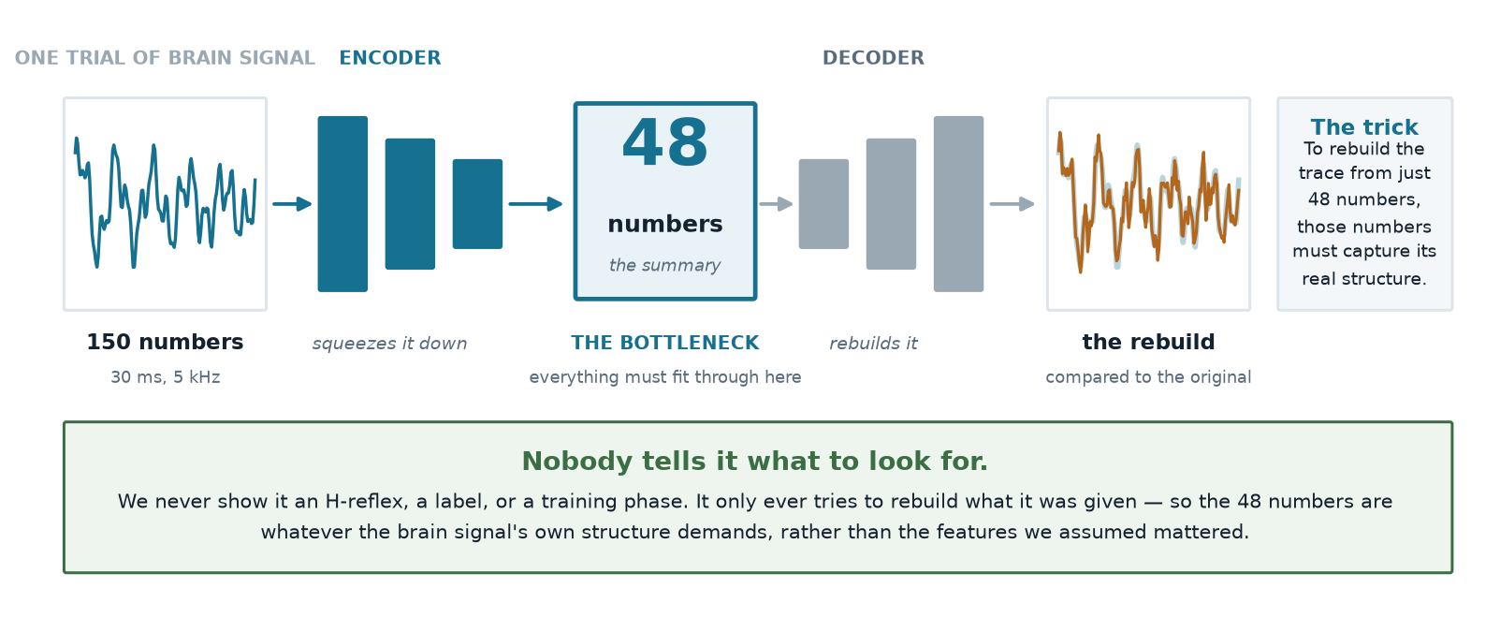
PART 3 · HOW WE BUILT IT
What the model actually is
Notes:
This is the model, and it's simpler than it sounds. On the left, one trial of brain signal — a hundred and fifty numbers. The encoder squeezes that down to forty-eight numbers. The decoder tries to rebuild the original from just those forty-eight. We train it by penalising the difference between the rebuild and the original. The important part is the bottleneck: to rebuild the trace from only forty-eight numbers, those numbers have to capture the trace's real structure rather than its noise. And crucially, nobody tells it what to look for. We never show it an H-reflex, a label, or a training phase. So the forty-eight numbers are whatever the signal's own structure demands, not the features we assumed mattered. After training we freeze it and use it purely as a description.

Slide 12
PART 3 · HOW WE BUILT IT
Training it, and the one trap we avoided
How it was trained
The trap
600,000
trials pooled across five animals
Pool several animals naively and the model learns to tell the animals apart — different electrodes, different amplitudes. That is a recording artefact wearing a biology costume.
12
passes through the data
~4 min
on a laptop GPU
0.0149 → 0.0070
reconstruction error
Fix: standardise every animal separately before pooling.
Why one model across all animals, rather than one per animal
A separate model per animal would describe each brain in its own private vocabulary, and you could never compare them. Training one model on all of them forces a shared vocabulary — so “this pattern of cortical activity” means the same thing in animal 3 as it does in animal 11. That is what makes the group comparisons later in the talk legitimate.
Notes:
Training details. Six hundred thousand trials pooled across five animals, twelve passes, about four minutes on a laptop GPU — these are small models. Reconstruction error halves and flattens. The trap we had to avoid: if you pool animals naively, the model learns to tell the animals apart, because they have different electrodes and different amplitudes. That's a recording artefact wearing a biology costume. So we standardise each animal separately before pooling. And the reason we train one model across all animals rather than one each: separate models would describe each brain in its own private vocabulary and you could never compare them. One shared model means a given pattern means the same thing in animal three as in animal eleven — which is what makes the group comparisons later legitimate.

Slide 13
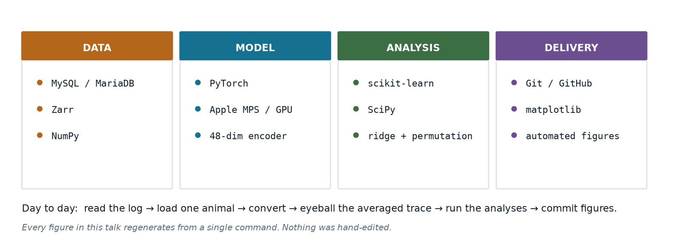
PART 3 · HOW WE BUILT IT
Tech stack and daily workflow
Notes:
The stack, in case it's useful. MariaDB for the archives, Zarr and NumPy for the arrays, PyTorch for the model running on Apple Silicon, scikit-learn and SciPy for the statistics, and matplotlib for figures. All Python, all open source, nothing exotic. Day to day the loop was: read the animal's log, load it, convert, look at the averaged trace to check the decode, run the analyses, commit the figures. Every figure in this talk regenerates from a single command — none of them were hand-edited, which matters when a number changes and six figures have to change with it.

Slide 14
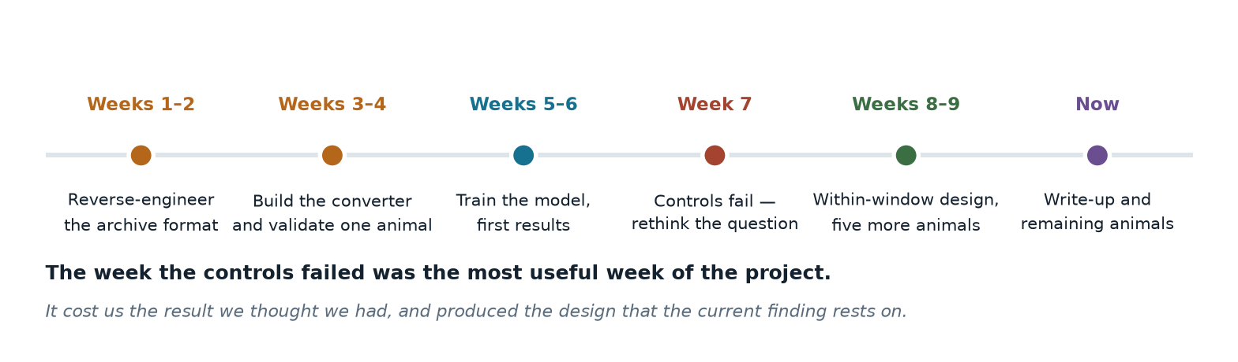
PART 3 · HOW IT WENT
How the summer actually went
Notes:
Roughly how the summer went, because the shape of it matters. Two weeks reverse-engineering the format. Two building the converter and validating one animal. Two training the model and getting first results, which looked good. Then week seven, when the controls failed and we had to rethink the question — that was the most useful week of the project. It cost us the result we thought we had and produced the design the current finding rests on. Then the new design and five more animals.

Slide 15
PART 3 · HOW WE BUILT IT
Why reflex size alone tells you nothing
The problem
The fix
A bigger shock makes a bigger reflex — no learning required. Across these recordings the delivered stimulus roughly quadrupled.
The M-wave sits in the same trace and reflects only the stimulus. It is a per-trial receipt for how much shock arrived. We remove its influence from every measure.
Early on this made one of our results come out backwards.
Dr. Carp's addition: the reflex also depends on how active the muscle already was. We now measure the 20 ms before each shock and remove that too.
Every number in the rest of this talk has both corrections applied.
Notes:
This slide matters because getting it wrong cost us a result. A bigger shock makes a bigger reflex with no learning involved, and across these recordings the delivered stimulus roughly quadrupled. Early on that made one of our findings come out backwards. The fix is that the M-wave sits in the same trace and reflects only the stimulus, so it's a per-trial receipt. Dr Carp added the second one: the reflex also depends on how active the muscle already was, so we measure the twenty milliseconds before each shock. Every number from here on has both corrections applied.

Slide 16
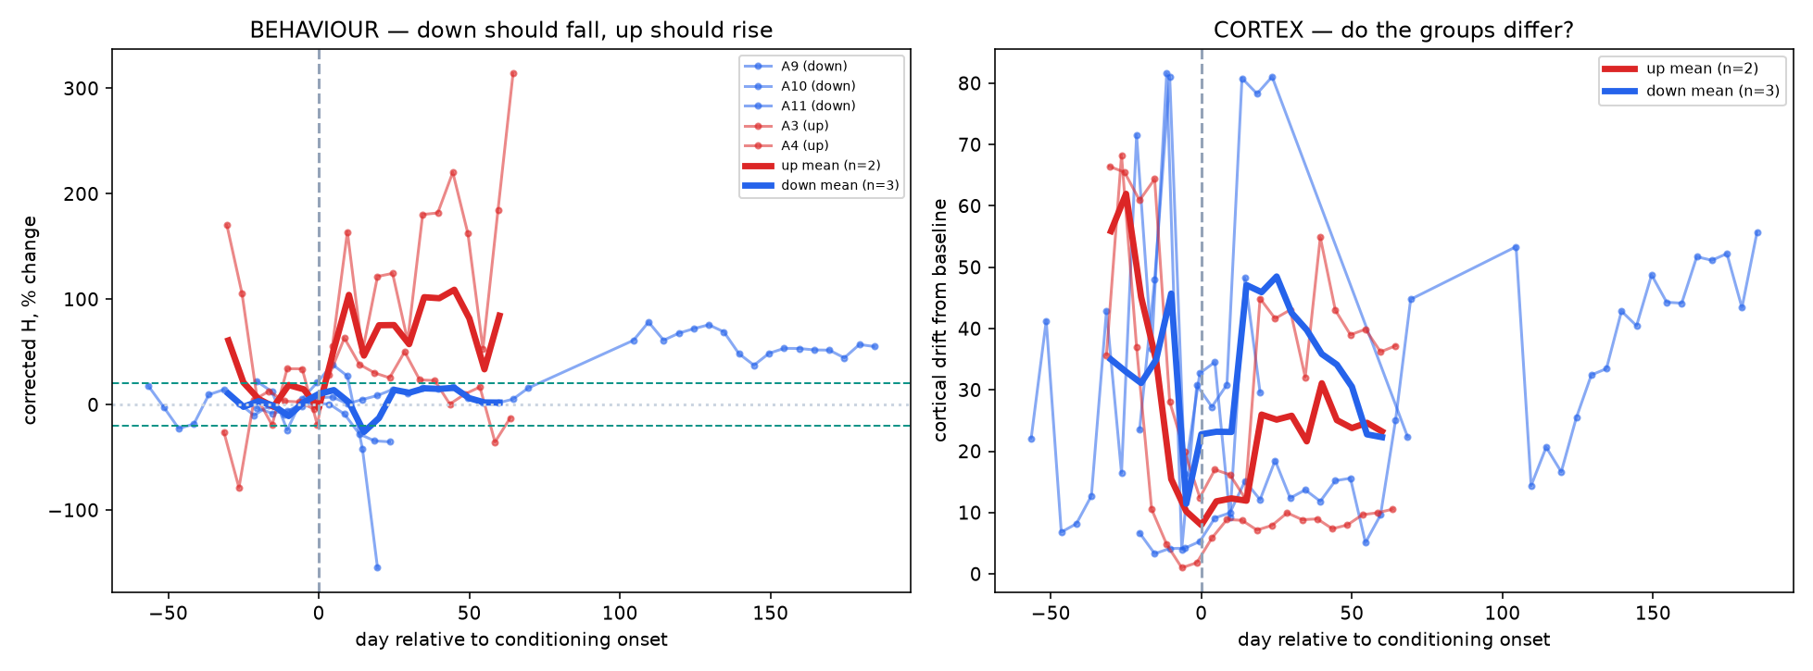
PART 4 · RESULT ONE
Conditioning works, in both directions
The positive control
Each animal is lined up to its own training start day. Up-trained animals (red) rise; down-trained (blue) fall.
Three of five clear the 20% criterion in the trained direction.
The two that don't become a built-in control later on.
Notes:
We lead with behaviour because it's the check that has to pass before anything else counts. Each animal is aligned to its own training start day. Up-trained animals rise, down-trained fall. Three of five clear the twenty percent criterion in the trained direction, and the two that don't come back later as a negative control. And again — this is after removing stimulus and background, so it isn't the stimulus creeping up.

Slide 17
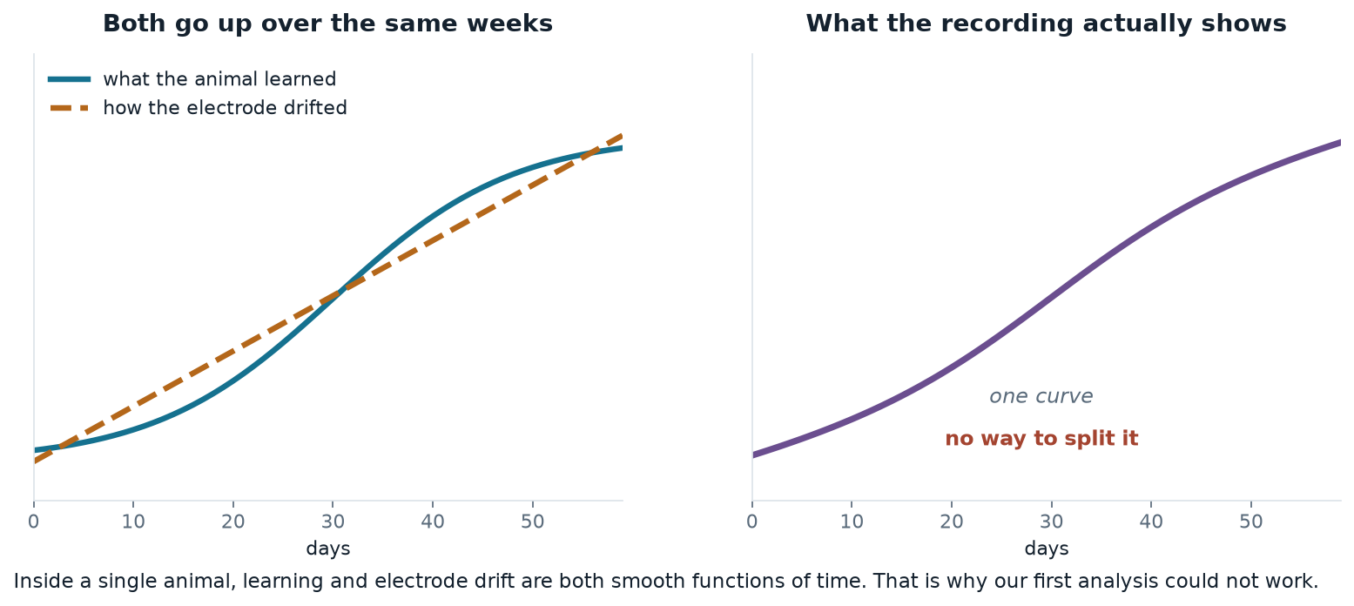
PART 4 · THE HARD PART
Two things change slowly over the same weeks
This is a limit of the study design, not of the data — and it shaped everything we did next.
Notes:
Now the hard part, and I want to be direct about it. Two things change slowly over the same weeks: the animal's learning, and the chronically implanted electrode. On the left, both curves go up. On the right is what the recording actually gives you — one curve, with no way to split it. Inside a single animal both are smooth functions of time, so no amount of analysis separates them. That's a limitation of the design rather than the data, and it shaped everything we did next.

Slide 18
PART 4 · RESULT TWO, A NEGATIVE
Our first approach did not survive its controls
We measured how far the average brain state moved across training. It moves — but three tests say the movement is the recording, not the animal.
Take baseline-only data and pretend half was training
Nothing happened, so it should show no movement
Moves just as much — 5 of 6 animals
Shuffle which trial belongs to which day
Keeps the numbers, destroys the timeline
No movement — the measure itself is sound
Compare animals trained up against trained down
Electrode drift doesn't care which way you trained
No difference between the groups
Two of these three were Dr. Carp's suggestions. They changed our conclusion.
Notes:
Our first approach was the obvious one: measure how far the average brain state moves across training. It does move, and it looked convincing. But three tests say that movement is the recording rather than the animal. If you take baseline-only data and pretend half of it was training, it moves just as much, in five of six animals. If you shuffle which trial belongs to which day, nothing moves — so the measure itself is fine. And electrode drift doesn't care which direction you trained the animal, and there's no difference between the up and down groups. Two of those three were Dr Carp's suggestions, and they changed our conclusion. I'd rather show you this than not.

Slide 19
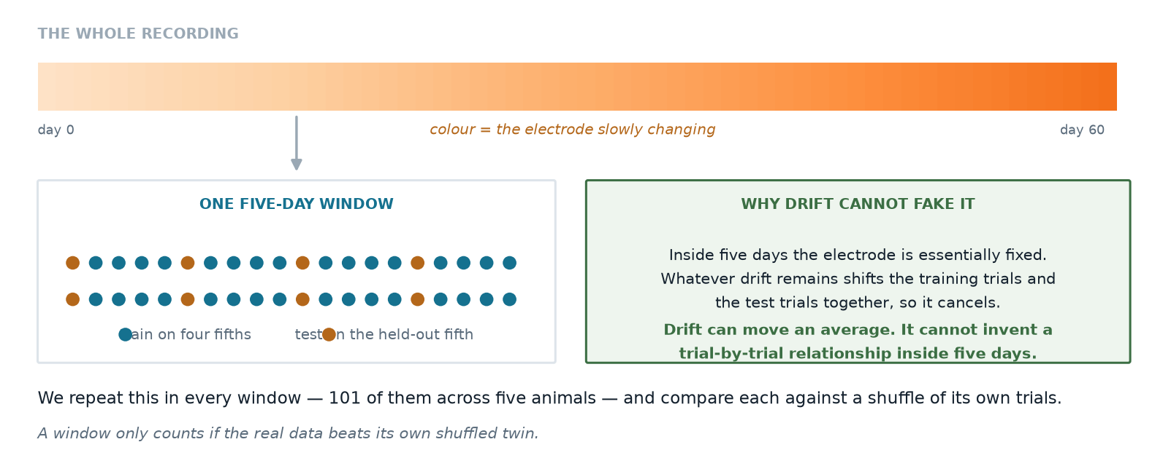
PART 4 · THE IDEA
So we asked a question drift cannot fake
Instead of
We ask
“Did the average brain state move over weeks?”
“Can the brain predict this trial's reflex?”
Notes:
So rather than keep fighting that confound, we changed the question. Instead of asking whether the average moved, we ask whether the brain can predict this particular trial's reflex. Here's the design, and it's the part I'd most like your reaction to. The top bar is the whole recording, with colour showing the electrode slowly changing. We chop it into five-day windows. Inside one window we train on four fifths of the trials and test on the held-out fifth. Within five days the electrode is essentially fixed, and whatever drift remains moves the training and test trials together, so it cancels. Drift can move an average. It cannot invent a trial-by-trial relationship inside five days.

Slide 20
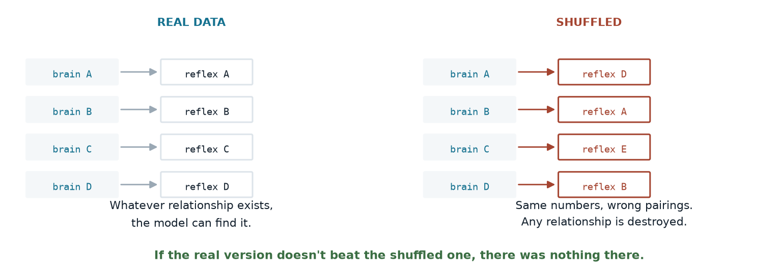
PART 4 · THE CONTROL
And each window is judged against itself
We repeat this in all 101 windows across five animals. A window only counts if the real data beats its own shuffled twin.
Notes:
And we don't just look at whether the prediction is good in absolute terms, because there's no natural yardstick for that. Instead each window is judged against itself: take the same trials, shuffle which reflex goes with which brain signal, and run the identical analysis. Same numbers, wrong pairings, so any real relationship is destroyed. If the real version doesn't beat the shuffled one, there was nothing there. We do that in all hundred and one windows.

Slide 21
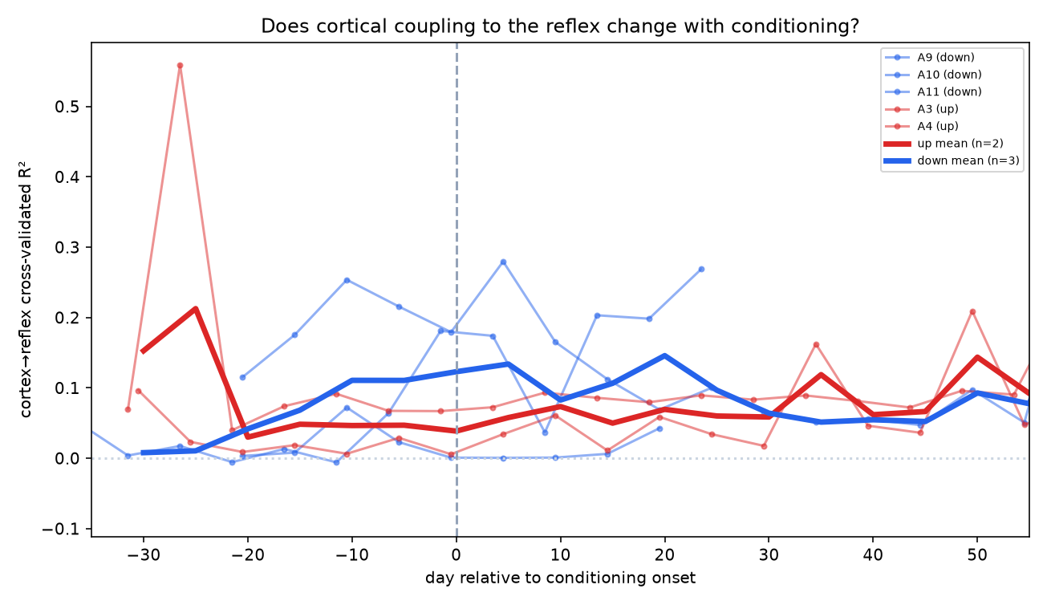
PART 4 · RESULT THREE, THE FINDING
The brain does carry a signal about the reflex
99 of 101
windows where the real data beat its own shuffled version
Present in all five animals.
Counting the animal as the unit of analysis:
t(4) = 3.81, p = 0.019
Small in size, but almost never absent.
Notes:
And here's the finding. In ninety-nine of a hundred and one windows the real data beat its own shuffled version, and it holds in all five animals. On the statistics I want to be careful. Counting each window as independent would badly overstate it, because windows within an animal share an electrode and an animal. Counting the animal as the unit of analysis gives t of three point eight one on four degrees of freedom, p equals nought point nought one nine. So the effect is small in size but almost never absent — and I'd argue reliability is the more meaningful property here.

Slide 22
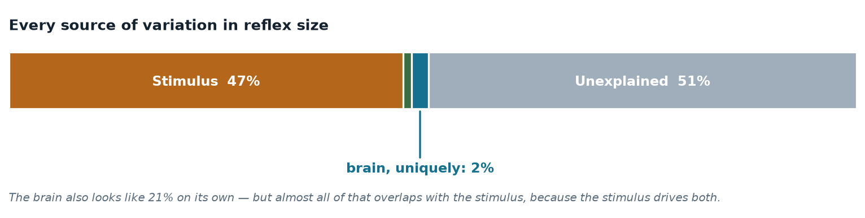
PART 4 · IN PROPORTION
How much does the brain actually explain?
Dr. Carp asked us to split the variance up. The stimulus dominates, and the brain overlaps with it heavily.
Why the brain's own 21% collapses to 2%
The stimulus drives both the cortical evoked response and the reflex, so most of what the brain appears to explain is the stimulus wearing a different hat. Only the part that survives once stimulus and background are already in the model counts as a genuine cortical contribution.
Notes:
Dr Carp asked us to split the variance up, and this is the answer. The stimulus dominates at forty-seven percent. Background is one. About half is still unexplained, which is normal for single-trial physiology. The brain on its own looks like twenty-one percent, but almost all of that overlaps with the stimulus, because the stimulus drives both the cortical response and the reflex. Only the part that survives once the other two are in the model — about two percent — counts as a genuine cortical contribution. That's a small number and I don't want to oversell it.

Slide 23
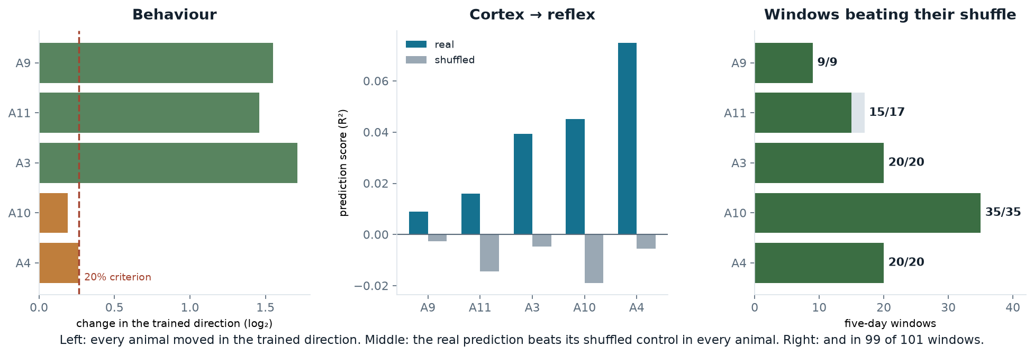
PART 4 · EVERYTHING AT ONCE
All five animals, all three measures
Notes:
This is everything on one slide. On the left, behaviour: every animal moved in the direction it was trained, three of them past the twenty percent line. In the middle, the prediction score against its shuffled control — real in blue, shuffled in grey — and the real bar is higher in every animal. On the right, how many five-day windows beat their own shuffle: nine of nine, fifteen of seventeen, and three animals at a hundred percent. Ninety-nine of a hundred and one overall.

Slide 24
PART 4 · RIGOUR
Everything we tried to kill it with
Baseline sham
Pretend part of the baseline was training
drift fails
Shuffled trial order
Keep the numbers, destroy the timeline
null ≈ 0
Stimulus strength
Is it just how hard we shocked?
survives
Pre-stimulus background
Is it muscle tone rather than brain?
survives
Within-window testing
Could electrode drift manufacture it?
drift cancels
Muscle crosstalk
Is the brain electrode picking up EMG?
r = +0.06
Up versus down
Does it depend on training direction?
no difference
Five it survives, two it fails — and the two failures are what told us the average-state approach was the wrong question.
Notes:
This is everything we tried to kill the result with. Five it survives, two it fails, and the two failures are what told us the average-state approach was the wrong question. Most of these were suggested by Dr Carp. If anyone here can think of something we haven't tried, that's genuinely the most useful thing I could take away from this meeting.

Slide 25
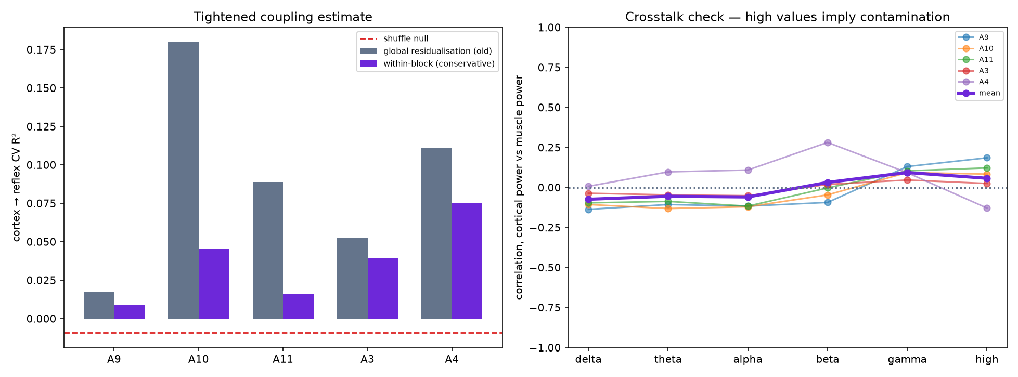
PART 4 · THE OBVIOUS OBJECTION
Is the brain electrode just picking up muscle?
The test
Both channels record at once, so the cortical electrode could in principle be registering muscle activity. Muscle artefact lives at high frequency, so that is where contamination would appear.
Above 100 Hz: r = +0.06
Essentially zero, and the low bands are slightly negative. The cortical signal also marginally leads the muscle, which is the acceptable direction.
Notes:
The obvious objection is that both channels are recorded simultaneously, so maybe the cortical electrode is just picking up muscle. Dr Carp suggested the test: correlate cortical power against muscle power and see how much they move together. Muscle artefact lives at high frequency, so that's where contamination would show. Above a hundred hertz the correlation is plus nought point nought six — essentially zero. The low bands are slightly negative. And the cortical signal marginally leads the muscle, which is the acceptable direction. So we don't think this is contamination, though I'd welcome a better test.

Slide 26
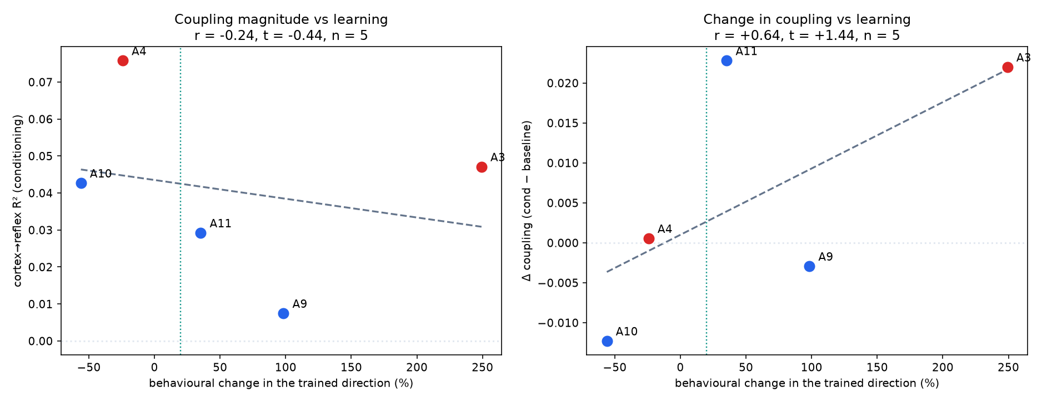
PART 5 · THE MOST PROMISING THREAD
Does it scale with how much they learned?
r = +0.71
between how much an animal learned and how much its cortical coupling changed
The two animals that failed to learn show no increase — a built-in negative control.
With five animals this is a direction, not a result. Five more are ready to process.
Notes:
This is the thread I think is most promising, and it was Dr Carp's suggestion. Animals differ in how much they learned, and two failed outright — those become a built-in negative control. The correlation between how much an animal learned and how much its cortical coupling changed is plus nought point seven one, and the two that failed show no increase. With five animals that's a direction rather than a result. Five more animals are downloaded and ready to process, and that's what would settle it.

Slide 27
PART 5 · A NEW THREAD
The metadata may be a measurement
An idea that came out of the last meeting, and one we think is worth pursuing.
What the reward threshold is
Why that is interesting
The experimenter raises it when the rat is beating the task and lowers it when the rat is struggling. It is adjusted by hand, day by day, across the whole experiment.
It is a record of how hard the task was for that animal — its engagement and effort — written down independently of anything we measure from the electrodes.
It is, in effect, a staircase procedure.
No shared noise with our signal processing.
Right now our scaling result correlates two things measured from the same electrodes.
If cortical coupling instead tracks a behavioural record kept by hand at the time, that is a far harder result to dismiss. We would like to build this next.
Notes:
One new thread, which came out of talking with Dr Carp. The reward threshold is adjusted by hand, day by day — raised when the rat is beating the task, lowered when it's struggling. That's effectively a staircase procedure, and it's a record of how hard the task was for that animal, written down independently of anything we measure from the electrodes. Right now our scaling result correlates two things measured from the same electrodes, which share noise. If cortical coupling instead tracks a behavioural record kept by hand at the time, that's a much harder result to dismiss. We'd like to build that next.

Slide 28
PART 5 · WHAT WE WOULD WRITE
Three things worth writing up
The method
A reproducible pipeline that recovers a twenty-year-old archive and learns a representation from it, on a laptop.
Useful to anyone with old chronic recordings sitting on a shelf.
The finding
Cortical activity carries a small, highly reliable single-trial signal about reflex size, independent of stimulus and excitability.
Extends Boulay et al. from a population relationship to a single-trial one.
The warning
The intuitive drift analysis produces a convincing result that three controls reject.
We would want to save the next group from spending months on it.
Target: a machine-learning venue, framed as an extension of the existing cortical–spinal work.
Notes:
If this becomes a paper, we think there are three pieces. The method — a reproducible pipeline that recovers a twenty-year-old archive and learns a representation from it on a laptop, which is useful to anyone with old chronic recordings on a shelf. The finding — cortical activity carries a small but highly reliable single-trial signal about reflex size, which extends Chad's work from a population relationship to a single-trial one. And the warning — the intuitive drift analysis produces a convincing result that three controls reject, and we'd want to save the next group from spending months on it. We'd aim at a machine-learning venue, framed as an extension of the existing cortical-spinal work.

Slide 29
PART 5 · WHY IT MIGHT MATTER
Where a single-trial cortical readout could help
Closing the loop
Understanding who responds
Rehabilitation
If cortex predicts the reflex before the fact, conditioning protocols could adapt trial by trial rather than day by day.
Roughly a third of animals — and people — don't respond to conditioning. A cortical readout might show why, early.
Reflex conditioning is already used clinically after spinal cord injury. Any handle on the cortical side is a handle on individualising it.
All three depend on the effect being larger and more reliable than what we can currently demonstrate. We are not there yet — but this is the direction that would make it worth getting there.
Notes:
Why this might matter, and I want to be careful not to oversell. If cortex predicts the reflex before the fact, conditioning protocols could in principle adapt trial by trial rather than day by day. Roughly a third of animals, and of people, don't respond to conditioning — a cortical readout might show why, early. And reflex conditioning is already used clinically after spinal cord injury, so any handle on the cortical side is a handle on individualising it. All three depend on the effect being bigger and more reliable than what we can currently show. We're not there. But that's the direction that makes it worth getting there.

Slide 30
PART 5 · NEXT
What happens next
1
Process the remaining animals
Five are downloaded and ready. Takes the sample from five to about ten.
this week
2
Power the scaling test
With ten animals the learning-versus-coupling correlation becomes a real test.
next
3
Frequency-resolved coupling
Which bands carry the reflex information? Sharpens the finding and the contamination argument.
next
4
The reward-criterion measure
An independent behavioural record to correlate against.
new thread
5
Write it up
Method, finding and warning.
after that
Notes:
What happens next. Five more animals are downloaded and ready, which takes us from five to about ten and is what powers the scaling test. Then frequency-resolved coupling, to see which bands carry the information — that sharpens both the finding and the contamination argument. The reward-criterion measure as an independent behavioural record. And then writing it up.

Slide 31
IN SUMMARY
What we can say
SOLID
Both directions, after controlling for stimulus strength and muscle excitability. Three of five animals met the lab's criterion.
Conditioning reproduces
REAL
It predicts reflex size above its own shuffled control in 99 of 101 windows and in every animal. Small — about 2% of variance uniquely — but almost never absent.
Cortex carries a single-trial signal
USEFUL NEGATIVE
The intuitive analysis produces a convincing result that three separate controls reject.
Average-state drift is not learning
Every number above is corrected for stimulus intensity and pre-stimulus muscle activity, and survives a shuffle control.
Notes:
To summarise. Conditioning reproduces in both directions with full stimulus control — that's solid. Cortex carries a small single-trial signal about reflex size that beats its own shuffled control in ninety-nine of a hundred and one windows and in every animal — that's real, and small. And the average-state drift analysis is a useful negative: it looks convincing and three controls reject it. Every number is corrected for stimulus and muscle activity.

Slide 32
STILL OPEN
What we know we haven't settled
1
Does the coupling grow with learning?
The correlation points the right way (r = +0.71) but five animals cannot settle it. Five more are processed and waiting.
2
Which frequencies carry it?
Would sharpen both the finding and the argument against muscle contamination.
3
Is 2% of variance biologically meaningful?
It is reliable. Whether it matters is a question for this room more than for us.
4
What else could produce it?
We have excluded stimulus, muscle tone, drift and crosstalk. We would genuinely like to know what we are missing.
Notes:
And the things we know we haven't settled. Whether the coupling grows with learning — the correlation points the right way but five animals can't settle it, and five more are processed and waiting. Which frequencies carry the signal. Whether two percent of variance is biologically meaningful, which is honestly a question for this room more than for us. And what else could produce it that we haven't excluded — we'd genuinely like to know what we're missing.

Slide 33
EVERYTHING IS PUBLIC
Code, data pipeline, figures and write-up
Project page
Repository
Write-up
switchrao777.github.io/hroc-ncan
github.com/switchrao777/hroc-ncan
docs/HROC_Report.pdf
Findings, figures and links in one place.
The full pipeline. Two commands per animal, reproducible end to end.
Six pages: background, methods, results, limitations, references.
What is in the repository
Every decoding and analysis script, the trained encoder, all 90+ figures, per-animal numerical results, a starter notebook, and setup instructions. No raw recordings — those stay with NCAN.
Notes:
Everything is public. There's a project page with the findings and figures, the repository with the full pipeline — two commands per animal and it runs end to end — and a six-page write-up. The repository has every script, the trained encoder, all the figures, per-animal results, a starter notebook and setup instructions. No raw recordings; those stay with NCAN. If anyone wants to run it on their own data, it should be straightforward.

Slide 34
Thank you
With thanks to Dr. Jonathan Carp and Teresa, whose suggestions — the sham control, the
randomised order test, and the pre-stimulus covariate — changed what this project concluded.
Suchith Rao · Tarun Senthil
switchrao777.github.io/hroc-ncan
Happy to take questions.
Notes:
Thank you. And genuinely — the sham control, the randomised order test and the pre-stimulus covariate were all Dr Carp's suggestions, and each one changed what this project concluded. Happy to take questions.

