Slide 1
WEEKLY UPDATE
The cortical signal is small
— and almost always there.
99 of 101 blocks above the null, across every animal. Plus all four controls you asked for.
Suchith Rao & Tarun Senthil • for Dr. Carp
Notes:
Good week. The headline is that the cortical effect is small in magnitude but extremely consistent — it is above the null in 99 of 101 five-day blocks, in every animal. I will also show you all four controls you asked for, and one number I had to revise down.

Slide 2
SINCE LAST WEEK
Four things you asked for
Partition the variance
How much does each factor explain?
Done — table next slide
1
Re-check the 0.35
Was stimulus removed properly?
Done — the number dropped
2
Test for crosstalk
Correlate cortex against muscle power
Done — no contamination
3
Does it scale with learning?
Failed animals as internal control
Done — r = +0.64
4
Notes:
Four things. Partition the variance — done, table on the next slide. Re-check the 0.35 to see whether the stimulus was removed properly — done, and the number dropped, which I'll explain. Test for crosstalk using your correlation method — done, no contamination. And whether the effect scales with how much each animal learned — done, and that one is the most promising.

Slide 3
ASK 1 · THE PARTITION
What explains reflex size
Stimulus (M-wave)
47%
Dominant — how much stimulus reached the muscle
Background excitability
1%
Small alone, but a necessary control
Cortex, alone
21%
Mostly overlaps stimulus — stimulus drives both
Cortex, unique
2%
What cortex adds once the others are known
Unexplained
51%
Trial-to-trial variability we can't account for
Your read was right: the three don't add up, because cortex and stimulus share variance.
Notes:
Here's the partition you asked for. Stimulus dominates at 47 percent. Background is 1. Cortex alone is 21, but most of that overlaps with stimulus because the stimulus drives both the cortical evoked response and the reflex. Cortex's unique contribution, once the other two are in the model, is 2 percent. And about half the variance is still unexplained. Your intuition in the meeting was right — they don't add up, because of that shared variance.

Slide 4
THE HEADLINE
Small effect, near-perfect reliability
For each five-day block we ask whether cortex beats a shuffle of that block's own labels. It does, almost every time.
99 / 101
5 / 5
p = 2×10⁻²⁷
blocks above the null
animals
sign test
A9
A10
A11
A3
A4
9 / 9
35 / 35
15 / 17
20 / 20
20 / 20
Why this matters more than the effect size: a small effect that appears essentially every time, in every animal, is not noise.
Notes:
This is the number I want you to take away. Rather than judging the effect by its size alone, ask how often it shows up. For every five-day block we test cortex against a shuffle of that block's own labels. It beats the shuffle in 99 of 101 blocks, in all five animals — a sign test gives p of two times ten to the minus twenty-seven. The effect is small, but it is almost always there, and a small effect that appears every time in every animal is not noise.

Slide 5
ASK 2 · THE CORRECTION
We stress-tested our own headline number
What we checked
The fix
I removed stimulus and background across ALL trials at once, then measured cortex within each 5-day block. If the stimulus–reflex relationship shifts between blocks, that leaves stimulus variance behind — and cortex tracks stimulus.
Remove them INSIDE each block, then decode. Nothing can leak across blocks. This is the conservative estimate and the one we'll quote.
0.35
0.09
0.04
−0.01
best block, old method
mean, old method
mean, corrected
shuffle null
Still above the null in every animal — the finding holds, it's just smaller than I said.
Notes:
You asked me to check whether the stimulus had been removed properly, and it had not. Last week I quoted 0.35. That was the best block, and on top of that I'd removed stimulus and background globally rather than block by block. If the stimulus-reflex relationship shifts between blocks, global removal leaves stimulus variance behind, and cortex tracks stimulus — so the number was inflated. Doing it inside each block gives 0.04. That's the number we'll quote from now on. It's still above the shuffle null in every animal, so the finding holds, it's just a smaller claim than I made last week.

Slide 6
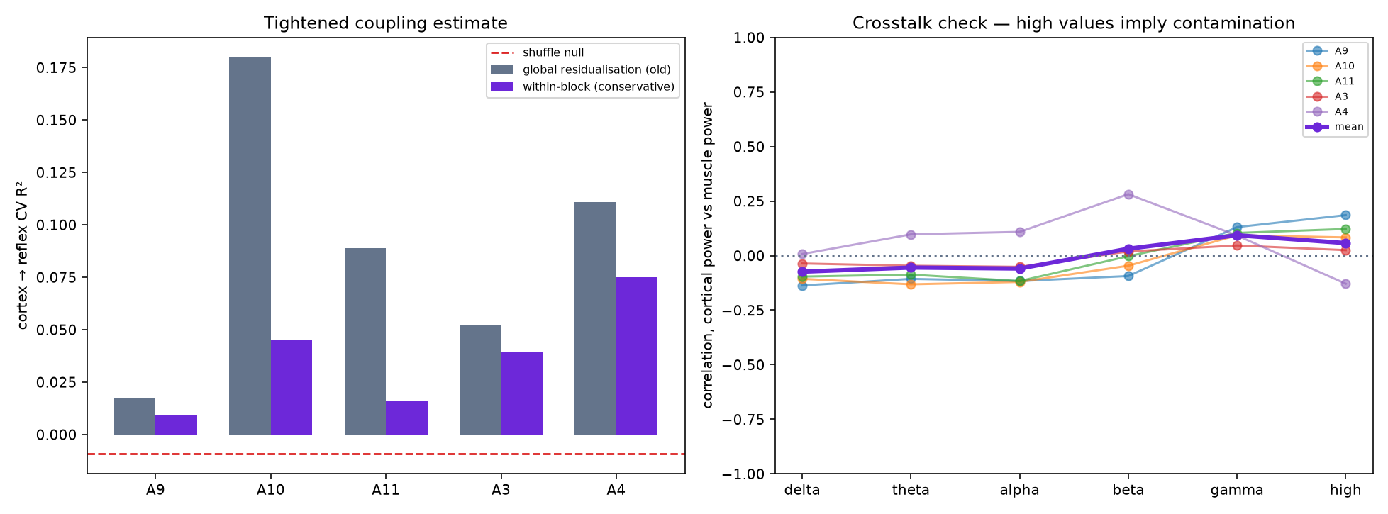
ASK 3 · CROSSTALK
No muscle contamination
Your method
Correlate cortical power against muscle power, band by band. Muscle artefact lives at high frequency, so contamination would show there.
Above 100 Hz:
r = +0.06
Essentially zero. Low bands slightly negative. Cortex marginally leads muscle, which is the acceptable direction.
Notes:
Crosstalk, using exactly the method you suggested — correlate cortical against muscle power and see how much coordination there is. Above 100 hertz, where muscle artefact lives, the correlation is plus 0.06, essentially zero. The low bands are slightly negative. And the lead-lag check has cortex marginally leading muscle, which you said would be the acceptable direction. So we don't think the ECoG is reproducing the EMG.

Slide 7
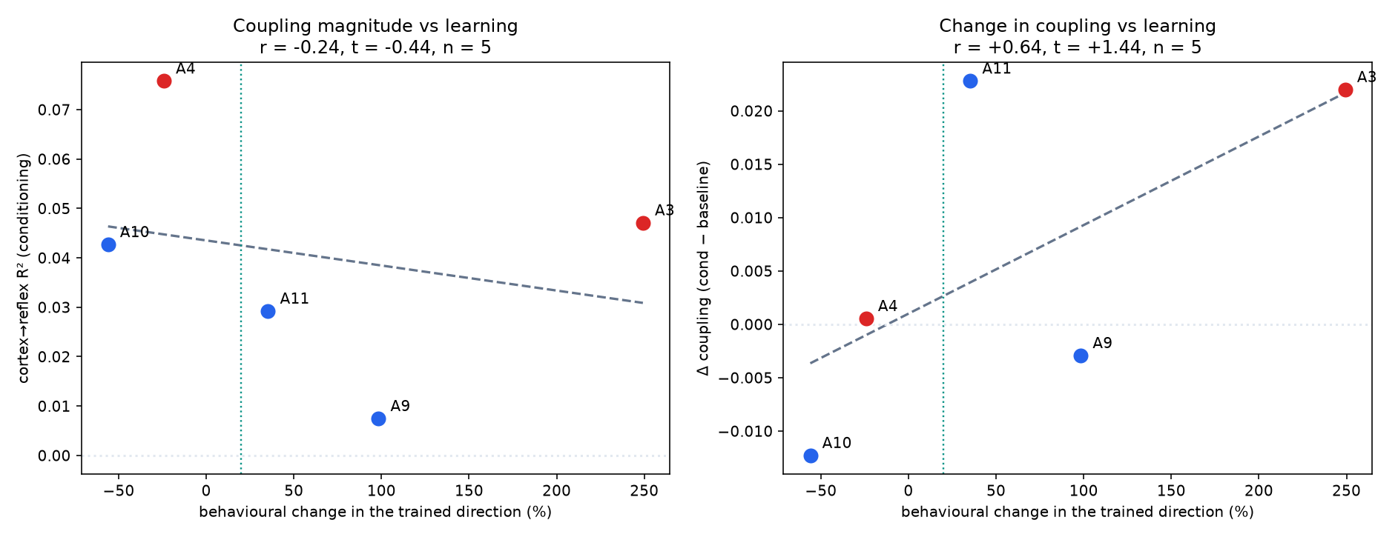
ASK 4 · THE INTERNAL CONTROL
The effect tracks how much they learned
Your idea
Animals that failed to condition shouldn't show the cortical effect. Two of ours failed — they're the built-in negative control.
r = +0.64
between learning and the change in coupling. The two successes gained coupling; the two failures didn't.
n = 5, so not significant yet.
Notes:
And this is your internal-control idea, which I think is the most promising thing we have. Animals differ in how much they learned and two of ours failed outright — those become the negative control. The correlation between learning and the change in coupling is plus 0.64. The two animals that succeeded gained coupling; the two that failed didn't. With five animals it isn't significant, but it's the right direction, and it's exactly what more animals would power.

Slide 8
NEW FINDING · A CONSTRAINT
A constraint worth knowing early
Using the reward criterion as a success readout across every animal's log — the same trick that found animals 3 and 4:
A3
up
RW 90 → 190
bar raised — learned
A4
up
RW 150 → 220
bar raised — learned
A1
up
RW 110 → 59
bar lowered — struggled
A6
up
RW 150 → 80
bar lowered — struggled
A12
up
—
ECoG electrode dead (2.8 µV)
So the up group is capped at two. The down group can still grow — 7, 8, 13, 14, 15 are ready to download.
Notes:
One new finding, and it's a constraint. I went back through every animal's log using the reward criterion as a success readout. For up-conditioning, raising the bar means the rat is beating it. Animals 3 and 4 had theirs raised, so they learned. Animals 1 and 6 had theirs lowered, so they struggled. And animal 12's electrode was dead. So the up group is capped at two, permanently — there isn't another good up-conditioned animal in this dataset. The down group can still grow, and 7, 8, 13, 14 and 15 are ready to download.

Slide 9
NEW THIS WEEK · DELIVERABLES
Everything now lives in one place
We put the project behind a single page so the code, the write-up and the slides stay in sync and are easy to hand to anyone.
REPOSITORY
REPORT
SLIDES
The pipeline
Six-page write-up
The decks
Decoding, the pooled autoencoder, every control, per-animal results. One command per animal, reproducible end to end.
Background, methods, results, limitations, references — with the four figures and the real numbers. Formatted as a handout.
This update, the talk for your group, and speaker notes for each.
github.com/switchrao777/hroc-ncan
docs/HROC_Report.pdf
slides/
Two blanks I left for you: Theresa's surname, and what Tarun and I should be listed as. I didn't want to guess on the write-up.
Notes:
One more thing from this week. We put everything behind a single page so it stays in sync and is easy to hand to anyone — the repository with the whole pipeline, a six-page write-up formatted as a handout with the real numbers and figures, and the slide decks. Two blanks I deliberately left: Theresa's surname, and what Tarun and I should be listed as on the write-up. I didn't want to guess at either.

Slide 10
NEXT
Between now and the 21st
1
Download and process the remaining animals
7, 8, 13, 14, 15 (down) plus 1 and 6 (failed up — negative controls). Takes n from 5 to about 12.
2
Re-run everything at the larger n
The scaling correlation is the analysis this powers. Fully automated — two commands per animal.
3
Build the presentation for your group
Pipeline explained with a data-flow figure, at the level you described.
4
Preview it with you
Before the 21st, so it's on par with what your group expects.
Question for you: with the up group capped at two, is the scaling analysis the right thing to build the paper on?
Notes:
Plan between now and the 21st. Download and process the remaining animals — the five down ones plus the two failed up animals, which are useful as negative controls. That takes us from five to about twelve. Re-run everything at that larger n, which is what powers the scaling correlation. Build the presentation for your group. And preview it with you beforehand. One question for you: given the up group is capped at two, is the scaling analysis the right thing to build the paper around rather than the direction contrast?

