Slide 1
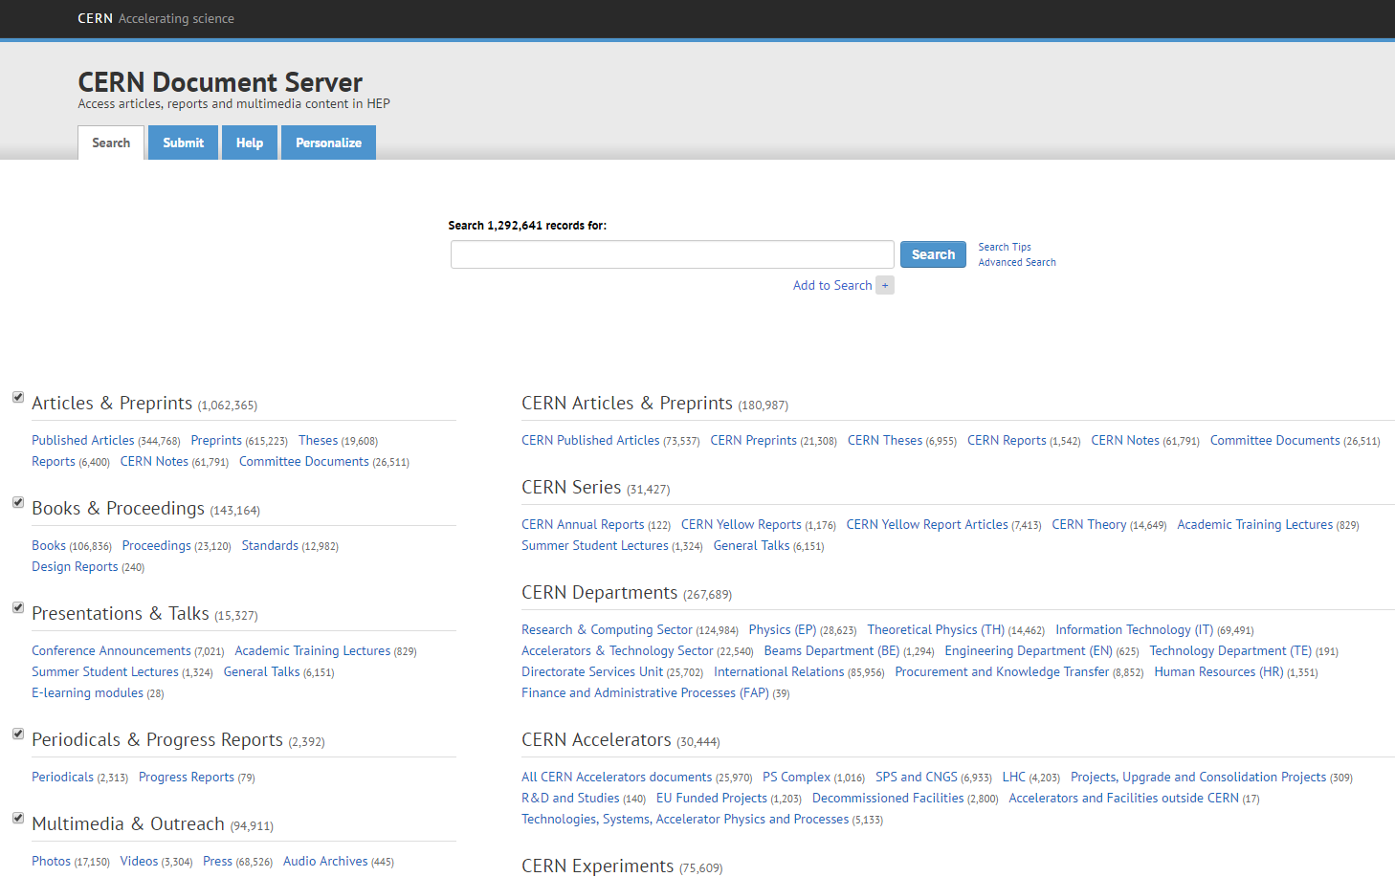
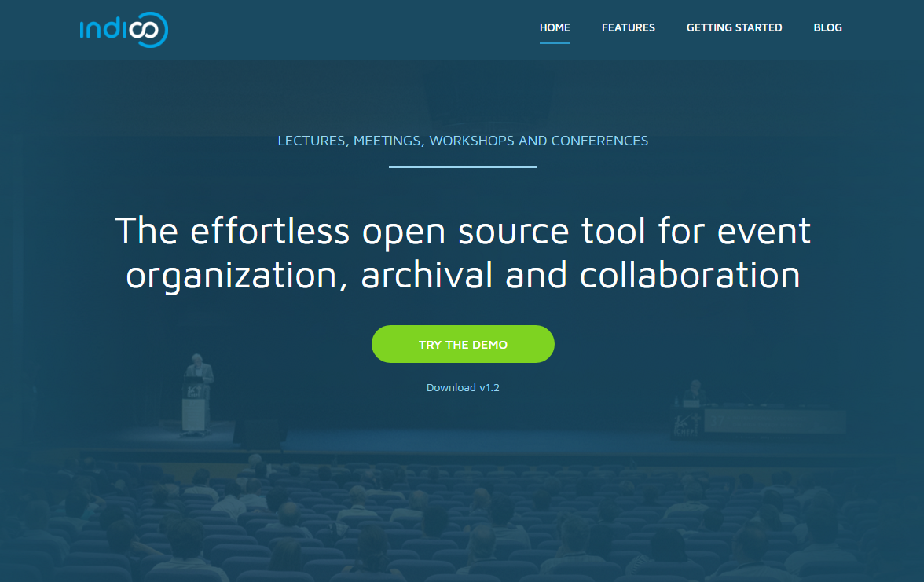
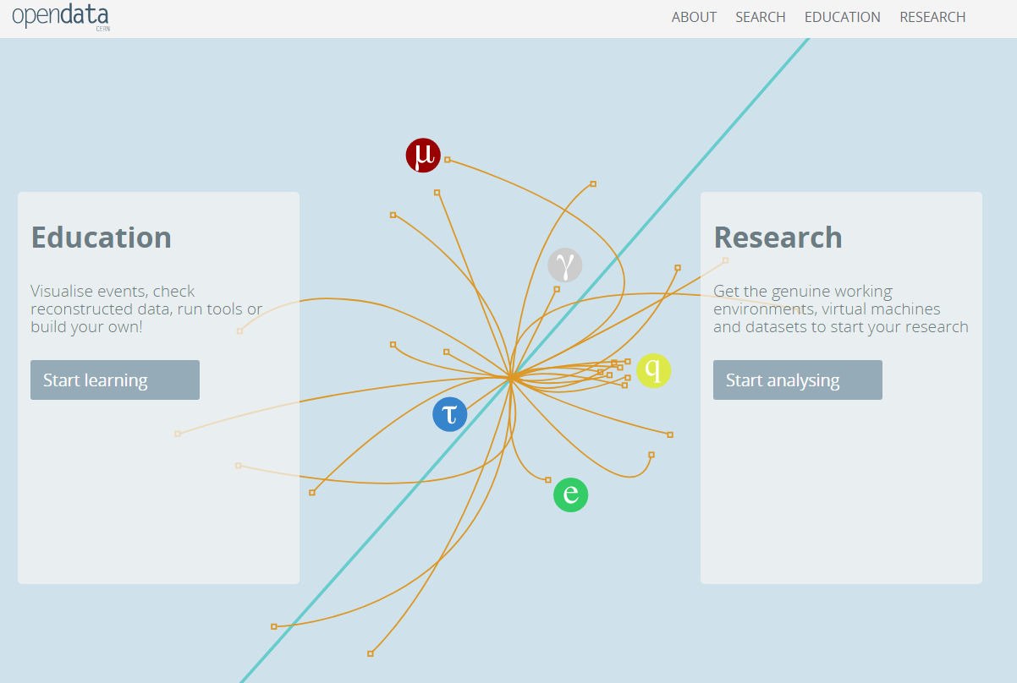
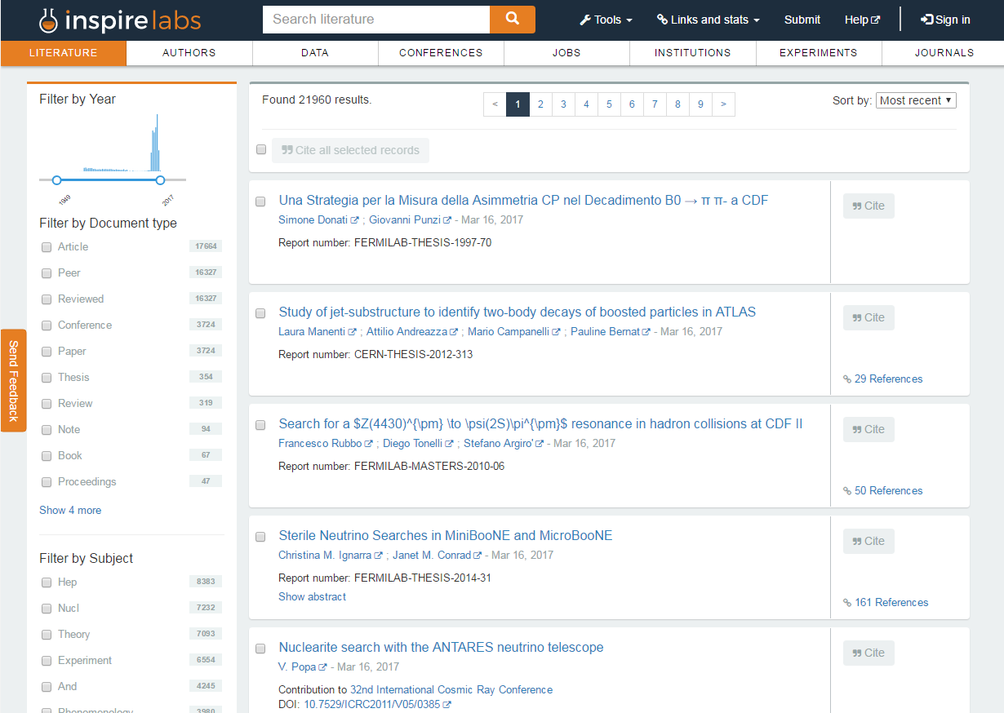
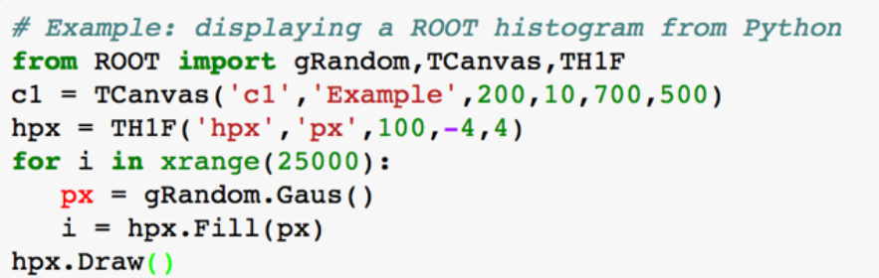
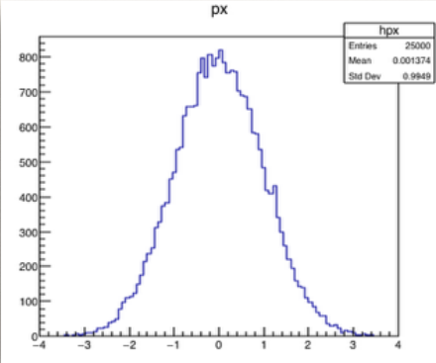
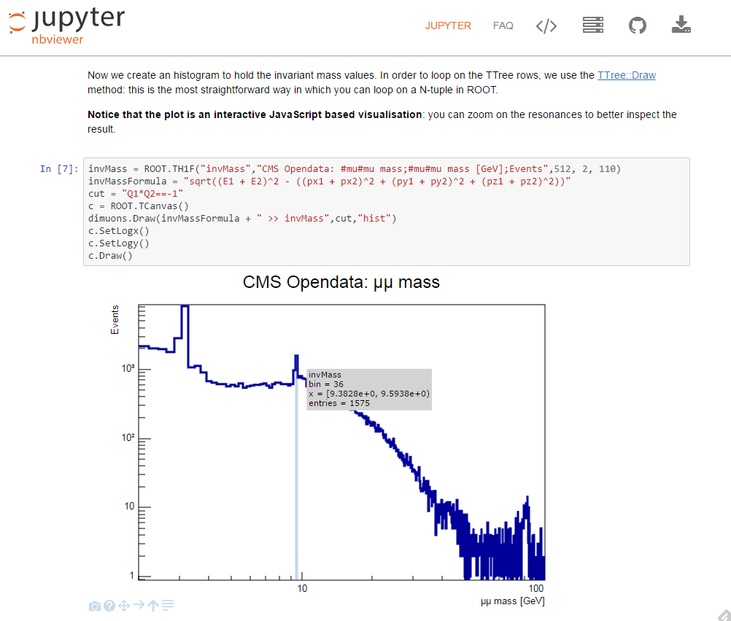
Python @ CERN
Sebastian Witowski
Invenio
Indico
All the discoveries at CERN, the big ones and the small ones, results in thousands of documents that have to go through the publication workflow. For that purpose, a digital library framework Invenio was created back in 2002. With this free an open source software you can create your own integrated library system (with module for borrowing books and tools for data curation), a multimedia archive or institutional repository (easily define ingestion and approval workflows to store publications of your institute).
The first version of started as a monolithic application, but with the recent version 3, Invenio shifted to a more modular approach.
Currently Invenio is used to power websites like:
With thousands of users at CERN (people working on the site and visiting scientists), organizing meetings can be a daunting task, but thanks to Indico, it’s actually very easy.
Indico is an open source tool for event organization, archival and collaboration. You can easily manage the whole event, starting from the registration process, abstract submission, reviewing process up to proceedings submission (check if the order is correct). If has a room booking module and plugins for various video conferencing tools.
Indico at CERN managed it’s first conference - CHEP - in 2004 and since then, there has been almost 500 000 different events organized with it’s help. Every week, around 25 000 unique users are using Indico.
CERN Document Server – CERN’s official repository for publications, articles, reports and multimedia content in High Energy Physics created at CERN. It easily manages 1 400 000 different records, including 200 000 photos, 100 000 books or 10 000 videos.
CERN Open Data Portal stores data from different experiments at CERN. You can visualize events directly in the browser and for more advanced analysis, you can create a Virtual Machine, import the data set and start your own analysis. And who knows, maybe you will discover something that thousands of scientists missed?
http://indico-software.org
PyROOT
INSPIRE – the biggest database for high energy physics literature run by a collaboration of CERN, DESY, Fermilab, IHEP, and SLAC (running since the 1970, in 2012 moved to Invenio).
Thousands of scientists every day analyze data produced by the LHC, trying to verify new theories and understand better the world around us. They need a tool that is fast for working with gigabytes of data but also easy to use by someone without much programming experience. And this is exactly why the PyROOT was born – a Python module that allows users to interact with the ROOT (data analysis framework written in C++).
PyROOT in more than a wrapper around ROOT. Python bindings are based on C++ reflexion information – thanks to that, Python classes are created dynamically when needed and C++ functions and globals are available automatically in Python.
SWAN
SWAN or Service for Web based Analysis is a platform to perform interactive data analysis in the cloud. Currently being tested at CERN, it allows users to connect to CERNBox (cloud storage built on top of Owncloud that uses EOS as a backend), where they can access experiments data as well as save their own results and work with the data using Jupyter notebook interface, as well as shell access from the browser. An easy way to analyse data without the need to install software.

Slide 2

Python @ CERN
Sebastian Witowski
CERN – home of the Large Hadron Collider that spits 1 petabyte of collisions data per second. None of today’s computing systems are capable of recording such rates, so the first level triggers are selecting only 1 in 10 000 events which are distributed among 170 computing centers in 42 countries (the Worldwide LHC Computing Group) which in turn select 1% of the remaining events for analysis. Even after such drastic data reduction, there are still around 50 petabytes of data produced at CERN per year.
How does Python fit in this ecosystem? It might not be fast enough to be used for filtering this amount of data, but nevertheless, there are has been many great projects created with Python at CERN.
Indico
With thousands of users at CERN (people working on the site and visiting scientists), organizing meetings can be a daunting task, but thanks to Indico, it’s actually very easy.
Indico is an open source tool for event organization, archival and collaboration. You can easily manage the whole event, starting from the registration process, abstract submission, reviewing process up to proceedings submission (check if the order is correct). If has a room booking module and plugins for various video conferencing tools.
Indico at CERN managed it’s first conference - CHEP - in 2004 and since then, there has been almost 500 000 different events organized with it’s help. Every week, around 25 000 unique users are using Indico.
Invenio
All the discoveries at CERN, the big ones and the small ones, results in thousands of documents that have to go through the publication workflow. For that purpose, a digital library framework Invenio was created back in 2002. With this free an open source software you can create your own integrated library system (with module for borrowing books and tools for data curation), a multimedia archive or institutional repository (easily define ingestion and approval workflows to store publications of your institute).
The first version of started as a monolithic application, but with the recent version 3, Invenio shifted to a more modular approach.
Currently Invenio is used to power websites like:
PyROOT
Thousands of scientists every day analyze data produced by the LHC, trying to verify new theories and understand better the world around us. They need a tool that is fast for working with gigabytes of data but also easy to use by someone without much programming experience. And this is exactly why the PyROOT was born – a Python module that allows users to interact with the ROOT (data analysis framework written in C++).
PyROOT in more than a wrapper around ROOT. Python bindings are based on C++ reflexion information – thanks to that, Python classes are created dynamically when needed and C++ functions and globals are available automatically in Python.
CERN Document Server – CERN’s official repository for publications, articles, reports and multimedia content in High Energy Physics created at CERN. It easily manages 1 400 000 different records, including 200 000 photos, 100 000 books or 10 000 videos.
http://indico-software.org
CERN Open Data Portal stores data from different experiments at CERN. You can visualize events directly in the browser and for more advanced analysis, you can create a Virtual Machine, import the data set and start your own analysis. And who knows, maybe you will discover something that thousands of scientists missed?
INSPIRE – the biggest database for high energy physics literature run by a collaboration of CERN, DESY, Fermilab, IHEP, and SLAC (running since the 1970, in 2012 moved to Invenio).
SWAN
SWAN or Service for Web based Analysis is a platform to perform interactive data analysis in the cloud. Currently being tested at CERN, it allows users to connect to CERNBox (cloud storage built on top of Owncloud that uses EOS as a backend), where they can access experiments data as well as save their own results and work with the data using Jupyter notebook interface, as well as shell access from the browser. An easy way to analyse data without the need to install software.

Slide 3
Python @ CERN
Sebastian Witowski
CERN – home of the Large Hadron Collider that spits 1 petabyte of collisions data per second. None of today’s computing systems are capable of recording such rates, so the first level triggers are selecting only 1 in 10 000 events which are distributed among 170 computing centers in 42 countries (the Worldwide LHC Computing Group) which in turn select 1% of the remaining events for analysis. Even after such drastic data reduction, there are still around 50 petabytes of data produced at CERN per year.
How does Python fit in this ecosystem? It might not be fast enough to be used for filtering this amount of data, but nevertheless, there are has been many great projects created with Python at CERN.
PyROOT
Indico
SWAN
Thousands of scientists every day analyze data produced by the LHC. They need a tool that is fast for working with gigabytes of data but also easy to use by someone with little programming experience. And this is exactly what the PyROOT is – a Python module that allows users to interact with the ROOT (data analysis framework written in C++).
PyROOT in more than a wrapper around ROOT. Python bindings are based on C++ reflexion information – thanks to that, Python classes are created dynamically when needed and C++ functions and globals are available automatically in Python.
With thousands of users at CERN (people working on the site and visiting scientists), organizing meetings can be a daunting task, but thanks to Indico, it’s actually very easy.
Indico is an open source tool for event organization, archival and collaboration. You can easily manage the whole event, starting from the registration process, abstract submission, reviewing process up to proceedings submission (check if the order is correct). If has a room booking module and plugins for various video conferencing tools.
Indico at CERN managed it’s first conference - CHEP - in 2004 and since then, there has been almost 500 000 different events organized with it’s help. Every week, around 25 000 unique users are using Indico.
SWAN or Service for Web based Analysis is a platform to perform interactive data analysis in the cloud. Currently tested at CERN, SWAN creates Virtual Machines that connect CERNBox (cloud storage built on top of Owncloud that uses EOS as a backend) with Jupyter notebook interface.
Users can then access the data and software available on EOS, store and share their own results or even have shell access to the VM from the browser. An easy way to analyse data without the need to install any software.
Invenio
All the discoveries at CERN, the big ones and the small ones, results in thousands of documents that have to go through the publication workflow. For that purpose, a digital library framework Invenio was created back in 2002. With this free an open source software you can create your own integrated library system (with module for borrowing books and tools for data curation), a multimedia archive or institutional repository (easily define ingestion and approval workflows to store publications of your institute).
The first version of started as a monolithic application, but with the recent version 3, Invenio shifted to a more modular approach.
Currently Invenio is used to power websites like:
CERN Document Server – CERN’s official repository for publications, articles, reports and multimedia content in High Energy Physics created at CERN. It easily manages 1 400 000 different records, including 200 000 photos, 100 000 books or 10 000 videos.
http://indico-software.org
CERN Open Data Portal stores data from different experiments at CERN. You can visualize events directly in the browser and for more advanced analysis, you can create a Virtual Machine, import the data set and start your own analysis. And who knows, maybe you will discover something that thousands of scientists missed?
INSPIRE – the biggest database for high energy physics literature run by a collaboration of CERN, DESY, Fermilab, IHEP, and SLAC (running since the 1970, in 2012 moved to Invenio).

Slide 4
Python @ CERN
Sebastian Witowski
CERN – home of the Large Hadron Collider that spits 1 petabyte of collisions data per second. None of today’s computing systems are capable of recording such rates, so the first level triggers are selecting only 1 in 10 000 events which are distributed among 170 computing centers in 42 countries (the Worldwide LHC Computing Group) which in turn select 1% of the remaining events for analysis. Even after such drastic data reduction, there are still around 50 petabytes of data produced at CERN per year.
How does Python fit in this ecosystem? It might not be fast enough to be used for filtering this amount of data, but nevertheless, there are has been many great projects created with Python at CERN.
PyROOT
SWAN
Thousands of scientists every day analyze data produced by the LHC. They need a tool that is fast for working with gigabytes of data but also easy to use by someone with little programming experience. And this is exactly what the PyROOT is – a Python module that allows users to interact with the ROOT (data analysis framework written in C++).
PyROOT in more than a wrapper around ROOT. Python bindings are based on C++ reflexion information – thanks to that, Python classes are created dynamically when needed and C++ functions and globals are available automatically in Python.
SWAN or Service for Web based Analysis is a platform to perform interactive data analysis in the cloud. Currently tested at CERN, SWAN creates Virtual Machines that connect CERNBox (cloud storage built on top of Owncloud that uses EOS as a backend) with Jupyter notebook interface.
Users can then access the data and software available on EOS, store and share their own results or even have shell access to the VM from the browser. An easy way to analyse data without the need to install any software.
https://root.cern.ch/pyroot
Indico
With thousands of users at CERN (people working on the site and visiting scientists), organizing meetings can be a daunting task, but thanks to Indico, it’s actually very easy.
Indico is an open source tool for event organization, archival and collaboration. You can easily manage the whole event, starting from the registration process, abstract submission, reviewing process up to proceedings submission (check if the order is correct). If has a room booking module and plugins for various video conferencing tools.
Indico at CERN managed it’s first conference - CHEP - in 2004 and since then, there has been almost 500 000 different events organized with it’s help. Every week, around 25 000 unique users are using Indico.
https://swan.web.cern.ch
Invenio
All the discoveries at CERN, the big ones and the small ones, results in thousands of documents that have to go through the publication workflow. For that purpose, a digital library framework Invenio was created back in 2002. With this free an open source software you can create your own integrated library system (with module for borrowing books and tools for data curation), a multimedia archive or institutional repository (easily define ingestion and approval workflows to store publications of your institute).
The first version of started as a monolithic application, but with the recent version 3, Invenio shifted to a more modular approach.
Currently Invenio is used to power websites like:
CERN Document Server – CERN’s official repository for publications, articles, reports and multimedia content in High Energy Physics created at CERN. It easily manages 1 400 000 different records, including 200 000 photos, 100 000 books or 10 000 videos.
http://indico-software.org
CERN Open Data Portal stores data from different experiments at CERN. You can visualize events directly in the browser and for more advanced analysis, you can create a Virtual Machine, import the data set and start your own analysis. And who knows, maybe you will discover something that thousands of scientists missed?
INSPIRE – the biggest database for high energy physics literature run by a collaboration of CERN, DESY, Fermilab, IHEP, and SLAC (running since the 1970, in 2012 moved to Invenio).

Slide 5






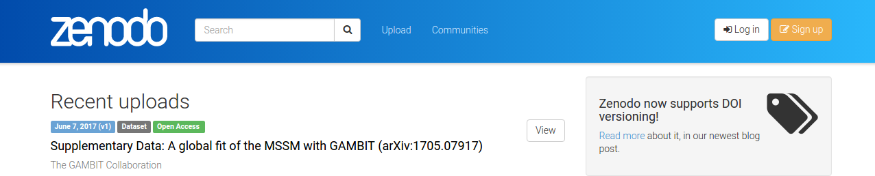
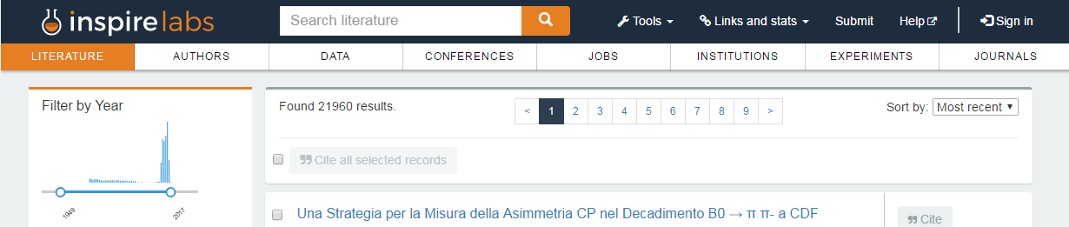
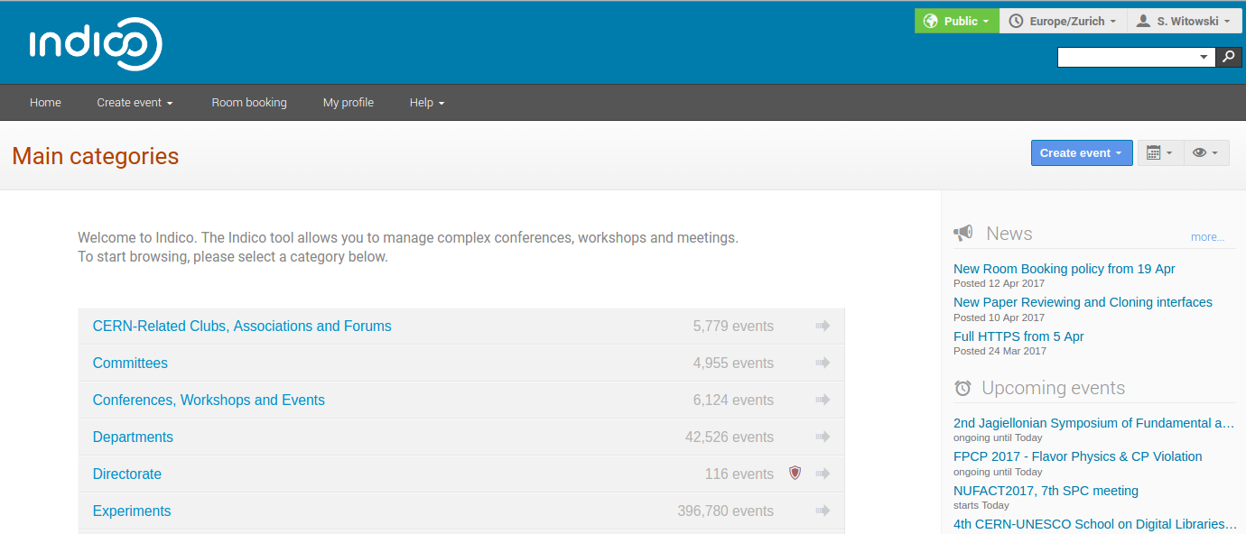
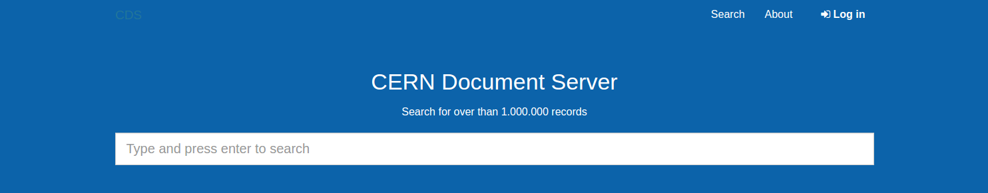



Python @ CERN
Sebastian Witowski
CERN – home of the Large Hadron Collider that can spit up to 1 petabyte of collisions data per second. None of today’s computing systems are capable of recording such rates, so the first level triggers are selecting only 1 in 10 000 events which are distributed among 170 computing centers in 42 countries (the Worldwide LHC Computing Grid) which in turn select 1% of the remaining events for analysis. Even after such drastic data reduction, there are still around 50 petabytes of data produced at CERN per year.
How does Python fit in this ecosystem? It might not be fast enough to be used for filtering this amount of data, but nevertheless, there are many great projects created with Python at CERN.
Grey text color: #666
+
Thousands of scientists every day analyse data produced by the LHC. They need a tool that works fast with gigabytes of data but also is easy to use by someone with little programming experience. And this is exactly what PyROOT is – a Python module that allows users to interact with ROOT (a data analysis framework written in C++, that is very popular in High Energy Physics community).
Users can use PyROOT directly in Python REPL. With all the ROOT classes and functions available out of the box, they can combine them with other modules like NumPy and SciPy to make make data analysis easier and faster.
PyROOT in more than just a wrapper around ROOT. Python bindings are based on C++ reflexion information. Thanks to that, Python classes are created dynamically when needed and C++ functions and globals are available automatically in Python.
SWAN or Service for Web based Analysis aims to let anyone analyse data without the need to install any software. Currently tested at CERN, SWAN creates Virtual Machines that automatically connect CERNBox (a cloud storage built on top of Owncloud that uses EOS as a backend) with Jupyter notebook interface. Thanks to the JavaScriptRoot plugin, all visualizations in the notebooks are interactive.
With SWAN users can:
Access the data and software available on the connected file system (EOS).
Easily store their own results and share them with others.
Run shell commands in the VM from the browser.
https://root.cern.ch/pyroot
As SWAN is gaining more popularity, a container-based EOS+CERNBox+SWAN solution is being developed. It will allow to deploy SWAN on premises, providing an easy way to setup data analysis environments.
All the discoveries at CERN, the big ones and the small ones, results in thousands of documents that have to go through the publication workflow. For that purpose, a digital library framework Invenio was created back in 2002.
With this free and open source software you can create:
Your own integrated library system (with module for borrowing books and tools for data curation).
A multimedia archive or research data repository.
An institutional repository (with easily defined ingestion and approval workflows to store publications of your institute).
Invenio first started as a monolithic application, but with the recent version 3, it shifted to a more modular approach.
https://swan.web.cern.ch
With thousands of users at CERN (people working on the site and visiting scientists), organizing meetings can be a daunting task, but thanks to Indico, it’s actually not that hard.
Indico is an open source tool for event organization, archival and collaboration. You can easily manage the whole event, starting from the registration process, abstract submission, reviewing process up to proceedings submission. It comes with a room booking module, integration with video conferencing tools and few other open source plugins.
Invenio powers projects like:
CERN Document Server - CERN’s official repository for publications, articles, reports and multimedia content.
Inspire - the biggest database for High Energy Physics literature run by a collaboration of CERN, DESY, Fermilab, IHEP, and SLAC.
Zenodo – an open access repository to share and preserve data, software and publications in any size from any research area (with easy GitHub integration, you can make your software citable).
Indico at CERN managed its first conference - CHEP - in 2004 and since then, there have been almost 500 000 events organized with its help. Every week, 25 000 users are using it to organize or participate in meetings.
http://indico-software.org
CERN does no only focus on physics. Some of the technologies developed here can be applied to other areas. Many diagnostic and therapeutic techniques (like the cancer radiotherapy with beams of protons) used in the medicine were developed from the research results at CERN. CERN is also involved in space missions dedicated to fundamental physics.
Many open source projects are used at CERN and when it's possible, developers try to contribute to those projects. GitLab is used as version control software, open community versions of MySQL, PostgreSQL and InfluxDB are used in the DB on demand service, ElasticSearch is used throughout many projects. CERN has created it's own Linux distribution called Scientific Linux CERN (based on Scientific Linux), it's own storage system (EOS) or Dropbox-like cloud synchronization service (CERNBox).
Invenio is also helping to build projects that will preserve the data from LHC experiments for future generations:
CERN Analysis Preservation – a project to capture all the elements needed to understand and rerun an analysis even after several years. It collects not only the data, but also the software, information about the environment, workflow, context and documentation. It tries to solve the problem that a lot of data can no longer be used as the software becomes obsolete.
CERN Open Data Portal stores data from different experiments at CERN. You can visualize events from the LHC directly in the browser. For more advanced analysis, you can create a Virtual Machine, import the data sets and start your own analysis. And who knows, maybe you will discover something that thousands of scientists missed?
http://invenio-software.org
https://home.cern ©CERN CC-BY-SA 4.0
CERN does not only focus on physics. There are many branches and parts of life that are affected by CERN discoveries (medicine?). The same applies to software. With the push from the management towards using more open source solutions, many interesting projects are being born at CERN every year. We use GitLab, and the GitLab team is actively contributing back. CERN created it’s own Linux distribution based on Scientifix Linux, it’s own files system (EOS), a Dropbox-like files storage, etc. etc.
use GitLab as source control software, In terms of software, when it's possible, open source software is preferred over the proprietary solutions. GitLab is the preferred solution for version control (with people contributing back to the GitLab project)
CERN tries to use open source software wherever it's possible
CERN does not only focus on physics. There are many branches and parts of life that are affected by CERN discoveries (medicine?). The same applies to software. With the push from the management towards using more open source solutions, many interesting projects are being born at CERN every year. We use GitLab, and the GitLab team is actively contributing back. CERN created it’s own Linux distribution based on Scientifix Linux, it’s own files system (EOS), a Dropbox-like files storage, etc. etc.

