Slide 1


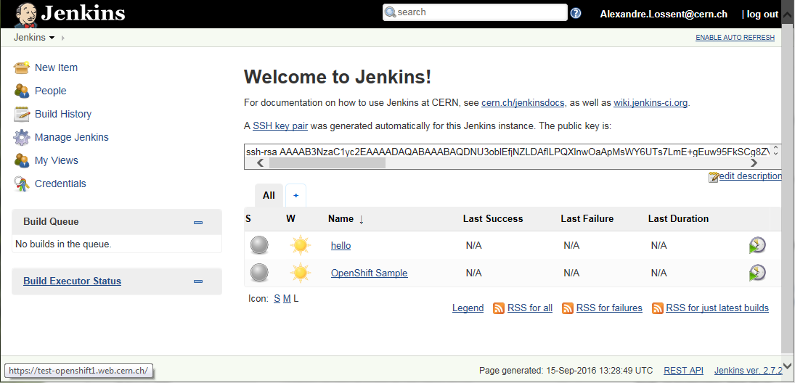

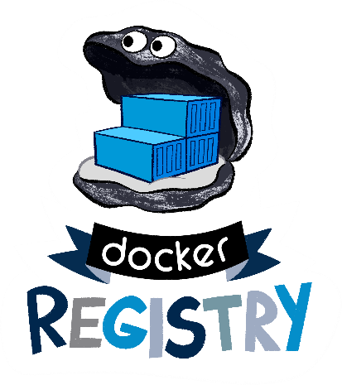






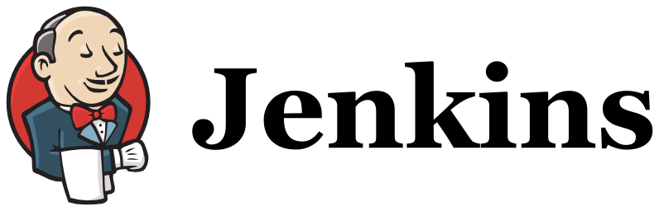
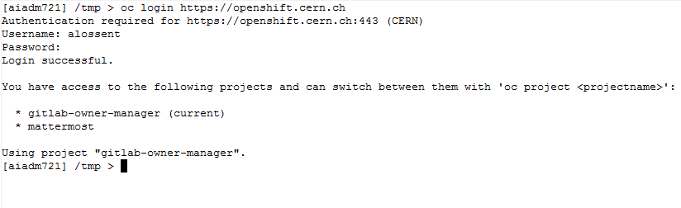

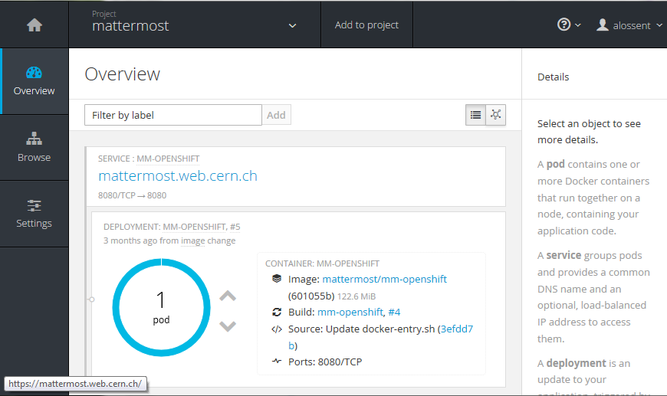




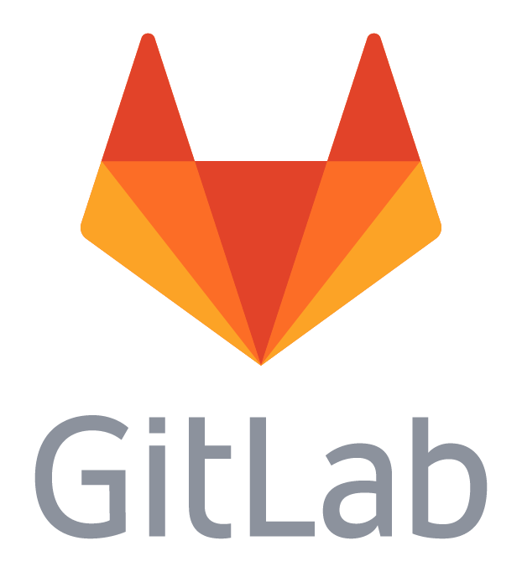


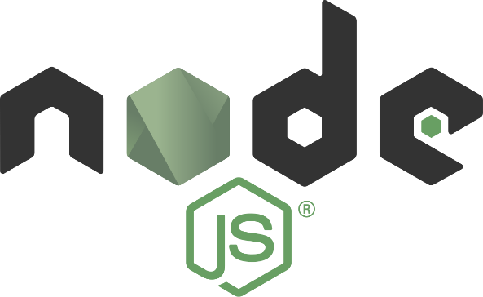






PaaS for web applications with OpenShift Origin
Alexandre Lossent (CERN), Alberto Rodriguez Peon (CERN)
Goals
Implementation
Use cases
Modernize web central hosting:
  Support modern development frameworks
  Provide more flexibility
  Reduce the need for “locally managed” web servers
Improve offering of tools to developers:
  Make it easier to get started
  Automate application deployment
  Integration with code hosting (GitLab)
  CI/CD pipelines (GitLab/Jenkins)
Facilitate deployment & operation of web applications:
  Fast prototyping
  Hosting of central services
  Self-service templates for application instances
  Save application manager from maintaining OS
CERN Web Frameworks strategy:
Use containers to host everything and widen
service options. OpenShift to orchestrate all.
Deployment:
  RedHat’s PaaS solution based on Docker and
  Kubernetes: OpenShift v3
  Open source version: OpenShift Origin
  Puppet-managed Openstack VMs
  Considering deployment on top of
  Openstack Magnum
Present Infrastructure (October 2016):
  27 VMs (2 clusters)
  9TB of app volume storage (Cinder, NFS)
Integration:
  CERN WebServices:
    name allocation
    management of project ownership and lifecycle
    quota management
  SSO authentication
  E-group authorization
  GitLab for code hosting and CI/CD pipelines
  CVMFS storage
  EOS storage
Jenkins CI:
  Self-service instances
  Dynamically provisioned container slaves
  More flexibility, better resource efficiency than VMs
Deploy 3rd party applications:
  Off the shelf Docker images or CERN customized
  CERN Central services
  Self-service per-team application instances
Architecture
Application owner
Web app1 user
Custom web application hosting:
  Automated build & deployment from sources in GitLab
  Development, staging and prod environments
  DBoD service provides databases as needed
  Support for multiple frameworks
Web app2 user
Web app3 user
Templates for 3rd party apps
SDN (virtual network)
Router node
Master
Node
HAProxy
container
Future
OpenShift master
Web app1
container
Web app2
container
Node
Generic web site hosting:
  Serve static & CGI content from shared EOS filesystem
  OpenShift to enable more dynamic scaling,
  load spread and flexibility than VMs
  4000+ sites currently on AFS
  1000+ Drupal websites
Web app3
container
Web app1
container
…
Kubernetes master
Docker
Node
Kubelet
Web app4
container
…
…
Network storage
Database-on-demand
https://home.cern

