Slide 1


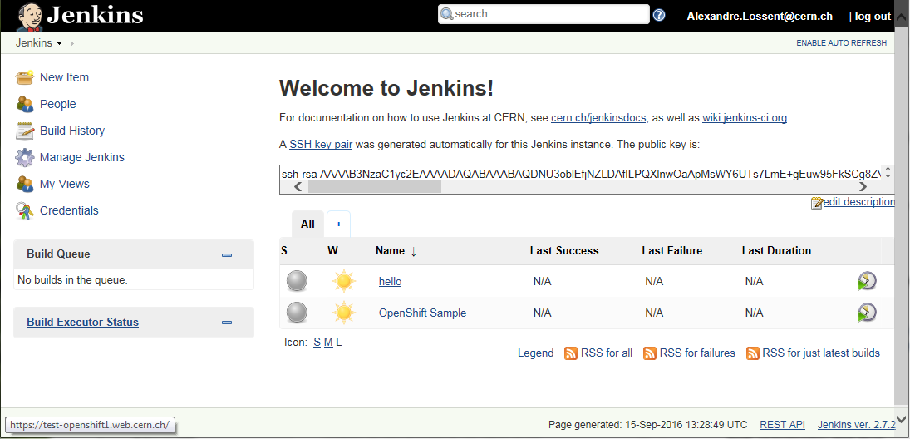

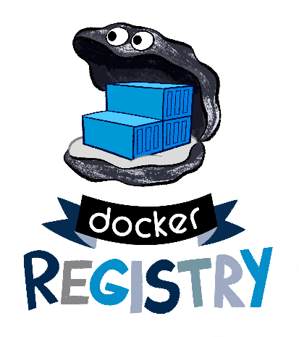







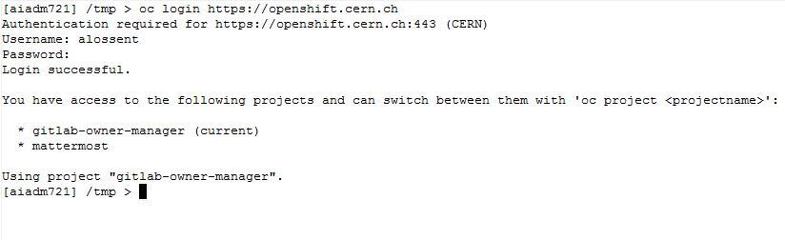

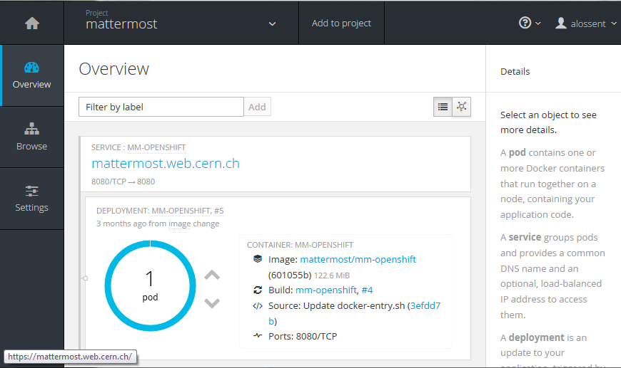




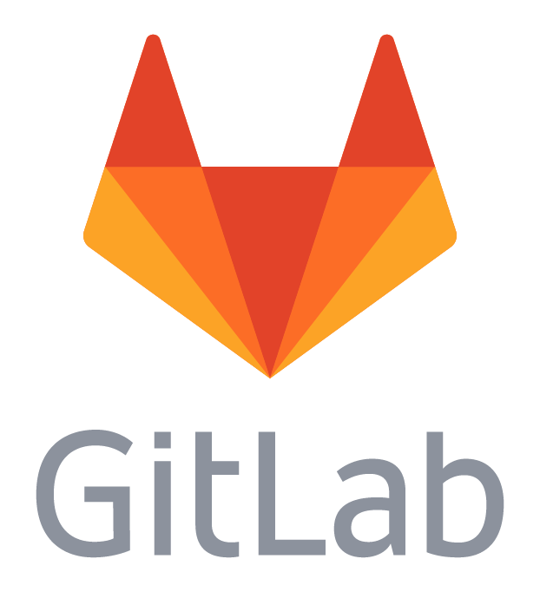


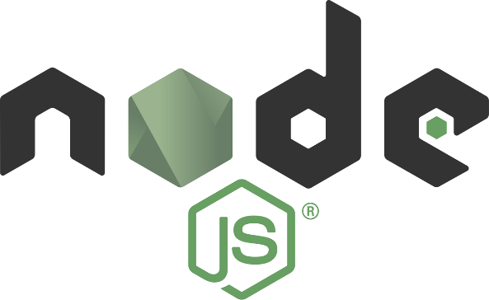






PaaS for web applications with OpenShift Origin
Alexandre Lossent (CERN), Alberto Rodriguez Peon (CERN)
Goals
Implementation
Use cases
Modernize web central hosting:
Support modern development frameworks
Provide more flexibility
Reduce the need for “locally managed” web servers
Improve offering of tools to developers:
Make it easier to get started
Automate application deployment
Integration with code hosting (GitLab)
CI/CD pipelines (GitLab/Jenkins)
Facilitate deployment & operation of web applications:
Fast prototyping
Hosting of central services
Self-service templates for application instances
Save application manager from maintaining OS
CERN Web Frameworks strategy:
Use containers to host everything and widen service options. OpenShift to orchestrate all.
Deployment:
RedHat’s PaaS solution based on Docker and Kubernetes: OpenShift v3
Open source version: OpenShift Origin
Puppet-managed Openstack VMs
Considering deployment on top of Openstack Magnum
Present Infrastructure (October 2016):
27 VMs (2 clusters)
9TB of app volume storage (Cinder, NFS)
Integration:
CERN WebServices:
name allocation
management of project ownership and lifecycle
quota management
SSO authentication
E-group authorization
GitLab for code hosting and CI/CD pipelines
CVMFS storage
EOS storage
Jenkins CI:
Self-service instances
Dynamically provisioned container slaves
More flexibility, better resource efficiency than VMs
Deploy 3rd party applications:
Off the shelf Docker images or CERN customized
CERN Central services
Self-service per-team application instances
Architecture
Application owner
Web app1 user
Custom web application hosting:
Automated build & deployment from sources in GitLab
Development, staging and prod environments
DBoD service provides databases as needed
Support for multiple frameworks
Web app2 user
Web app3 user
Templates for 3rd party apps
SDN (virtual network)
Router node
Master
Node
HAProxy container
Future
OpenShift master
Web app1 container
Web app2 container
Node
Generic web site hosting:
Serve static & CGI content from shared EOS filesystem
OpenShift to enable more dynamic scaling, load spread and flexibility than VMs
4000+ sites currently on AFS
1000+ Drupal websites
Web app3 container
Web app1 container
…
Kubernetes master
Docker
Node
Kubelet
Web app4 container
…
…
Network storage
Database-on-demand
https://home.cern

