Slide 1
Stock Analysis Tool
Graph, statistics, and portfolio

Slide 2
Work divided
Backend (Sangwon Jeong)
Key Features :
=>Retrieving stock data
=>Carving data retrieved
=>Output requested data
=>Statistical & Numerical calculations
Frontend (Donggu Kang)
Key Features :
=>Drawing graphs
=>Making User-friendly UI

Slide 3
Backend
American stock data retrieved by using 3rd party API (Alpha Vantage).
Alpha Vantage : gives us “Date”, “Close”, “High”, “Low”, “Open”, and ‘Volume.”
Carving them for the ease-of-use and saving them into a csv format.
Retrieving Stock Data & Carving them

Slide 4
Backend
Method-call design :
Stock S_TSLA = new Stock(“TSLA”);
S_TSLA.retrieve;
S_TSLA.request(“CLOSE”, “2015-01-01”, “2017-01-01”);
Gives “Close” price information from 2015-01-01 to 2017-01-01.
Returning a requested data

Slide 5
Backend
Computing various statistical values.
Ex) Geometric Mean, Arithmetic Mean, Percentage Changes by time quantum (Monthly, Daily, etc…) and date ranges, Moving Average(5, 20, 30, 60, 120…), etc…
These numerical and statistic values will then be used to draw a graph and build a portfolio.
Statistical Analysis

Slide 6
Frontend
주가 변화율, 이동평균선(Moving Average)
30D, 90D…
누적 수익율(Cumulative Retrun) -> 30D, 90D, 365D..
수익율의 히스토그램(Distribution)
Statistical Analysis

Slide 7
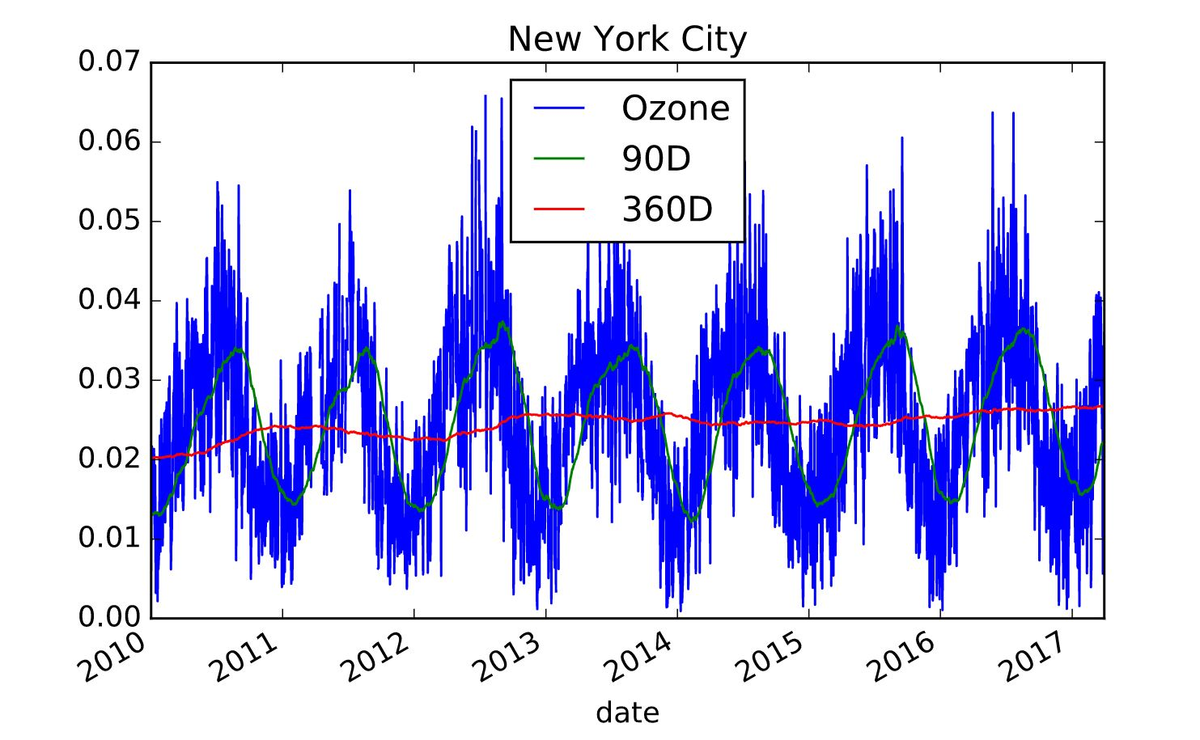
Frontend
이동평균선 (Ozone of NewYork City)
Statistical Analysis

Slide 8
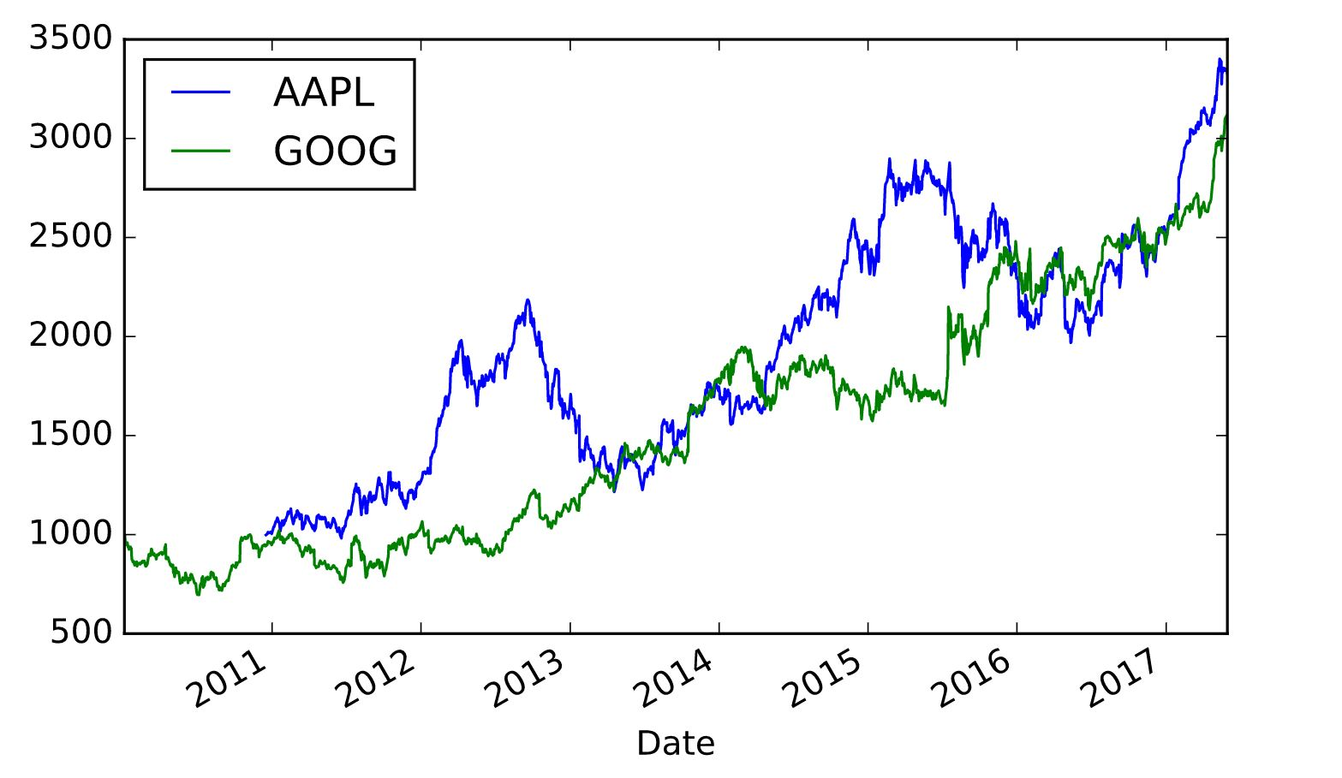
Frontend
수익률 변화 (Google, Apple)
Statistical Analysis

Slide 9
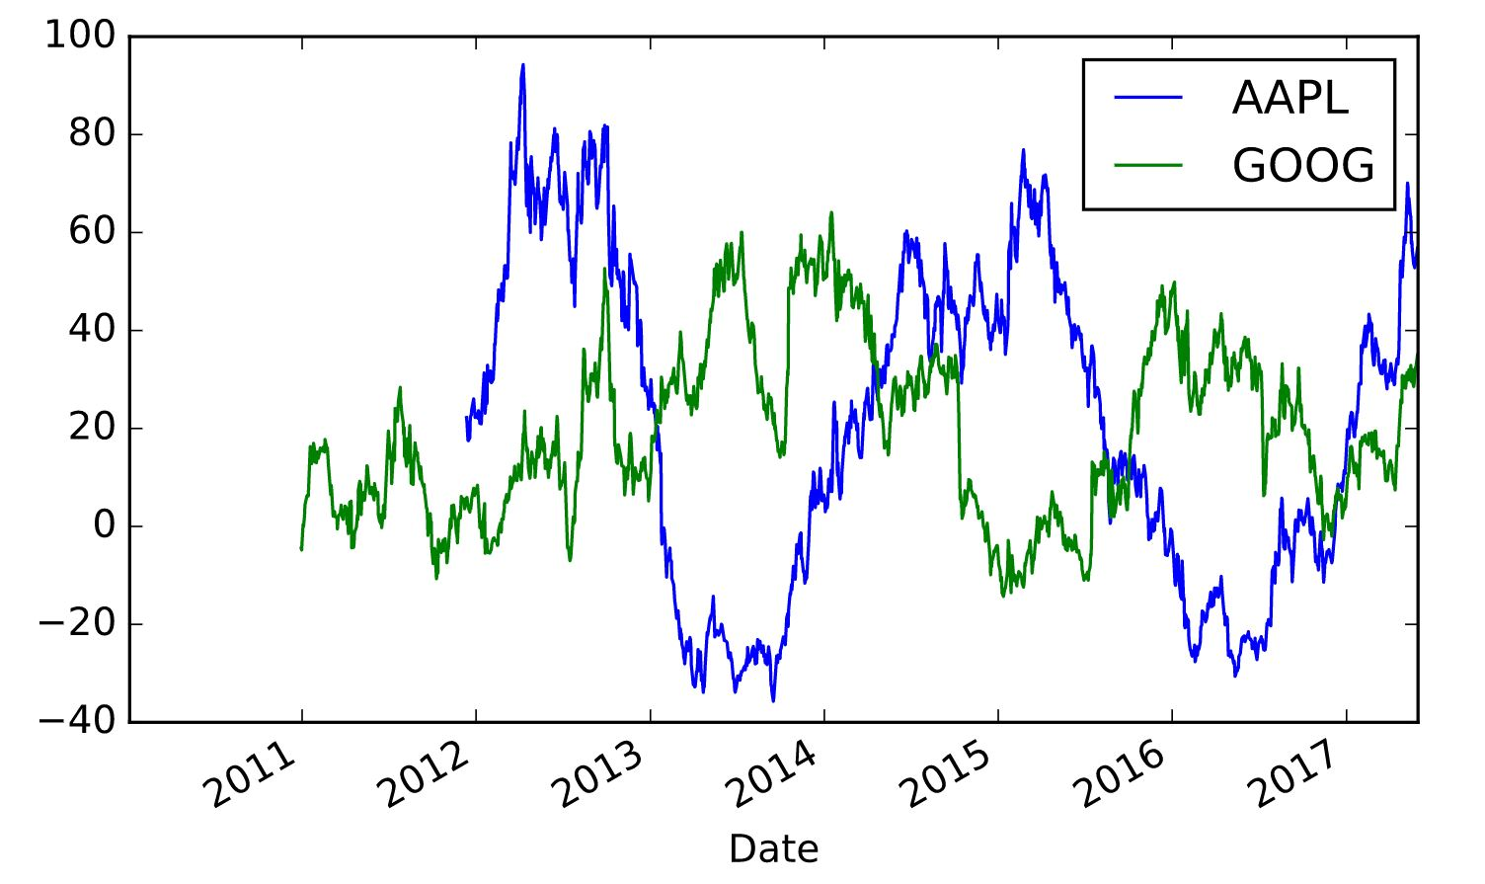
Frontend
1년 누적수익률(Cumulative Return)
Statistical Analysis

Slide 10
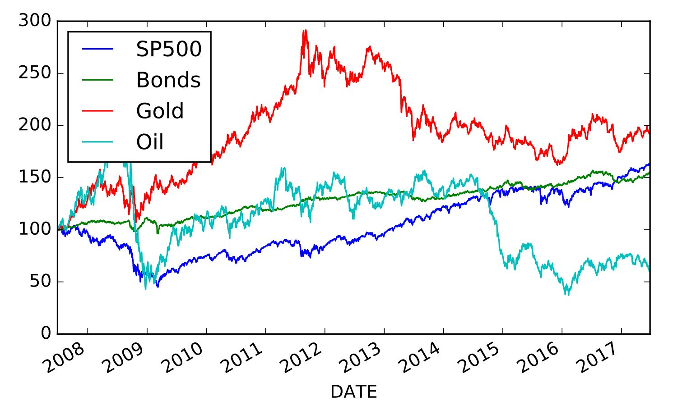
Frontend
원자재 가격 비교
Statistical Analysis

Slide 11
감사합니다

