Slide 1
计算机网络
曾华燊 研究员 PhD
第六单元：补充与复习
（6-1）
（连续编号17讲）

Slide 2
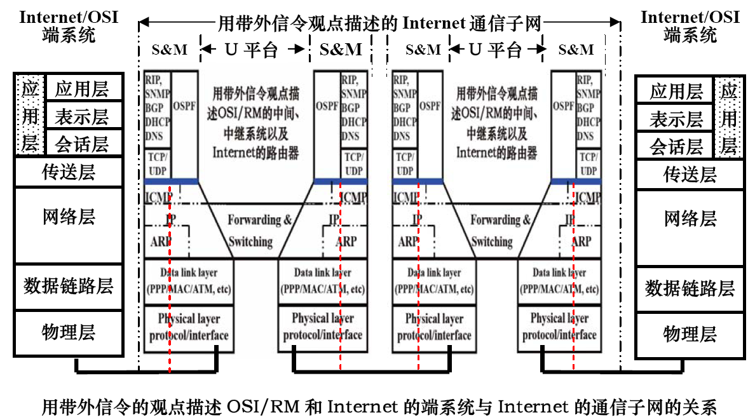
UNI NNI UNI
网络层：端系统和通信子网
传送层：端系统和通信子网
的信控、管理平台
数据链路层与物理层：端系统与通信子网通用（已在第2单元讨论）

Slide 3
17.1 网络安全问题
① 网络安全涉及信息交换的网络部位
通信子网（用户域网、接入网、骨干网）：通信安全（Tapping/Intercepting/replaying)
两个平台（U-平台和S&M-平台）
用户域网（CPN - Custom Premises Network): 既涉及通信子网的安全问题，又涉及端系统的安全问题）
OSI/RM中的端系统（End-system)
防止外部入侵（Intrusion detection/prevention/filtering)
信息安全 (End-to-end Encryption)

Slide 4
② 通信过程中的不安全性
窃听/截获/重放攻击（Tapping/Intercepting/ Replay attack) （合法/非法）
Tapping/ Intercepting - Telephone tapping (or wire tapping/wiretapping in the US) is the monitoring of telephone and Internet conversations by a third party, often by covert means.
Historically, the monitoring connection was applied to the wires of the telephone line of the person who was being monitored and drew off or tapped a small amount of the electrical signal carrying the conversation.
Legalized wiretapping by the police or other recognized governmental authority is otherwise known as lawful interception. ——Wikipedia
现代窃听：接入线路/设备或者利用电磁辐射、光泄漏获取信息；截获部分关键内容（报头、特殊字段）/全部内容。

Slide 5
重放攻击（Replay attack）: A replay attack is a form of network attack in which a valid data transmission is maliciously or fraudulently repeated or delayed.
This is carried out either by the originator or by an adversary who intercepts the data and retransmits it, possibly as part of a masquerade attack by IP packet substitution (such as stream cipher attack). ——Wikipedia
截获数据改变（内容/时间关系）或截取密码（Passwords或会话标签）
信控与管理平台的潜在不安全性（以破坏为目的）
采用与攻击端系统类似的方式扰乱网络运行（例如：DoS攻击）
对信控、管理协议的攻击（路径信息交换、DNS等）

Slide 6
③ 防止窃听/重放的技术
防窃听：
防止接入（有线、无线）
加密/隐藏（报头，如IPSec；内容：端到端加密）
U-平台: VPN/VLAN, Tunneling
The IETF has decided not to consider requirements for wiretapping as part of the process for creating and maintaining IETF standards. （RFC 2804 - IETF Policy on Wiretapping)
防止重放

Slide 7
例：
Suppose Alice wants to prove her identity to Bob. Bob requests her password as proof of identity, which Alice dutifully provides (possibly after some transformation like a hash function); meanwhile, Mallory is eavesdropping the conversation and keeps the password. After the interchange is over, Mallory connects to Bob posing as Alice; when asked for a proof of identity, Mallory sends Alice's password read from the last session, which Bob must accept.

Slide 8
A way to avoid replay attacks is using Session Tokens: Bob sends a one-time token to Alice, which Alice uses to transform the password and send the result to Bob (e.g. computing a hash function of the session token appended to the password). On his side Bob performs the same computation; if and only if both values match, the login is successful. Now suppose Mallory has captured this value and tries to use it on another session; Bob sends a different session token, and when Mallory replies with the captured value it will be different from Bob's computation.

Slide 9
Session tokens should be chosen by a (pseudo-) random process. Otherwise Mallory may be able to guess some future token and convince Alice to use that token in her transformation. Mallory can then replay her reply at a later time, which Bob will accept.
Bob can also send nonces but should then include a Message authentication code (MAC), which Alice should check.

Slide 10
Time stamping is another way of preventing a replay attack. Synchronization should be achieved using a secure protocol. For example Bob periodically broadcasts the time on his clock together with a MAC. When Alice wants to send Bob a message, she includes her best estimate of the time on his clock in her message, which is also authenticated. Bob only accepts messages for which the timestamp is within a reasonable tolerance. The advantage of this scheme is that Bob does not need to generate (pseudo-) random numbers.

Slide 11
④ 端系统/用户域的不安全性（以截取信息、攻击端系统为目的）
非法访问（窃取信息）
恶意攻击（破坏、使系统崩溃或瘫痪, e.g. DoS）
DoS/DDoS - denial-of-service attack (DoS attack) is an attempt to make a computer resource unavailable to its intended users.
attempts to "flood" a network, thereby preventing legitimate network traffic;
Attempt to disrupt a server by sending more requests than it can possible handle, thereby preventing access to a service;
attempts to prevent a particular individual from accessing a service;
attempts to disrupt service to a specific system or person.
Attacks can be directed at any network device, including attacks on routing devices and Web, electronic mail, or Domain Name System servers.

Slide 12
DoS攻击的方式
SYN Flooding - sends a flood of TCP/SYN packets, often with a forged sender address. Each of these packets are handled like a connection request, causing the server to spawn a half-open connection, by sending back a TCP/SYN-ACK packet, and waiting for an TCP/ACK packet in response from the sender address. However, because the sender address is forged, the response never comes. These half-open connections consume resources on the server and limit the number of connections the server is able to make, reducing the server's ability to respond to legitimate requests until after the attack ends.

Slide 13

LAND attack - A LAND attack involves sending a spoofed (Joking) TCP SYN packet (connection initiation) with the target host's IP address with an open port as both source and destination. The attack causes the targeted machine to reply to itself continuously and eventually crash.
ICMP floods - A smurf attack is one particular variant of a flooding DoS attack on the public Internet. It relies on mis-configured network devices that allow packets to be sent to all computer hosts on a particular network via the broadcast address of the network, rather than a specific machine.
Ping flood is based on sending the victim an overwhelming number of ping packets, usually using the "ping -f" command. It is very simple to launch, the primary requirement being access to greater bandwidth than the victim.

Slide 14

UDP floods - UDP floods include "Fraggle attacks". In a fraggle attack an attacker sends a large amount of UDP echo traffic to IP broadcast addresses, all of it having a fake source address. It is a simple rewrite of the smurf attack code.
Fraggle Rock is a children's television series with a total of 5 seasons and 96 episodes running from January 10, 1983 to March 30, 1987 on HBO in the United States and CBC Television in Canada. The series was created by Jim Henson, primarily featuring a cast of Muppet creatures called Fraggles, with music by Philip Balsam and Dennis Lee.

Slide 15
Teardrop attack - involves sending IP fragments with overlapping oversized payloads to the target machine. A bug in the TCP/IP fragmentation re-assembly code cause the fragments to be improperly handled, crashing the operating system as a result.[1] Windows 3.1x, Windows 95 and Windows NT operating systems, as well as versions of Linux prior to 2.0.32 and 2.1.63 are vulnerable to this attack.
Application level floods - On IRC, IRC floods are common electronic warfare weapon
A "banana attack" is another particular type of DoS. It involves redirecting outgoing messages from the client back onto the client, preventing outside access, as well as flooding the client with the sent packets. An attacker with access to a victim's computer may slow it until it is unusable or crash it by using a fork bomb.

Slide 16
Nukes - Nukes are malformed or specially crafted packets.
WinNuke is a type of nuke, exploiting the vulnerability in the NetBIOS handler in Windows 95. A string of out-of-band data is sent to TCP port 139 of the victim machine, causing it to lock up and display a Blue Screen of Death. This attack was very popular between IRC-dwelling script kiddies, due to easy availability of a user-friendly click-and-crash WinNuke program.
SQL Injection - A denial of service is not an attack in itself, but rather a condition that can be created through a variety of means. One of the vectors of attack through which a DoS condition can be created is SQL Injection.
SQL Injection is a Layer 7 vulnerability that occurs when an application does not properly validate input. A user crafts malicious input containing SQL commands that the application, since there is no proper validation, unknowingly executes.

Slide 17
解决手段：阻挡（e.g. Firewall, Intrusion Detection/Prevention)、诱导（e.g. honey spot)、专用杀毒工具等
⑤ RFC 1825 - Security Architecture for the Internet Protocol - not an overall Security Architecture for the Internet and is instead focused on IP-layer security.

Slide 18
17.2 本课程复习
基、通、体、带、协
① 基 ——基本概念，它贯穿全书
通用基本概念：计算机网络
通——通信技术
香农定理
调制：用待传信号改变载波信号的某种物理特征的方式（待传信号和载波都可能为模拟/数字信号）
模调模载(调幅、调频、调相）、
模调数载(调幅，如PAM、脉冲宽度调制、脉冲位置调制等）
数调模载(调幅、调频、调相）

Slide 19
波形：用电平数、极性、是否归零以及与时钟（时间）的关系来描述信号形状及变化规律。
编码：出于传输或纠错等方面原因改变“符号”（symbol)的比特数及其对应关系的过程。
与波形相结合的编码：曼切斯特编码幻灯片 32
复用
带宽、速率（波特率、比特率）
介质：同轴电缆、光纤、双绞线
综合布线系统（结构化布线系统）幻灯片 33：

Slide 20
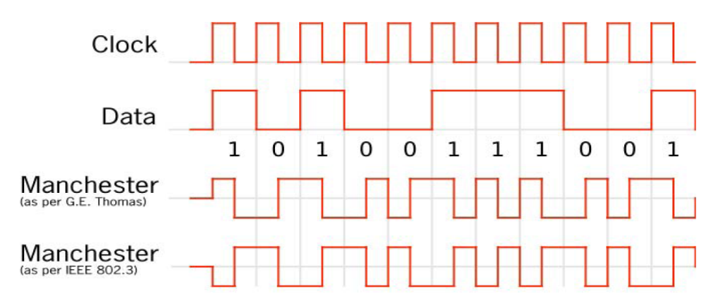
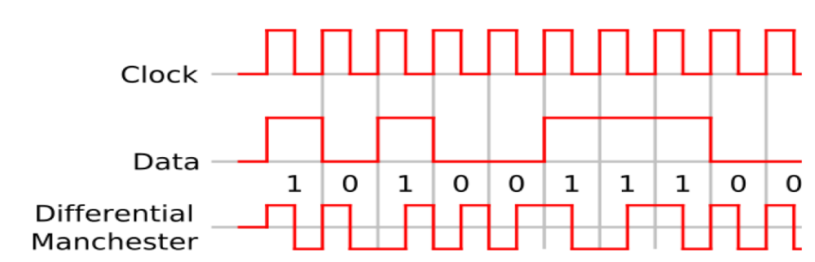
差分曼切斯特编码，在每个数据比特到来时，本比特为“0”可有跳变；否则无跳变。

Slide 21
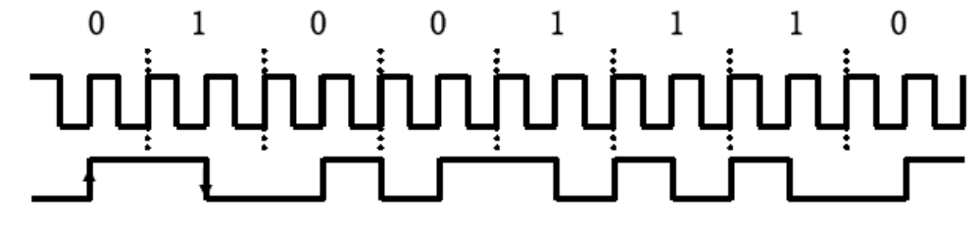
实际上，曼切斯特编码在两个时钟内传送一个数据比特，
在两个时钟周期之间总有一次跳变，因此易于检测并可作
为收发双方同步的手段。802.3用“高到低”代表“1”，
“低到高”代表“0”；反之亦可。

Slide 22
① 建筑群子系统——又称楼间干线子系统，由楼管理间与设备间（网络与电话机房）内的配线设备之间的连线（光缆或大对数电缆）组成。
② 垂直子系统——楼内连接各楼层的垂直干线，有时也简称干线子系统。
③ 水平子系统——从楼层管理间到工作区的信息插座间的设备与层内水平线路的总称。
④ 工作区子系统——从信息插座到终端间连线与插头的总称。
⑤ 设备间子系统——中心机房的配线设备与跳线的总称。
⑥ 管理子系统——楼层用跳接设备与跳接线的总称，通常每层 1 个，对小系统也可数层1个。

Slide 23
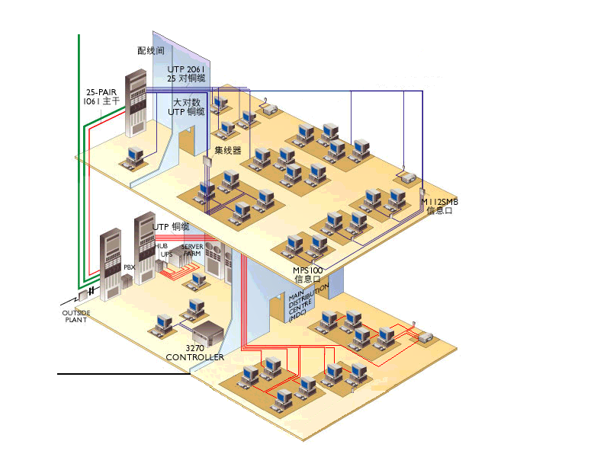

Slide 24
体——体系结构，贯穿全书，核心为（ OSI/RM ），其基本概念包括：
层 （上下排列的子系统）
协议：约束同层（对等）实体将的规程
服务：下一层实体共同为上一层提供的通信功能，服务在邻层间通过交换服务原语完成。
各层基本功能（描述的“特性”）
物理层：通信技术（功能）机械、电气、规程
数据链路层：以帧为基础的点到点可靠传输（成帧、数据透明性、检错/重传、确认、流控 （Sliding Window)， 典型协议：HDLC
网络层：地址、寻址/选经、拥塞控制；概念：掩码、子网、最佳路径……

Slide 25
传送层：端到端可靠传输（概念上：直接进行端到端传输层协议数据单元（T-PDU)的交换，不涉及中间节点；尽管实际上必须利用网络层和下层的逐级传输服务。
会话层：会话控制、同步控制
表示层：信息表达格式与传送格式（ASN.1和传送语法BER）、加密、压缩
常用应用层协议：

Slide 26
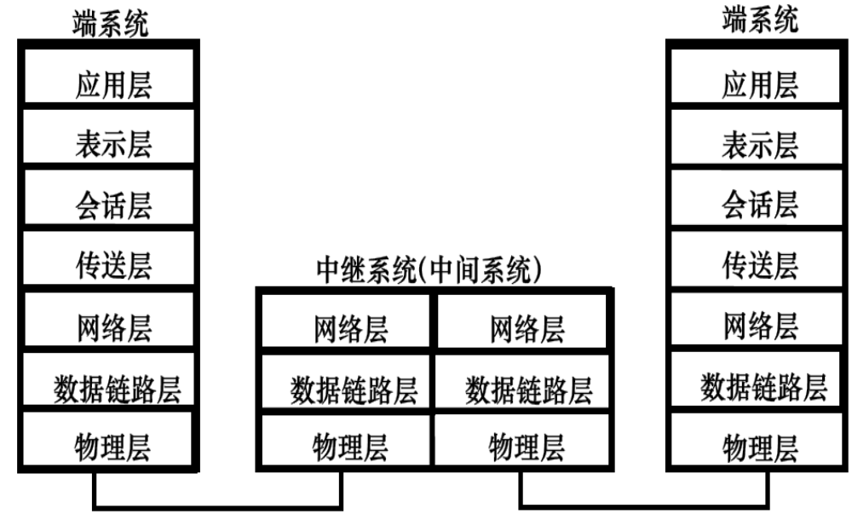

Slide 27
带——带外信令，贯穿本课程讲述，是本课程核心概念和基本教学思路
通信技术中的带外信令概念
计算机网络中重新界定的内涵 （非“带”也！）：强调协议层次——平台（平面）
用“带外信令概念”更能够解释Internet通信子（路由器）的工作过程幻灯片 39
带外信令不但适用与中间系统，也使用与对端系统的解释幻灯片 40
FTP是另一个解释带外信令普适性的应用协议。

Slide 28
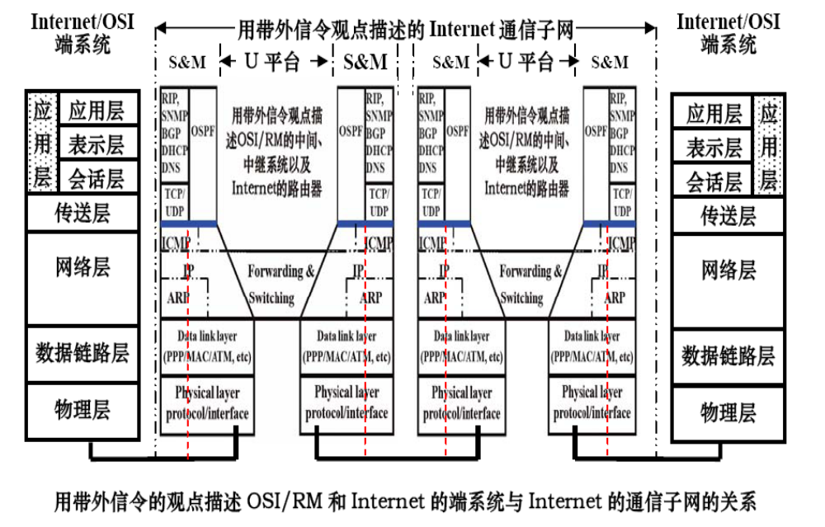

Slide 29
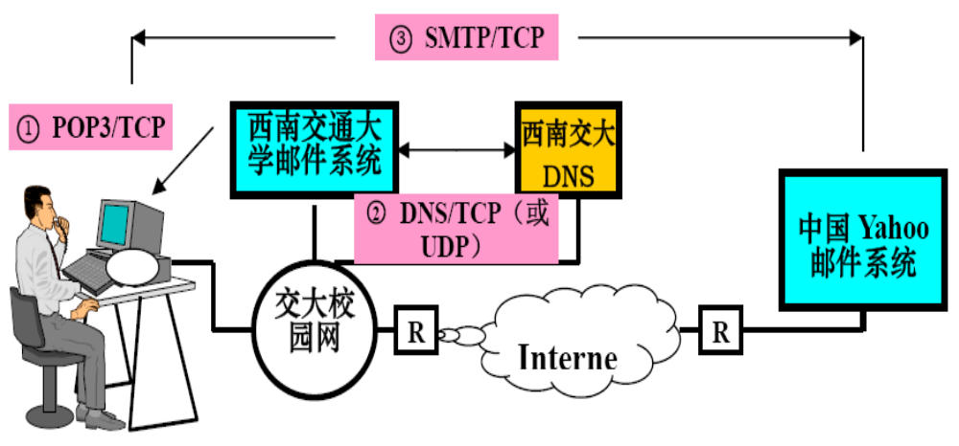
用带外信令观点解释邮件系统工作

Slide 30
② 协——协议（物理层常被ITU成为物理接口），层层实际协议
各层典型协议
物理层：RS-232c (S 100接口）
数据链路层：HDLC (成帧、透明、检错/重传、流控/确认（Sliding Window)
网络层：IP和选径（查表）、拥塞控制 （不同平台不同机制）
典型协议：IP
传送层（传输层）：UDP/TCP

Slide 31
应用层典型协议
端系统：FTP、3W、Telnet、SMTP/POP3
通信子网信控管理平台：DNS（利用UDP/TCP实现）、RIP/OSPF/BGP、SNMP (也涉及端系统中的网关工作站）
路由协议（IGP内部网关/外部网关协议EGP)典型IGP：路径信息交换协议（RIP)，属矢量距离（VD – Vector Distance)或称最少Hop数），理解如何构建路径表（书: P209)

Slide 32
协议状态变迁图/表
ITU的描述对象是DTE与DCE之间的接口状态变迁。换言之，是由DTE事件（即DTE发出的PDU)或DCE事件引起的接口状态变迁！回顾第2单元关于HDLC接口(见HDLC帧的种类（PDU种类）列表。
抽象观察点，并无协议实体，因此，
只进（事件）不出（无协议行为）。
DTE事件
DCE事件
DTE
DCE
DTE与DCE间接口

Slide 33
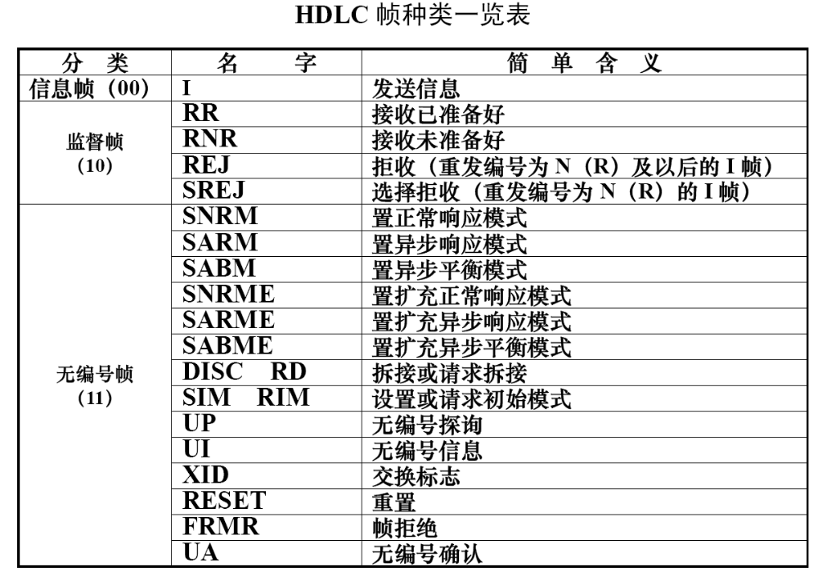
HDLC帧种类与PDU名称

Slide 34
DTE-DCE接口上（抽象观察点）的状态变迁图
Not Ready
DCE连续发送01111110，
表示对方准备好接收！
DCE sends SABM
Link
Disconnected
DTE sends SABM
DTE sends DISC
Wait for DTE conf.
Wait for DCE conf.
（否定性响应！）
DCE sends DISC
（肯定性响应！）
Data Transfer
（肯定性响应）
DTE sends UA
DCE sends UA
注：上图中未反映DTE和DCE同时发SABM，即请求建立链路冲突（Collision)的情况，此时，需引入新状态“呼叫冲突”。ITU通常将以接受DCE呼叫优先的策略。

Slide 35
上图中所描述的状态变迁是ITU定义的DTE-DCE之间的抽象观察点（接口）的状态变迁。由于该点无协议实体，因此图中没有该抽象观察点的“行为”（Action)，只有来自DTE或DCE的“事件”（Event)。
当用软件或硬件实现DTE或DCE实体时，我们需要的是对该实体的状态变迁。这就需要重新进行描述。即当描述DTE的状态变迁时，将抽象观察点拉回DTE实体再进行描述，此时，DCE发出的PDU便成为DTE的事件，而DTE发出的是PDU是DTE实体的“行为”（Action)。

Slide 36
以DTE为协议对象描述典型状态变迁
选择与数据链路建立、拆除和数据传输相关的PDU: SABM、UA、DISC 和I-帧
对DTE，外部事件（External Event)包括：
DCE发出的SABM：请求建立异步平衡模式，即请求建立双向链路）
DCE发出的UA：对DTE请求建立异步平衡模式SABM的肯定性应答）
DCE发出的DISC：请求拆除已建立的链路或对DTE发出的SABM的否定性应答（拒绝）
DCE发出的I-帧

Slide 37
对DTE，内部事件(Internal Event)包括：
时钟：例如请求建立链接等待时钟TLW (Link-set-up wait)等
上层用户请求建立链路或拆除链路的请求（注意：在OSI/RM中，如果数据链路层支持多个数据链路层的连接，应表现为：服务原语中的N-Connect- Request或这N-Disconnect-Request，在相应的数据链路层中建立一条对应的链路；对于HDLC这样的共享单个链路的场合，只要物理层线路准备好/或系统初始化后，就自动建立一条数据链路，直到物理层故障故障为止。）

Slide 38
DTE可能采取的行为（动作）Action包括：
DTE发出UA, 作为对DCE请求建立链路命令SABM的肯定性应答。
DTE发出DISC，作为拒绝DCE请求建立链路命令SABM的否定性应答。
当决定拆除已有的链路时，主动发出DISC要求拆除链路（可能是上层输出传输完成后，有上层发出的拆除链路的请求造成）

Slide 39
分别站在DTE和DCE立场上讨论状态变迁（即DTE或DCE内部的协议状态变迁），引入符号：Action/ Event 表示在该事件触发下采取的行动/行为。
A3: DTE发出DISC/E3:收到DCE来或上层或物理层要求拆除
E6: Any Event
other than E1,E2
A2:DTE sends SABM/
E2: DCE连发01111110
S0:Link
Disconnected
注意：E3和E5把DTE自身发出DISC或I帧当作事件，实际上应理解为上层要求断链或物理层故障，或上层要求发数据的事件触发的行动。
A3/E3
A1:DTE sends UA/
E1:DCE SABM
S1:Wait for
DCE conf.
S2:Data
Transfer
E4:DCE UA
E5: 收DCE来的或
DTE发出 I-Frame
DTE的HDLC数据链路层状态变迁图

Slide 40
注意：
上图中尚未画出个状态中其他事件可能引起的状态转变和采取的行动，但状态变迁图已经显得较为复杂了。因此，状态变迁图往往只画出主要或最关心的状态变迁过程，较难全面地描述状态变迁过程。
为此，引入了状态变迁表：用不同的“事件”(Ei)出现在不同“状态”(Sj)下协议实体采取的“行动”（Action i – Ai)和新状态（New State k - NSk)来描述。在有一种以上选择时，在对行为和新状态的描述可用条件（Predicate m – Pm)分别描述。

Slide 41
将上图中的状态与事件重新改述如下：
S0:Link Disconnected (无链路状态）
S1:Wait for DCE confirm (等待DCE确认是否建立链路）
S2: Data Transfer State (数据传输状态，即链路已建立）
E1: 收到DCE发来的SABM命令（请求建链）
E2: DCE连续发送“01111110”(DCE物理层就绪）
E3: 收到DCE发来的DISC
E3’: DTE上层要求断链
E3”: 物理层故障

Slide 42
E4: 收到DCE发来的UA(同意建立数据链路)
E5: 收DCE来的 I-Frame
E5’: DTE上层要求发数据
E6: 不再使用此复合事件！
A1: DTE sends UA to DCE
A2:DTE sends SABM to DCE (请求建立链路）
A3: DTE sends DISC to DCE
A4: No Link ↑user
A5: Send I-frame to DCE

Slide 43
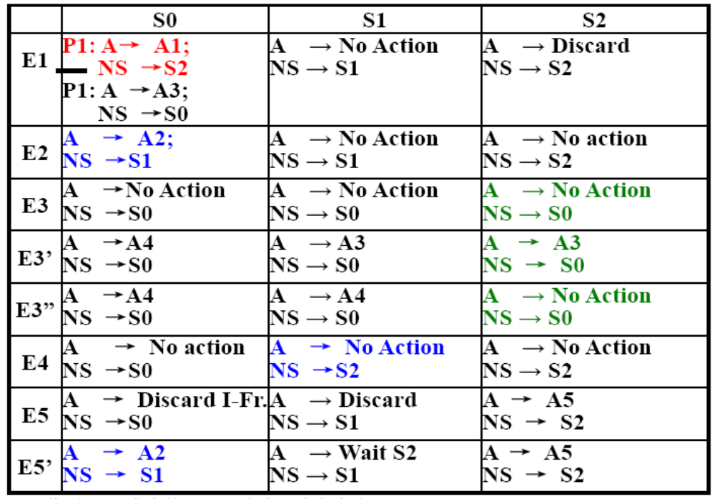

Slide 44
OSI/RM中状态变迁图表可用于描述协议实体内部状态的变化或服务访问点（SAP)内的连接端点的状态变化。

