Slide 1


PRESENTED BY THE ENGINEERING GUILD
FIELD BRIEFING // v1.0
STEM ENGINEERING CHALLENGE SERIES
OPERATION SKYLINE
The Rescue Glider Challenge
Salvage. Engineer. Deploy. Save the zone.
Saturday, 15 August 2026 · Innovation Hangar, Main Auditorium

Slide 2



OP-SKYLINE // PRIORITY: CRITICAL
Disaster Strikes Again.
● MISSION BRIEFING
Disaster strikes again.
While approaching the rescue zone, teams hit dangerous terrain and severe conditions that halt all ground movement.
The rescue point lies beyond a mountain ridge — and time is running out.
Using only salvaged aircraft materials and available resources, each team must design and build an emergency glider capable of carrying critical supplies across the obstacle.
The mission now depends on your engineering creativity, precision, and teamwork.
02 / 10 BRIEFING
OPERATION SKYLINE // The Rescue Glider Challenge

Slide 3
EVENT OVERVIEW
Your Objective, Rescue Engineers
Build a flight-worthy glider from salvage that clears the ridge and delivers its payload to the rescue zone.
01
02
03
04
Engineer the Airframe
Secure the Payload
Clear the Ridge
Hit the Zone
Design & assemble a glider from the salvaged materials on your bench.
Carry the supply capsule — mass counts, but it must arrive intact.
Achieve the distance to cross the obstacle and reach the far side.
Land on-target. Accuracy over the rescue point wins the mission.
03 / 10 OBJECTIVE
OPERATION SKYLINE // The Rescue Glider Challenge

Slide 4

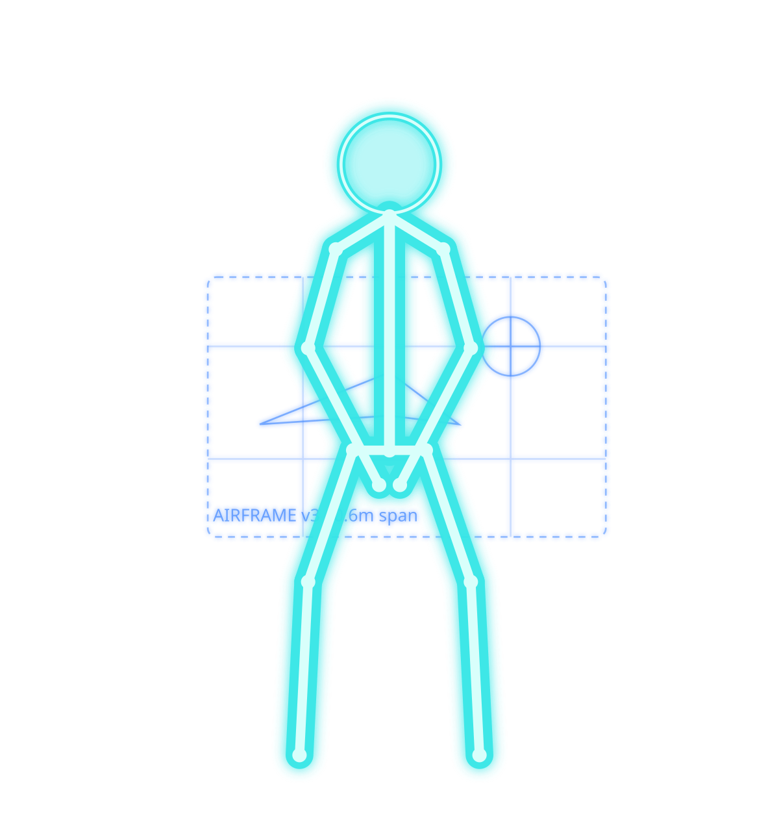
SEQUENCE 01 / 03
ASSEMBLE THE GLIDER
BUILD
Salvage becomes airframe. Hands, blueprints, and precision under pressure.
04 / 10 BUILD
OPERATION SKYLINE // The Rescue Glider Challenge

Slide 5


SEQUENCE 02 / 03
DEPLOY
LAUNCH
Wind up. Read the air. One clean release sends the payload skyward.
05 / 10 LAUNCH
OPERATION SKYLINE // The Rescue Glider Challenge

Slide 6


SEQUENCE 03 / 03
TARGET: RESCUE ZONE
IMPACT
The arc holds true. Supplies strike the zone. Mission accomplished.
06 / 10 IMPACT
OPERATION SKYLINE // The Rescue Glider Challenge

Slide 7
RULES & CONSTRAINTS
Field Regulations
01
02
03
Salvage Only
Build Window
Launch Rules
Balsa, paper, card, tape & string from the supply crate
No pre-built kits or powered components
One roll of tape per team — spend it wisely
45 minutes to design & construct
10-minute strategy huddle before the clock
Tools down when the siren sounds
Hand-launch only, from behind the deploy line
One practice throw, three scored attempts
Glider must be intact after each flight
07 / 10 RULES
OPERATION SKYLINE // The Rescue Glider Challenge

Slide 8
JUDGING CRITERIA
How the Mission Is Scored
35%
Distance
Clearing the ridge — measured from the deploy line to touchdown.
30%
Target Accuracy
Proximity of landing to the marked rescue zone.
20%
Design & Craft
Structural creativity, aerodynamics, and build quality.
15%
Teamwork
Coordination, safety, and clean execution under time.
08 / 10 JUDGING
OPERATION SKYLINE // The Rescue Glider Challenge

Slide 9
MISSION TIMELINE
Schedule of Operations
09:00
Check-in & Briefing Teams assemble. Mission parameters issued.
09:30
Salvage Distribution Supply crates handed out. Inspect your materials.
09:45
Build Window Opens 45 minutes on the clock. Engineer the airframe.
10:30
Deploy & Fly Hand-launch trials across the ridge.
11:30
Judging & Scoring Distance, accuracy, design, and teamwork tallied.
12:15
Awards Ceremony Rescue honors awarded. Mission debrief.
09 / 10 TIMELINE
OPERATION SKYLINE // The Rescue Glider Challenge

Slide 10

DEPLOY
Good Luck, Rescue Engineers
The ridge is waiting. The zone is counting on you.
Salvage. Engineer. Deploy.
OPERATION SKYLINE // The Rescue Glider Challenge

