Slide 1
Sensing Design for Vehicular Sensor Networks
Seonwoo Kim
SKKU
sogongyeo@gmail.com
03/Feb/2023
ICS Intern Meeting

Slide 2
Outline
Overview
Background
Objectives
Research Topic
System Model
Problem Formulation
Reinforcement learning
Reinforcement Learning-based Algorithm
SUMO Simulation
MDP Model
PPO Simulation

Slide 3
overview
Part 1

Slide 4
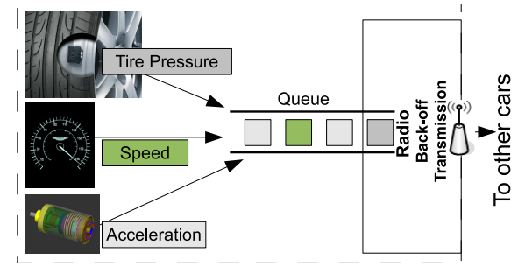
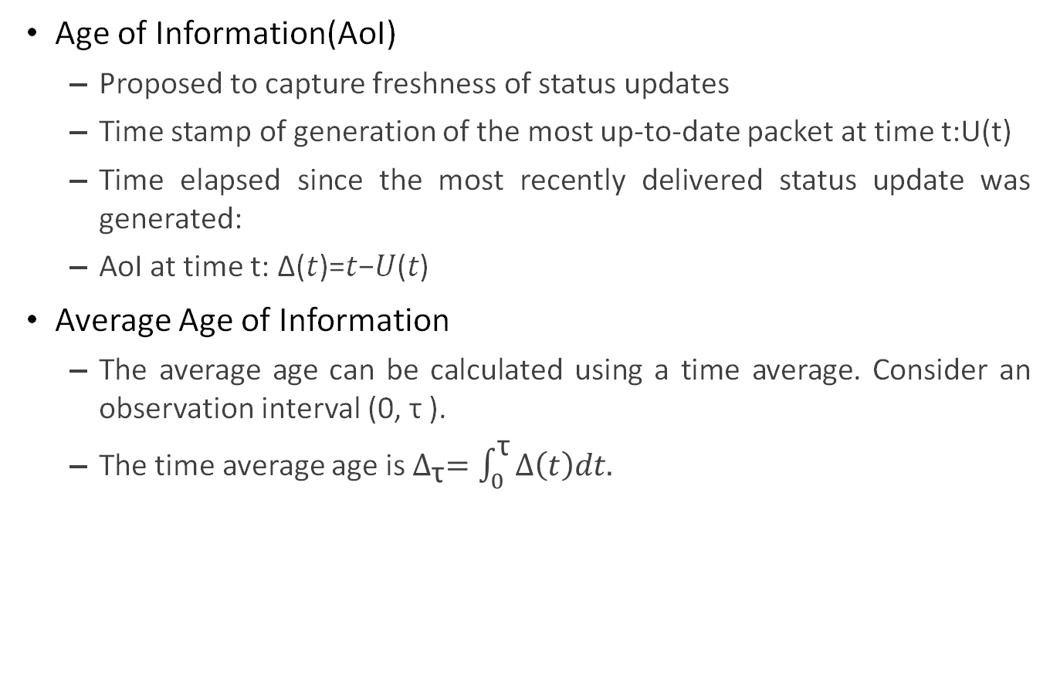
Background
Age of Information(AoI)
Proposed to capture freshness of status updates
Time stamp of generation of the most up-to-date packet at time t:U(t)
Time elapsed since the most recently delivered status update was generated:
AoI at time t: ∆(𝑡)=𝑡−𝑈(𝑡)
Average Age of Information
The average age can be calculated using a time average. Consider an observation interval (0, τ ).
The time average age is $∆_{\text{τ}}=\int_{0}^{\text{τ}}{∆\left(t\right)dt.}$

Slide 5
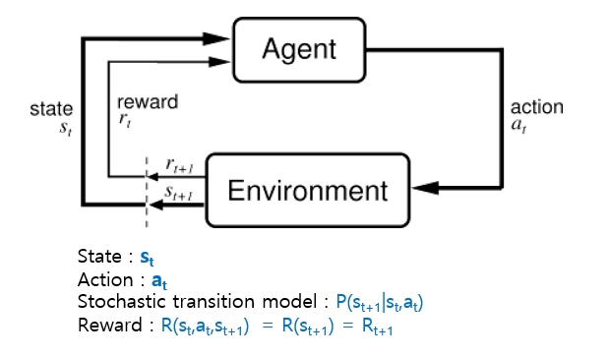
Background
Reinforcement Learning MDP
The major components of RL are as detailed below:
Agent: Take actions and receives rewards
Environment: Represents the outside world that interacts with agents
State: condition or position in which the agent is currently exhibiting
Action: What the agent does while interacting with the environment
Rewards: An indicator to the agent on how good or bad the action taken was

Slide 6
Objectives
Propose the new sensing model that ensures the data freshness in vehicular sensor network
Formulate the average Age of Information minimization problem
The formulated problem is difficult to solve in the usual way since the position of the vehicle changing every hour.
To be adaptive to the dynamic environment, apply the reinforcement learning method.

Slide 7
Research Topic
Part 2

Slide 8
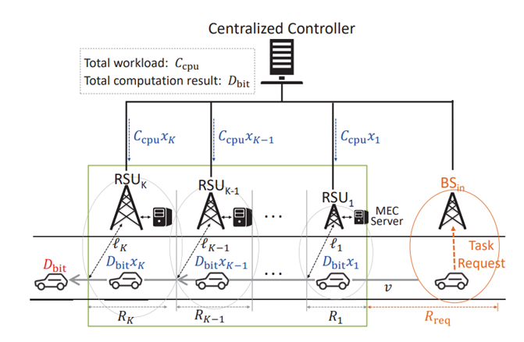
System Model
Vehicular sensor network model
–Three types of nodes are consisted:
Task publishers generating content items,
The connected vehicles are organized as a vehicular sensor network (VSN) when participating urban sensing.
Several vehicular sensing platforms have been designed to collect data generated in urban space.
Edge server (RSUs) make sensing decisions of the vehicles.

Slide 9
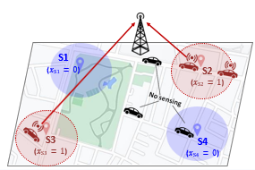

System Model
•Vehicular sensor network model
Sensing region selection from edge server
$x_{1}(t)$ , $x_{2}$(t) , $x_{3}(t$), $x_{4}(t)$ ∈ {0,1}
Sensing area selection period: τ
Sensing area selection for s at time t(=Nxτ)
When $x_{s}(t)$ = 1 : sensing area 𝑠 is selected as a target

Slide 10
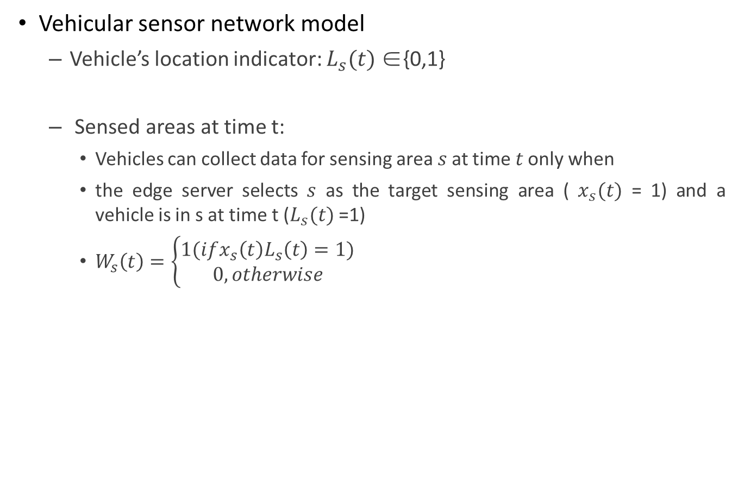
System Model
Vehicular sensor network model
Vehicle’s location indicator: $L_{s}(t)$ ∈{0,1}
Sensed areas at time t:
Vehicles can collect data for sensing area 𝑠 at time 𝑡 only when
the edge server selects 𝑠 as the target sensing area ( $x_{s}(t)$ = 1) and a vehicle is in s at time t ($L_{s}(t)$ =1)
$W_{s}\left(t\right)=\left\{\begin{aligned}1(ifx_{s}\left(t\right)L_{s}\left(t\right)=1) \\ 0, otherwise\end{aligned}\right.$

Slide 11
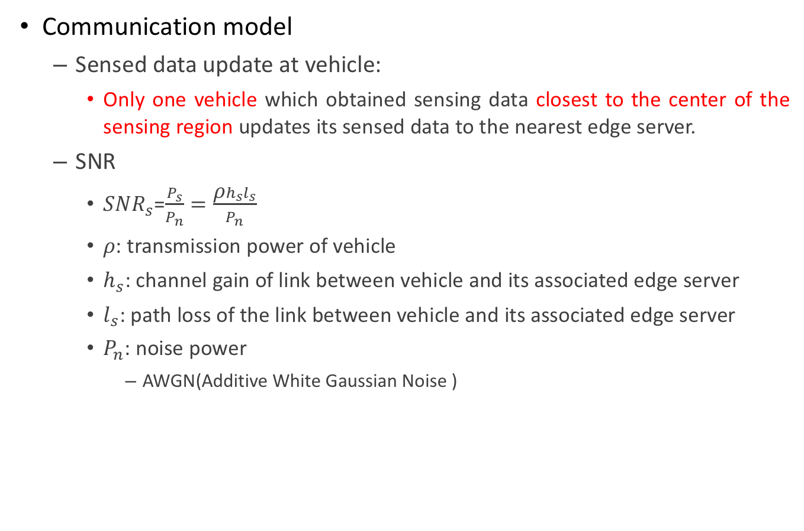
System Model
Communication model
Sensed data update at vehicle:
Only one vehicle which obtained sensing data closest to the center of the sensing region updates its sensed data to the nearest edge server.
SNR
${SNR}_{s}$=$\frac{P_{s}}{P_{n}}=\frac{\text{ρ}h_{s}l_{s}}{P_{n}}$
𝜌: transmission power of vehicle
$h_{s}$: channel gain of link between vehicle and its associated edge server
$l_{s}$: path loss of the link between vehicle and its associated edge server
$P_{n}$: noise power
AWGN(Additive White Gaussian Noise )

Slide 12
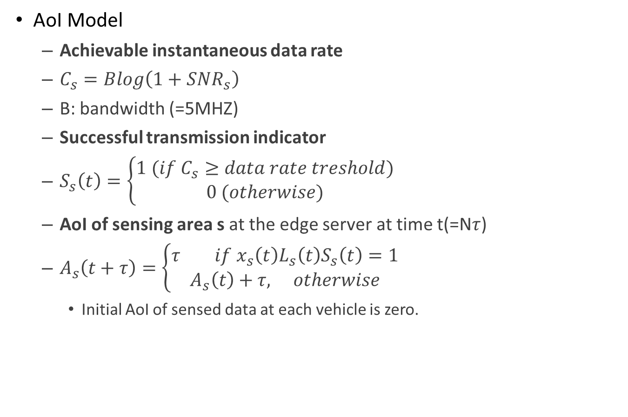
System Model
AoI Model
Achievable instantaneous data rate
$C_{s}=Blog\left(1+{SNR}_{s}\right)$
B: bandwidth (=5MHZ)
Successful transmission indicator
$S_{s}\left(t\right)=\left\{\begin{aligned}1 (if C_{s}≥data rate treshold) \\ 0 (otherwise)\end{aligned}\right.$
AoI of sensing area s at the edge server at time t(=N$τ$)
$A_{s}\left(t+τ\right)=\left\{\begin{aligned}τ if x_{s}\left(t\right)L_{s}\left(t\right)S_{s}\left(t\right)=1 \\ A_{s}\left(t\right)+τ, otherwise\end{aligned}\right.$
Initial AoI of sensed data at each vehicle is zero.

Slide 13
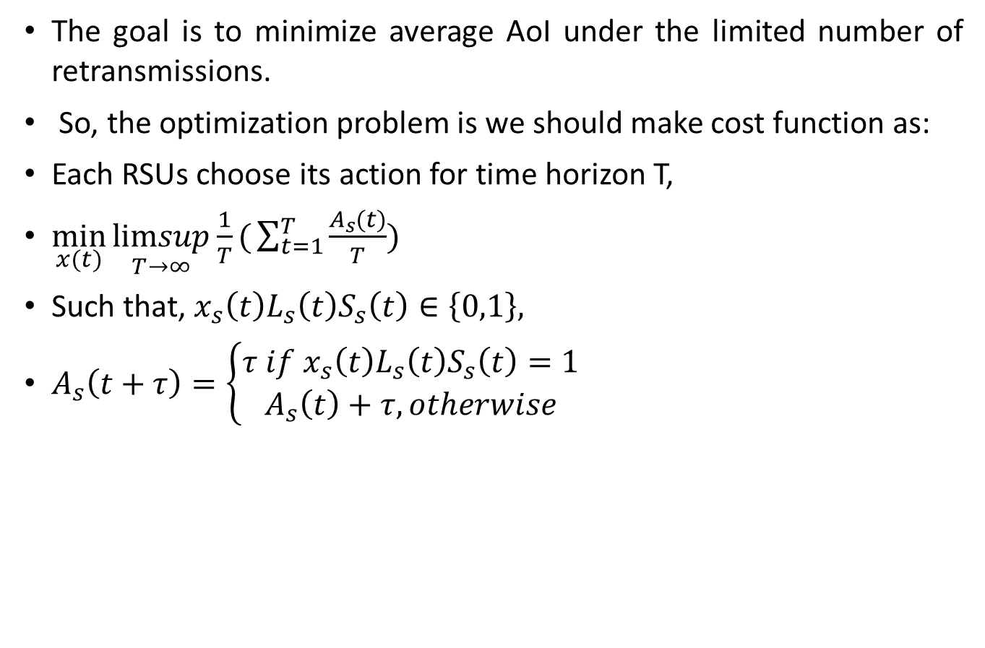
Problem Formulation
The goal is to minimize average AoI under the limited number of retransmissions.
So, the optimization problem is we should make cost function as:
Each RSUs choose its action for time horizon T,
$\min_{x(t)}{\underset{T→∞}{limsup}{\frac{1}{T}}(}\sum_{t=1}^{T}{\frac{A_{s}(t)}{T})}$
Such that, $x_{s}\left(t\right)L_{s}\left(t\right)S_{s}\left(t\right)∈\left\{0,1\right\},$
$A_{s}\left(t+τ\right)=\left\{\begin{aligned}τ if x_{s}\left(t\right)L_{s}\left(t\right)S_{s}\left(t\right)=1 \\ A_{s}\left(t\right)+τ, otherwise\end{aligned}\right.$

Slide 14
Reinforcement learning
Part 3

Slide 15
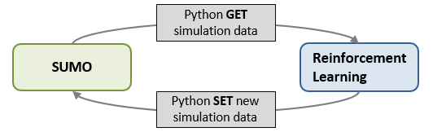
Reinforcement Learning-based Algorithm
Simulation structure
SUMO
Generate vehicular traffic
Generate multiple types of vehicles driving in the network
Locate “Detectors” that measure the number of vehicles that have touched each detector
Python & RL
Run RL based on SUMO simulation data

Slide 16
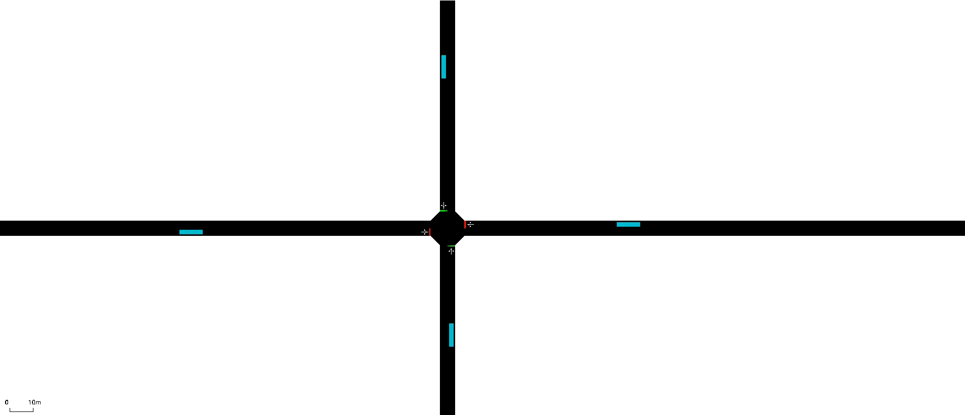
SUMO Simulation

Slide 17
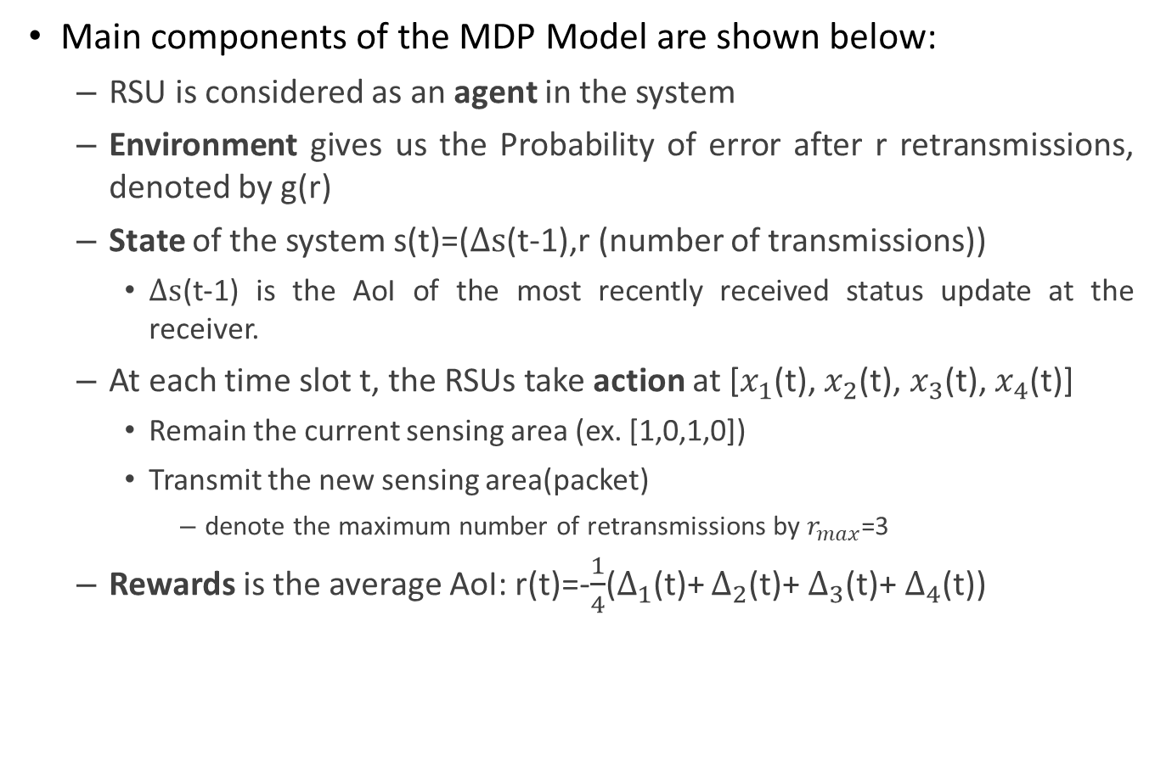
MDP Model
Main components of the MDP Model are shown below:
RSU is considered as an agent in the system
Environment gives us the Probability of error after r retransmissions, denoted by g(r)
State of the system s(t)=($∆s$(t-1),r (number of transmissions))
$∆s$(t-1) is the AoI of the most recently received status update at the receiver.
At each time slot t, the RSUs take action at [$x_{1}$(t), $x_{2}$(t), $x_{3}$(t), $x_{4}$(t)]
Remain the current sensing area (ex. [1,0,1,0])
Transmit the new sensing area(packet)
denote the maximum number of retransmissions by $r_{max}$=3
Rewards is the average AoI: r(t)=-$\frac{1}{4}$($∆_{1}$(t)+ $∆_{2}$(t)+ $∆_{3}$(t)+ $∆_{4}$(t))

Slide 18
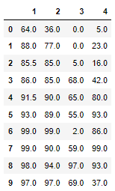
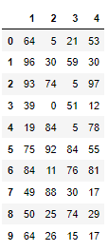



PPO Simulation
Simulate test_realization.py and calculate $x_{s}(t)$:
Bring each detector’s mean vehicle number information by csv file
Generate random int 0-100 integer by randint
Compare mean vehicle number > random int
Define sensed area by above processes

Slide 19
Thank you
Any Questions?
Email :sogongyeo@gmail.com

