Slide 1


Willkommen
Coding Dojo 19.10.2015
Twitter: #CodingDojoVie
Next Session: Nov 14th GDCR@Frequentis

Slide 2
Moderation
Ernst Fastl
DI(FH),MSc
Software Development 9y & Scrum Master 5y
„Continuous Improver and Education Junkie“
Scrum Master @ ÖLG

Slide 3

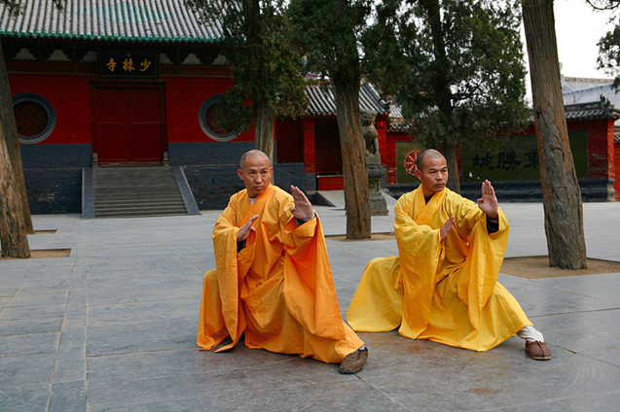

Continuous improvement philosophy
Kung fu
“... any skill that is
acquired through
learning or practice ...”
Kaizen
„change for better“
Wikipedia

Slide 4
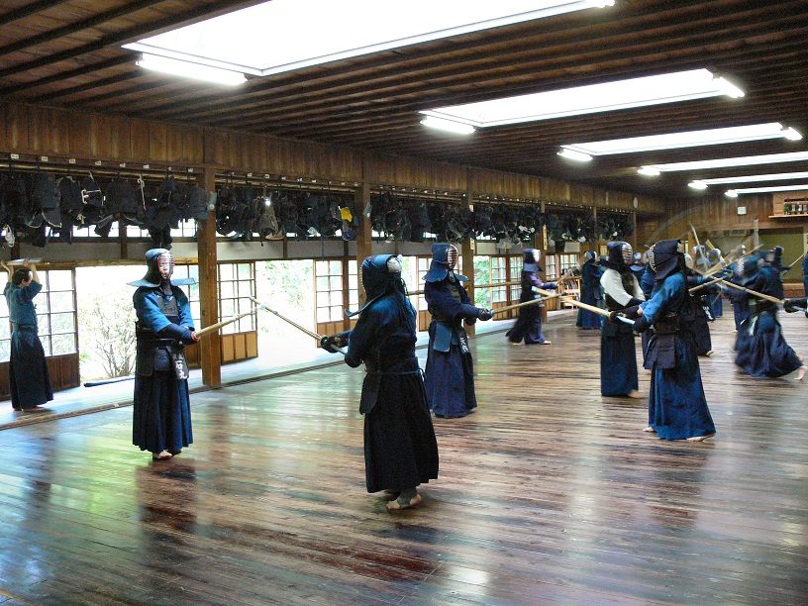
Coding Dojo Mindset
Dojo = Place of the way
„A relaxed state of mind increases the ability to learn“
Safe place outside work
We are here to learn
Relax and slow down
Focus on doing it right

Slide 5
Two Basic Rules
Collaborative = Pair Programming
Test Driven Development

Slide 6
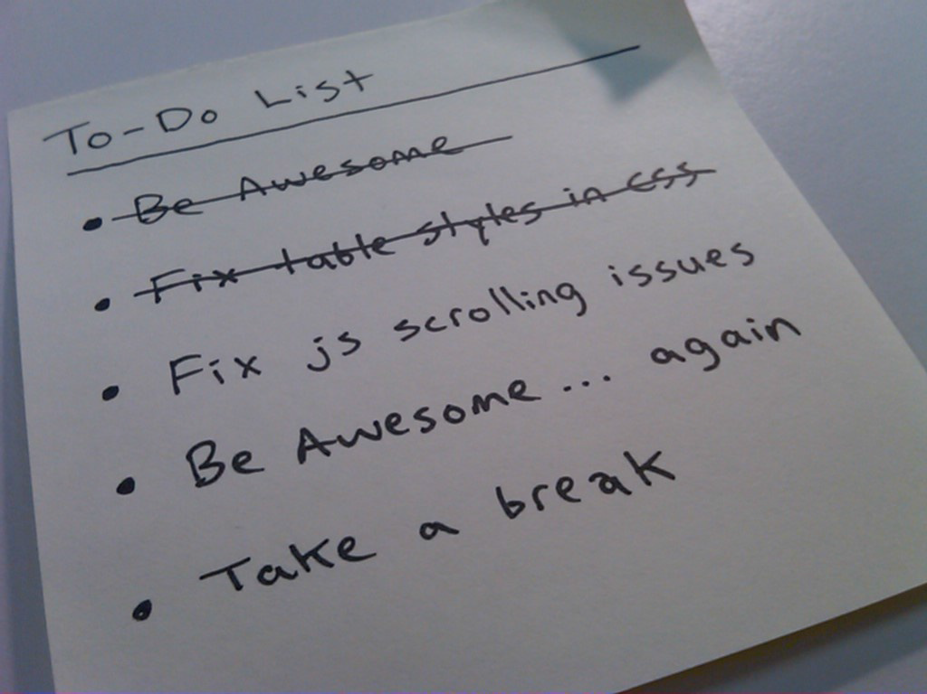
Coding Dojo Structure
Introduction 10‘
Round 1 50‘
  Code 45‘
  Reflect 5‘
Break 10‘
Round 2 50‘
  Code 45‘
  Reflect 5‘

Slide 7
The Assignment – English Numerals
Input: 17,745.09 EUR
Output:
“seventeen thousand, seven hundred forty-five euros and nine cents”

Slide 8
Round 1
Find a partner and agree on a language
Ping-Pong Pair-Programming

Slide 9
Topics for reflection
With which Test Case did you start?
What has surprised you?

Slide 10
Round 2
If you are already done :
implement another language (i.e. German)
and/or
write conversion from words back to numbers

Slide 11
Topics for reflection
How did you need to change the code to enable the new requirements?
What would you have done
differently if you had known the new requirements in the beginning?

Slide 12
Final
Ernst Fastl
Images:
en.wikipedia.org

Slide 13
Thanks

