Slide 1
Coding Dojo 141215
Next: CodeCop @ Lambdaheads (Meetup) (January)
Notes:
©2013 Catalysts

Slide 2

Agenda
Introduction 10‘
Round 1 50‘
  Code 45‘
  Reflect 5‘
Break 10‘
Round 2 50‘
  Code 45‘
  Reflect 5‘
Beer @ Hawidere?
Notes:
©2013 Catalysts

Slide 3
We implement your wishes into software –
Individually and agile.
With our multi-functional team, we handle the entire process of individual software development. We have developed a wide variety of solutions for our clients: always “on time and on budget”.
We also organize the Catalysts Coding Contest: http://contest.catalysts.cc/en/
Notes:
©2013 Catalysts

Slide 4
Moderation
Martin Hillbrand
DI(FH) , MA
Software Development (8y, now just for fun) & Scrum/Agile > 6y
„Team work & fun @ work“
Working as Project Lead, Product Owner, Scrum Master, Agile Coach @ Catalysts
Notes:
©2013 Catalysts

Slide 5
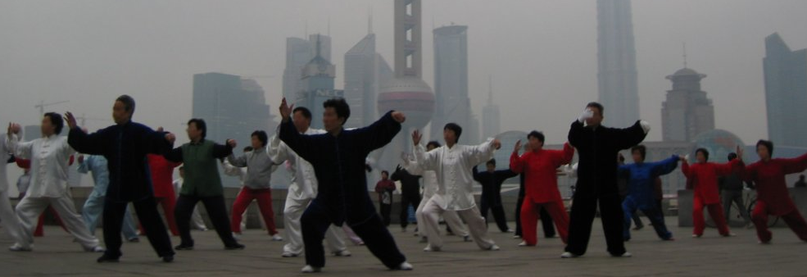
Continuous improvement philosophy
Kung fu 功夫
“... any skill that is
acquired through
learning or practice ...”
Kaizen 改善
„change for better“
Notes:
©2013 Catalysts

Slide 6
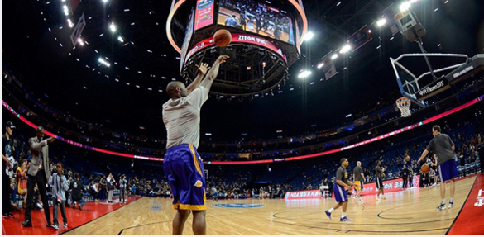
Kobe Bryant
“He’s not great by accident is my point. He puts the work in. And I think what I learned about Kobe is he’s so hungry to be good, he puts the work in. I just think his hunger and his determination is what I was most impressed with.”
Notes:
©2013 Catalysts

Slide 7
Rules for the DOJO
Safe place outside work
We are here to learn
Relax and slow down
Focus on doing it right
Collaborative == Pair Programming
Test Driven Development
Notes:
©2013 Catalysts

Slide 8
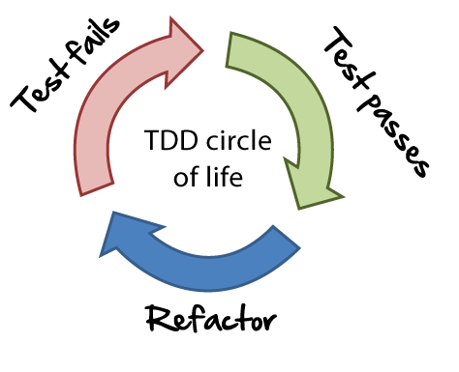
The assignment – Christmas Delivery
Round 1:
Concentrate on doing it right, rather then finishing it.
Process:
  Get the US, ask questions
  Implement it.
  Get the next US story
Notes:
©2013 Catalysts

Slide 9
Now?
Reflection
Break
Notes:
©2013 Catalysts

Slide 10
The assignment – Christmas Delivery
Round 2:
Constraint: SILENT PAIRING
Process:
  Same as before.
Notes:
©2013 Catalysts

Slide 11
Now?
Reflection
Notes:
©2013 Catalysts

Slide 12
Martin Hillbrand
@master_hilli
Martin.hillbrand@catalysts.cc
Linkedin/Xing
HAPPY CHRISTMAS!
*
XXX
XXXXX
XXXXXXX
XXXXXXXXX
N
Images:
en.wikipedia.org
http://www.viralhoops.com/kobe-bryant-motivational-stories/
http://code.joejag.com/coding-dojo/christmas-delivery
http://www.agilenutshell.com/assets/test-driven-development/tdd-circle-of-life.png
Coding Dojo Handbook - Emily Bache
Notes:
©2013 Catalysts

