Slide 1


Welcome
Coding Dojo 24.05.2015
Twitter: #CodingDojoVie
Next Session: Jun 18th GDCR@Frequentis

Slide 2
Moderation
Ernst Fastl
Software Development 9y
Scrum Master 5y
Scrum Master @ ÖLG 3½y

Slide 3
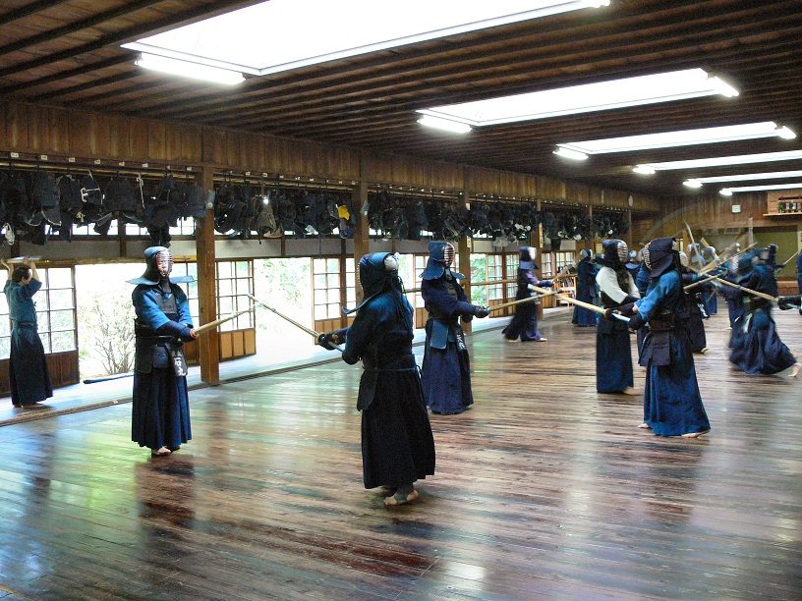
Coding Dojo Mindset
Dojo = Place of the way
„A relaxed state of mind increases the ability to learn“
Safe place outside work
We are here to learn
Relax and slow down
Focus on doing it right

Slide 4
Two Basic Rules
Collaborative = Pair Programming
Test Driven Development

Slide 5
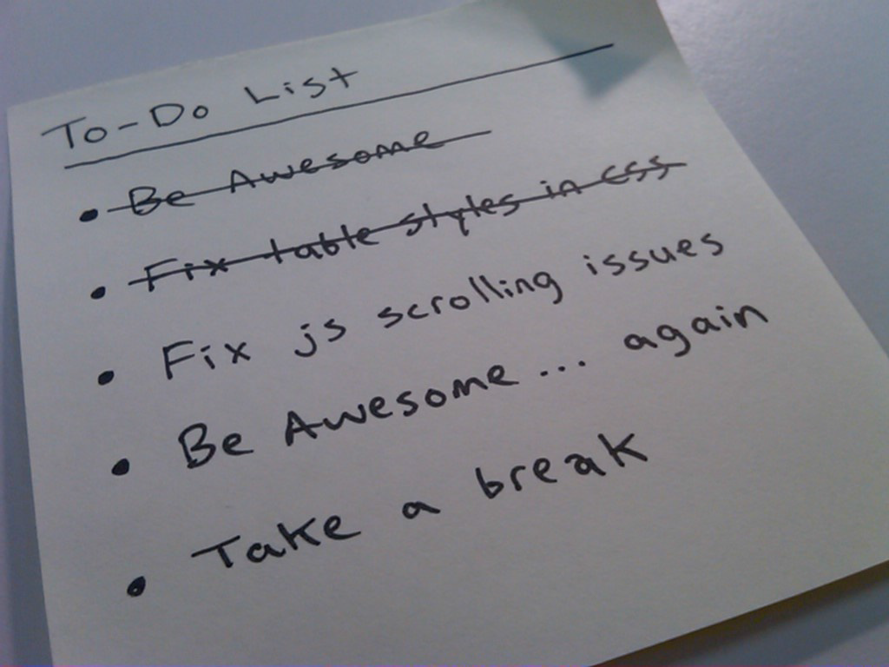
Coding Dojo Structure
Introduction 10‘
Round 1 50‘
  Code 45‘
  Reflect 5‘
Break 10‘
Round 2 50‘
  Code 45‘
  Reflect 5‘

Slide 6
The Assignment – Potter
Once upon a time there where only 5 Harry Potter books for sale
Input: Harry Potter books in basket
e.g. : [0,0,1]
Output:
Total Prize e.g. 8 + 8 * 2 * 0,95 = 23,20 EUR

Slide 7
The Assignment – Potter
Pricing Model:
One copy of any of the five books costs 8 EUR.
If, however, you buy two different books from the series, you get a 5% discount on those two books.
If you buy 3 different books, you get a 10% discount.
With 4 different books, you get a 20% discount.
If you go the whole hog, and buy all 5, you get a huge 25% discount.
Note that if you buy, say, four books, of which 3 are different titles, you get a 10% discount on the 3 that form part of a set, but the fourth book still costs 8 EUR.

Slide 8
The Assignment – Potter
What is the catch?
[1,1,2,2,3,3,4,5] -> 51.20 EUR
2x4 books is cheaper than 1x3 + 1x5

Slide 9
Round 1
Make a test list (or use provided)
Agree on order of implementation
(no coding in the first 10 minutes)
Diagram by Emily Bache
Overview
Red
Refactor
Green

Slide 10
Topics for reflection
With which Test Case did you start?
Did you build up the algorithm gradually, driving development with tests?

Slide 11
Round 2
Find 5 more feasible tests

Slide 12
Topics for reflection
How much work would it be to update your code if they introduced a 6th book into the series or changed the discount percentages?
What has surprised you?

Slide 13
Final
Ernst Fastl
Images:
en.wikipedia.org

Slide 14
Thanks

