Slide 1

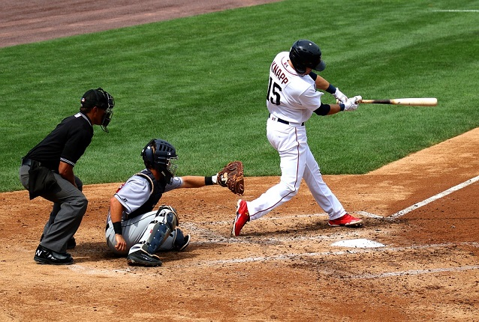
Baseball And Linear Regression
Predicting Wins
Scott Lew

Slide 2
The Goal
Predict a baseball team’s wins in a season using a variety of batting & pitching statistics.

Slide 3
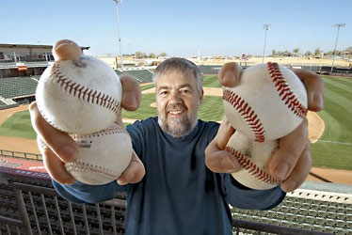
Precedent for Predicting Wins: Bill James
‘Godfather’ of Sabermetrics
Statistician and baseball historian
“Pythagorean Theorem of Baseball” Predicts Win% using Runs scored & Runs allowed
photo:Keith Philpott for TIME magazine

Slide 4
Methodology
Problem: Predict baseball team wins using batting & pitching stats
Web scraping to obtain statistics from 1876-2018. Linear Regression Models to predict wins.
Evaluate Regression Models
Conclusions: What are some important predictors of wins?

Slide 5
Resources & Tools
BeautifulSoup: web scraping
www.baseball-reference.com: batting & pitching statistics
scikit learn: regression model
statsmodel: regression model

Slide 6
Some Potential Batting Stats To Predict Wins
Hits (H): Hits produce runs
Runs scored: Runs help win games
Batting Average (BA): Good batting produces hits
On Base Percentage (OBP): Getting on base is helpful

Slide 7
Potential Pitching Stats To Predict Wins
Earned Runs Average (ERA): metric for pitching, the lower the better…. fewer runs allowed
Save (SV): A good metric for relief pitchers performance
Innings Pitched (IP): Another metric for good pitching

Slide 8
Dataset
MLB Stats from 1876- 2018
28 Batting Stats
35 Pitching Stats

Slide 9
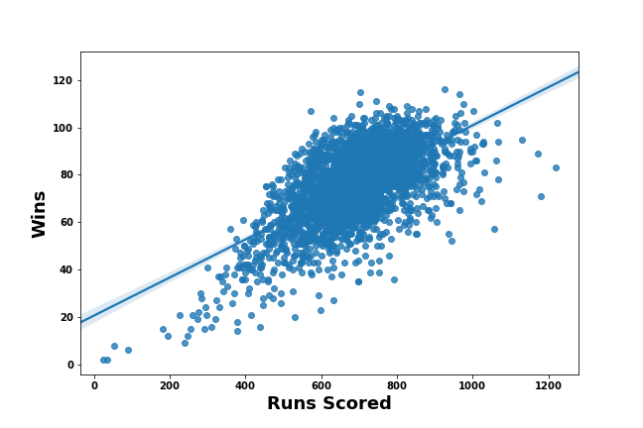
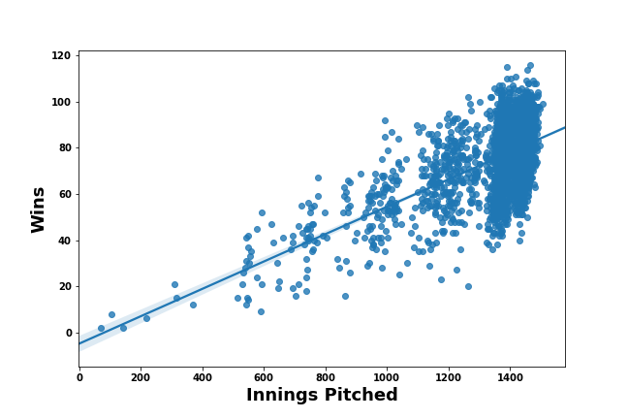
EDA: Stats With Correlation To Wins

Slide 10
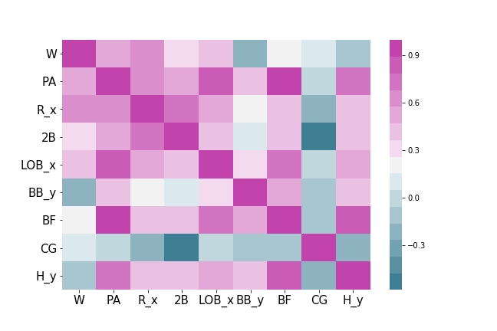
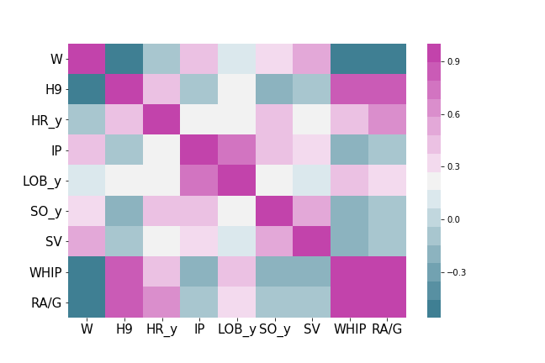
Heatmap: Correlation of Stats with Wins
Runs scored (R_x), Innings Pitched (IP), & Save (SV): all have positive correlation with wins

Slide 11
OLS Regression
Perform multiple linear regression with statsmodels and Scikit Learn using all stats for initial regression model
Select features with backwards stepwise regression
Feature selection using LASSO

Slide 12
Backwards Stepwise Regression
60 Features
33 Features

Slide 13
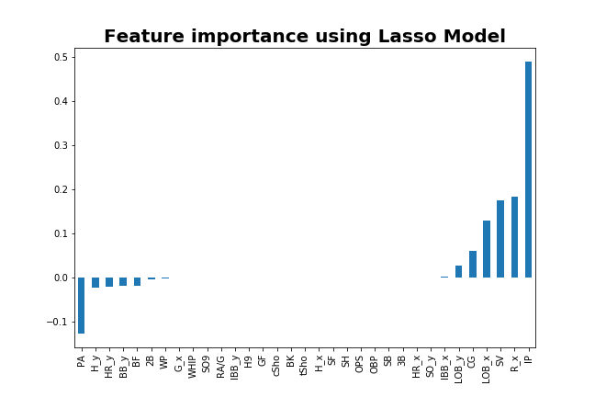
LASSO Selection
33 Features
16 Features

Slide 14
Some Stats Used To Predict Wins
=======================================================
coef std err t P>|t| [0.025 0.975]
------------------------------------------------------------------------------
PA -0.2743 0.006 -49.435 0.000 -0.285 -0.263
R_x 0.2919 0.004 68.689 0.000 0.284 0.300
LOB_x 0.2771 0.006 48.856 0.000 0.266 0.288
IP 0.6798 0.027 25.344 0.000 0.627 0.732
SV 0.0742 0.012 6.418 0.000 0.052 0.097
=======================================================
Statsmodel OLS
All the above features are significant in predicting wins

Slide 15
Linear OLS Model
16 Batting & Pitching stats used to predict wins.
RMSE of 1.9 for test data
R² of 99%
However, multicollinearity exists in the model with these predictors

Slide 16
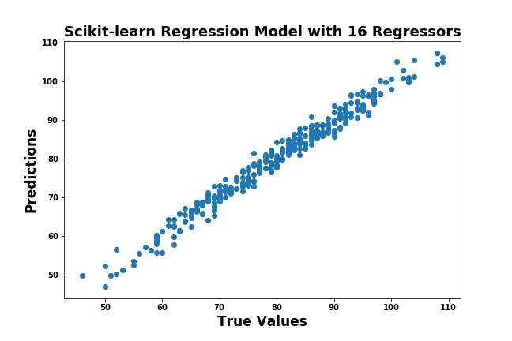
OLS Model Predictions

Slide 17
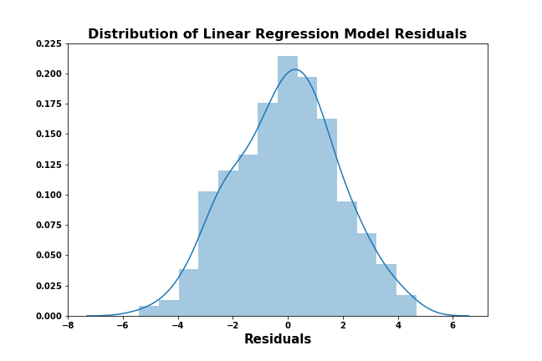
Residual Analysis
Normal Distribution of Residuals

Slide 18
CONCLUSIONS
Team Runs scored (R_x), Innings Pitched(IP), LOB_x & SV are good predictors of wins.
Good batting & pitching are always useful in baseball.
Future Work: Incorporate Financial Stats such as average team salary and/or Fielding Stats into regression models.

Slide 19
THANKS!

