Slide 1
Presetation
LIU SHENGWEI
S1037766

Slide 2
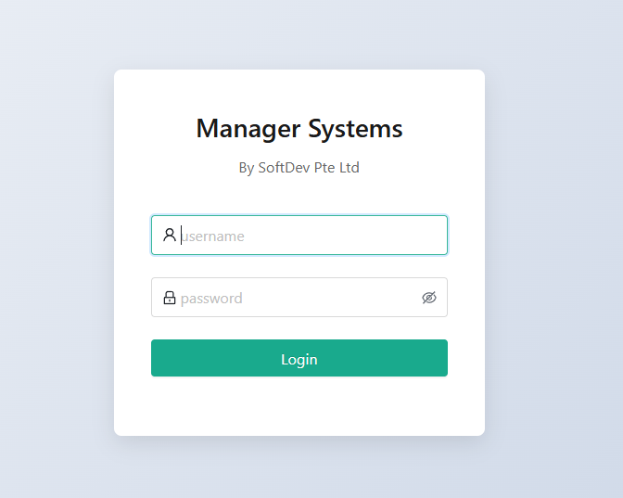
Login Page

Slide 3
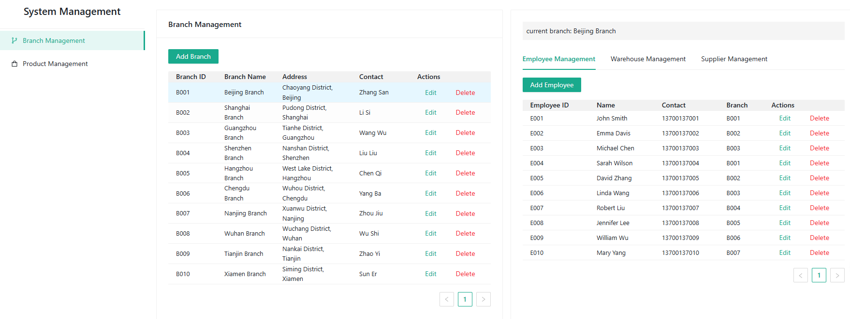
System Page

Slide 4
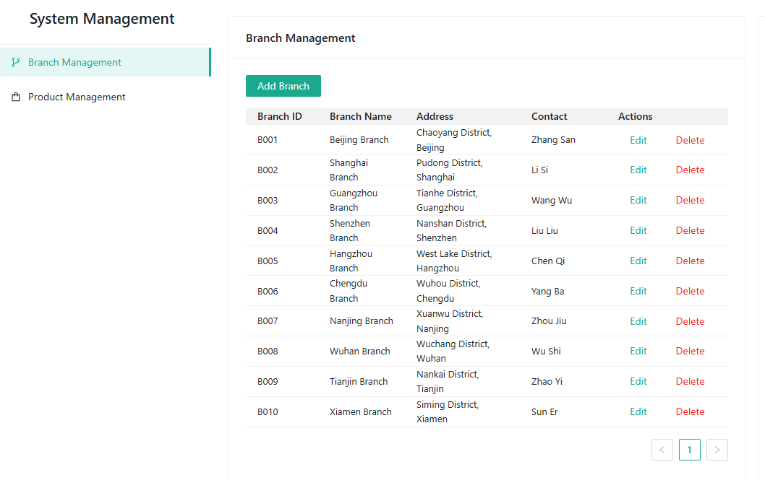
Branch Manage List

Slide 5
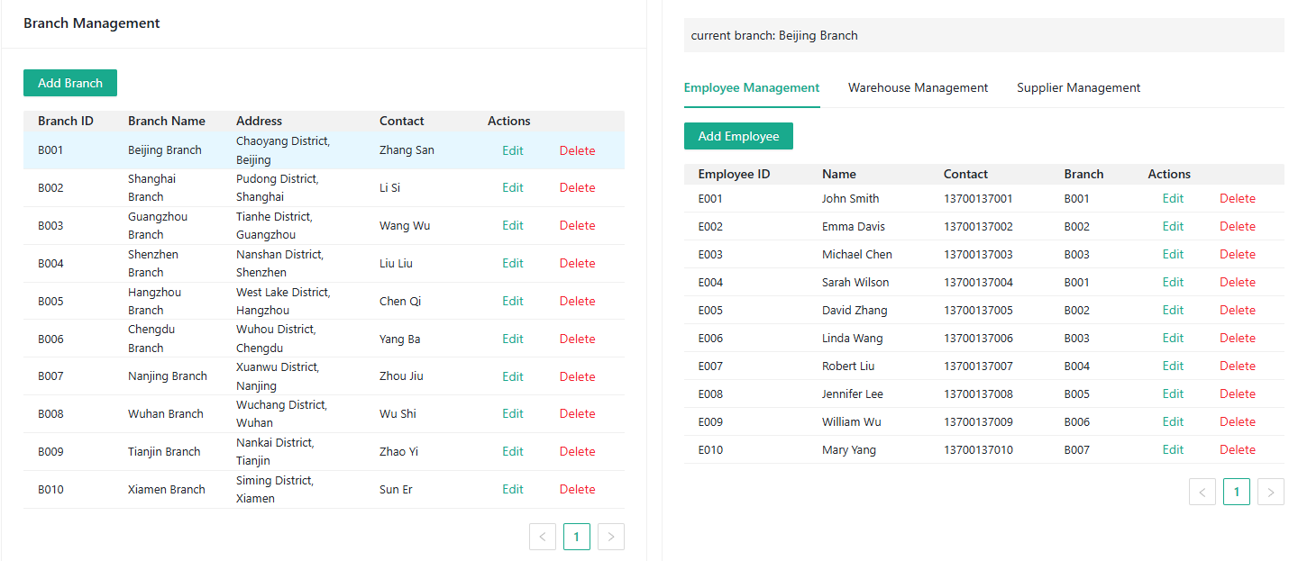
Branch with Employee

Slide 6
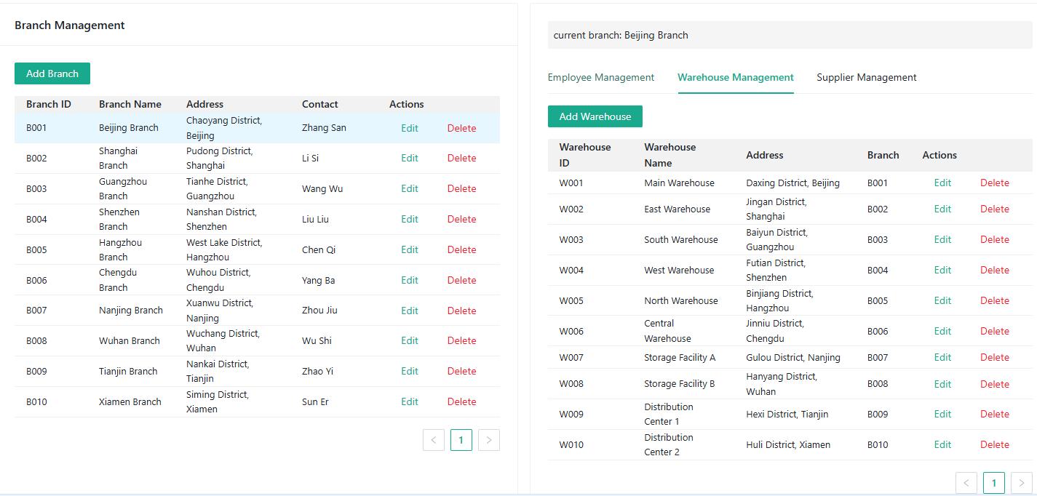
Branch with Warehouse

Slide 7
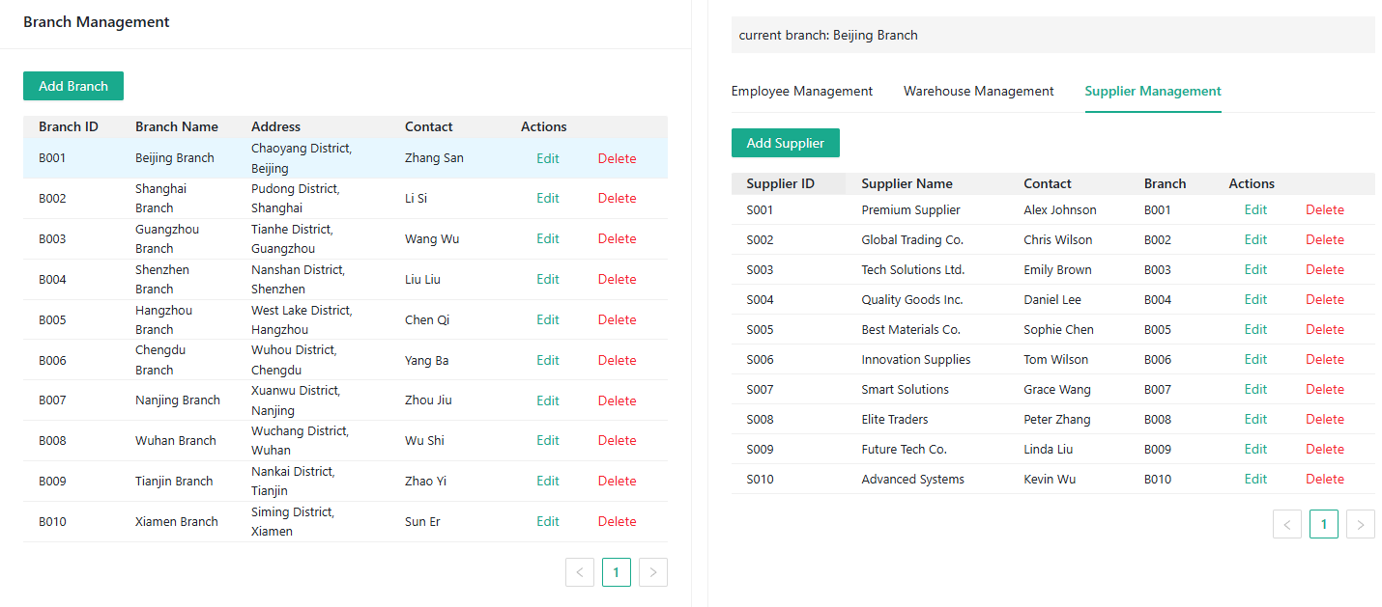
Branch with Supplier

Slide 8
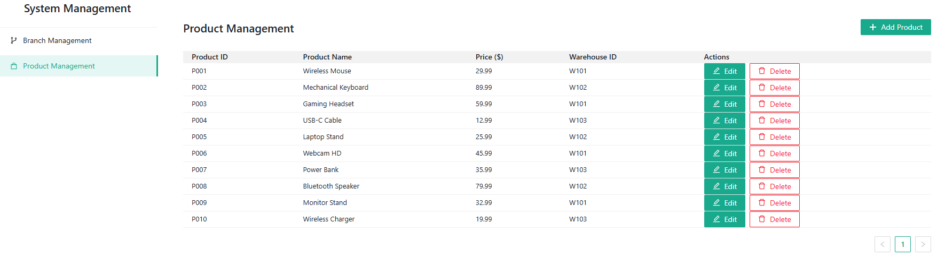
Product Manage

