Slide 1
Getting an Earful
The Unexpected Services of a
Digital Scholarship Unit
Zach Coble @coblezc
Monica McCormick @moncia
Jennifer Vinopal @jvinopal
Digital Library Federation Forum
10/28/2014
@coblezc
@moncia
@jvinopal
Notes:
Intro / Context - 5 min (Zach Coble)
Digital Scholarship Services, in the first official year of our existence at NYU, have shifted from modeling our work (a model which we’ve described here in the past) to actually doing it as a formal unit, with the addition of one full-time staff member (Zach) joining the 3 other team members who all work in multiple places.
Our services include repositories, digital publishing, consultation for DH and other kinds of scholarly projects, workshops and training. We are beginning to pilot using Omeka and WordPress for research web sites, too.
We predicted that a key function of our unit would be to prioritize which projects/user needs get what type of service (standard, customized, etc.) But we realize that one of our contributions to NYU Libraries is acting as a link between other parts of the organization. Our service model requires us to coordinate expertise from across the Libraries to meet our clients’ needs -- data services, digital library technology, metadata experts, subject specialists, and special collections folks.
To ensure that all these colleagues understood how we hoped to work with them, over this past year we did inreach to most of the Libraries departments and several coordinating groups. After describing our services and our approach, we’d end with questions like “what do the scholars you see need? How can we work with you to support them?”
What we didn’t anticipate was the extent to which we would become the nosey switchboard operators of our own organization, listening in on library departmental conversations about their own service frustrations. In some cases we heard what our Libraries colleagues needed--infrastructure, workflows, and procedures that could help them work more effectively and better serve our clients.
And along with many projects and consultations from faculty and students, a number of our clients came from within the Libraries, indicating that there had been an unmet need there.
The following case studies illustrate how the needs of not only our scholars’ but also our colleagues reveal ways to integrate diverse services across Libraries and IT, and how this vantage point provides a unique opportunity to address longstanding organizational issues. We are using these case studies to help us better understand how we can articulate some complex needs, so that all of us -- not just our little unit -- can address these challenges systemically.

Slide 2
Lessons from Case Studies
These requests
revealed internal needs
and new ways to collaborate
Digital Library Federation Forum
10/28/2014
@coblezc
@moncia
@jvinopal

Slide 3


“I need a server”
The antiquated “i5” service
Digital Library Federation Forum
10/28/2014
@coblezc
@moncia
@jvinopal
Notes:
The i5 service: Zach
Define the problem: need for relatively low-tech web infrastructure (i.e. LAMP stack)
Install a CMS: WordPress, Omeka
Use cases: online exhibit, conference website, sandbox space
How we heard about the problem
A long-standing problem. Been receiving these types of requests for years...you’ve heard us talk about the “faculty website problem” before
Scholars have built workarounds
A computer science professor who teaches a DH course uses her department’s own server to have each student install their own instance of Wordpress
Most scholars either purchase their own hosting or use free options like wordpress.com or omeka.net
Pressure: DSS being asked to help develop a more cohesive DH community on campus, along with plans to create a masters-level DH certificate program
In other words: we need more robust support services - to at least be able to help someone who comes in and says “I just need a basic website”
Description of problem and how it arises from the POV of different departments
DSS: we’re front-facing, the ones who constantly have to say “no”
ITS: currently providing i5 service
Their big concern is staffing to support such a service, they’re just not staffed for it at the moment
Security issues raised for the types of access requests we have
Giving admin permissions to noobs on servers that also contain sensitive data
Addressing external client requests revealed numerous internal issues
Sylvester Manor: scholar wanted to create online exhibit of Fales collection
difficulties finding the right place to host (ITS, DLTS, scholar’s own web host)
Solution: DLTS hosts
Took 15 minutes to create site, but 9 months of discussions to get to that point
Outcome
DSS looking into creating a stopgap service that meets our needs
Partnering with DLTS to possibly offer a service parallel to i5
Need for customization a primary motivator
Our clients require ability to install plugins, have 20 students install WP instances
Turf battles: we don’t want to “steal” a service from another department and harm a partnership

Slide 4
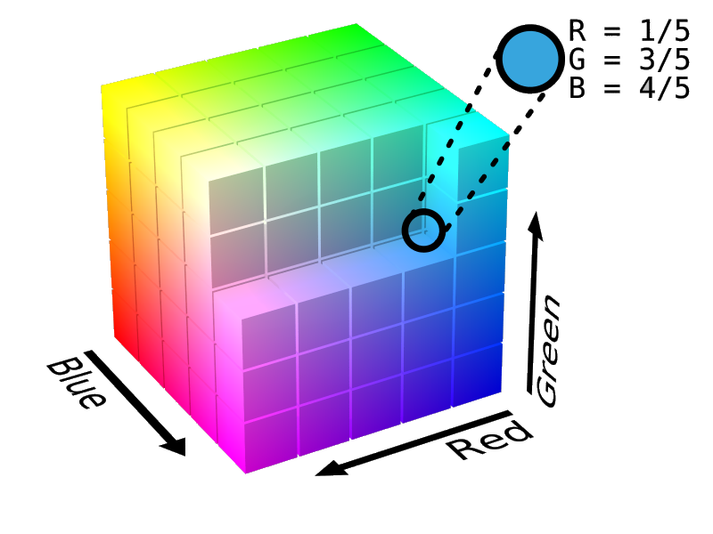
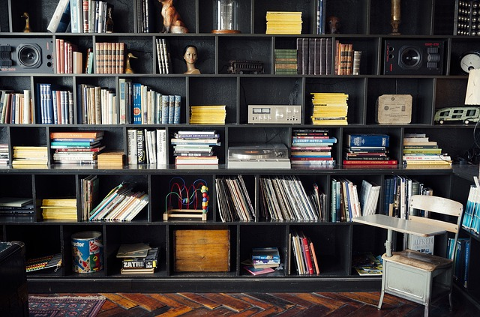

“I need an exhibit”
Scholars + Special Collections + DLTS + DSS
Digital Library Federation Forum
10/28/2014
@coblezc
@moncia
@jvinopal
Notes:
Scholars digitizing special collections (Jennifer Vinopal)
Over the past year we’ve gotten three requests from graduate students wanting to digitize parts of one of our special collections — Fales Library — to create online exhibits with a scholarly apparatus. Until now scholars have not had the ability to scan special collections materials.
Our 3 special collections are very interested in supporting these projects. The benefits to special collections include
expanding the use of their collections
greater collaboration with scholars
visibility and promotion via the scholars’ published websites
In one case a scholar is clearing rights to digitize and publish the items she’s scanning
also this is a great means for our special collections to get even more of their collections digitized, since scholars may be requesting access to collections that wouldn’t otherwise be in the DL pipeline.
All good, right?
Well, the challenge is that existing digitization workflows were created in conjunction with our Digital Library team for digitizing either complete collections, or large swaths of them.
That’s because our DL operation, like many of yours I am guessing, was designed for a very different purpose than the one that Digital Scholarship Services is now proposing. DL was designed, for the most part, to efficiently digitize and preserve library collections as comprehensively and quickly as possible. Whereas DSS is designed to help scholars get and use the data they need to make scholarly arguments.
What these scholars needed was the ability to digitize selectively (the same way they would quote selectively when making an argument in a print publication).
These perfectly reasonable requests were at odds with our existing DL workflows which had been established over a long period of time, and which included:
communication methods,
file naming conventions,
project management processes,
materials transfer between Special Collections and DL,
documentation conventions
scheduling
etc.
We had never before had non-DL people digitizing materials for preservation, so there would also be an impact on space and workstation allocation, and on staffing, since the scholars would need additional training and oversight.
In collaboration with DL and Fales Library, we’ve had to revisit our existing protocols and adapt them to this new kind of activity. Among other things we’ve developed:
processes for collaboratively writing/approving scope of work documents so 3 departments (Special Collections, Digital Library, Digital Scholarship Services) plus the scholar all agree on the work to be done
we’ve developed processes for prioritizing and scheduling work to accommodate the timeframe of the scholars
we’ve developed a process to train and oversee scholars who will digitize special collections materials for their own use BUT who also need to scan to preservation standards so we can archive these items
we’ve developed a way for special collections tell us how to name files for these discrete items and how these items relate to the larger collections of which they are just a part
we’ve developed a clear delineation between DSS’s responsibilities and those of DLTS (this delineation sounds pretty straightforward, but it’s all part of the maturation process of a new department that relies heavily on collaboration with other departments, but risks stepping on people’s toes in the process)
I’ll conclude by simply saying that these three projects have allowed us to pilot a new “scholar-digitized special collections material” service (though it needs a better name) and to develop a systematic process for meeting these requests while helping both special collections and digital library technology services expand their capacity to support scholars.

Slide 5
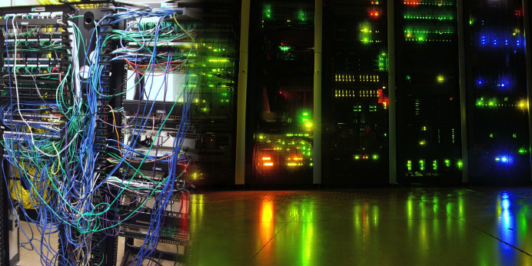
“We’re running out of storage!”
The “N Drive Problem”
Digital Library Federation Forum
10/28/2014
@coblezc
@moncia
@jvinopal
Notes:
The N Drive problem (Monica McCormick):
Third case study is about a longstanding issue that we heard when we did an inreasch session with our Special Collections Steering group, which includes the heads and key managers of our two special collections, the Fales Library, the Tamiment and Wagner Labor Archives, university archives, plus the directors (our AUL-equivalent) of Collections, Libraries ITS, and Digital Library Technology Services. This is a big group of people from many levels of the organization.
The need: patrons who have used our special collections regularly need digital copies of items, for inclusion in their published works and presentations, or for other research purposes. Staff in our 3 special collections units, on 3 different floors, use local scanning equipment to make these files, create some minimal metadata for them, share copies with the patron, and store a copy on the general library server, known as the “N drive.” That’s the shared drive for all library staff to store documents and working material. It’s not designed for preservation of digital images. But it’s readily available.
Metadata creation is irregular or nonexistent and storage is not systematic, and quality is not at the highest standard, because most patrons don’t need that. Our large-scale digitization for preservation, which we generally do for whole collections, with careful controls for metadata, item numbering, and storage in a repository specifically designed to support best practices for digital preservation. But because most of our special collections have not been digitized, we have this ad-hoc, unsystematic, but now common way to do digitization-on-demand for short-term access and use.
Perspectives on the problem:
Special collections staff cannot easily determine what has already been digitized; duplication is likely to occur. They frequently run into space limits on the N drive because the need for that space is unpredictable. From their POV, this digitization is part of the mission to provide access to our collections.
For Libraries ITS, it’s challenging and inefficient to try and provide a lot of storage space without much advance planning. And because the N drive is not designed for preservation of digitized collections, there are some concerns about its suitability for this purpose.
For heads of collections and preservation, this process is perceived as a slightly rogue activity, doing an “end run” around established protocols and standards. They’re concerned about the stability.
Our contribution:
We cannot solve this problem ourselves (way beyond our brief) but being able to articulate it from all perspectives helps to begin shaping a solution.
And because our unit is engaged in our repository services (both the IR and the preservation repository) we have an understanding the pros/cons of our current systems to meet this need. We have begun conversations about a short-term solution.
We are engaged in a broad survey of all our repository needs , so the “N drive problem” will be a particular use case for that analysis. If this need hadn’t come up we could have been addressing the larger repositories problem without solving for this need. We have a deeper understanding, which is always good.

Slide 6
Topics for Discussion
Advocating for addressing internal needs
Balancing internal vs. external clients
Flashy projects vs. infrastructure building
Creating cross-organizational workflows
Developing shared priorities across departments
Digital Library Federation Forum
10/28/2014
@coblezc
@moncia
@jvinopal
Notes:
Conclusion + Discussion with the audience
For our own, new, unit, these experiences have helped to clarify our role. The nature of our work is to link together other departments’ services, but we believe we are doing more than just coordinate. These cases have shown us where we may want to rethink some of the workflows, infrastructure, and protocols that undergird the library’s work. Our cases are identifying service gaps, how some existing procedures do not fully address the reality of patron needs. We are potentially stepping on toes, stirring up trouble, calling into question some established procedures. We are also, we hope, finding new opportunities for collaboration.
It seems that one of our contributions is to show how long-standing problems can be re-articulated and seen afresh, and then to
propose solutions that are more likely to succeed.

Slide 7
Rights
RGB cube CC BY-SA 3.0 by SharkD
Page URL: http://commons.wikimedia.org/wiki/File%3ARGB_Cube_Show_lowgamma_cutout_b.png
Attribution: By RGB_farbwuerfel.jpg: Horst Frank RGB_color_solid_cube.png: SharkD derivative work: SharkD Talk (RGB_farbwuerfel.jpg RGB_color_solid_cube.png) [CC-BY-SA-3.0 (http://creativecommons.org/licenses/by-sa/3.0)], via Wikimedia Commons
All other images CC0 licensed by the owners.
Excluding the creative content noted above, this presentation is licensed by the authors under a Creative Commons Attribution 3.0 Unported license (CC BY 3.0) http://creativecommons.org/licenses/by/3.0/deed.en_US
Digital Library Federation Forum
10/28/2014
@coblezc
@moncia
@jvinopal

