Slide 1
Indoor Navigation
김진용, 임준성

Slide 2
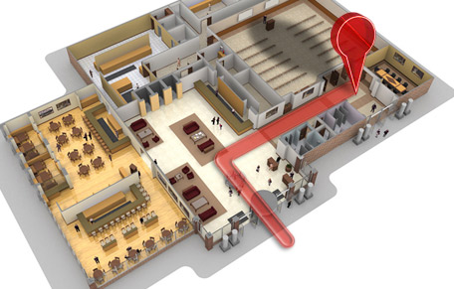
Introduction
An indoor positioning system (IPS) is a term used for a network of devices used to wirelessly locate objects or people inside a building.
- wikipedia -

Slide 3
Introduction
Outdoor
Indoor
Car navigation
Indoor navigation
Service
GPS
Global Positioning System
?
IPS
Indoor Positioning System
Positioning
Not works effectively in indoor or urban canyon situation

Slide 4
Introduction
Indoor Positioning System (IPS)
Infrared-based
Ultra Sonic-based
RFID-based
WLAN-based

Slide 5
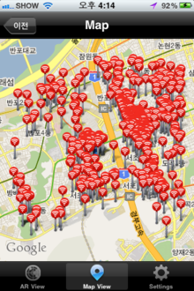
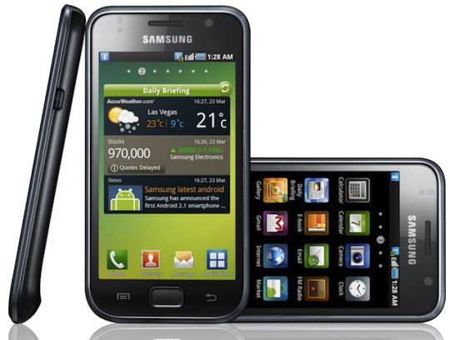
Introduction
WiFi Positioning System(WPS)
Existing WLAN infrastructure can be used easily
Nearly all new mobile devices are now equipped with a WiFi chip
Generally, error distance is within 10m.

Slide 6
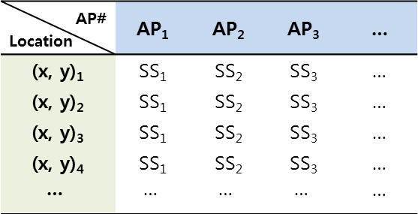
Introduction
Overview of fingerprinting approach
Training phase
AP# Location | AP₁ | AP₂ | AP₃ | …
(x, y)₁ | SS₁ | SS₂ | SS₃ | …
(x, y)₂ | SS₁ | SS₂ | SS₃ | …
(x, y)₃ | SS₁ | SS₂ | SS₃ | …
(x, y)₄ | SS₁ | SS₂ | SS₃ | …
 |  |  |  | …
(x, y)₁
AP₁ ,SS₁, AP₂, SS₂, …
store
average
AP₁ ,SS₁, AP₂, SS₂, …
AP₁ ,SS₁, AP₂, SS₂, …
AP₁ ,SS₁, AP₂, SS₂, …
<WRM>
Positioning phase
Pattern Matching
(?, ?)
AP₁ ,SS₁, AP₂, SS₂, …
estimate
(x, y)
<Mobile Device>
e.g. k-NN, SVM, NN, …

Slide 7
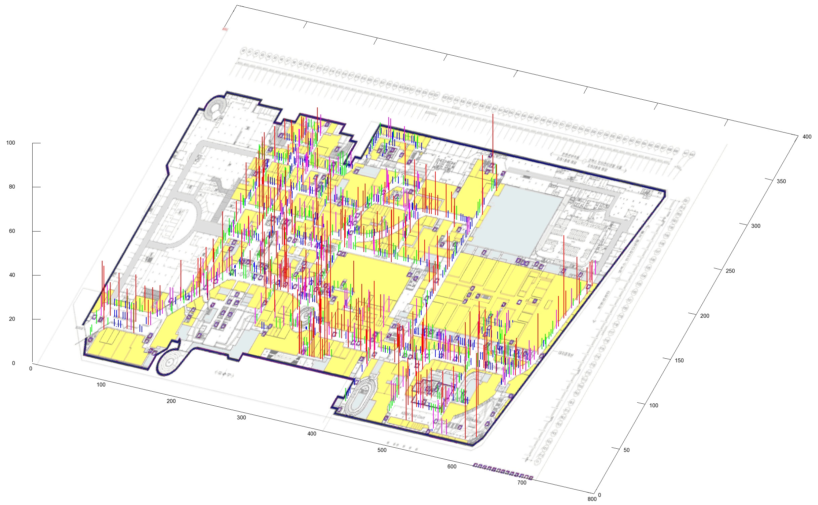
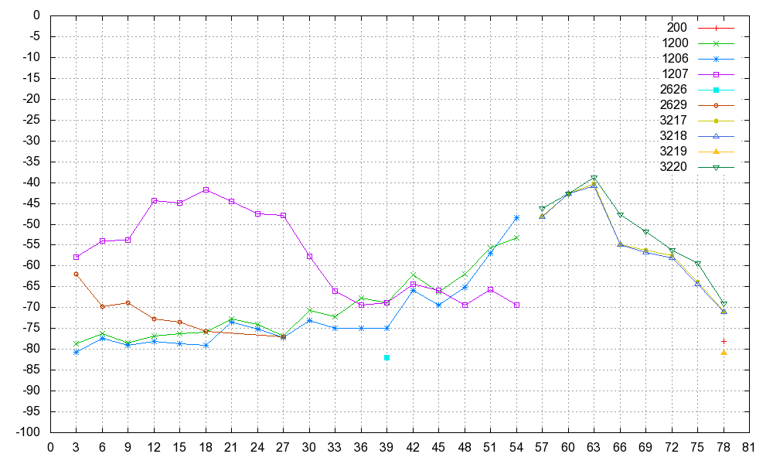
Introduction

Slide 8
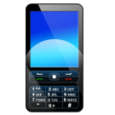
Introduction
WLAN-based IPS
Suffers from signal fluctuation – limitation of accuracy

Slide 9
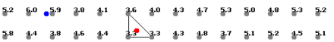
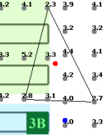
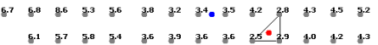
Technique
K-NN(K-Nearest neighbor) algorithm
the k-nearest neighbor algorithm (k-NN) is a method for classifying objects based on closest training examples in the feature space.
<Fig. 1>
<Fig. 2>
<Fig. 3>

Slide 10
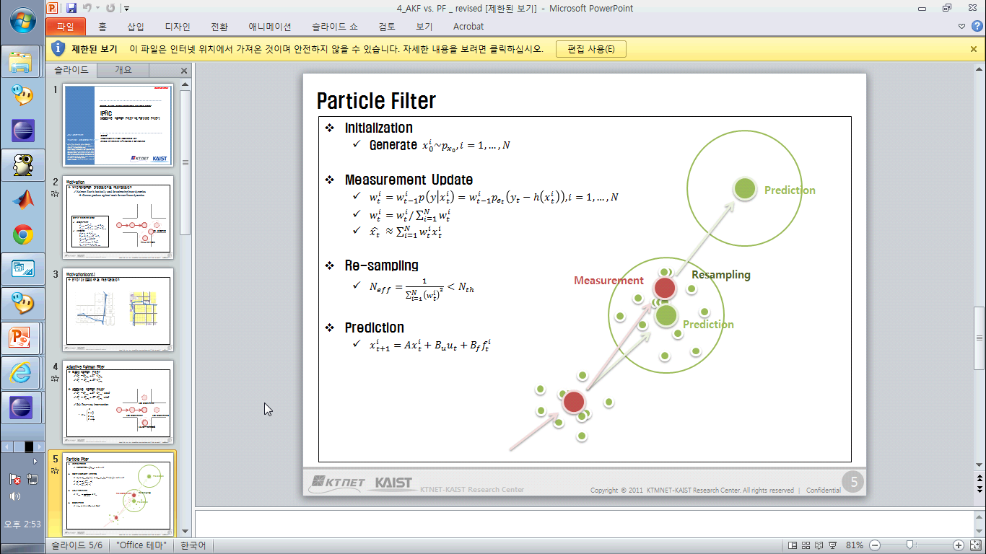
Technique
Particle Filter
In statistics, a particle filter is a sophisticated model estimation technique based on simulation
Prediction
Measurement
Resampling
Prediction

Slide 11
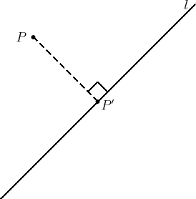
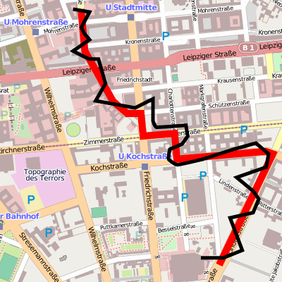
Technique
Map Matching Algorithm

Slide 12
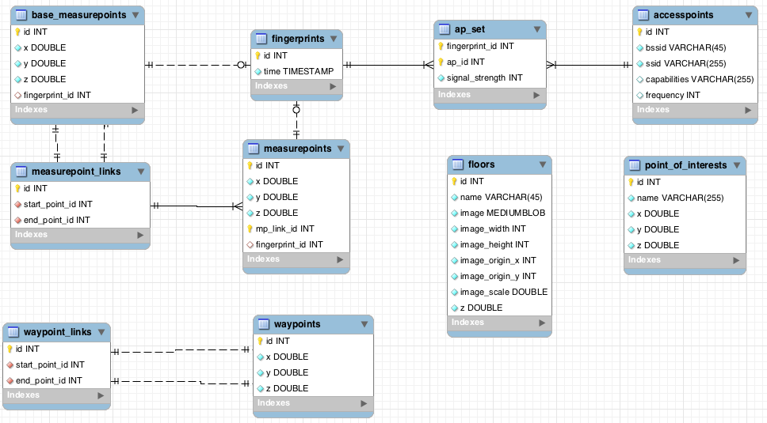
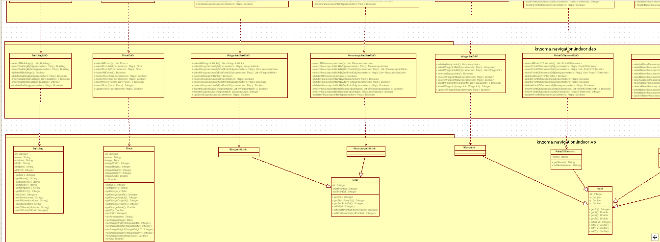
Role
Junsung, Lim
Design DB schema
Implement localization engine

Slide 13
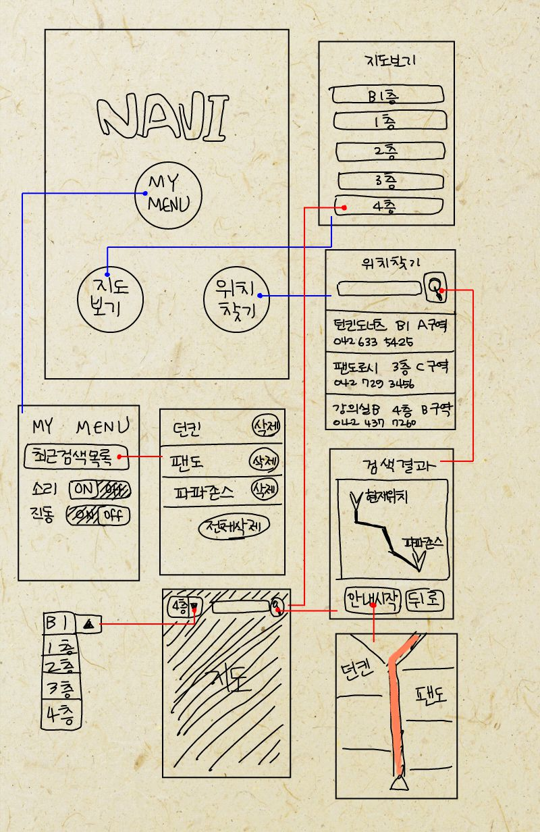
Role
Jinyong, Kim
UI/UX
Android

Slide 14
Implementation
Mapping Tool (for developer)
WiFi Collecting Tool (for developer)
Navigation Service (for user)

Slide 15
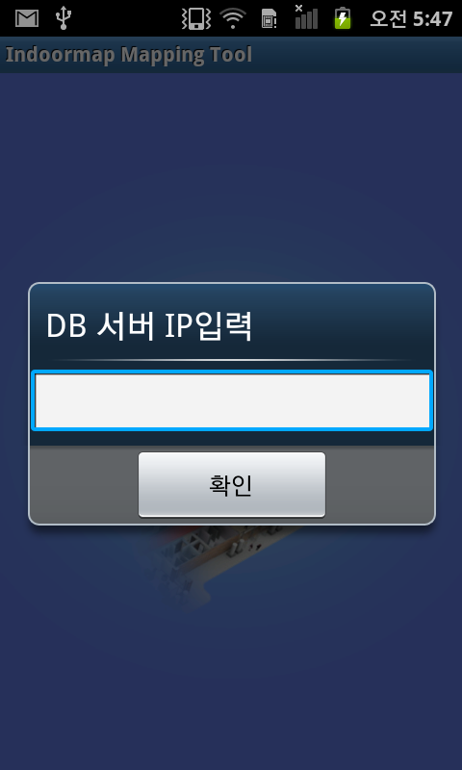
Mapping Tool
Select WRM Server

Slide 16
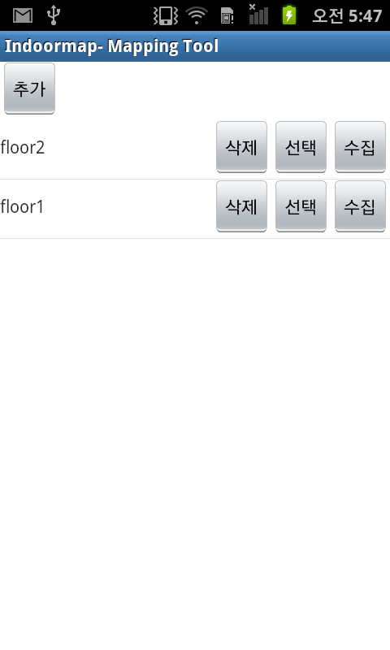
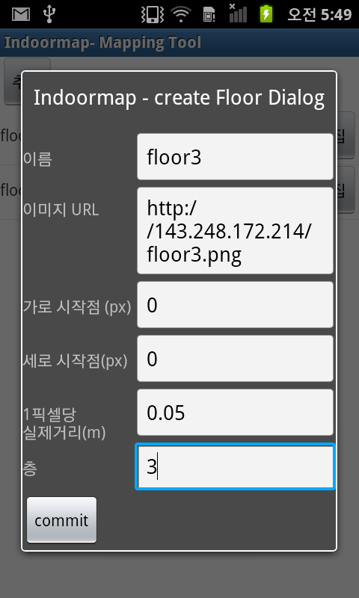
Mapping Tool
Select Floor
Insert Floor

Slide 17
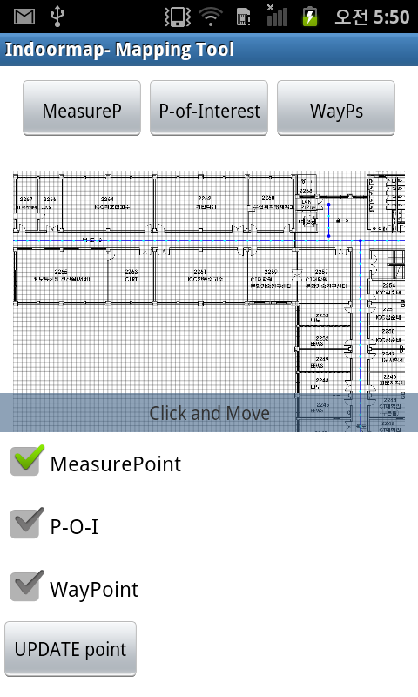
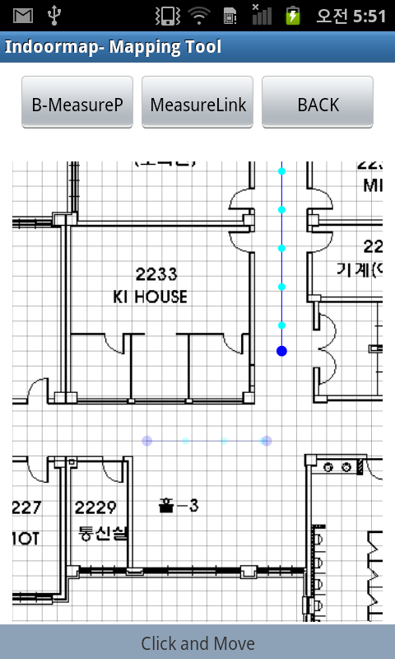
Mapping Tool
Measure point

Slide 18
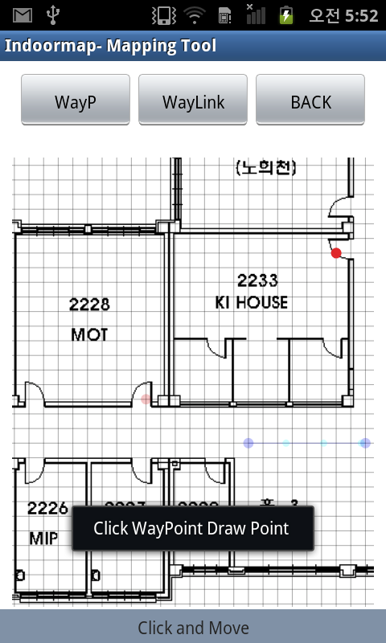
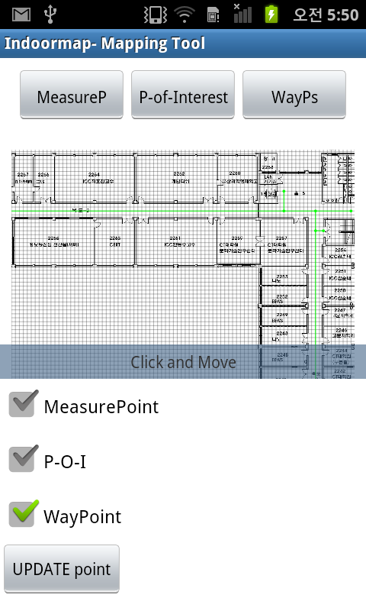
Mapping Tool
Way point

Slide 19
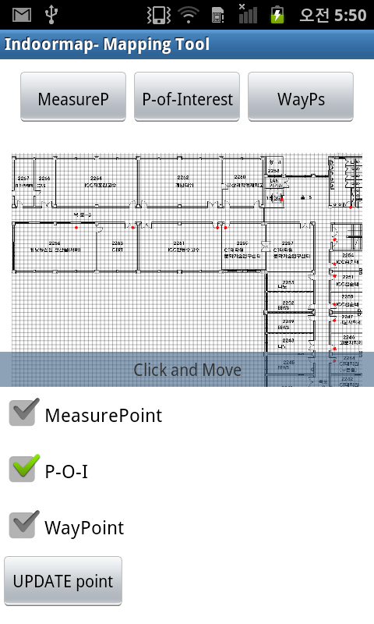
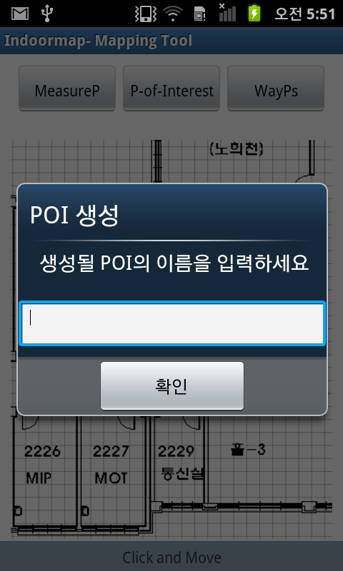
Mapping Tool
POI(Point Of Interesting)

Slide 20
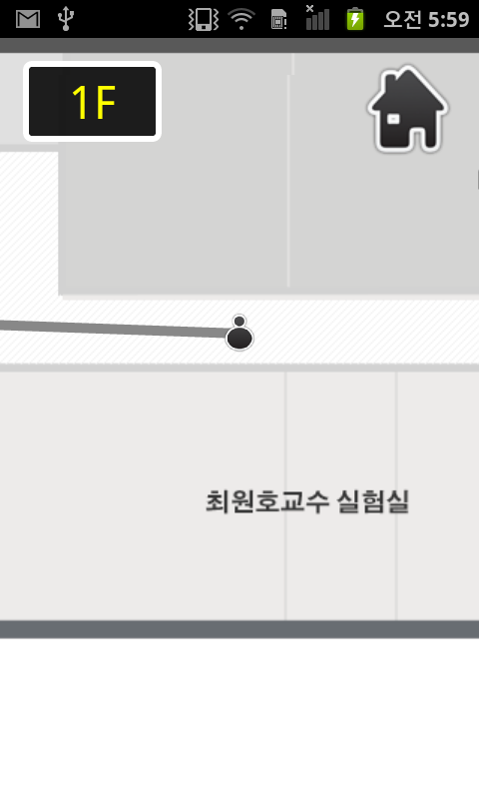
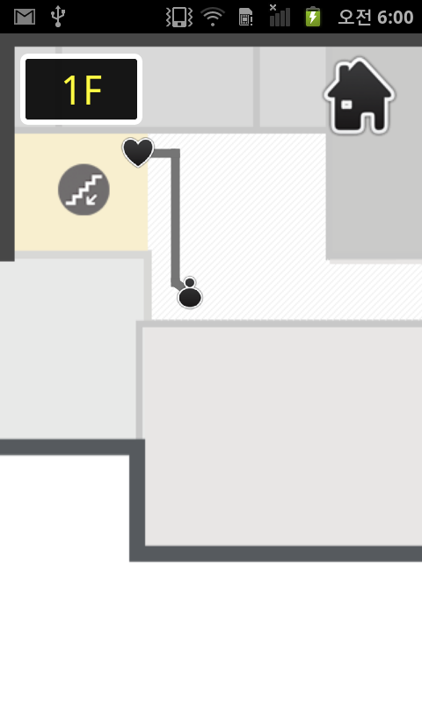
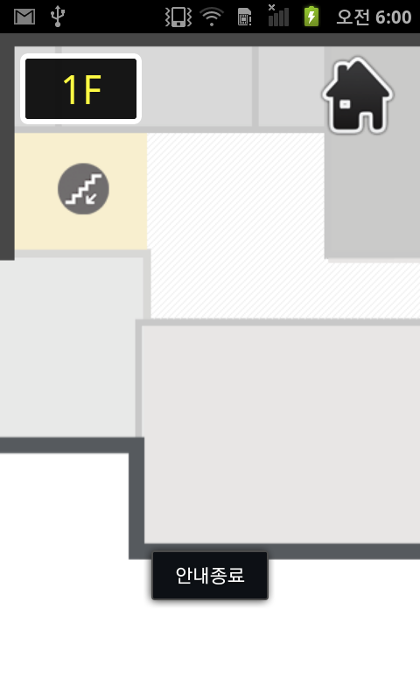
Navigation Service
Navigation

Slide 21
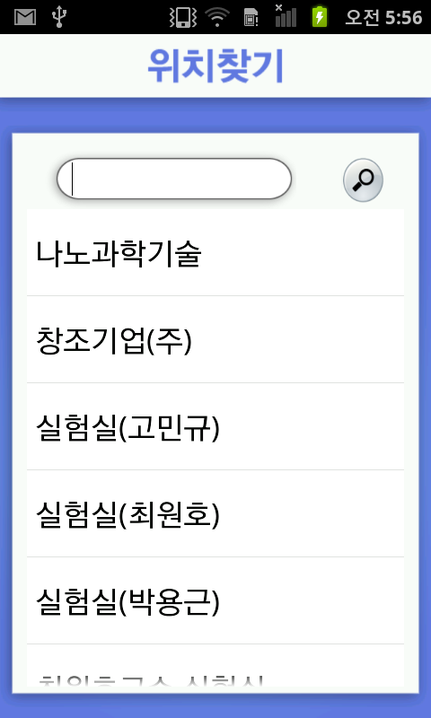
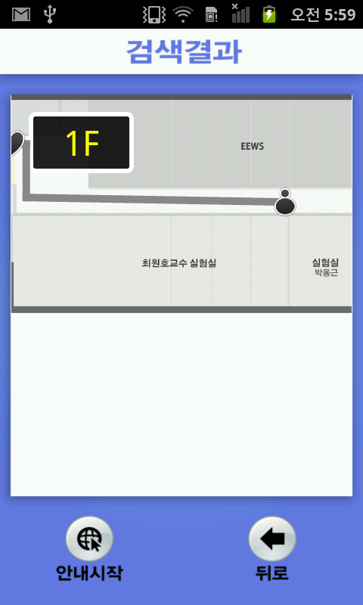
Navigation Service
위치 검색 & 탐색

Slide 22
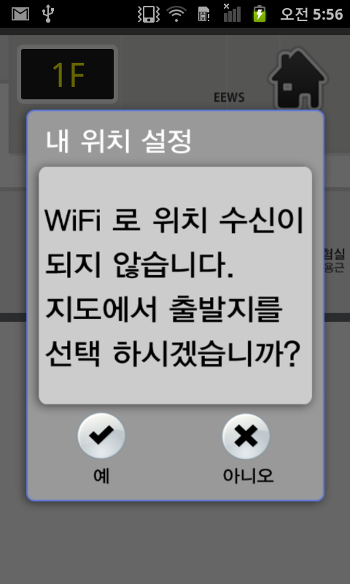
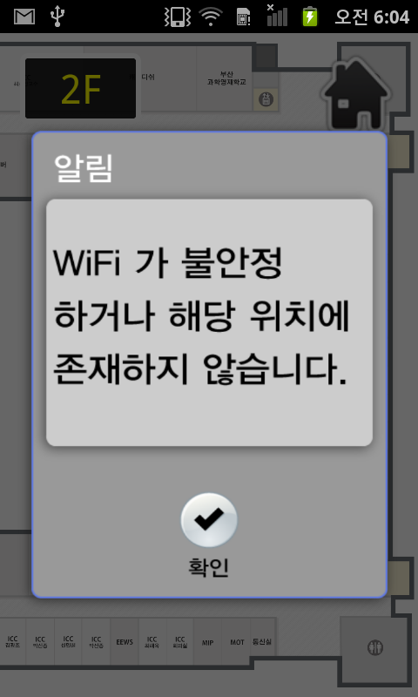
Navigation Service
경고

Slide 23
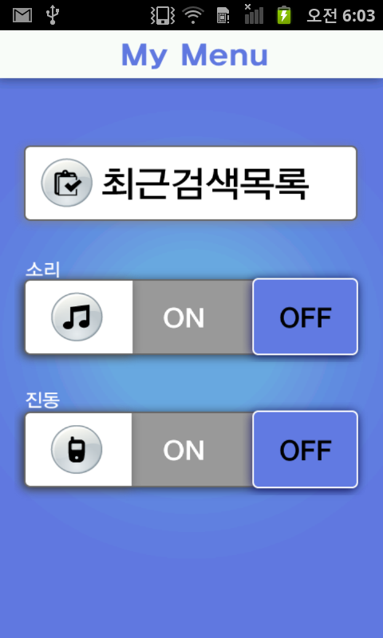
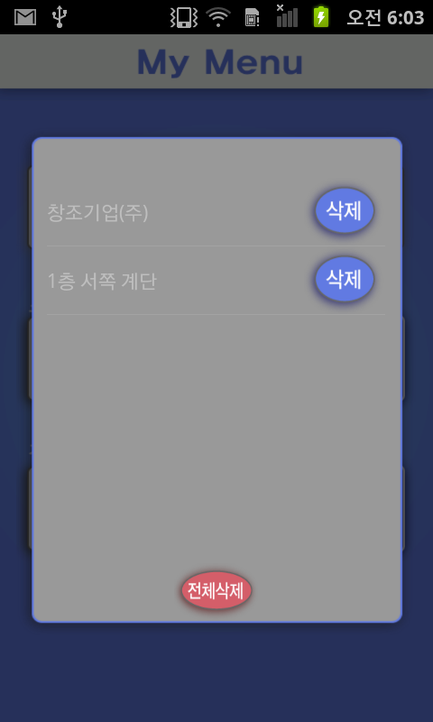
Navigation Service
옵션

Slide 24
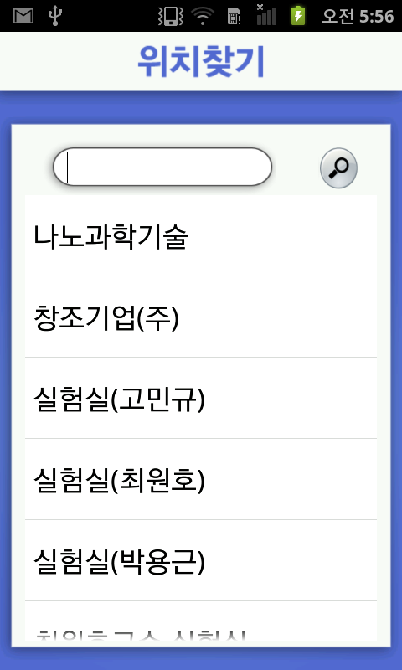
Navigation service

Slide 25
Demo

Slide 26
Future work
Integrate with GPS-based navigation serv-ices
Improve accuracy of localization

Slide 27
Q & A

