Slide 1
Indoor Navigation
김진용, 임준성

Slide 2
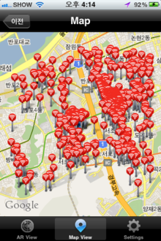
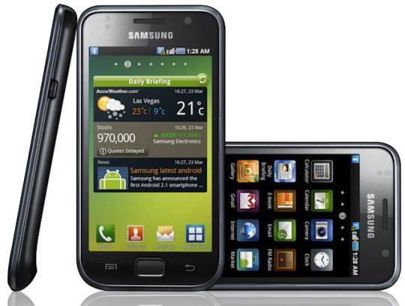
Introduction
WiFi Positioning System(WPS)
Existing WLAN infrastructure can be used easily
Nearly all new mobile devices are now equipped with a WiFi chip
Generally, error distance is within 10m.

Slide 3
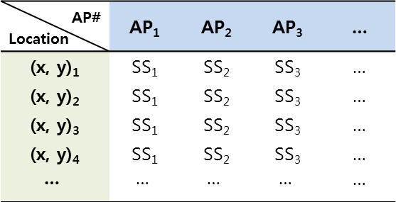
Introduction
Overview of fingerprinting approach
Training phase
AP# Location | AP₁ | AP₂ | AP₃ | …
(x, y)₁ | SS₁ | SS₂ | SS₃ | …
(x, y)₂ | SS₁ | SS₂ | SS₃ | …
(x, y)₃ | SS₁ | SS₂ | SS₃ | …
(x, y)₄ | SS₁ | SS₂ | SS₃ | …
 |  |  |  | …
(x, y)₁
AP₁ ,SS₁, AP₂, SS₂, …
store
average
AP₁ ,SS₁, AP₂, SS₂, …
AP₁ ,SS₁, AP₂, SS₂, …
AP₁ ,SS₁, AP₂, SS₂, …
<WRM>
Positioning phase
Pattern Matching
(?, ?)
AP₁ ,SS₁, AP₂, SS₂, …
estimate
(x, y)
<Mobile Device>
e.g. k-NN, SVM, NN, …

Slide 4
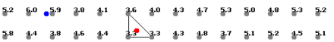
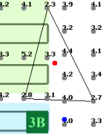
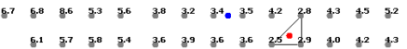
Technique
K-NN(K-Nearest neighbor) algorithm
the k-nearest neighbor algorithm (k-NN) is a method for classifying objects based on closest training examples in the feature space.
<Fig. 1>
<Fig. 2>
<Fig. 3>

Slide 5
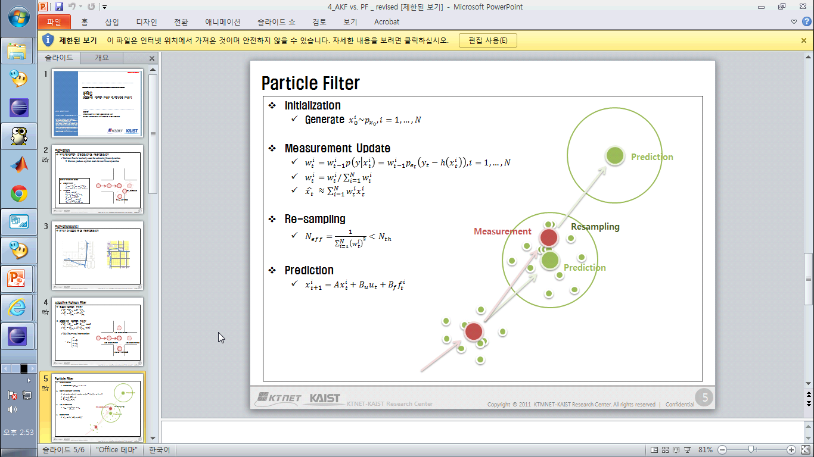
Technique
Particle Filter
In statistics, a particle filter is a sophisticated model estimation technique based on simulation
Prediction
Measurement
Resampling
Prediction

Slide 6
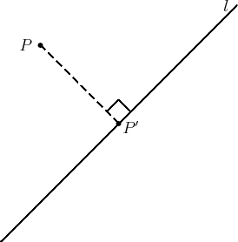
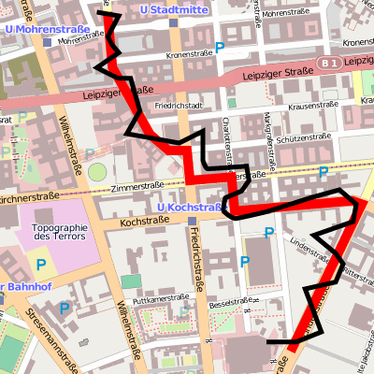
Technique
Map Matching Algorithm

Slide 7
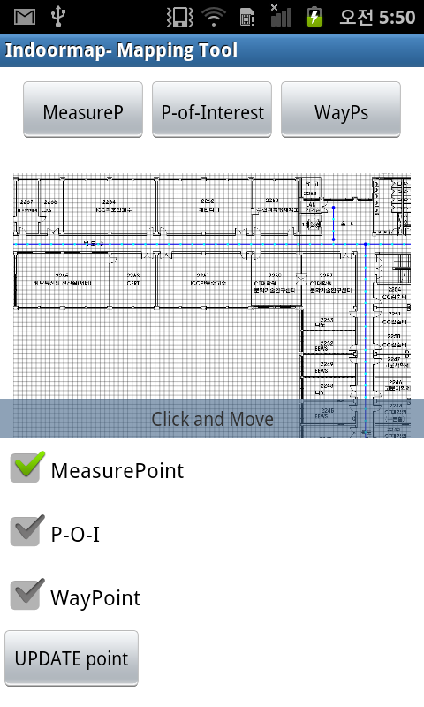
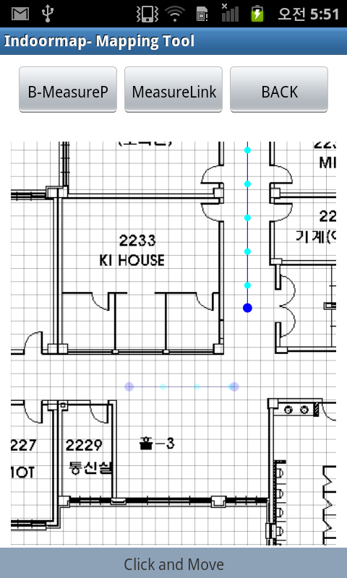
Mapping Tool
Measure point

Slide 8
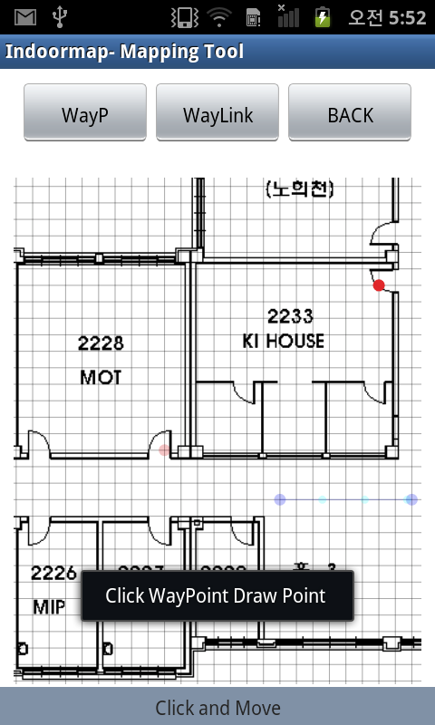
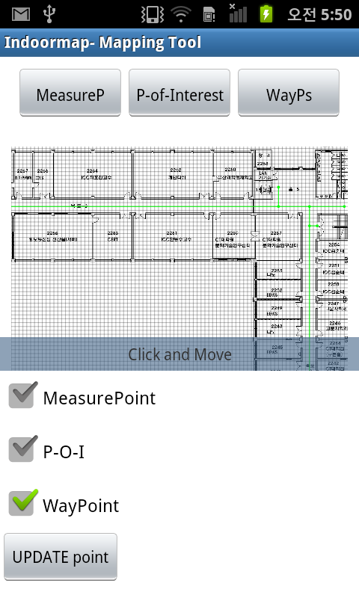
Mapping Tool
Way point

Slide 9
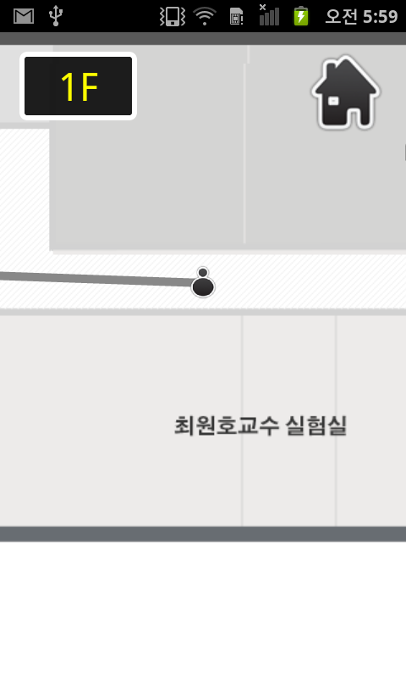
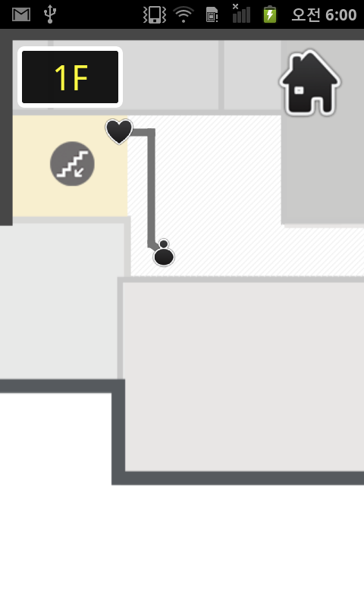
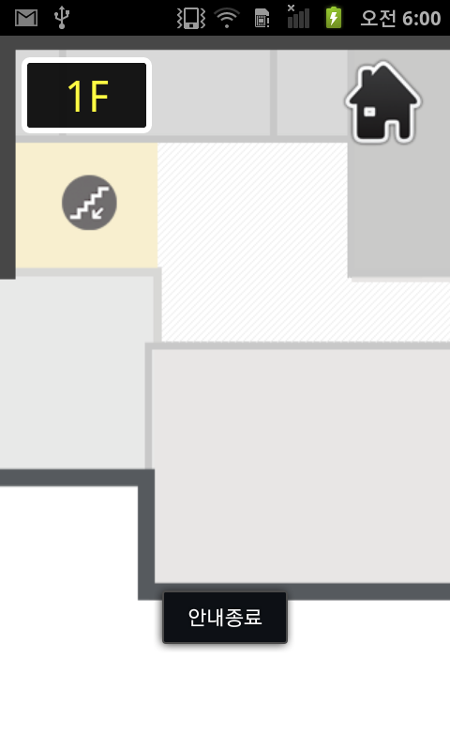
Navigation Service
Navigation

