Slide 1
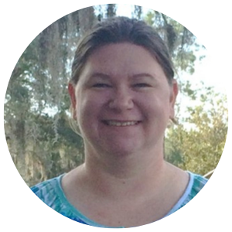
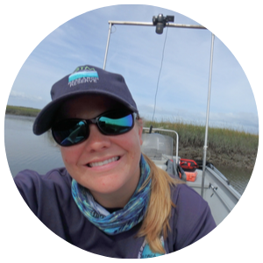
The Next Step with R: Data Management, Graphics, and Functions
Kim Cressman Grand Bay NERR
Kimberly.Cressman@dmr.ms.gov
Shannon Dunnigan Guana Tolomato Matanzas NERR
Shannon.Dunnigan@FloridaDEP.gov

Slide 2
Introduction

Slide 3
How today will go…
Notes:
Sticky notes, Rmarkdowns, PowerPoint & live coding, “your turns”, mini-challenges, and neighborly collaboration is encouraged!

Slide 4
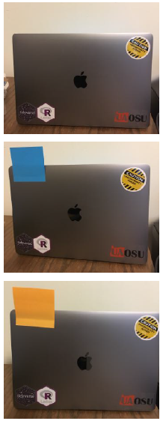
No sticky note: “I’m happily working on it”
Purple sticky note: “I’m all done and ready to move on”
Yellow sticky note: “I’m stuck, can someone help me?”
(or flag us down)
Image @cwickham

Slide 5
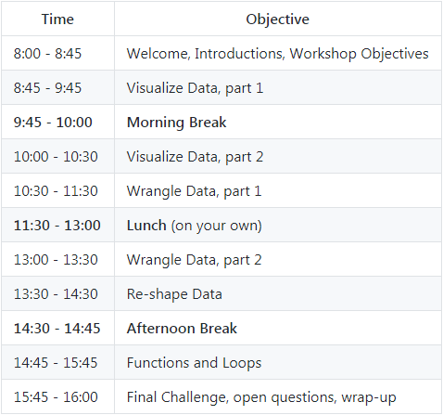

Slide 6
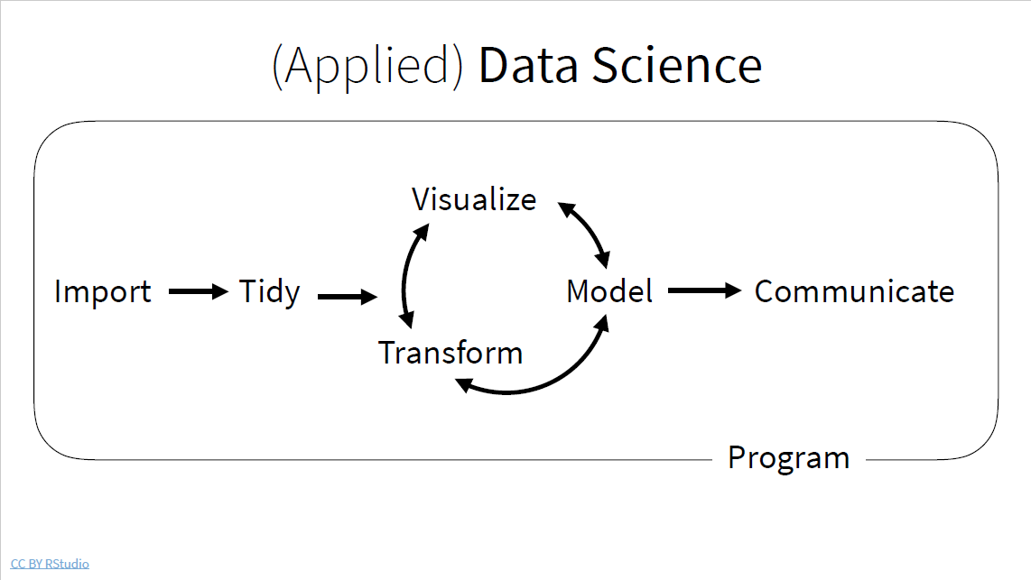
*
*
*
*
*
Notes:
The purpose of this workshop is to really improve your knowledge of R and to help provide you with tools to use it in your daily workflow.
You will learn to automate daily tasks, manage data in a reproducible framework (using tidyverse R packages dplyr and tidyr), make publication ready graphs (using R package ggplot2), and write functions during the course of this workshop.

Slide 7
Workflow Basics
Tips and tricks to making your R work more productive

Slide 8
Workflow Basics: Tips and tricks to making your R work more productive
Save the source, not the workspace
Notes:
There’s nothing worse than discovering three months after the fact that you’ve only stored the results of an important calculation in your workspace, not the calculation itself in your code.

Slide 9
Workflow Basics: Tips and tricks to making your R work more productive
Save the source, not the workspace
Use an IDE (integrated development environment), like RStudio

Slide 10
Workflow Basics: Tips and tricks to making your R work more productive
Save the source, not the workspace
Use an IDE (integrated development environment), like RStudio
Project-oriented workflow
Notes:
Everything you need is in one place, and cleanly separated from all the other projects that you are working on.

Slide 11
Workflow Basics: Tips and tricks to making your R work more productive
Save the source, not the workspace
Use an IDE (integrated development environment), like RStudio
Project-oriented workflow
Use projects and the `here` package

Slide 12
Workflow Basics: Tips and tricks to making your R work more productive
Save the source, not the workspace
Use an IDE (integrated development environment), like RStudio
Project-oriented workflow
Use projects and the `here` package
Use standardized naming conventions
TL;DR - machine and human readable and plays well with default ordering (put something numeric first).
Left pad other numbers with zeros (to avoid the ‘10’ coming before ‘01’). Avoid spaces in file names, punctuation, and accented characters.

Slide 13
Workflow Basics: Tips and tricks to making your R work more productive
Save the source, not the workspace
Use an IDE (integrated development environment), like RStudio
Project-oriented workflow
Use projects and the `here` package
Use standardized naming conventions
Coding review
package::function()
<-
Pipes! `%>%` from the `magrittr` package

Slide 14
Workflow Basics: Tips and tricks to making your R work more productive
Save the source, not the workspace
Use an IDE (integrated development environment), like RStudio
Project-oriented workflow
Use projects and the `here` package
Use standardized naming conventions
Coding review
Keyboard Shortcuts: there’s an RStudio Cheatsheet for that!
We love:
alt+- :for <-
ctrl+enter :to run one or more lines
ctrl+shift+m :for %>%
ctrl+shift+c :to comment/uncomment
ctrl+i :to indent prettily
Notes:
We love:
alt - for <-
ctrl enter to run one or more lines
ctrl shift m for %>%
ctrl shift c to comment/uncomment
ctrl i to indent prettily

Slide 15
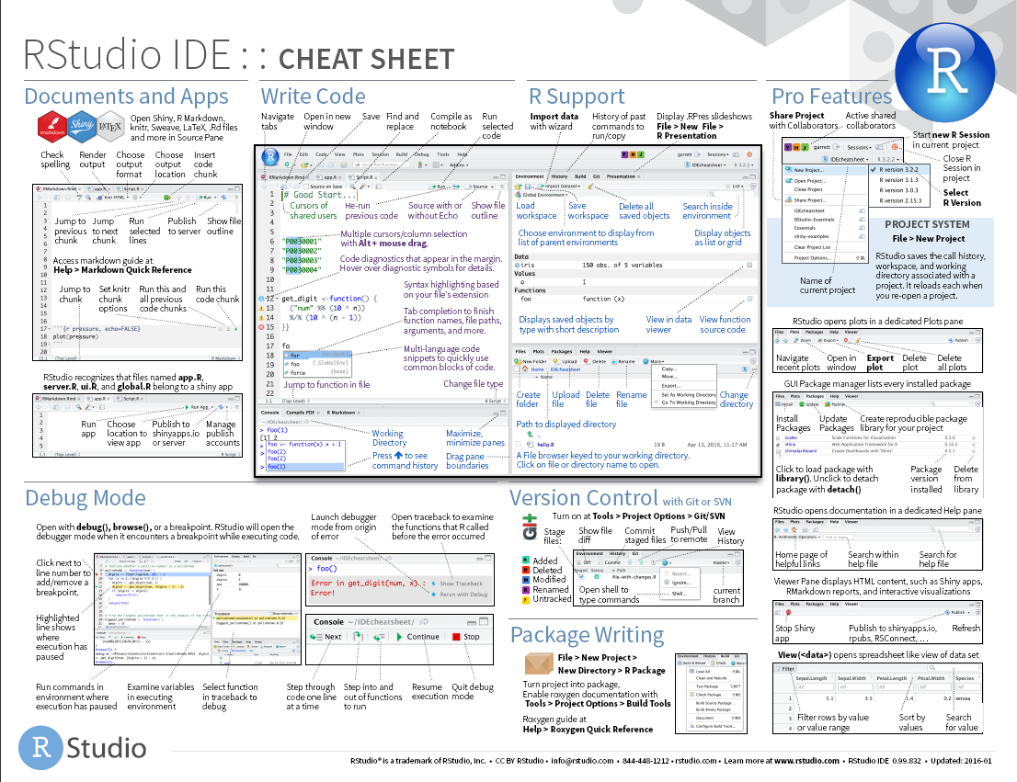
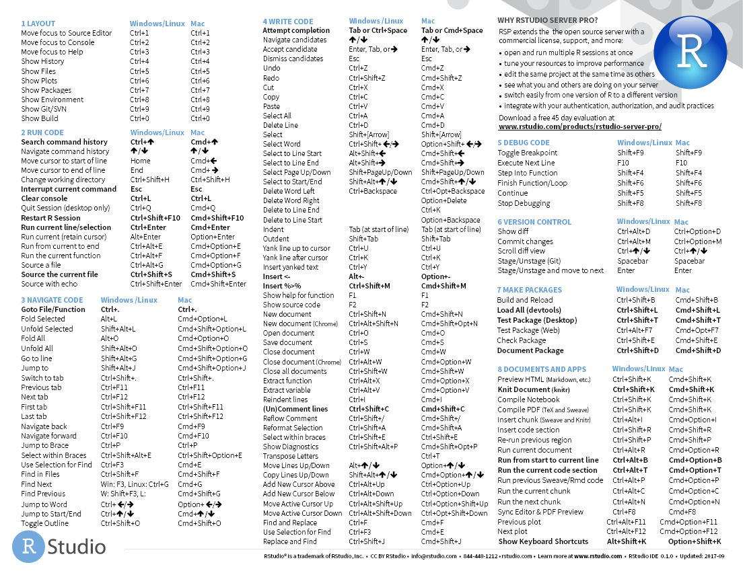

Slide 16
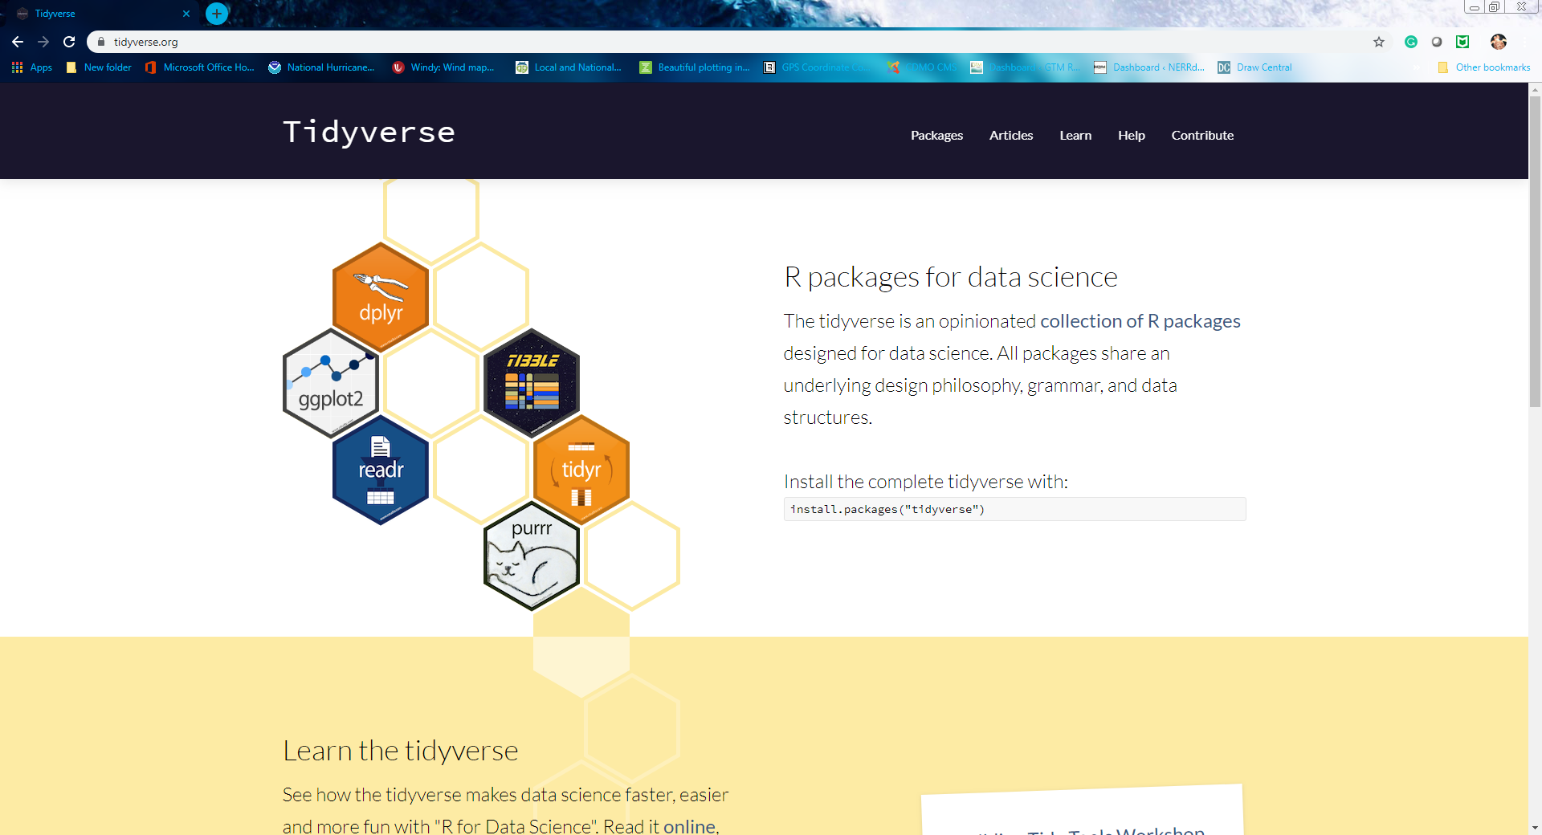
www.tidyverse.org
Notes:
We will be heavily focusing on tidyverse packages because … they’re packages that are designed to work well together and use readable code that we can understand

