Slide 1
Visualize Data
Notes:
Why start with data visuals?
First step in data exploration and it has a very clear payoff – “I wanted to make a plot, and I did!”

Slide 2
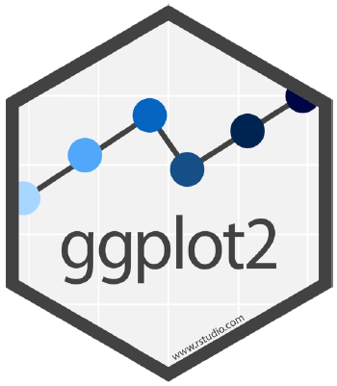

ggplot2
One of the earliest packages in the tidyverse
Implements the “grammar of graphics”

Slide 3
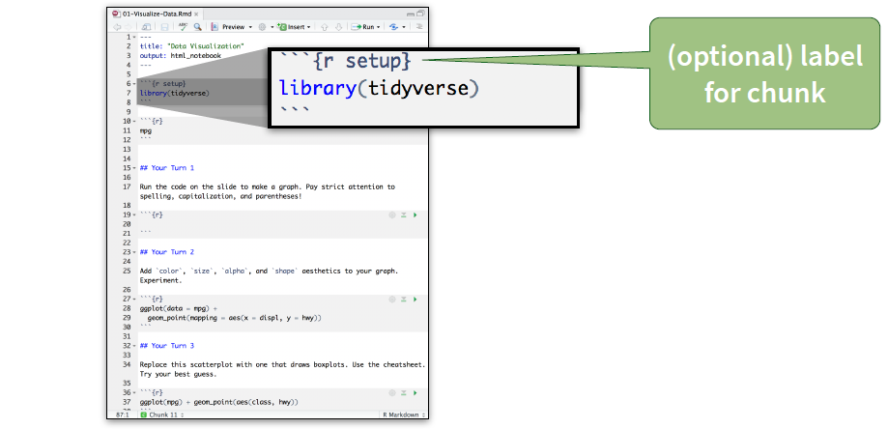
Setup The setup chunk is always run once before anything else
CC by RStudio

Slide 4

About the data
Monthly averages of water quality data (e.g., temperature, salinity, dissolved oxygen, etc.) from 6 National Estuarine Research Reserves

Slide 5
BLAH BLAH Text about the

Slide 6
QUIZ
What relationship do you expect to see between temperature (temp) and dissolved oxygen (do_mgl)?

Slide 7
YOUR TURN 1
Run this code in your notebook to make a graph.
Pay careful attention to spelling, capitalization, and parentheses!
ggplot(data = wq) +
geom_point(mapping = aes(x = temp, y = do_mgl))

Slide 8
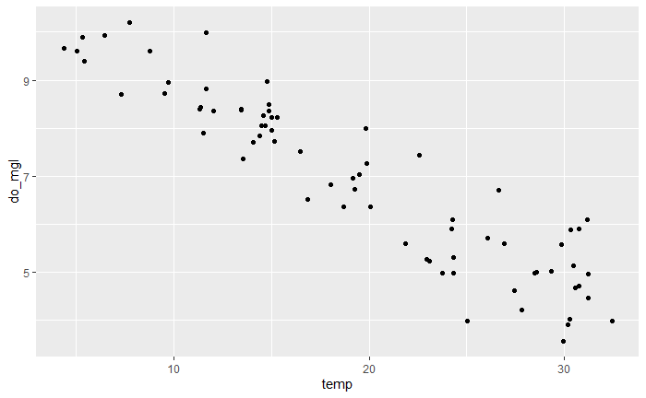
ggplot(data = wq) +
geom_point(mapping = aes(x = temp, y = do_mgl))

Slide 9
ggplot(data = wq) +
geom_point(mapping = aes(x = temp, y = do_mgl))

