Slide 1
Visualize Data
Notes:
Why start with data visuals?
First step in data exploration and it has a very clear payoff – “I wanted to make a plot, and I did!”

Slide 2
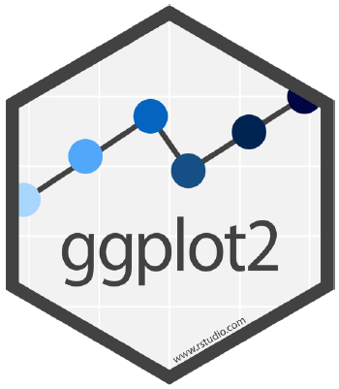

ggplot2
One of the earliest packages in the tidyverse
Implements the “grammar of graphics”

Slide 3
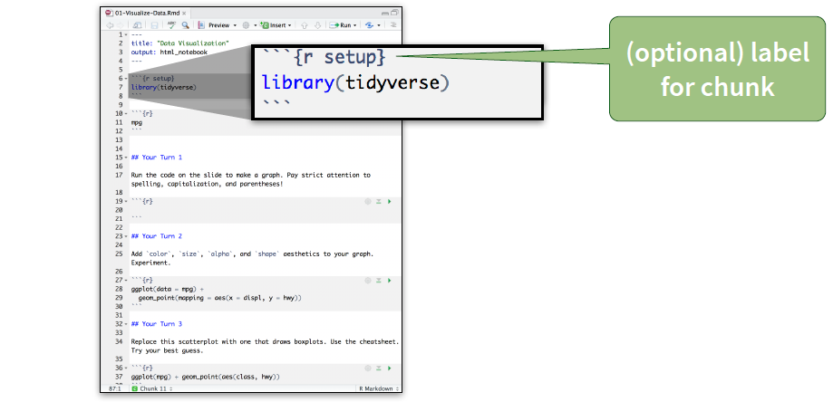
Setup The setup chunk is always run once before anything else
CC by RStudio

Slide 4

About the data
Monthly averages of water quality data (e.g., temperature, salinity, dissolved oxygen, etc.) from 6 National Estuarine Research Reserves

Slide 5
Be sure to check out the data
You can use:
`head()`, `tail()`, `str()`,
or
‘dplyr::glimpse()`

Slide 6

QUIZ
What relationship do you expect to see between temperature (temp) and dissolved oxygen (do_mgl)?
00:30

Slide 7
YOUR TURN 1
Run this code in your notebook to make a graph.
Pay careful attention to spelling, capitalization, and parentheses!
ggplot(data = wq) +
geom_point(mapping = aes(x = temp, y = do_mgl))
I’m working on it
I’m stuck! Help!
I’m done!
02:00

Slide 8
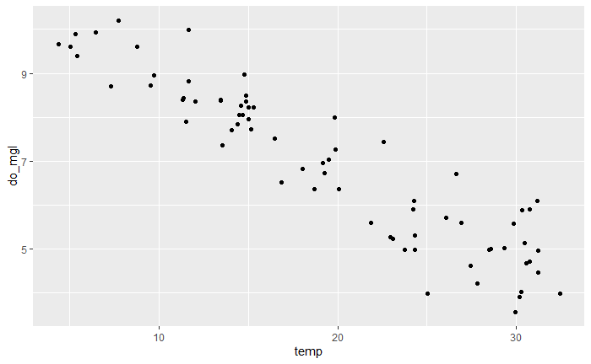
ggplot(data = wq) +
geom_point(mapping = aes(x = temp, y = do_mgl))

Slide 9
Be sure to always put the ‘+’ at the end of a line, never at the start.
ggplot(data = wq) +
geom_point(mapping = aes(x = temp, y = do_mgl))
Initialize the figure with ggplot()
Add layers with geom_ functions
Notes:
Initialize the figure with ggplot(), this creates a coordinate system that you can add layers to. The first argument of this function is the dataset to use in the graph, so ggplot(data = <DATA>) creates an empty graph.
Each geom function takes a mapping argument. This is how variables are defined and mapped to visual properties. Mapping argument is always paired with aes() and the x and y arguments of aes() specify which variables to map to the x and y axes by looking into the `data` argument.

Slide 10
A template
ggplot(data = <DATA>) +
<GEOM FUNCTION>(mapping = aes(<MAPPINGS>))
geom_point(mapping = aes(x = temp, y = do_mgl))

Slide 11
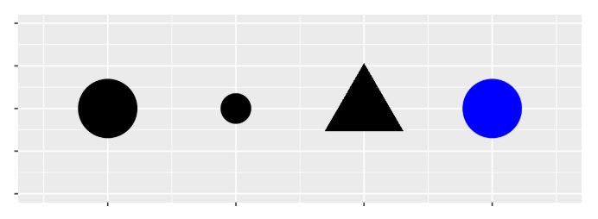
So, what are mappings?
Aesthetics are the visual properties of the objects in your plot.
Mappings describe how aesthetics should relate to variables in the data.

Slide 12
Mappings describe how aesthetics should relate to variables in the data.
Visual Space
Data Space
color
Red
Gold
Green
Blue
Purple
state
Alaska
California
Florida
Mississippi
South Carolina

Slide 13
Aesthetic property
Variable to map to
ggplot(data = wq) +
geom_point(mapping = aes(x = temp, y = do_mgl, color = state))
ggplot(data = wq) +
geom_point(mapping = aes(x = temp, y = do_mgl, size = state))
ggplot(data = wq) +
geom_point(mapping = aes(x = temp, y = do_mgl, shape = state))

Slide 14
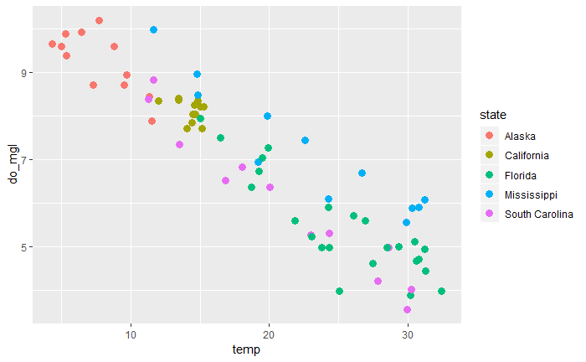
Aesthetic property
Variable to map to
ggplot(data = wq) +
geom_point(mapping = aes(x = temp, y = do_mgl, color = state))
Legends are automatically added

Slide 15
YOUR TURN 2
In the next chunk, add color, size, alpha, and shape aesthetics to your graph. Play around with the data!
What happens when you map aesthetics to discrete and continuous variables?
What happens when you apply more than one aesthetic?
05:00

Slide 16
You can also set the aesthetic properties of your geom manually.
ggplot(wq) +
geom_point(aes(x = temp, y = do_mgl, color = “blue”))
vs
ggplot(wq) +
geom_point(aes(x = temp, y = do_mgl), color = “blue”)

Slide 17
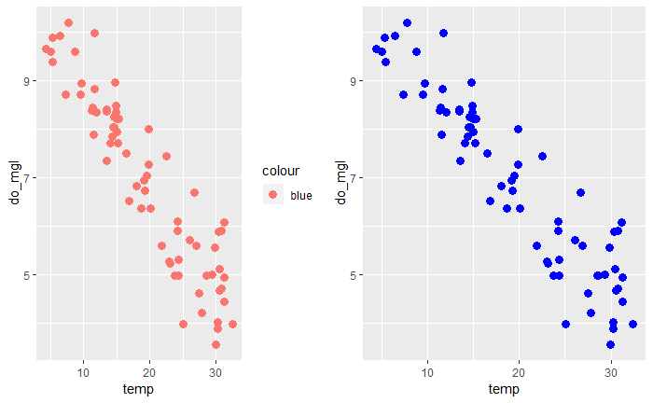
ggplot(wq) +
geom_point(aes(x = temp, y = do_mgl, color = “blue”))
ggplot(wq) +
geom_point(aes(x = temp, y = do_mgl), color = “blue”)
Notes:
To set an aesthetic manually, set the aesthetic by name as an argument of your geom function; i.e. it goes outside of aes(). You’ll need to pick a level that makes sense for that aesthetic.

Slide 18
TL;DR
Inside of aes(): maps an aesthetic to a variable ggplot(wq) +
geom_point(aes(x = temp, y = do_mgl, color = state))
Outside of aes(): sets an aesthetic to a value ggplot(wq) +
geom_point(aes(x = temp, y = do_mgl), color = “blue”)

Slide 19
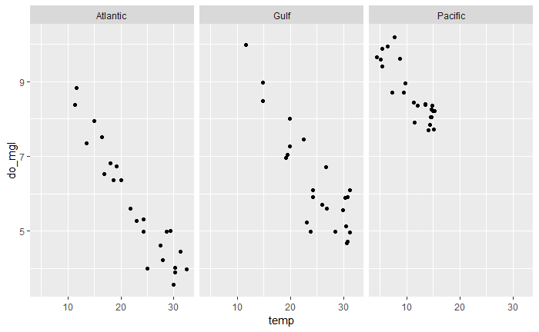
What if I don’t want to add additional variables as aesthetics?
If they are categorical variables, you can use facets!
Subplots that each display one subset of the data

Slide 20
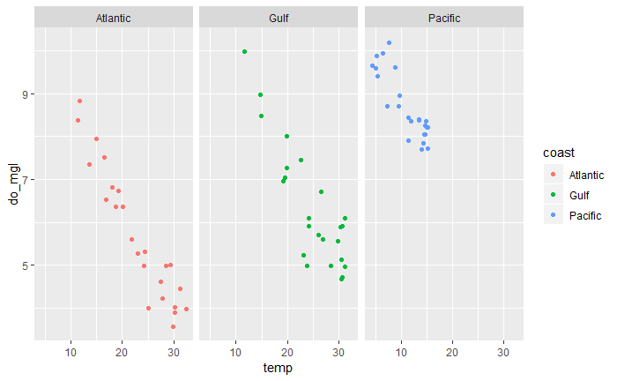
What if I don’t want to add additional variables as aesthetics?
If they are categorical variables, you can use facets!
Subplots that each display one subset of the data

Slide 21
facet_wrap() ← for a single variable
ggplot(data = wq) +
geom_point(mapping = aes(x = temp, y = do_mgl)) +
facet_wrap(~ coast, nrow = 1)

Slide 22
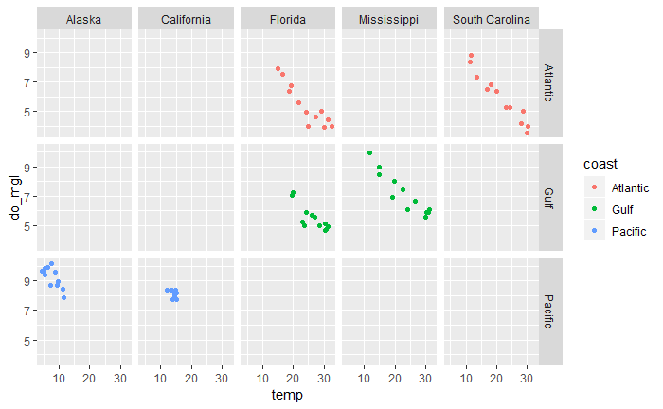
facet_grid() ← for a combo of 2 variables
Sigh…it’s a bad graph, I know!
ggplot(data = wq) +
geom_point(mapping = aes(x = temp, y = do_mgl)) +
facet_grid(coast ~ state)

Slide 23
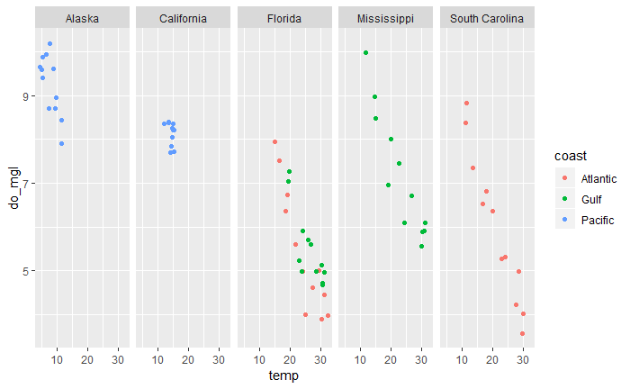
facet_grid() ← for a combo of 2 variables
ggplot(data = wq) +
geom_point(mapping = aes(x = temp, y = do_mgl)) +
facet_grid(. ~ state)
Use this in place if you would prefer not to facet in the rows or columns dimension

Slide 24
YOUR TURN 3
Using the `wq` data, plot temperature (temp) by month as a scatterplot and facet by state and coast.
Play around with facet_grid() and facet_wrap().
What kinds of things do you notice?
05:00

Slide 25
Geoms

Slide 26
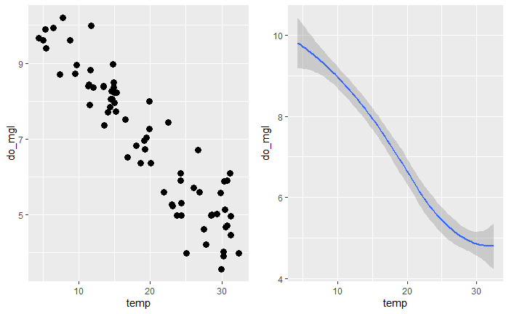
How are these plots similar? Different?
Notes:
They have the same x var, y var, and data. They have different geometric objects (geom); the visual object used to represent the data.

Slide 27
geoms
ggplot(data = <DATA>) +
<GEOM_FUNCTION>(mapping = aes(<MAPPINGS>))
Every geom requires a mapping argument

Slide 28
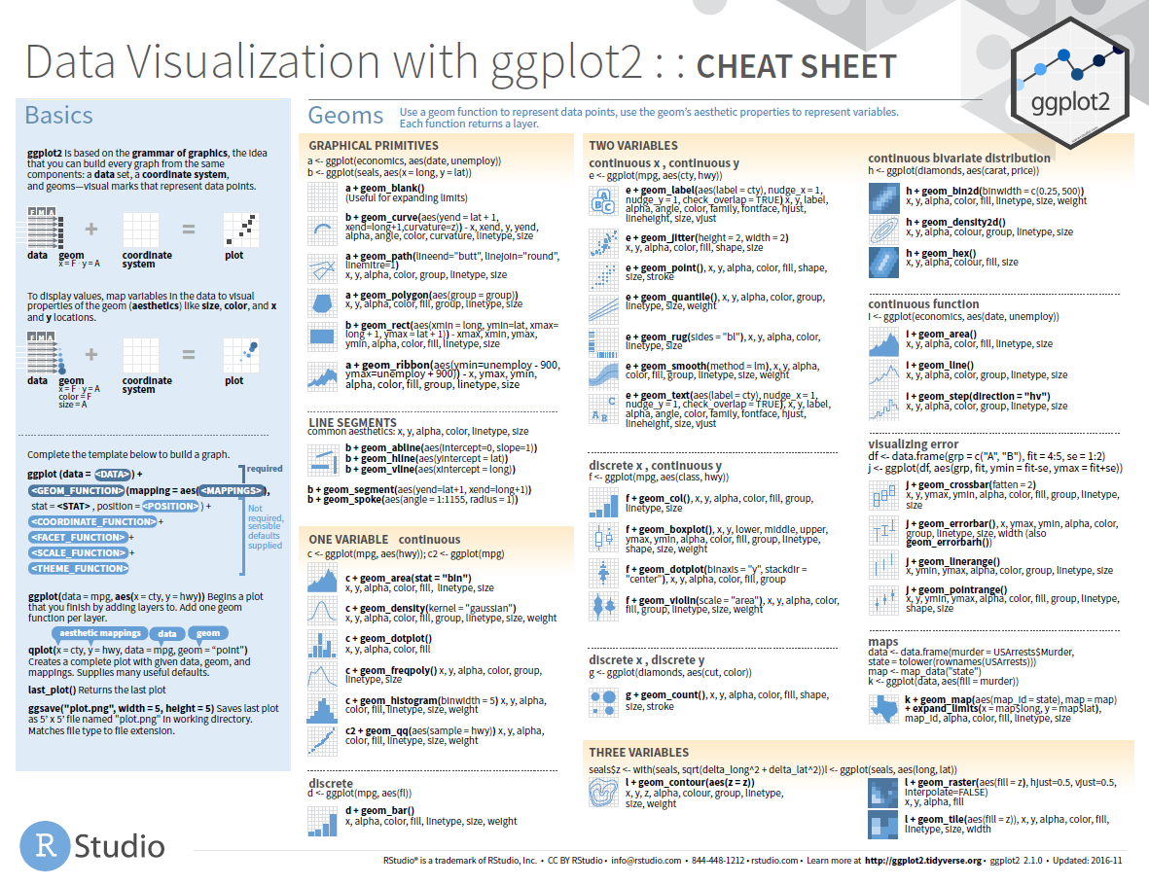
You can also find the supported aesthetics by visiting the ?help for each geom!

Slide 29
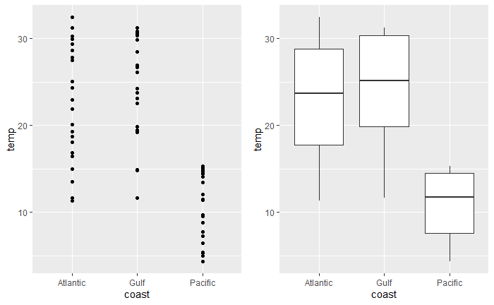
YOUR TURN 4
With a partner, decide how to replace the scatterplot with one that draws boxplots. Use the cheatsheet and try your best guess!
02:00

Slide 30
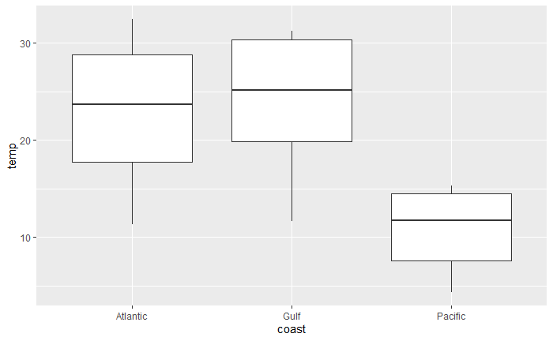
ggplot(data = wq) +
geom_boxplot(mapping = aes(x = coast, y = temp))

Slide 31
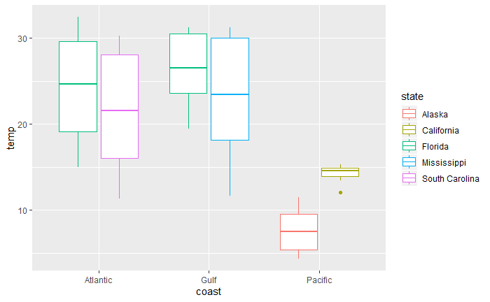
ggplot(data = wq) +
geom_boxplot(aes(x = coast, y = temp, color = state))

Slide 32
YOUR TURN 5
Load the `diamonds` dataset and examine it. This dataset is provided in the `ggplot2` package.
Create a bar chart of cut colored by cut. Use the cheatsheet.
02:00

Slide 33
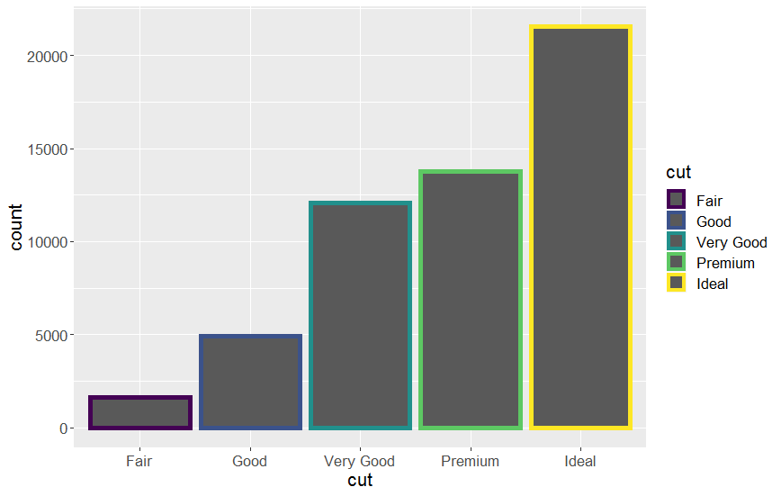
ggplot(data = diamonds) +
geom_bar(mapping = aes(x = cut, color = cut)

Slide 34
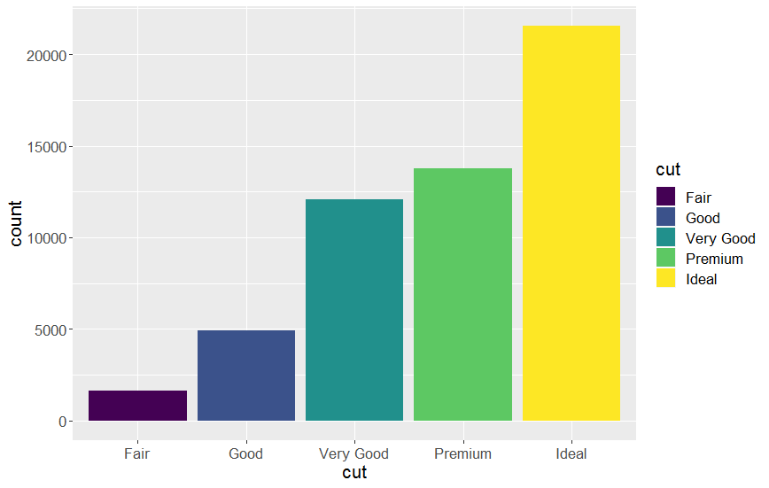
ggplot(data = diamonds) +
geom_bar(mapping = aes(x = cut, fill = cut)

Slide 35





Hold up…count is not a variable in `diamonds`!
Many graphs plot the raw values of your dataset while others calculate new values to plot:
Bar charts, histograms, and frequency polygons bin data and plot bin counts (# of points that fall into each bin)

Slide 36
Hold up…count is not a variable in `diamonds`!
Many graphs plot the raw values of your dataset while others calculate new values to plot:
Smoothers, geom_smooth(), fit a model to your data and plot the predictions from the model

Slide 37
Hold up…count is not a variable in `diamonds`!
Many graphs plot the raw values of your dataset while others calculate new values to plot:
Boxplots compute a summary of the distribution and display it in a formatted box

Slide 38
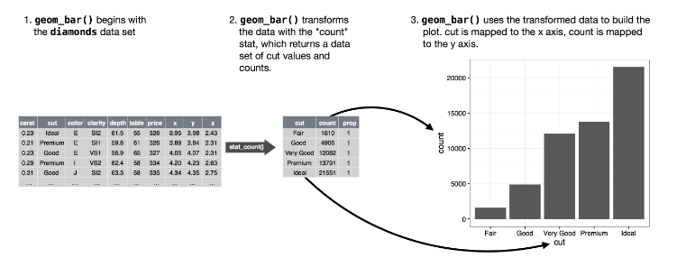
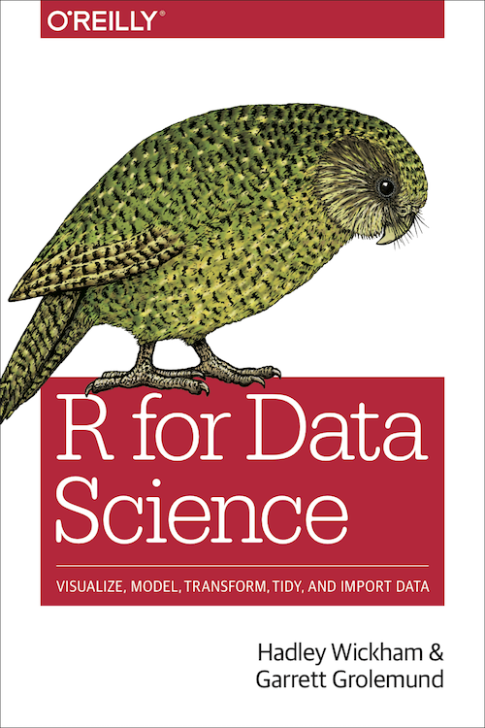
Hold up…count is not a variable in `diamonds`!

Slide 39
stat
Short for “statistical transformation” - the algorithm that is used to create new values for a graph.
One of the five components of each layer!
ggplot(data = <DATA>) +
<GEOM_FUNCTION>(mapping = aes(<MAPPINGS>),
stat = <STAT>,
position = <POSITION>)
Learn what stat a geom uses by inspecting the default value for the stat argument.
Ex: ?geom_bar

Slide 40
YOUR TURN 6
Determine what the default stat is for each of the following geoms:
`geom_line`
`geom_density`
`geom_smooth`
01:00

Slide 41
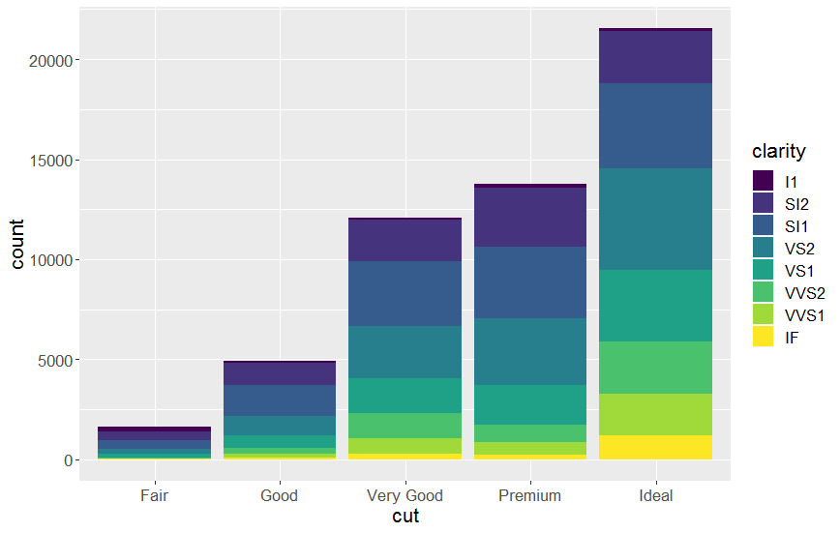
Position: how overlapping objects are arranged
ggplot(data = diamonds) +
geom_bar(mapping = aes (x = cut, fill = clarity))
Stacking is automatic and the default position with geom_bar
Notes:
How overlapping objects are arranged

Slide 42
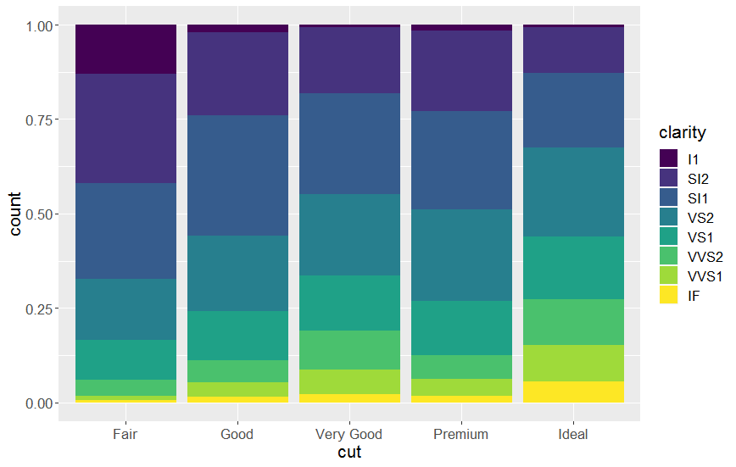
Position: how overlapping objects are arranged
ggplot(data = diamonds) +
geom_bar(mapping = aes (x = cut, fill = clarity),
position = “fill”)

Slide 43
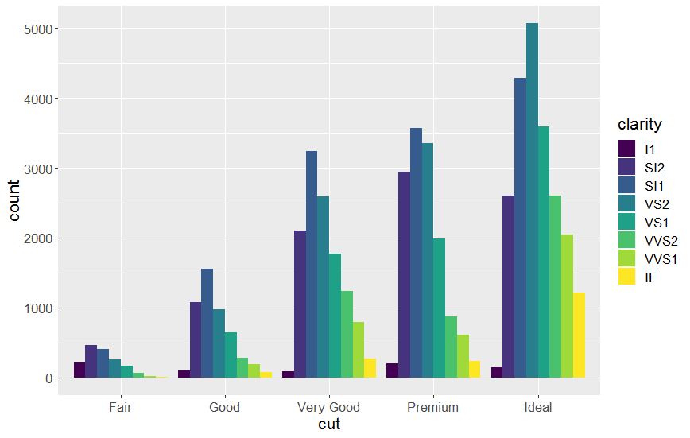
Position: how overlapping objects are arranged
ggplot(data = diamonds) +
geom_bar(mapping = aes (x = cut, fill = clarity),
position = “dodge”)

Slide 44
YOUR TURN 7
Predict what this code will do, then run it.
ggplot(wq) +
geom_point(aes(temp, do_mgl)) +
geom_smooth(aes(temp, do_mgl))
02:00

Slide 45
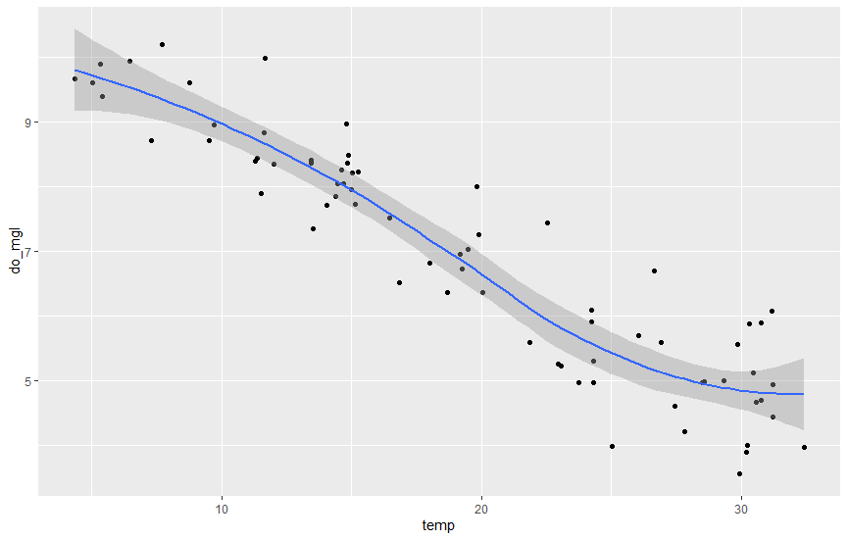
Global vs. Local
ggplot(data = wq, mapping = aes(x = temp, y = do_mgl)) +
geom_point() +
geom_smooth()
Mappings and data that appear in ggplot() will apply globally to each layer

Slide 46
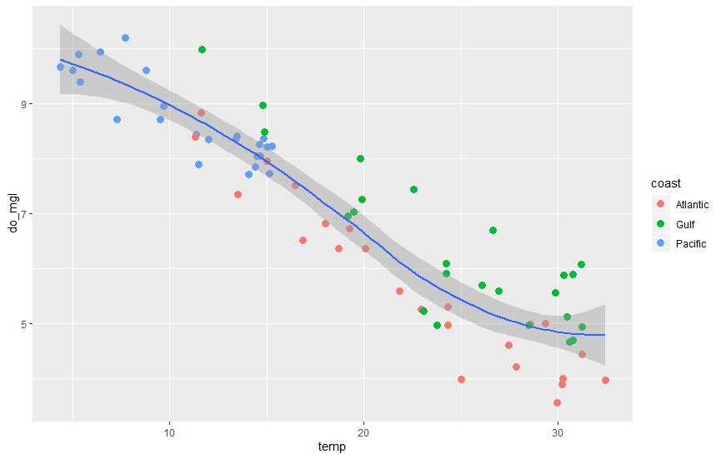
Global vs. Local
ggplot(data = wq, mapping = aes(x = temp, y = do_mgl)) +
geom_point(mapping = aes(color = coast)) +
geom_smooth()
Mappings applied in geom_function will add or override the global mappings for that layer only

Slide 47
Let’s recap. To make a graph…
1. Pick your data set
ggplot(data = <DATA>) +

Slide 48
Let’s recap. To make a graph…
1. Pick your data set
ggplot(data = <DATA>) +
<GEOM FUNCTION>()
2. Choose the best geom to display cases

Slide 49
Let’s recap. To make a graph…
1. Pick your data set
ggplot(data = <DATA>) +
<GEOM FUNCTION>(mapping = aes(<MAPPINGS>))
3. Map aesthetic properties to variables.
2. Choose the best geom to display cases

Slide 50
Let’s recap. To make a graph…
ggplot(data = <DATA>) +
<GEOM FUNCTION>(mapping = aes(<MAPPINGS>),
stat = <STAT>,
position = <POSITION>)
Not required, but defaults are supplied by the specified geom

Slide 51
How about a break?
15 minutes

Slide 52
What else can I do?
Scales, themes, and saving your plot.

Slide 53
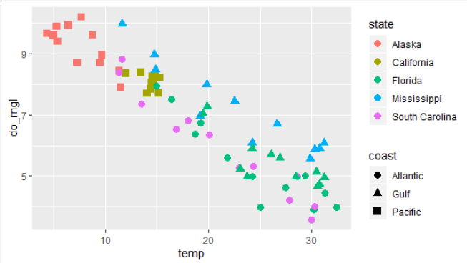
Scales control the way your data is mapped to your geom and are required for every aesthetic.
ggplot2 selects sensible defaults, but you can provide further adjustments.
ggplot(wq, aes(x = temp, y = do_mgl)) +
geom_point(aes(shape = coast, color = state), size = 3)
Notes:
In the following example, you map temp and do_mgl from wq to both the shape and color of the points. This creates two separate, but overlapping, scales: One scale controls shape, while the second scale controls the color of the points:

Slide 54
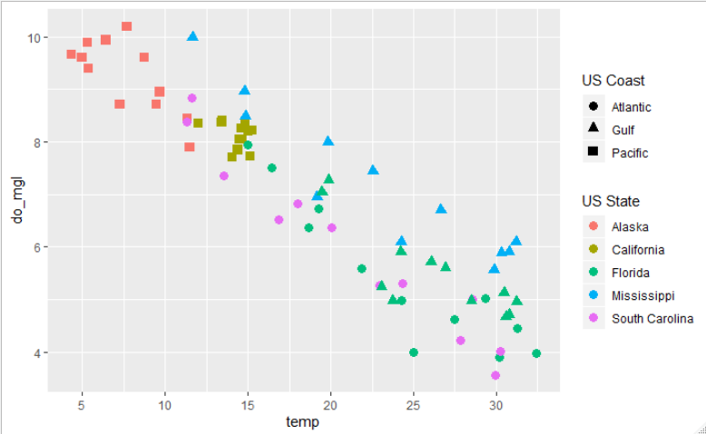
The specific scale function you use is dependent on the type of scale
ggplot(wq, aes(x = temp, y = do_mgl)) +
geom_point(aes(shape = coast, color = state), size = 3) +
scale_shape_discrete(name = "US Coast") +
scale_color_discrete(name = "US State") +
scale_y_continuous(breaks = c(2, 4, 6, 8, 10)) +
scale_x_continuous(breaks = c(5, 10, 15, 20, 25, 30, 35))

Slide 55
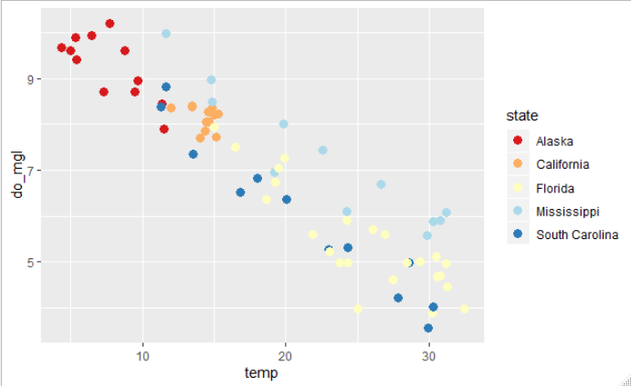
scale_color_brewer()
Visit colorbrewer2.org for more information!
ggplot(wq, aes(x = temp, y = do_mgl)) +
geom_point(aes(color = state), size = 3) +
scale_color_brewer(type = “div", palette = “RdYlBu")

Slide 56
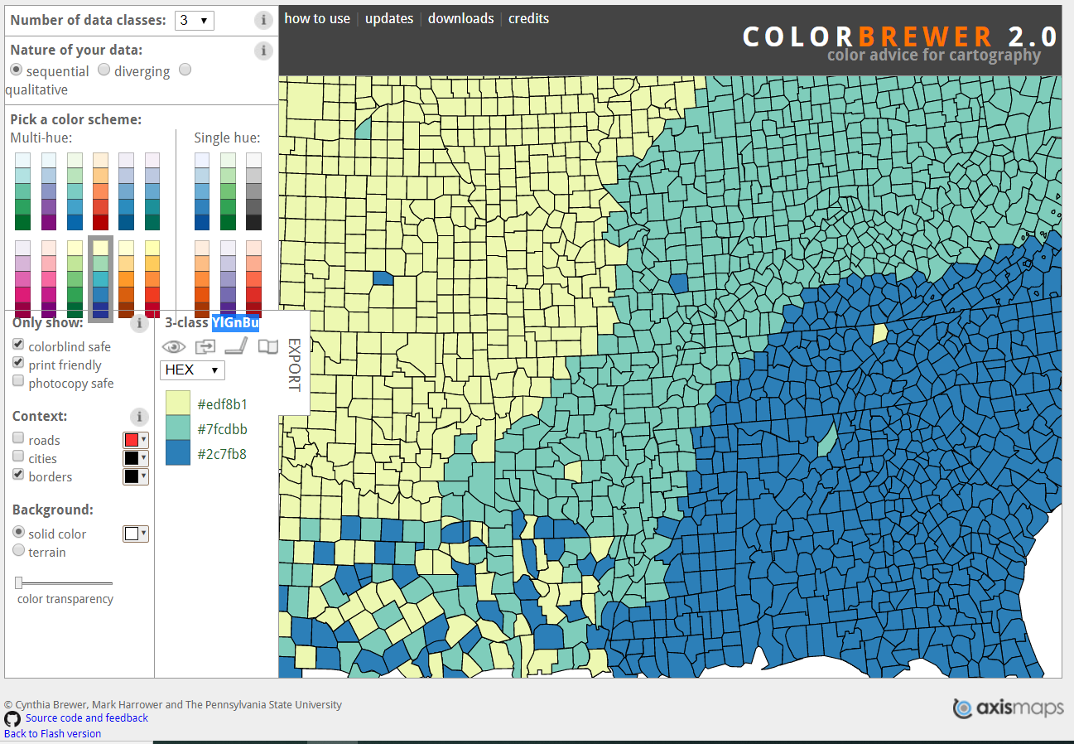
www.colorbrewer2.org

Slide 57
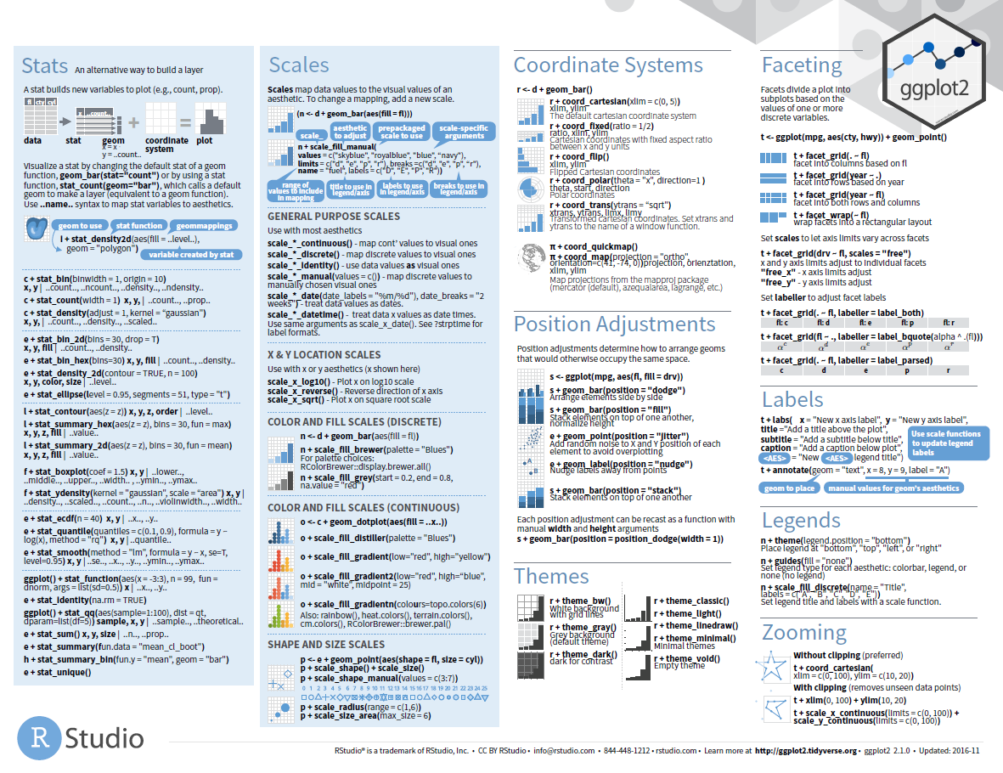

Slide 58
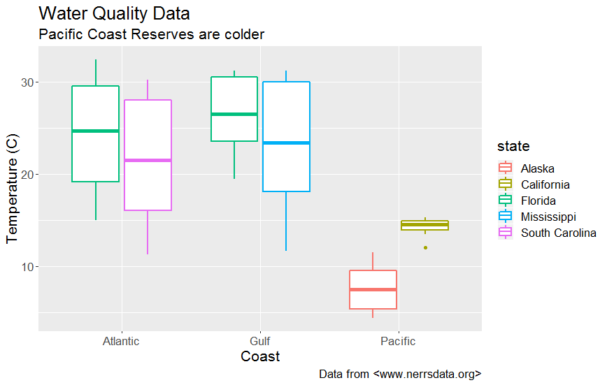
Titles and Captions

Slide 59
Titles and Captions
ggplot(data = wq) +
geom_boxplot(mapping = aes(x = coast, y = temp, color = state)) +
labs(x = "Coast",
y = "Temperature (C)",
title = "Water Quality Data",
subtitle = "Pacific Coast Reserves are colder",
caption = "Data from <www.nerrsdata.org>")

Slide 61
Themes: the non-data elements of your plot.
Do not affect how the data is:
rendered by geoms, or
transformed by scales.
Help you make the plot aesthetically pleasing or match an existing style guide (fonts, ticks, panel strips, backgrounds, etc).

Slide 62
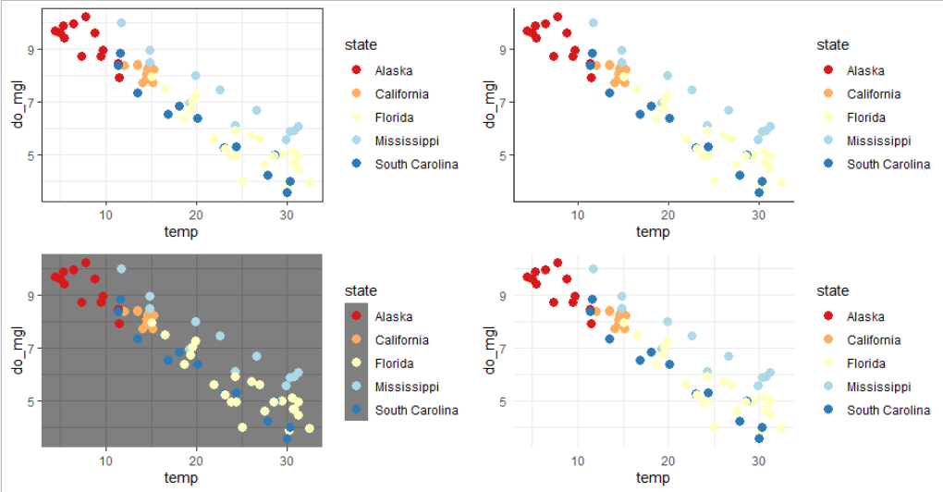

Slide 63
The ggthemes package by Jeffrey Arnold provides even more complete themes!

Slide 64
Structure of the theme system
Three components:
theme() function
Theme elements (e.g., plot.title element which controls the appearance of the plot title)
Element function (of which there are four)
element_text()
element_line()
element_rectangle()
element_blank()

Slide 65
Structure of the theme system
p + theme(plot.title = element_text(size = 18),
axis.y.title = element_text(size = 12),
axis.x.title = element_text(size = 12),
axis.text = element_text(vjust = 0.9),
panel.background = element_rect(fill = “white”))
Explore all the different elements by going to the help page ?theme

Slide 66
ggThemeAssist

Slide 67
Saving your plot

Slide 68
YOUR TURN 8
What does this command return?
getwd()
00:30

Slide 69
The Working Directory
R associates itself with a folder (i.e., directory) on your computer.
This is the “working directory”
R will look for files here
R will save files here
The files pane of RStudio IDE will display your working directory

Slide 70
Saving plots
ggsave() will save the last plot.
ggsave(“my-first-plot.png”)
ggsave(“my-first-plot.tiff”)
You can further specify size:
ggsave(“my-first-plot.png”, height = 6, width = 8,
units = “cm”)
Or even resolution:
ggsave(“my-first-plot.png”, dpi = 300)

Slide 71
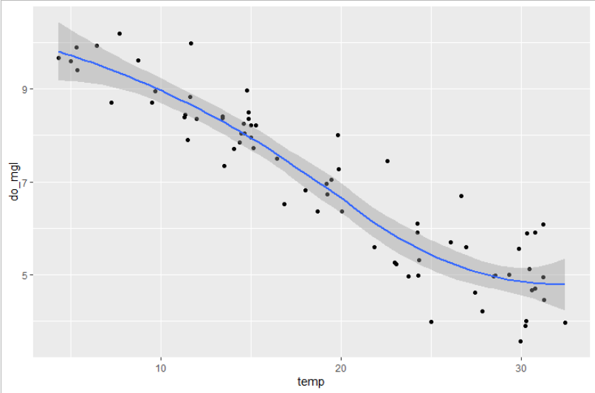
YOUR TURN 9
Save your last plot and then locate it in your files pane.
(You may have to refresh your files list).
01:00

Slide 72
ggplot2 template

Slide 73
CHALLENGE
Using the diamonds data make a scatterplot of carat by price and assign color by clarity.
Customize the themes and colors of the plot to make it the *ugliest* plot that you can.
Save this plot in your files pane.
05:00

