Slide 1
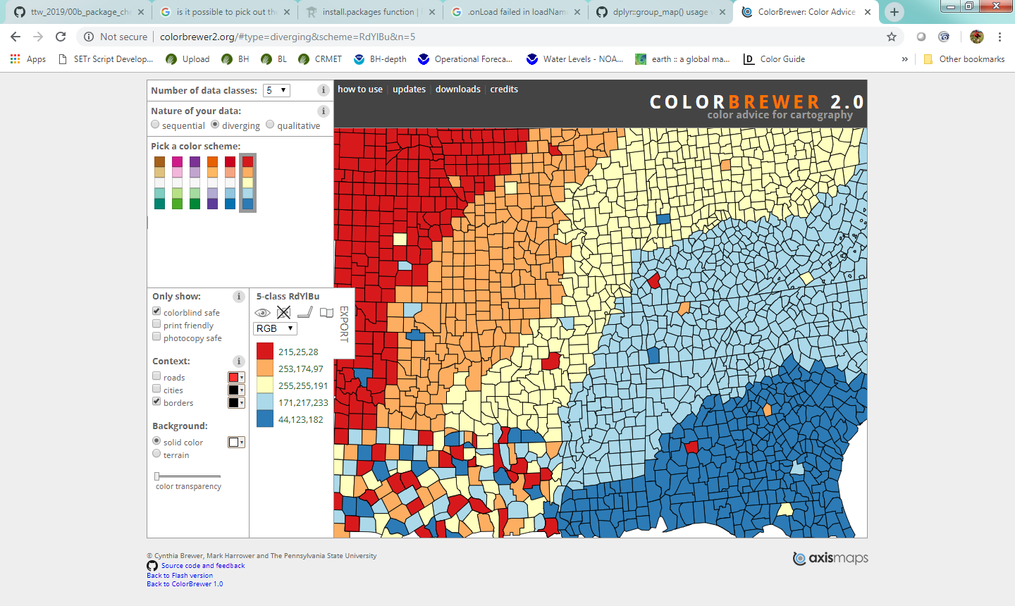

Red: RBG 192, 0, 0. Hex #C00000
Blue: RBG 47, 85, 151. Hex #2F5597
Gray: RGB 127, 127, 127. Hex #7F7F7F
yellow used in pie charts for “not enough information”: #fffacd
according to rgbtohex.net this is:
R 255, G 250, B 205

