Slide 1


PAINT APP
C++ Final Semester Project
Swodesh Sharma (076bel048)
Roshan Niraula(076bel035)
Akriti Acharya(076bel005)
Subekshya Dani(076bel045)

Slide 2
Objectives
The main objectives regarding our project are as follows:
To implement the concept of Object Oriented Programming in the application development.
To implement graphics on creating programs on C++ and developing larger programs.
To make a base for the development of the larger and complex programs working in a team in the future.

Slide 3
Introduction
It is a drawing application where we can create different artworks simply playing around with the tools like rectangle, triangle, square, etc.
With a few swooshes, drags and clicks, we can create weird arrangements of overlapping shapes filled with color.
We can erase sections, paint and draw freehand lines.
We can also change different background colours.

Slide 4
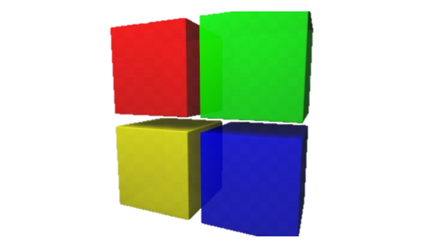

Development Environment
So this paint app is built using…..
Compiler: GCC compiler
IDE: CodeBlock
GUI library: OpenGL
OpenGL (Open Graphics Library[3]) is a cross-language, cross-platform application programming interface (API) for rendering 2D and 3D vector graphics. The API is typically used to interact with a graphics processing unit (GPU), to achieve hardware-accelerated rendering.
GLUT

Slide 5
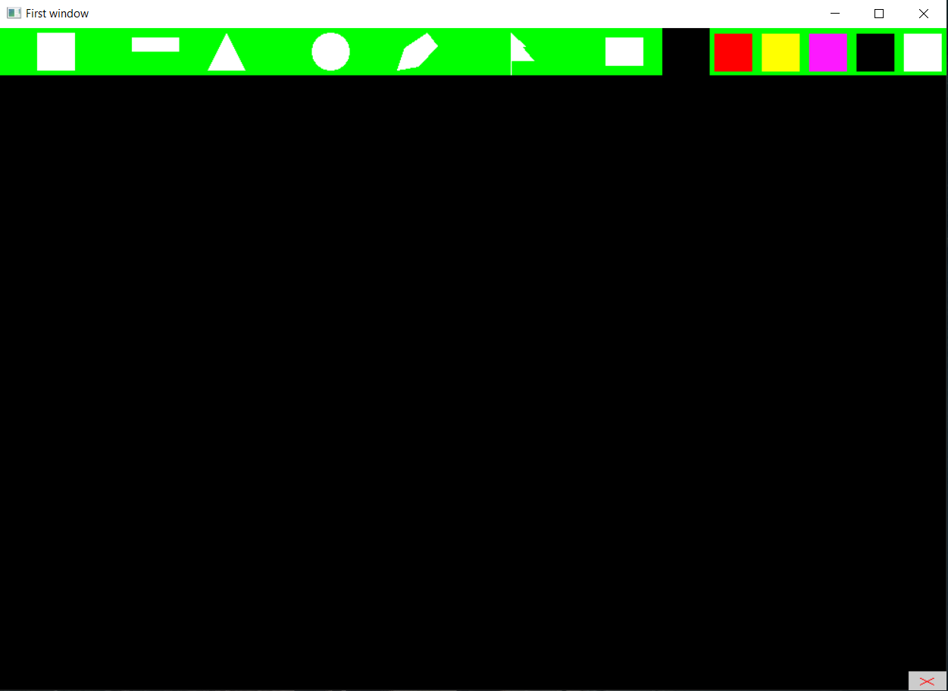
Paint App Demo
Menu
Background
Color
Work Space
Exit

Slide 6

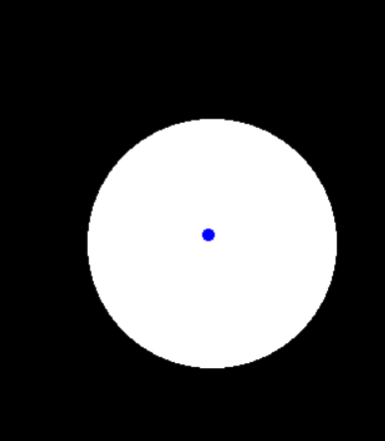

Instructions
Left click any objects to select them and
Use right click to add them in the screen
Select the background color using this
Now if you want to change the property of this object which you just added to the workspace you can do it by selecting the object and looking the instructions that pops up in the screen
If the blue cursor pops up then it means you can select it and change its values

Slide 7
Block Diagram
main
glutDisplayFunc(display);
glutReshapeFunc(reshape);
glutTimerFunc(0,timer,0);
Every 1/60 sec
glutDisplayFunc(display);
Components addition, deletion, components data change every paint function takes place inside this section
Paint App
Exit

Slide 8
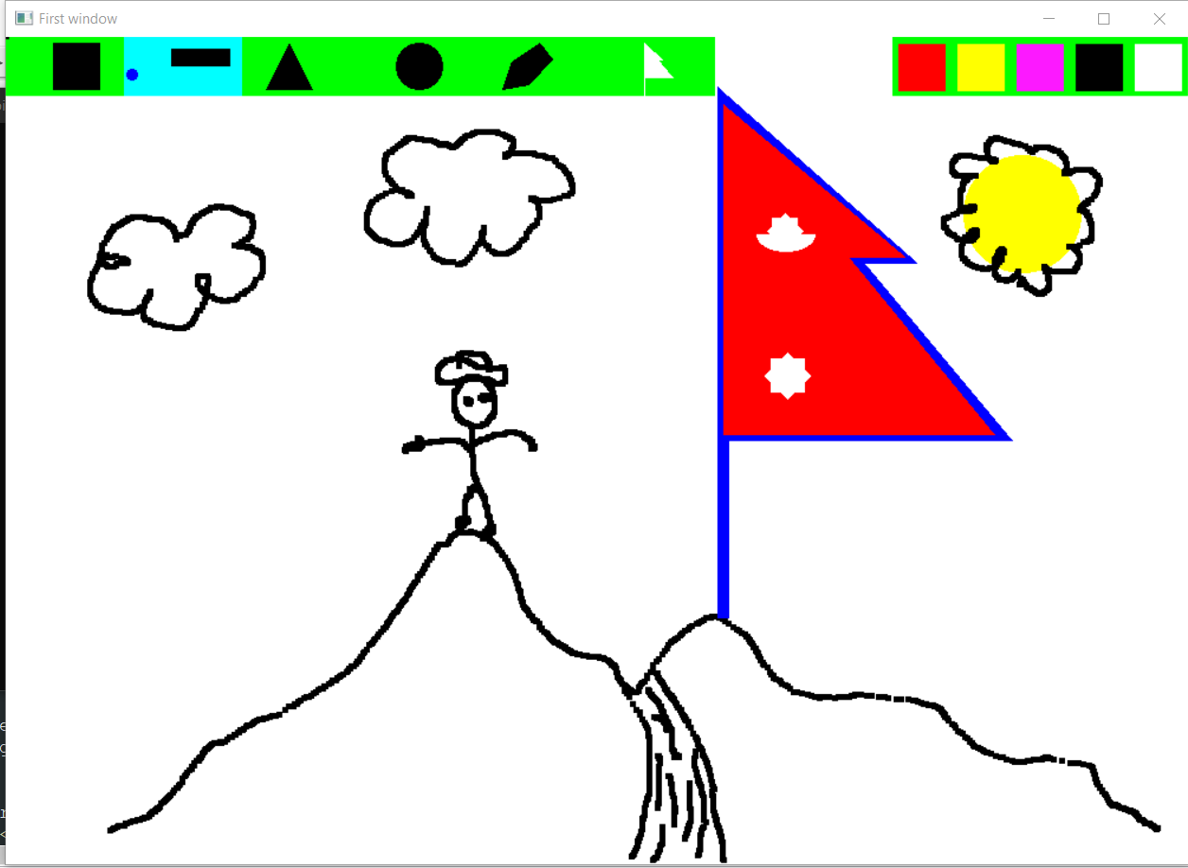
Some snapshots

Slide 9
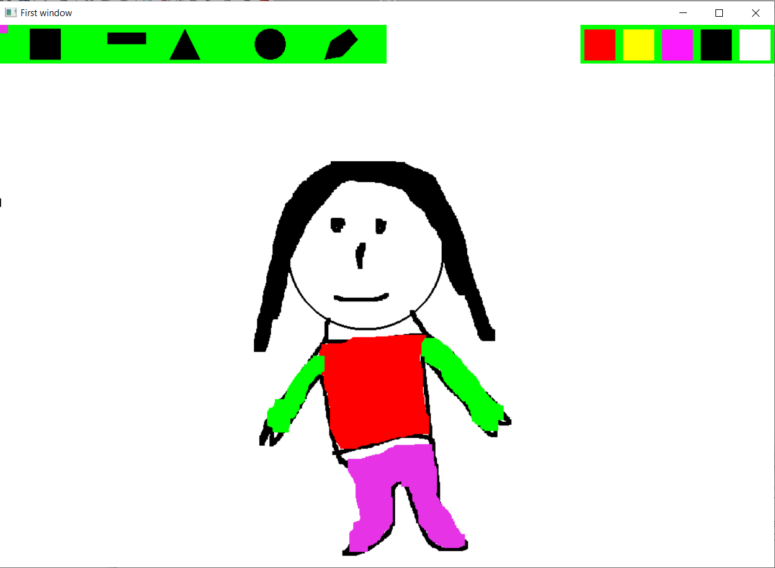

Slide 10
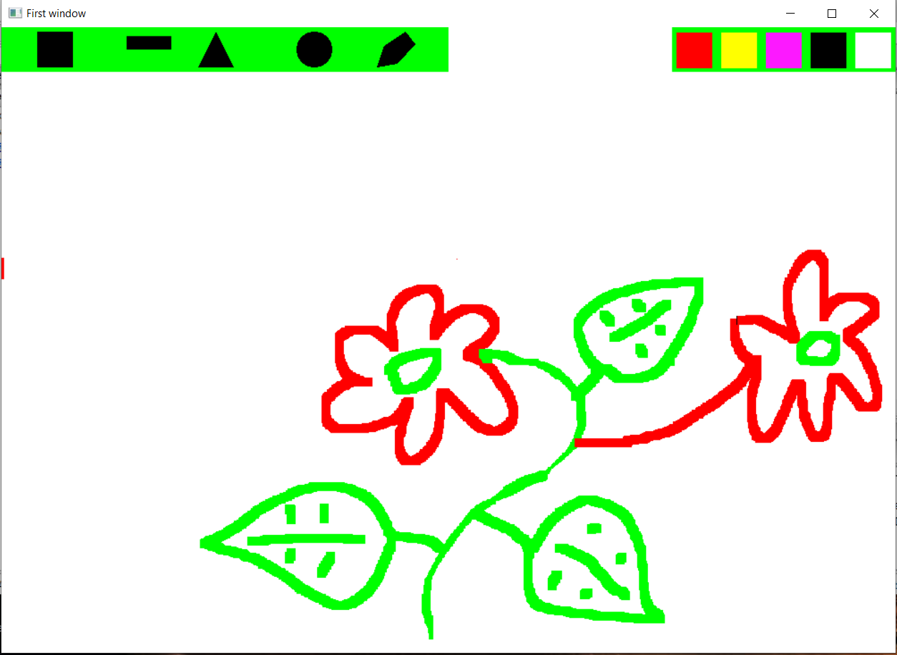

Slide 11
STORED DATA
Added every 1/60th second
SCREEN
Clears and updates every 1/60th second

Slide 12
DEMO

Slide 13
Problems occurred during coding
Due to the compiler version difference there were minor problems that we faced during working as a team. The code written by one was not working on other.
Later we all used the same version of compiler c++98
It was daunting developing proper logic at first due to lack of proper reference materials.
Our project required use of graphics which was completely new for us. We had to spend most of our time researching through numbers of e-books, websites and video tutorials in order to grasp the whole concept of GLUT.
Including all the features of Object-Oriented Programming into our project was one of our main challenges.
Due to lack of face-to-face interaction, we faced problems communicating.

Slide 14
Limitations and further Enhancement
The graphics are not good as we aimed to be.
Several features of OOP like operator overloading, steam computation couldn’t be enforced.
Crucial features for any art designing application like saving drawing, airbrush tool, adding text etc. aren’t available in our application, which will be available presently.
For convenience of user features like undo, redo, copy and pasting feature shall be added in near future
The visual of our application can be made more appealing.

Slide 15
Conclusion
Implementation of the academic knowledge of the OOP approach
Working with graphics
Expansion of concept and skills on Project Management
Development of the program that can be realized practically
Understanding of professionalism and advantage of working together as a team

