Slide 1
Welcome to Michigan Give Camp in Ann Arbor
July 17-19, 2009
Notes:
Mike

Slide 2
What is a Give Camp?
“A technical tsunami of goodwill”
    - Pam Smith of the Child Care Network, one of the charities from Ann Arbor Give Camp 2008
“The single best community event I have ever attended. Sorry, Days of .NET. Sorry, VS Live, SD, Tech Ed, MVP Summit. Great events, all, but not the same. There's just something different about all working together under a deadline.”
- From Martin Shoemaker’s blog
Not a competition!
Notes:
Mike

Slide 3
Planning Committee
Todd Bohlen
Greg Campeau
Michael Eaton
David Giard
Josh Holmes
Jennifer Marsman
Patrick Steele
Notes:
Mike

Slide 4
JEFF MCWHERTER
And special thanks to…
Notes:
Mike

Slide 5
Team Leads
Nathan Blevins
John Burns
Adam Colton
Matt Davis
Michael Eaton
Jason Follas
Brian Genisio
David Giard
Michael Hacker
John Hopkins
Bob Karaban
Jeff McWherter
Carey Payette
Chris Roland
Len Smith
Kevin Swiber
Jay Wren
Jamie Wright
Notes:
Mike

Slide 6
Remote Sites
Columbus – Carey Payette
Knoxville – Nathan Blevins
Some of you will be working with them! ☺
  Cons: you don’t get to work next to them
  Pros: you can work from home if you choose
Notes:
Mike

Slide 7













Thank You, Sponsors!!!
Notes:
Mike: speak to “Todd is awesome” and introduce Todd
Todd

Slide 8
Thanks to our generous sponsors
Domino’s Pizza
Microsoft
VERIO
NEW (Nonprofit Enterprise at Work)
SRT Solutions
TechSmith
PR Newswire
Dunkin Donuts
Notes:
Todd

Slide 9
Thanks to our generous sponsors
Devexpress
Telerik
O’Reilly
Wrox
H & H Consulting
Zen
Red Gate
Bottle Docker
Notes:
Todd

Slide 10
A special thanks to Washtenaw Community College for providing the facilities for this weekend’s event
Roger Palay, VP of WCC
Neil Gudsen and the Business and Computer Technologies Division
Notes:
Mike – recognize Patrick.
If guy from WCC is here, let him talk briefly.

Slide 11
LINH SONG, NEW
Notes:
Mike – introduce Linh

Slide 12
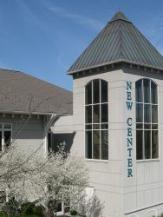

Introducing NEW
Nonprofit Enterprise at Work (NEW)
15 year old nonprofit focused on delivering nonprofit support services
Offices in Detroit and Ann Arbor
Serve 500+ nonprofits annually
Focused on Southeast Michigan
Text

Slide 13




Programs
Governance
Training
Matching
Assessments
Webinars
NP Directory
Funding Search
Best Practices
Office Space
Conference Space
IT Solutions
Support
Social Media

Slide 14
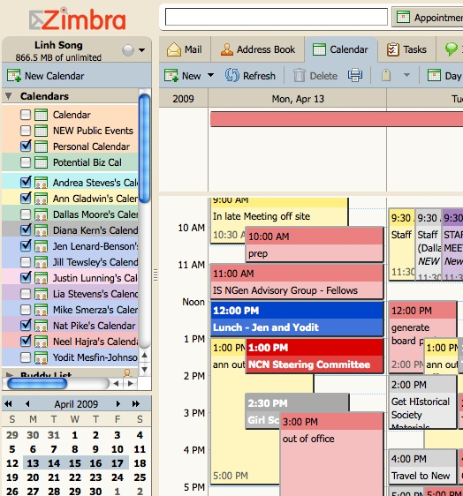

npServ
Nonprofit IT support
  1/4 traditional IT costs
  “Green,” can use older machines
  Automatic backups to data center
Financial fileserver
Remote access
Web-based email
Social media
  www.new.org/connect
  twitter @new_org

Slide 15



Become a fan of NEW to get information about special events, workshops & webinars, exchange ideas with other people in the nonprofit sector, and see photos and videos.
http://www.facebook.com/group.php?gid=60978461809&ref=ts
Follow NEW’s Twitter updates for the down-low on events, news, special announcements and breaking news items.
www.twitter.com/new_org
NEW’s blog includes thoughts from NEW CEO, Neel Hajra, interviews with nonprofit board members, volunteers, community partners and other NEW experts.
http://new.org/blog/

Slide 16
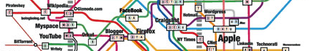
Free IT Assessments to A2 Give Camp Participants in SEMichigan!
Contact Linh at lsong@new.org for details.
6
http://informationarchitects.jp/webtrends2007

Slide 17
Verio’s offer of free hosting
Free hosting until Jan 2010
After then, it is $12.95/month
Details at http://www.verio.com/windows-expression
Accounts are based on IIS6, but include ASP.NET 3.5 and SQL Express. Complete list of the supported features, under the heading "EHS":
https://vwsver.sslcert24.com/features/
Please sign up for Matt’s time in BE-158.
Notes:
Jen

Slide 18
Microsoft NGO portal
http://www.microsoft.com/NGO
Released July 9, 2008
Services available:
  NGO Stories
  Discussion Forums
  Free/discounted software
  Low-cost hardware
  Software support
  Training and certification
Notes:
Jen
http://www.microsoft.com/presspass/press/2008/jul08/07-09NGOConnections701PR.mspx

Slide 19
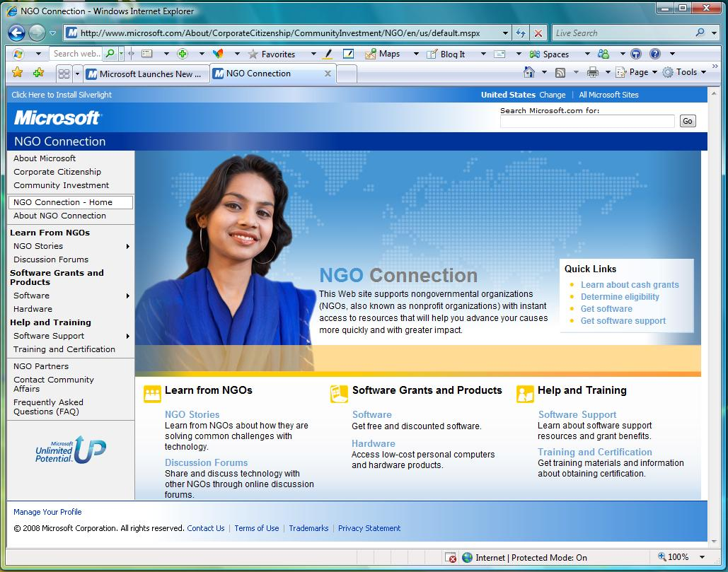
Notes:
Jen

Slide 20
Schedule of Events
Friday
  5:00 P.M. Registration Opens
  6:10 P.M. Opening Ceremonies (LA-275)
  7:00 P.M. Domino’s Pizza Dinner
  (Community Park)
  7:30 P.M. Team Orientation (Community Park/BE Building)
Notes:
Mike

Slide 21
Schedule of Events
Saturday
  7:00 A.M. Breakfast (BE-158) – Continental
  plus McDonalds on demand @8am
  12:00 P.M. Lunch (BE-158/Park) – Tio’s
  1:00 P.M. Group Photo
  6:00 P.M. WCC BBQ Dinner at Garrett’s
  (Student Center Building)
Notes:
Mike

Slide 22
Schedule of Events
Sunday
  7:00 A.M. Breakfast (BE-158) – Continental
  and Dunkin Donuts, plus
  McDonalds on demand @8am
  12:00 P.M. Lunch (BE-158/Park) – Domino’s
  Oven-Baked Sandwiches
  3:00 P.M. Code Handoff (BE Building)
  4:00 P.M. Closing Ceremonies and Project Presentations (LA-275)
  5:00 P.M. Tear Down and Clean Up
Notes:
Mike

Slide 23
Friday Dinner
Following the opening ceremony we will move to Community Park. Here we will break into development teams, introduce ourselves, begin discussing the project with the charity representative. Pizza, salad, and drinks will be served during this time. You are welcome to eat outside or go to your classrooms and whiteboard while eating.
Notes:
Mike

Slide 24
Meal Sign-ups
Domino’s will be providing Oven Baked Sandwiches for Sunday lunch. There are five varieties to choose from. There’s a sign-up sheet in BE-158. Please stop by before noon Saturday to indicate your preference.
A continental breakfast will be available each morning in BE-158 beginning at 7:00. We’ll be making a McDonald’s run each morning at 8:00 (?). Stop by to place your order before 8am.
Notes:
Mike

Slide 25
Developer Lounge or “Break Room”
Coffee, soft drinks, water and snacks are available 24 hours a day in BE-158.
Need a diversion? An XBOX 360 console is setup in BE-158.
Notes:
Mike

Slide 26
Give Camp Staff
Someone from the Give Camp staff is available 24 hours in room BE-158.
Please come to BE-158 if you have a question, want food, or are stuck in your coding project.
Notes:
Mike

Slide 27
Overnight Camping
Tent Camping is permitted in Community Park (just south of the Business Education Building). Please note that tent stakes are NOT permitted in any grass or landscaped areas.
Indoor sleeping is permitted within the Business Education Building classrooms.
Notes:
Mike – introduce Patrick
Patrick

Slide 28
After Hours Access
The north entrance of the Business Education Building is open from 7:30 A.M. to 7:00 P.M. daily. After hours access is available through the exterior door of BE-158.
Please be sure to wear your Give Camp ID badge at all times. It is required for after hours entry.
Notes:
Patrick

Slide 29
Keep it clean
Washtenaw Community College has generously donated these facilities for our use. Please help reduce the Sunday clean up effort by keeping trash picked up. If you’d like to volunteer to help with clean up on Sunday, please sign up in BE-158.
Notes:
Patrick

Slide 30
Thank you for your cooperation!
Washtenaw Community College is a smoke free and alcohol free facility. Please do not smoke while on campus.
Alcoholic beverages cannot be consumed in the class rooms, park facilities or parking lots.
Notes:
Patrick

Slide 31
Showers
There are about 8 men’s showers and about 6 women’s showers.
Bring your own towel, soap, etc…
These showers are accessible through the restrooms at the north end of the Morris Lawrence Building, and are not conspicuous. Within each of the restrooms, there is another door that says “Off Limits” (or something of the sort). These doors are the shower room doors. There is actually a locker area that can be used while individuals are showering.
Notes:
Patrick

Slide 32
Shower Schedule
Showers will be available at the Morris Lawrence Building on the following schedule:
Friday night 9-10PM
Saturday morning 9-11AM
Saturday night 9-10PM
Sunday morning 9-11AM
Notes:
Patrick

Slide 33
Feeling Lucky?
At the conclusion of Give Camp on Sunday, we'll draw random winners from the volunteers to win software and books, donated by DevExpress, JetBrains, Microsoft, O’Reilly, TechSmith, and Telerik!
Notes:
Mike

Slide 34
Room Logistics
BE 158 – “Break Room” with refreshments, XBOX 360, staff
BE 180 – Sleeping room
We will be working in the BE building; you can use most classrooms (8 total). Wander around the first and second floors, and find a comfortable home. Looking for teams working on similar projects (php groups together, etc.) to work in the same room might be helpful.
Notes:
Mike

Slide 35
Stand-ups
Group comes together for status and to unblock
Based on scrum, in which each team member answers 3 questions:
  What have you done since the last one?
  What are you doing before the next one?
  What’s blocking you?
Good for finding others with knowledge you need, but DON’T WAIT UNTIL A STAND-UP if you are blocked. Come to the break room (BE-158).
Notes:
Mike
Will start on Saturday

Slide 36
Info to share, learn, or discuss?
Open space unconference board in the Break Room
If there is something that you would like to teach, learn, or discuss, propose a topic on the board at a certain time.
Anyone interested in that topic can attend.
Possible topics:
  Len Smith on Search Engine Optimization
  Mike Woelmer and Jay Wren on bzr (if devs want source control)
  Betsy Weber on social media (Facebook and Twitter)
Notes:
Mike

Slide 37
Speaking of social media…
If you are on Twitter (http://twitter.com):
  Follow @MichGiveCamp and @GiveCamp
  The official hash tag of the Michigan Give Camp in Ann Arbor is #aagivecamp.
IRC Channel: ##aagivecamp on freenode.net
Notes:
Mike

Slide 38
Team Meeting
If your charity rep leaves, make sure that you understand the project before they go. If you want feedback throughout weekend, get a charity rep phone number.
Deployment strategy (USB drive per team provided by Red Gate)
Charity reps must be back by 3pm on Sunday – choose a meetup place!
Notes:
Jen
USB drive will be brought to you

Slide 39
2009 Give Camp Charities
All About Animals Rescue
Closer to Home Animal Advocates
Community & Home Supports
Eisenhower Dance Ensemble
Great Sauk Trail Council, Boy Scouts of America
Interfaith Hospitality Network at Alpha House
Notes:
Jen

Slide 40
2009 Give Camp Charities
Latino Family Services
Legacy Land Conservancy
Lend A Helping Hand
Leslie Science and Nature Center
Motivity
Paula Ratchford Ministries
People’s IALAC Community Center
Resource Genesee
Notes:
Jen

Slide 41
2009 Give Camp Charities
Sisters of Mary
Southeast Michigan Regional Energy Office
Starting Over Airedale Rescue
Workplace Research Foundation
Notes:
Jen

Slide 42
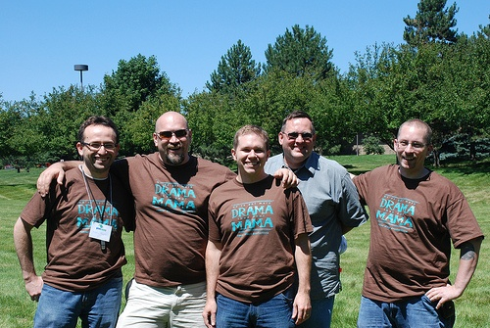
Now a word from one of last year’s attendees: Josh Holmes
Notes:
Josh
Recount last year, inspire them, get them excited, and send them off to make a difference!

Slide 43

Josh Holmes participated as both a developer and a nonprofit!
Notes:
Josh

Slide 44
THANK YOU FOR MAKING A DIFFERENCE!!!
Notes:
Josh

