Slide 1
Ann Arbor Give Camp
July 17-19, 2009

Slide 2
DISTRIBUTE EVALUATIONS

Slide 3
Planning Committee
Todd Bohlen
Greg Campeau
Michael Eaton
David Giard
Josh Holmes
Jennifer Marsman
Patrick Steele
Interested in helping out next year?
Notes:
Mike

Slide 4
Above and Beyond
Lori Bohlen – bought and managed much of the food, made extra trips, made sure coffee was made and drinks were on ice
Barry Stahl – flew in from Arizona to participate in GiveCamp and learn the ropes because he wants to run his own
Ken “the Designer“ Arbogast-Wilson – helped 9 nonprofits with design!
Chris Roland - ustream feeds, supporting multiple projects, and taking charge of the Closer to Home charity

Slide 5

HAPPY BIRTHDAY,
NATHAN BLEVINS!

Slide 6














Thank You, Sponsors!!!

Slide 7
Offer from O’Reilly
35% discount off any print or e-book at http://oreilly.com using discount code GCAMP

Slide 8
Free 2 hour tech assessments from NEW
NEW's npServ Program is pleased to offer free technical assessments to all Give Camp applicants in recognition of your pressing IT needs. The assessment's goals are to refer organizations to low-cost and often free resources in addition to our support, if appropriate. Ultimately the assessment is a tool to use for grant requests and to formulate IT policies and infrastructure......that works! This 2-hour process will result in documents for the following:
1. IT Inventory
Details what is in your inventory, current shape/status of these items, and recommendations for each item
2. SVOR Document
An overview of our findings as a result of the tech assessment. It is broken down into four segments (Strengths, Vulnerabilities, Opportunities and Resources).
3. Fee Proposal
Preliminary fee structure/overview for implementing npServ as your technology provider, if appropriate.
Please contact Linh Song at lsong@new.org if your organization is interested in this offer. We look forward to hearing from you!

Slide 9
A special thanks to Washtenaw Community College for providing the facilities for this weekend’s event
Neil Gudsen and the Business and Computer Technologies Division

Slide 10
Verio rocks!
We love Matt Lagrotte! Thanks for the free hosting offer and for flying out to make sure that everything was set up correctly.

Slide 11
Microsoft NGO portal
http://www.microsoft.com/NGO
Released July 9, 2008
Services available:
  NGO Stories
  Discussion Forums
  Free/discounted software
  Low-cost hardware
  Software support
  Training and certification
Notes:
http://www.microsoft.com/presspass/press/2008/jul08/07-09NGOConnections701PR.mspx

Slide 12
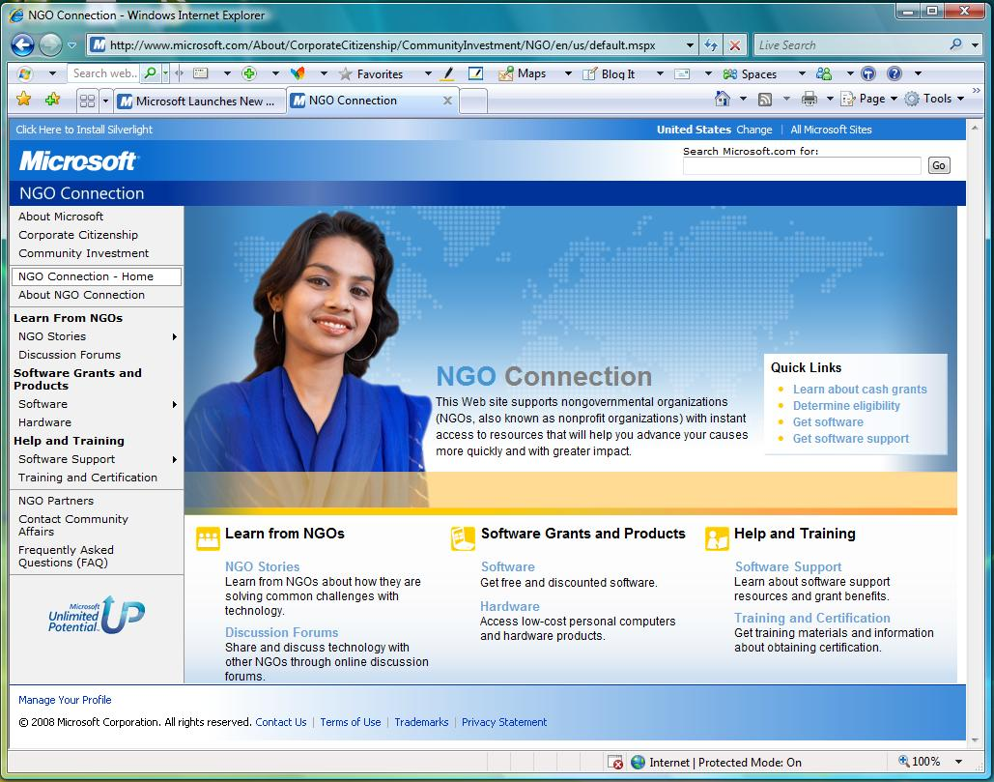

Slide 13
Need help with cleanup
If you can stay an extra 20 minutes, please come to room BE-158.

Slide 14
2009 Give Camp Charities
Sisters of Mary
All About Animals Rescue
Community & Home Supports
Eisenhower Dance Ensemble
Great Sauk Trail Council, Boy Scouts of America
Notes:
Jen

Slide 15
2009 Give Camp Charities
Interfaith Hospitality Network at Alpha House
Closer to Home Animal Advocates (Knoxville)
Latino Family Services (Knoxville)
Legacy Land Conservancy
Lend A Helping Hand
Leslie Science and Nature Center
Motivity
Notes:
Jen

Slide 16
2009 Give Camp Charities
Paula Ratchford Ministries
People’s IALAC Community Center
Resource Genesee
Southeast Michigan Regional Energy Office
Starting Over Airedale Rescue
Workplace Research Foundation
Notes:
Jen

Slide 17
Recognition
Please share stories about your teammates who went above and beyond.

Slide 18
The Developer Community
Get involved!
Southfield, Ann Arbor, Lansing, Grand Rapids, Kalamazoo, and Toledo all have .NET user groups.
List of local developer user groups: http://tinyurl.com/nldlg4

Slide 19
Save the Date
Michigan Give Camp in Ann Arbor
July 16-18, 2010
http://www.michigangivecamp.org
Michigan Give Camp in Grand Rapids
November 13-15, 2009
http://www.grgivecamp.org

Slide 20
TURN YOUR EVALUATIONS
IN NOW FOR DRAWING!

Slide 21
Giveaways – Raffle Tickets
2 Windows Vista Ultimate
2 Office Ultimate 2007
2 Visual Studio Pro 2008
12 Expression Web Step by Step book and software
1 DevExpress DXperience Enterprise license
3 DevExpress CodeRush & Refactor! Pro licenses
Books
1 Camtasia Studio
1 SnagIt
5 Telerik Premium Collection for .NET
3-month pro edition of Zen
1 ReSharper
1 dotTrace Profiler
1 TeamCity Build Agent
1 IntelliJ IDEA
1 RubyMine
Notes:
2 Visual Studio Pro 2008
2 Office ultimate
2 windows vista ultimate
12 Expression Web step by step book
12 Expression Web software
1 Camtasia Studio
1 SnagIt
5 Telerik premium collection for .NET
3-month pro edition of Zen
Books

Slide 22
THANK YOU!

