Slide 1
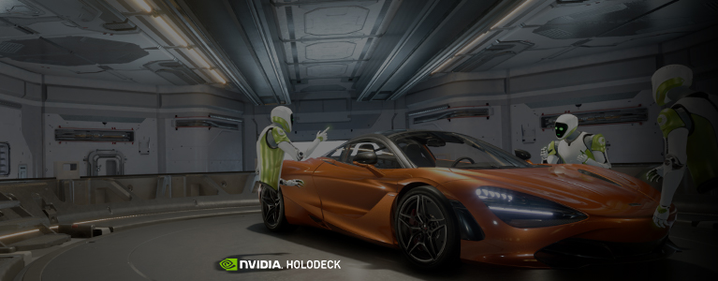
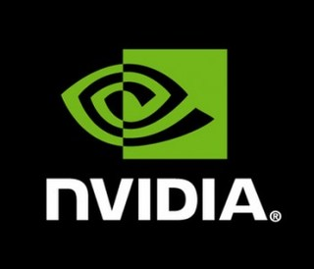
PROJECT HOLODECK
CS-4331-002: Student’s Choice Presentation
Simon Woldemichael

Slide 2
Outline
Overview
How does it work?
What are it’s benefits/applications?
Preview video
How can you use it?

Slide 3
Overview
Announced May 10, 2017 by NVIDIA Corporation at GTC.
A high fidelity virtual reality environment for collaborative design.
Compatible with computer-aided design models made with Autodesk 3DS (Max or Maya) that are rendered with NVIDIA Iray.

Slide 4

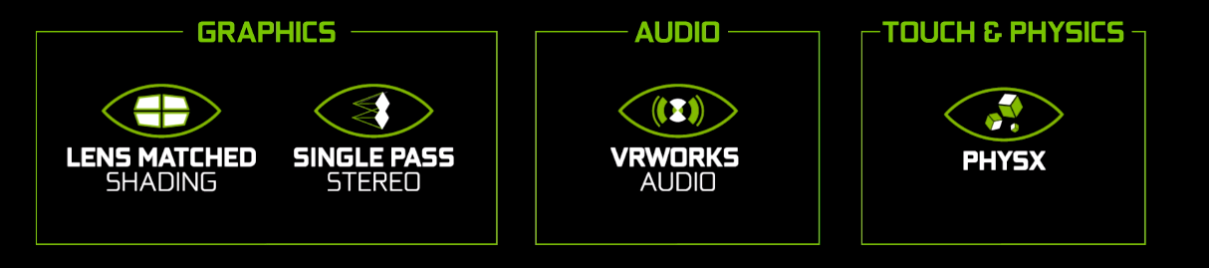
How does it work?
Frameworks
Epic Games’ Unreal Engine 4
Enhanced with:
NVIDIA VRWorks
NVIDIA DesignWorks
NVIDIA GameWorks

Slide 5
Benefits
Eliminates geographical barriers.
Speeds up prototyping phases.
Saves resources ($$$).

Slide 6
Applications
Eliminates geographical barriers.
Speeds up prototyping phases.
Saves resources.

Slide 7
How can you use it?
Eliminates geographical barriers.
Speeds up prototyping phases.
Saves resources.

Slide 8
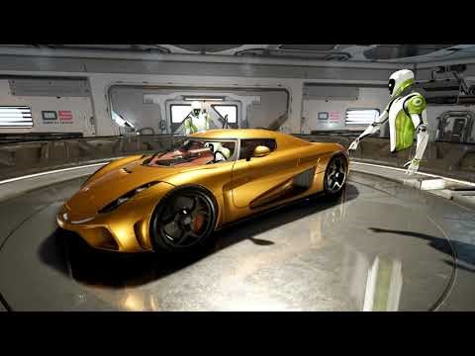

Slide 9


