Slide 1
Functional Programming
How to have confidence in your code

Slide 2

How I Felt as I mastered OO

Slide 3
Mutability
There is nothing permanent except change.
-Heraclitus
Same operations do not always produce the same results.
You have to understand and monitor everything that happened previously.
Someone else may alter your data in the middle of your processing

Slide 4
Mutability Concessions
I know it’s ultimately needed in various situations
Making intermediate copies of enormous objects can be unreasonably slow/memory intensive
In reality, your beautiful functional code is likely calling all kinds of ugly mutable code deep down
Bit-shifting is also a valuable technique – Does that mean it should be used throughout your stack?

Slide 5
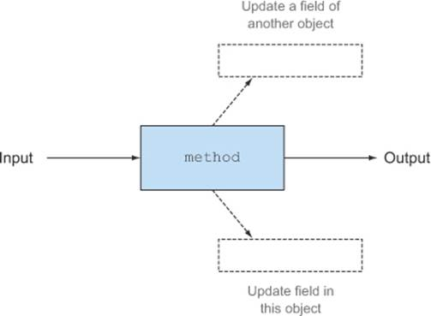
Side Effects
Notes:
Time is an implicit parameter in many, many procedure calls.

Slide 6
Side Effects
Writing some data to disk
Updating the User Interface.
Send data across the network
Checking system clock
Moving a physical device
Changing the value of a variable

Slide 7
Implied Parameters
The content in the database
A local parameter that needs to be configured by a previous method call.
  Server server = new SmtpServer();
  start(server);
  sendEmail(message, server);
The time you execute a command

Slide 8
How I Felt as I mastered OO

Slide 9

How I Felt as I learned more about Functional Programming

Slide 10

How I Felt as I learned more about Functional Programming

Slide 11
Immutable Transformations
Transformations as an alternative to flow control
Notes:
take a starting value and apply a series of transformations to get the final results

Slide 12
Pattern Matching
Take a value on one end and transform it into a new value.
Compiler can assist in making sure that you’ve covered every possibility.
Can be moved around as a distinct unit

Slide 13
Sealing the cracks
If you are using a sealed trait/class, then you can guarantee that you’ve covered all possible outcomes
You want to be sure you have a transformation that “matches” each situation
sealed trait Location
case object School extends Location
case object Home extends Location
case object Restaurant extends Location
def catchPhrase(location: Location): String = location match {
case school: School => “Class time”
case home: Home => “Home sweet home”
case restaurant: Restaurant => “Let’s eat”
}

Slide 14
Stop worrying about the shape of your data
Map: “Apply this to everything in this structure”
Fold: “Take every item in this structure and produce one result”

Slide 15
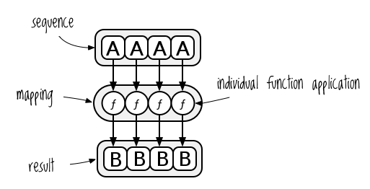
Immutable Transformations
Map: Apply the same function to every item in a collection, then return a new collection.
Scala Definition: (Using a List[A])
def map[B](f: (A) ⇒ B): List[B]

Slide 16
Immutable Transformations
More map examples:
blackAndWhiteImg = pixels.map(convertToGrayscale)
tomatoes = seeds.map(water).map(fertilize).map(prune).map(harvest)
properNames = people.map(person.match {
    case man: Male => “Mr. “ + man.name
    case woman: Female => “Mrs. “ + woman.name
    case unknownGender => “Zhe”
  }

Slide 17
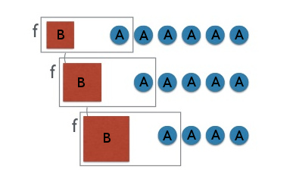
Immutable Transformations
Fold: Start with a specific value, and then perform successive transformations as you digest a collection of elements.
def foldLeft(startValue: B)(op: (B, A) ⇒ B): B
Notes:
This is a right arrow, rather than an equals sign, because the function can guarantee that 1 A and 1 B will always produce a new B.
It’s only 1 directional though, because the same B can be produced by many different combinations of A and B.

Slide 18
Immutable Transformations
More fold examples:
PastaSauce = tomatoes.fold(saucePan)
          (currentSaucePan + slice(tomato)
deansList = students.fold(emptyList)(analyzeGrades)
painting = strokes.fold(blankCanvas)(applyStroke)
suspiciousTransactions =
  transactions.fold(suspiciousFromLastWeek)(applyFraudMetrics)
CurrentRepoContent =
  commits.fold(blankCommit)(applyChangeset)

Slide 19
Stating the problem
Sam And Joe are People.
They share a Car.
They need to travel between Home, School, and a Restaurant.
The Car runs out of gas as it travels.
Sam or Joe can fill up the Car.

Slide 20
Scala Specifics
Case classes
  case class Car(fuel: Int, location: Location)
    Simple data classes
    Provided methods: equals, toString, copy
Tuples – Collection of heterogeneous types
The right arrow =>
  It expresses a transformation.
    From a value to a value
    From a type to a type
  “We can take all the ingredients on the left side, and reliably produce 1 value on the right side.
Try[Scene] can have 2 forms:
  Success(scene) // scene is the value that we wanted.
  Failure(exception) // exception is the reason we could not get a Scene.

Slide 21
Code Examples

Slide 22
Separate behavior from Data
Simple immutable data classes
  case class Car(fuel: Int, location: Location)
Pure functions that manipulate them
  Don’t rely on “this”
Swap out data classes later as needs change.
Alter and add functions that don’t require access to internal/static variables

Slide 23

Question: What’s an immutable data structure that you deal with every single day?
Notes:
This simple logo describes the entire structure.
It’s got branch and leaf nodes.
-Figure out where my disconnect of “branch” is happening
Ideally, branch commits will have a single lineage.
When they have 2 children, something must be telling it which to apply first.
-Timestamps automatically
-Humans when a problem occurs

Slide 24
Code Sample

Slide 25

A Complete History

Slide 26
Throwing Exceptions breaks clean flow nearly as much as gotos
Exceptions aren’t that special or unusual, they don’t deserve a completely separate and opaque code flow
Exceptions are valuable, don’t just throw them around!
Who knows how many layers that Exception will get thrown through before someone realizes that it needs to be caught?
Every error case should be handled/corrected or returned from the function.

Slide 27

The People That Pay Me
https://www.solutionreach.com/company/careers

Slide 28


Slide 29
Extra Slides

Slide 30
Consider showing how to periodically compress changesets into a single change
- Combining results should be straightforward
- Once you’ve added commit messages, combine them into a single multiline string as you squash commits
- This is how immutable databases can be used without eternally growing.

Slide 31
Digging Deeper
ScalaFiddle – Try out Scala in your browser
https://scalafiddle.io/
Functional Programming in Scala (Book):
http://tinyurl.com/zlk8axe
Functional Programming Principles in Scala (Online Course):
https://www.coursera.org/learn/progfun1
Neophytes Guide to Scala (Blog):
http://danielwestheide.com/scala/neophytes.html
Functional Geekery (Podcast):
https://www.functionalgeekery.com/
Purely functional Data Structures (Book):
http://tinyurl.com/gwjjly7
Math Union Programming (Blog - very math heavy!)
https://jeremykun.com/main-content/
If you want to learn FP via Haskell:
http://learnyouahaskell.com/

