Slide 1
Korea Growth Plan 2030
RTB House, Wook 2026

Slide 2
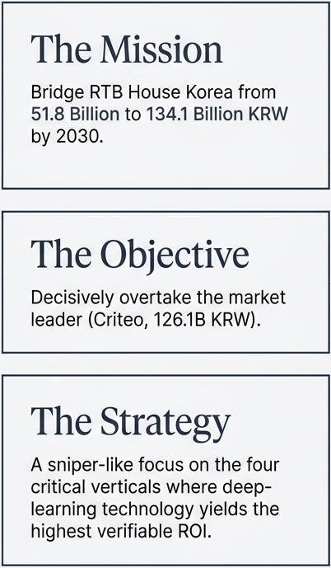
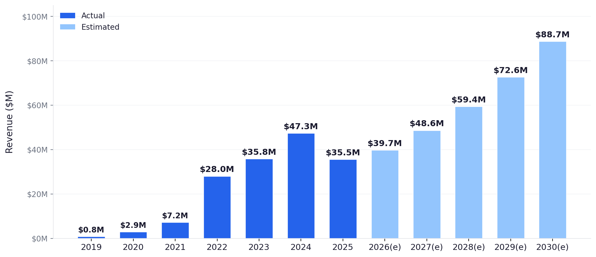
Summary: RTB House Korea 2030
• 2025 baseline: Estimated at 40% of Criteo Korea's DART-disclosed revenue ($88.7M × 40% = $35.5M)
Key Assumptions
• 2030 target: Grow to match Criteo Korea's 2025 revenue level ($88.7M) — reclaiming market #1
• CAGR 2025→2030: ~20% | Churn rate: 12% annual (B2B SaaS benchmark) | Team: 6 → 12 elite salespeople

Slide 3
1. High-Level Strategy
Focus Industries & Rationale
# | Sector | Budget (e) | Why Prioritized
1 | E-Commerce & Retail | $2.1B | 45–50% of Korea's digital ad spend. Deep learning dynamic banner optimization in mega-catalog (100K+ SKU) environments. #1 Criteo win-back target.
2 | K-Brands Global D2C | $1.4B | Samsung, APR/Medicube, Samyang. Massive budgets shifting to global cross-border (CBEC) purchase conversions. Fastest revenue growth driver.
3 | Gaming & App | $1.1B | CPI/LTV optimization = survival for publishers. Predictive LTV modeling proves efficiency vs Moloco & AppLovin in UA campaigns.
4 | Legacy Giants | $1.8B | Hyundai, Telcos, Finance. Branding-focused KPIs. Mid-long term pipeline via ContextAI (cookieless), Brand Safety, and in-house agency partnerships.

Slide 4
2. Top Prospective Clients
Tier 1 Targets (Annual Budget $3.5M+) & Deal Strategy
Target | Sector | Ad Spend | Current | Attack Strategy
Coupang / SSG / Gmarket / 11st | E-Commerce | $947M+ (10-K) | Criteo | 30-day free A/B test. Measure iROAS vs Criteo at 50:50 traffic split in mega-catalog.
Samsung / LG Electronics | Global Tech | $1B+ (Global) | Multi-DSP | Global D2C retargeting for electronics malls. Target direct traffic → purchase ROAS.
APR / Olive Young / Amorepacific | K-Beauty | $100M+ | Meta, Criteo | Global targeting for beauty device NA expansion and cross-channel purchase induction.
Nexon / Krafton / Netmarble | Gaming | $100M+ /company | Moloco, AppLovin | UA for global titles. Prove LTV prediction superiority via predictive deep learning.
3-Step Deal Framework
① PROVE IT
② SCALE IT
③ LOCK IT
30-day free A/B test 50:50 split vs incumbent DSP Measure Incremental Conversions
On success, migrate budget 30% → 50% → 70% to RTB House
Quarterly iROAS reporting via Ghost Ads methodology Raise Switching Costs

Slide 5
3. Campaign Projections
Quarterly Launch Targets (2026–2030)
Year | Q1 | Q2 | Q3 | Q4 | Annual Launches | Active Campaigns | Revenue
2026 (Foundation) | — | — | 20 | 24 | 44 | 235 | $42.2M
2027 (Scale-up) | 24 | 25 | 26 | 26 | 101 | 308 | $55.4M
2028 (Expansion) | 24 | 25 | 26 | 26 | 101 | 372 | $66.8M
2029 (Acceleration) | 25 | 26 | 26 | 27 | 104 | 431 | $78.4M
2030 (Reclaim #1) | 28 | 29 | 29 | 30 | 116 | 495 | $94.3M
Key Assumptions
• Blended Revenue per Campaign: $179K/yr (90% standard $105K + 10% mega $844K)
• Annual Churn Rate: 12% (B2B SaaS benchmark)
• 2030 Target: 495 active campaigns

Slide 6
4. Revenue Metrics
Per-Salesperson Projections — Lean Organization Model
Year | Headcount | New Booking / Person | Gross New | Churn (12%) | Net Growth | Revenue
2026 | 6 | $1.76M | $10.6M | –$4.4M | +$6.2M | $42.6M
2027 | 8 | $1.79M | $14.3M | –$5.1M | +$9.3M | $51.9M
2028 | 10 | $1.86M | $18.6M | –$6.2M | +$12.5M | $64.4M
2029 | 11 | $1.97M | $21.7M | –$7.7M | +$14.0M | $78.4M
2030 | 12 | $2.11M | $25.3M | –$9.4M | +$16.0M | $94.3M
2026 Per-Salesperson Quarterly Detail (6 AEs)
Metric | Q2 (Ramp-up) | Q3 | Q4 | H2 Total
New Campaigns / Person | — | 3–4 | 4 | ~7
New Booking / Person | — | $774K | $985K | $1.76M
Team New Launches | — | 20 | 24 | 44
Team New Revenue | — | $4.6M | $6.0M | $10.6M

Slide 7
5. Operational Activities
Building a Successful Foundation Beyond Sales
🏢 Lean Team & Employer Branding
💡 Innovative Solution Selling
📊 Market Education & Client Success
Position RTB House as 'Europe's #1 Deep Learning AI Tech Company' (not an ad agency). 45% of Warsaw HQ = engineers.
ContextAI (Cookieless): Real-time webpage context analysis via DL+NLP. RTB House's OBTD framework adopted by Google Privacy Sandbox.
Publish Incrementality Whitepapers: Shift Korean market from last-click ROAS fixation to Ghost Ads-based iROAS measurement.
2026: Hire 1 Senior AE (mega-account closer, $70K+/mo deals). 2027–28: +2 AEs + 2 CMs for 25+ launches/quarter pace.
Video Retargeting: Auto-generated 15s dynamic video ads. +30-50% CTR uplift. Key for K-Beauty global D2C campaigns.
Institutionalize Quarterly QBRs with iROAS reporting. Goal: Lower annual churn from 12% → below 10%.
Quarterly 'Deep Learning in AdTech' Tech Talk. Internship pipeline via Seoul National Univ. / KAIST AI labs.
Predictive LTV Modeling (Gaming): 14-day LTV prediction via deep learning. Concentrate bids on high-value user segments for UA.
Bi-annual 'Incrementality Summit Korea' — strategic sales event showcasing Tier 1 A/B test results to secure H2 pipeline.

Slide 8
6. First 6 Months & Onboarding
Challenge Identification & Risk Mitigation
Top 3 Risks During Leadership Transition
# | Risk | Context | Impact
1 | Loss of Core Assets & Key Talent | Failing to defend and leverage existing core assets and top talent during transition | Organizational momentum loss & pipeline collapse
2 | Insufficient Global Knowledge Transfer | Proven winning plays from other markets not sufficiently localized to Korea | Growth ceiling & repeated inefficiencies
3 | Right Person, Right Build Failure | Recruiting misaligned talent during aggressive team expansion | Resource waste & delayed market entry
Risk Mitigation — Phased Action Plan
Phase | Period | Key Mitigation Actions
Phase 1: Listen | Day 1–30 | 1:1 Listening Tour (all 20 members) → identify flight risks and core assets early Shadow Week: observe Sales/AM in action without intervening Deliver 1 Quick Win to build credibility through action
Phase 2: Align | Day 31–60 | Build Competency Map + Flight Risk assessment → immediate retention conversations Design Global → Local Playbook transfer pipeline (DACH, UK, Japan best practices) Establish 3 weekly rituals (Mon Pipeline / Wed 1:1 / Fri Wins & Learns)
Phase 3: Lead | Day 61–90 | Declare 2026→2030 growth vision with concrete revenue targets ($42.2M → $88.7M) Define Right Person criteria and begin first strategic hire (Senior AE) Activate Delegation Framework: CM owns only Tier 1 accounts + HQ relations

Slide 9
7. Integration & Leadership Initiatives
First 6 Months — Building Trust, Transferring Knowledge, Enabling Growth
Talent Retention & Leverage (Risk #1)
Global Knowledge Transfer (Risk #2)
Right Person, Right Build (Risk #3)
• Map every team member's core competencies and flight risk level by Day 60
• Audit Top 3 winning plays from DACH, UK, France, Japan markets
• Use 60-day weekly cadence to observe org strengths and gaps before any hiring
• Immediate 1:1 career conversations for high-risk seniors — present clear growth paths
• Apply Korea Localization Filter — what works, what doesn't in agency-driven market
• Define Right Person criteria: ① DL/programmatic fluency ② A/B test sales ③ culture fit
• Convert tacit knowledge (client histories, deal playbooks) into shared team assets
• Launch monthly "Global → Local" sessions (bidirectional: Korea exports wins too)
• First hire: 1 Senior AE with mega-account closing experience ($70K+/mo deals)
• Grant clear ownership and decision-making authority → "my role is growing here"
• Immediately apply Criteo win-back playbooks from Europe to Commerce Squad
• Principle: "Fill the seat correctly, not quickly" — 1 wrong hire delays growth 6 months
Weekly Operating Cadence (3 Rituals Only)
Day | Meeting | Participants | Duration | Purpose
Mon | Pipeline Review | All Sales + AM | 30 min | Pipeline status + competency gap observation
Wed | 1:1 Coaching | Individual (rotating) | 30 min | Deal coaching + growth direction (behavior-based)
Fri | Wins & Learns | Entire team (voluntary) | 20 min | 1 success + 1 failure lesson → learning culture
Core Principle: "Don't manage — coach. Don't dictate — bridge. Don't assume — listen."

Slide 10
8. Structural Evolution
Short-Term Team Structure (6–12 Months) — Vertical Squads by Industry
Vertical Squad Organization (Day 91–180)
Reorganize existing 20-person team by redefining roles to maximize core talent strengths — not a large-scale overhaul.
Squad | Composition | Target Accounts | 2026 Mission | Market Rationale
🛒 Commerce Squad | Sr. Sales 1 AM 2, TAM 1 | Coupang, Musinsa, Olive Young, SSG | Onboard 2 new Tier 1 clients | E-Commerce = $3.2B–$3.5B (45–50% of digital ad spend). #1 Criteo win-back path.
🎮 Gaming & App Squad | Sales 1 AM 1, TAM 1 | Nexon, Krafton, Netmarble | 1 Tier 1 A/B test success → conversion | Gaming = $1.1B–$1.4B budget. Predict LTV to beat Moloco/AppLovin.
🌏 K-Brand & Growth Squad | Sales 1 AM 1 | APR, Samyang, Yanolja, Toss | Build 2 global D2C pipelines | Hybrid K-Brand = $1.4B–$1.8B. Global CBEC = explosive growth driver.
Lean Hiring Roadmap
Period | Headcount | Key Hire | Purpose
2026 (Now → 6) | 5 → 6 | 1 Senior AE (mega-account closer) | Breakthrough for H2 44 new launches, Tier 1 deals
2027–28 (8 → 10) | +4 | 2 AEs + 2 Campaign Managers | Match 25+ launches/quarter pace, K-Brand D2C dedicated
2029–30 (11 → 12) | +2 | 1 Data Scientist + 1 Sr. AE | Complete 495 active campaign operating system

Slide 11
9. Team Collaboration
Sales & AM Alignment, Motivation, and Driving Results
2 Collaboration Rituals (Simple = Executable)
① Pre-flight Handoff
② Monthly Win/Loss Review
• Sales prepares a 1-page Campaign Brief before every AM handoff
• 30 min/month. Sales + AM jointly analyze 1 won deal and 1 lost deal
• Includes: client KPIs, budget/terms, competitive landscape, decision-maker map
• Rule: No blame. Only discuss "how can we win next time?"
• Korea-specific: must specify whether final decision-maker is advertiser or agency
• CM shares own failure first → builds psychological safety
• This single line dramatically improves AM communication efficiency
• Korean culture: 'sharing failures' conflicts with face-saving → CM leads by example
Motivation System
💰 Monetary
🌟 Non-Monetary
• Team-wide bonus on quarterly target achievement (separate from individual commission)
• Quarterly Top Performer: Warsaw HQ R&D Center visit + global workshop participation
• Team-level rewards prevent silos and reinforce collaboration culture
• Aligned with RTB House values: Kindness, Curiosity, Excellence, Ownership
• Non-monetary growth opportunities are the strongest retention lever for Korean talent

Slide 12
10. Performance Measurement
KPIs, OKRs & Revenue Targets — 70% Quantitative + 30% Qualitative
A. Sales
Metric | Frequency | Year 1 Target
New Bookings (MRR) | Monthly | $150K/mo → $800K by Q4
New Campaign Launches | Quarterly | 10+ quarterly (min $7K/m)
Pipeline Coverage | Weekly | 3x quarterly
O: "#1 DL Performance" in Korea
KR1: C-level DL seminar 1x/quarter | Quarterly
KR2: 2+ Korean case studies published | Semi-annual
B. Account Management
C. Country Manager
Metric | Frequency | Year 1 Target
Scale-up Rate (test → regular) | Quarterly | 20%+ conversion rate
Campaign Churn Rate | Monthly | Below 5% monthly
Time-to-Value | Campaign | tROAS in 21 days
O: Become client's strategic partner
KR1: 100% QBR completion | Quarterly
KR2: In-depth training 2x/yr | Semi-annual
Metric | Year 1 Target
Revenue Growth (YoY) | +16% (foundation year)
Team Attrition Rate | Below 10% (vs industry avg 20%+)
New Vertical Expansion | First revenue in 2+ new verticals
Internal Survey | 8/10 (semi-annual anonymous survey)

