Slide 1
Assignment 2 Writeup
Name:
GT Email:

Slide 2
Part-1 ConvNet

Slide 3
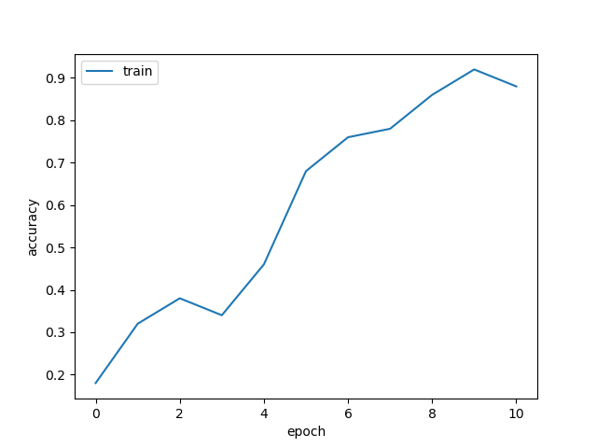
Put your learning curve here:

Slide 4
My CNN Model

Slide 5
Describe your model design in plain text here:
My beginning of my model consists of 4 Conv/Max Pool layers chained together with increasing output channels in the Convolution layers. The initial out channel is 16, which doubles to 32, 64,128, and 256 to reflect larger and larger features, from clusters of pixels, to edges, to motifs. The final layers are linear layers which gradually decrease from 1024 to 512 to 256 to 128 to 10 which reflect the total number of classes, helps the gradient flow gradually into class probabilities. There also 2 ReLu layers, one after the final convolution layer and one after the 2nd to last linear layer. They serve as a sort of ‘on’ or ‘off’ switch to help the network decide if the input window of the image resembles close enough to the feature the convolution picked out by firing or remaining dormant. All convolution layers have 0 stride (for no information loss), padding of 1 and a kernel size of 2; it worked well enough in the Vanilla CNN, otherwise I would have scanned the CIFAR images in more detail for picking out a good window size. All max pool layers have a kernel size of 2 and 0 stride.
Describe your choice of hyper-parameters:
I chose a large batch size of 256 to decrease noise every training epoch. I decreased the regularization to 0 during my initial experiments and increased it slowly to a final value of 0.00005 once I could see it was helping the validation accuracy as opposed to hurting it. I chose an initial learning rate of 0.01 after experimentation, 0.001 had almost no change after 10 epochs, and 0.1 had NaN’s show up in the loss function. I chose a momentum of 0.9 as I read that it’s a good value for most networks (link). I kept my step values at [22,25] which I also found by tuning – I kept increasing the left step up because I saw the loss function starting to slow down once the epoch hit the left most value, up until 22 which got the accuracy to over 80%. The right most value is the number of epochs which means it never hits the fast decay step.
What’s your final accuracy on validation set?
0.81

Slide 6
Data Wrangling

Slide 7
What’s your result of training with regular CE loss on imbalanced CIFAR-10?
Fill in your per-class accuracy in the table
 | Class 0 | Class 1 | Class 2 | Class 3 | Class 4 | Class 5 | Class 6 | Class 7 | Class 8 | Class 9
CE Loss

Slide 8
What’s your result of training with CB-Focal loss on imbalanced CIFAR-10?
Tune the hyper-parameter beta and fill in your per-class accuracy in the table
 | Class 0 | Class 1 | Class 2 | Class 3 | Class 4 | Class 5 | Class 6 | Class 7 | Class 8 | Class 9
beta=?
beta=?

Slide 9
Put your results of CE loss and CB-Focal Loss(best) together:
 | Class 0 | Class 1 | Class 2 | Class 3 | Class 4 | Class 5 | Class 6 | Class 7 | Class 8 | Class 9
CE Loss
CB-Focal

Slide 10
Describe and explain your observation on the result:

