Slide 1

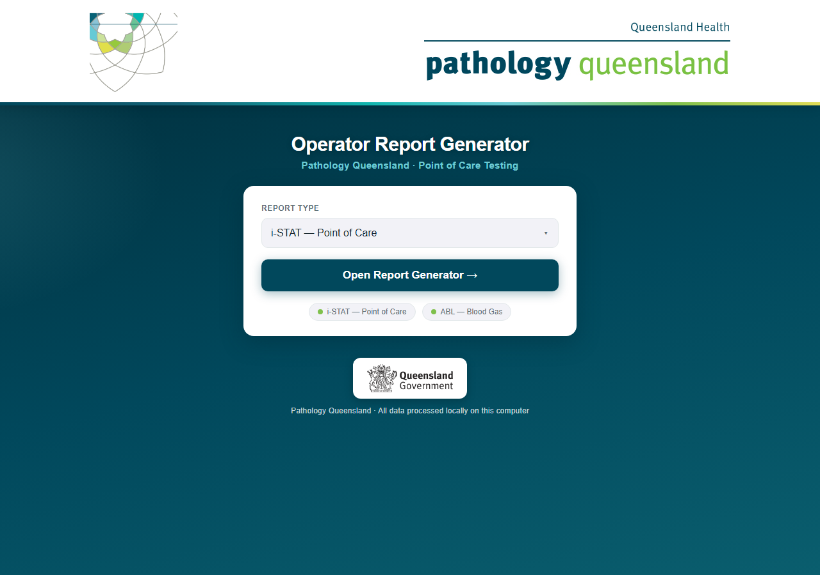
Operator Report Generator
User guide — generating the monthly i-STAT and ABL reports
The selection page you see at every launch
Pathology Queensland · Point of Care Testing · September 2026
Conceived, designed and built by Craig MacKenzie · Chemistry Department, Townsville Group Laboratory · Pathology Queensland
Notes:
This guide walks through the complete monthly routine: starting the program, generating i-STAT reports, generating ABL reports, and what to do when something looks wrong.

Slide 2
Before you start — what you need
The USB drive Everything runs from it; nothing is installed on the PC
Good to know
The FIRST launch on a new computer can take up to 30 seconds — the browser opens by itself when ready.
The black console window is the engine room: leave it open while working, close it to stop everything.
Reports never leave the drive — everything is processed locally.
A NEW PC must be licensed first: the selection page shows its machine ID — send it to the PoC lead and install the licence file you get back. Licences last 12 months.
BitLocker password Windows asks for it when you plug the drive in
History passwords Each app asks for its own at launch (i-STAT and ABL) — held by the PoC team; there is NO recovery if forgotten
This month’s export files The i-STAT export (e.g. "iSTAT Report 202609.xlsx") and the ABL operator error export — keep them in "Monthly reports" on the drive
Notes:
Two passwords exist: BitLocker for the drive itself, and the history password inside the i-STAT app. Stress that the history password has no recovery — a forgotten password means the history must be reset.

Slide 3
Starting the program
1
Plug in the drive
Enter the BitLocker password when Windows asks.
2
Double-click "Start PQ Reports.bat"
On the root of the drive. A console window opens and stays open.
3
Wait for the browser
The selection page opens itself at localhost:5750 when everything is ready.
4
Choose the report type
Pick "i-STAT — Point of Care" or "ABL — Blood Gas" from the drop-down and click Open. Green dots = engine ready.
The selection page — both engines show a green dot when ready
New PC? The selection page shows a lock card with the machine ID — send it to the PoC lead and install the licence file (.lic) you receive. Both report types can be run in one session.
Notes:
If someone clicks Open before an engine has finished starting, the button waits and navigates automatically — no need to retry.

Slide 4
Licensing a PC (first use on a computer)
BOTH
The lock card
Getting a licence
On a PC without a licence the selection page shows PC NOT LICENSED with the machine ID and hostname instead of the report-type drop-down. Nothing runs until a licence covering this PC is installed — the engines show a lock page too.
Send the machine ID to the PoC lead. You receive a small .lic file issued for that PC, valid for 12 months. Licences cannot be created on the drive — only the PoC lead’s keygen can issue one.
Installing it
Renewal and the Licences page
Choose the file under Install licence file and click Install licence — or copy it to the root of the drive. The page reloads with the normal drop-down and the engines unlock at once.
Licences expire with the 12-month QIS review: a notice appears 30 days before, a 30-day grace period follows, then the PC locks. “Licences” at the foot of the page shows every licence on the drive and the PCs it covers.

Slide 5
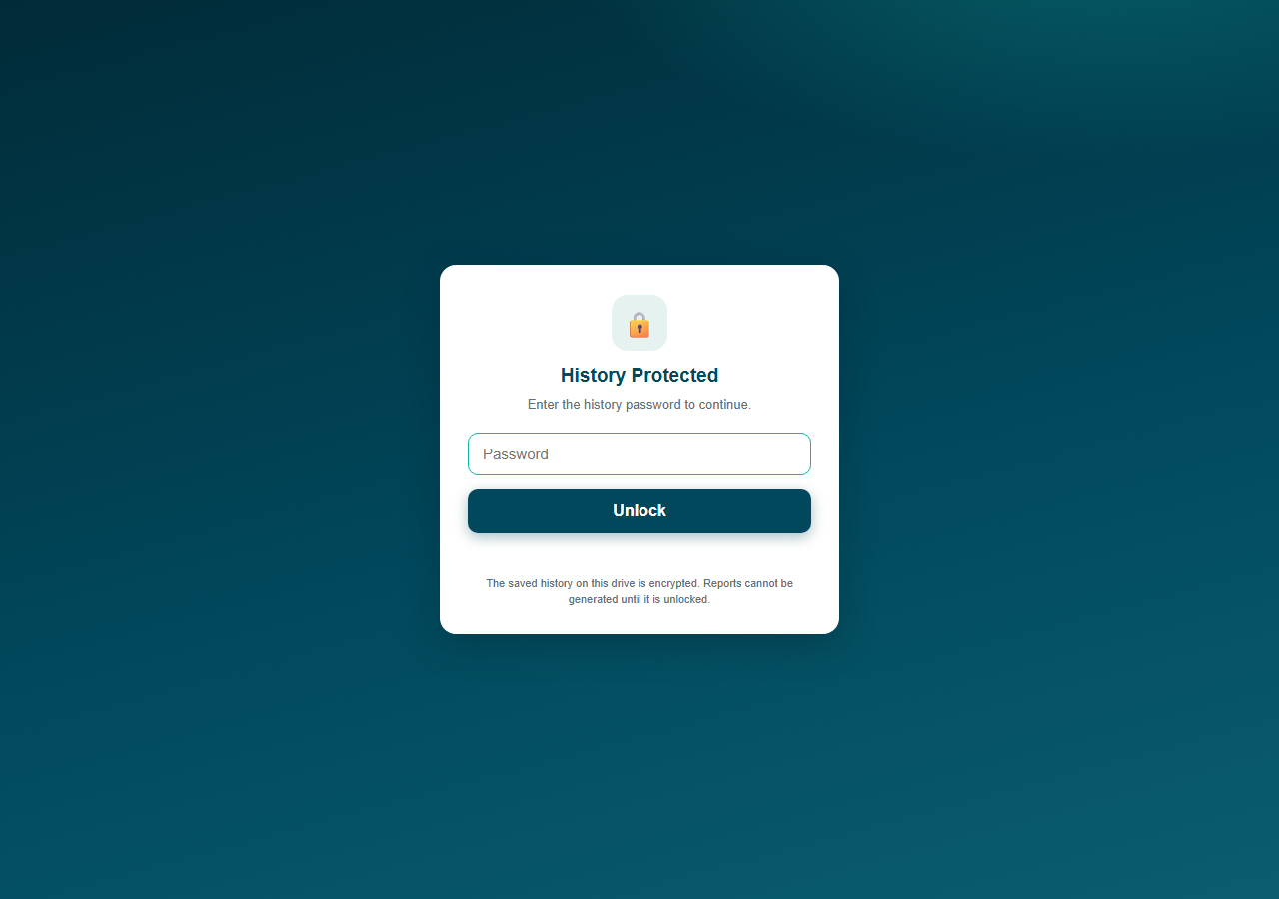
Unlock the history
i-STAT
1
Enter the history password
The i-STAT app opens on this screen every launch. Type the team’s history password and press Unlock (or Enter).
2
Wrong password?
You get a clear message and can try again. Every attempt is recorded in the audit log.
Forgotten password? There is no recovery — by design. The history must be reset and rebuilt from the retained monthly exports. Contact the PoC lead before touching anything.
Reports cannot be generated until unlocked
Notes:
This screen exists because the staff-performance history on the drive is encrypted. Generation is blocked until the password is entered.

Slide 6
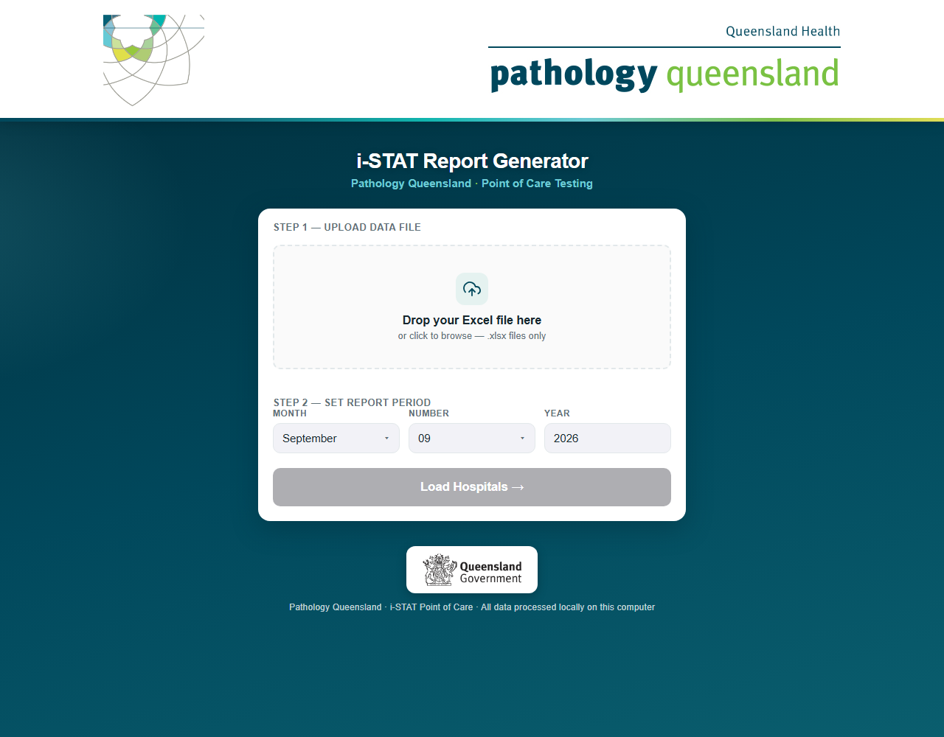
Load the export and set the period
i-STAT
1
Drop the monthly export onto Step 1
Drag "iSTAT Report YYYYMM.xlsx" from the "Monthly reports" folder onto the drop zone (or click it to browse).
2
Check the report period
Month and year fill in automatically from the filename — correct them if needed.
3
Click "Load Hospitals"
The app reads the file and lists every hospital found, grouped by HHS.
If the file is not a valid i-STAT export, the app refuses it with a clear message — it will never silently produce empty reports.
Step 1: drop zone · Step 2: report period
Notes:
The filename convention (YYYYMM) drives the auto-detected period. Loading a big export takes a few seconds.

Slide 7
Select hospitals and generate
i-STAT
1
Tick the hospitals you need
Use "Select All", or tick whole HHS groups / individual hospitals. The summary shows the count.
Output location
Reports\iSTAT\<YYYY-MM Month>\<HHS>\i-STAT_<Hospital>_<Month>.docx
2
Click "Generate Reports"
A progress bar shows each hospital as it is processed and the number of reports written so far.
Large sites
23 sites, from Townsville to RBWH, get one report per ward plus a Site Overview page
Re-running a month
Generate the same month again any time — its data is simply replaced
3
Open the reports folder
When "Reports Ready" appears, click the button — reports are filed by HHS, with the count of documents written and of dormant analysers left out.
Trends & follow-up
History and recurring-operator flags update themselves each run
Notes:
Generation is per-hospital, so one problem hospital never spoils the batch — any errors are listed at the end while the rest complete.

Slide 8

Generate the reports
ABL
1
Drop the ABL operator error export
The monthly Radiometer ABL export (.xlsx). The ABL app asks for its history password first, like i-STAT.
2
Set the report month and year
Auto-detected from the filename where possible.
3
Click "Load Analyzers"
Every Hospital → Department appears with its analysers listed — tick the reports you want.
4
Click "Generate Reports"
Progress bar, then "Reports Ready" and the open-folder button, exactly like i-STAT.
The ABL app — same look, department-based selection
Notes:
The ABL flow mirrors i-STAT, but selection is by department rather than hospital, and there is no unlock screen.

Slide 9
Outputs and things to know
ABL
Where reports land
Flag rules (fixed)
Reports\ABL\<YYYY-MM Month>\<Hospital>\ABL_<Department>_<Month>.docx — one Word report per department, plus ABL_<Hospital>_Hospital_Summary_<Month>.docx per hospital.
An operator is flagged ⚠ with MORE than 10 tests (11+) AND an error rate over 10% in the month. 10 tests or fewer = "not assessed", never flagged.
Re-running a month
Trend charts
Generate the same month again any time — that month’s data is simply replaced, and the trend charts stay correct.
Per-analyser history builds month by month, encrypted like i-STAT’s; 12-month charts with every error segment labelled; a repeated top error is flagged in red.
Notes:
The flag thresholds are fixed in the app so every department is judged identically, month after month — there is nothing to configure.

Slide 10
What the report contains (1 of 2)
i-STAT
1
Monthly Snapshot
The month in one block: overall rate, errors vs cartridges, top error, flagged staff.
Error rate 4.5% (12 errors / 266 cartridges)
Top error: P3 Cartridge Handling · Staff flagged: 2
2
Historical Performance
TWO charts per device: the error-rate trend over the colour bands, and the Cartridges Run & Error Mix chart (next slide).
improving ↓
3
Performance Summary
Device-by-device: cartridges, errors and rate, banded Champions → Needs attention.
i-STAT 1;9001 80 carts 4 errors
5.0% Excellent
i-STAT 1;9002 74 carts 5 errors
6.8% Accept.
4
Simulators Run
Electronic QC (simulator) checks recorded on each device during the month.
EQC checks: 9001 — 8 ✓ 9002 — 6 ✓ 9003 — 7 ✓
5
Monthly Ceramic Cleaning
Each analyser listed with its cleaning-cartridge count. Every i-STAT needs 3 per month; any shortfall fails the department.
Completed ✓
— listed per analyser; any analyser under 3 shows a red Fail
Examples shown with fictional data — layouts match the real Word report.
Notes:
First half of the i-STAT report, in document order, each with a miniature of what that section looks like: snapshot block, trend chart over the colour bands, the banded device table, simulator QC counts, and the ceramic cleaning check.

Slide 11
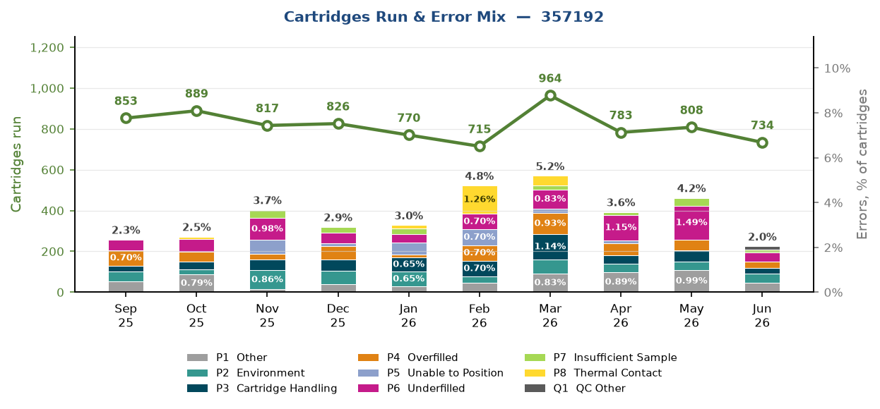
The Cartridges Run & Error Mix chart
i-STAT
Green line
Cartridges run each month — the device’s workload
Coloured bars
That month’s errors as % of cartridges, split by error category — same colours as the legend
Total on top
The month’s overall error rate sits above each stack
Builds itself
A new month is added every time you generate — history back to Sep 2025 is already included
A real render (device serial only — no staff data). Every device gets one of these.
Read the two together: a rising error line with one colour dominating the bars tells you exactly what to fix — and whether workload explains it.
Notes:
New feature: the second Historical Performance chart, matching the ABL reports. Workload line above, error-mix bars below, month totals on top of each stack. Ten months of history (Sep 2025 - Jun 2026) were backfilled from the retained exports, so it debuts fully populated.

Slide 12
What the report contains (2 of 2)
i-STAT
6
Cartridge Error Details
Every error event with location, staff member, category and code. 3+ errors shows in red; a clean month prints "No errors ✓".
Brightwater ICU Hollybrook, Hayden P3 — Cartridge Handling ×3
Brightwater ED Tarwin, Morgan P6 — Underfilled Cartridge ×1
7
Error Type Summary
The month’s top error types with likely cause and count — where errors come from.
P3
6
Cartridge Handling
Underfilled
Other
P6
4
P1
2
8
Top Error Code Analysis
Plain-English explanation of each top code — the device message and its usual cause.
P3 — Cartridge Handling (6 occurrences)
"Usually caused by pressing on the cartridge after insertion, or moving the analyser mid-test..."
9
Error Type Trend
Month-by-month top error type — the same code two months running is flagged ⚠.
July: P6 August: P3 September: P3 ⚠ repeated
10
Staff Requiring Follow-up
The action section: "This Month" (3+ errors) and "Recurring" (consecutive months at this site).
Hollybrook, Hayden 5 errors 18.5%
Quambone, Reese 3 errors 75.0%
red = act on it
Examples shown with fictional data — layouts match the real Word report.
Notes:
Second half of the i-STAT report with a miniature beside each section. Red consistently means "look here" — red names in the details, the ⚠ repeat flag, and the follow-up tables are the parts to action.

Slide 13
Overview reports and the dormant list
i-STAT
Site Overview — large sites
Dormant analysers — the 4-month rule
Every site that is split by ward also gets one page listing each ward’s analyser: cartridges, errors, error % with its band, simulator runs and ceramic ✓/✗, plus a whole-site total. Filed with the ward reports as i-STAT_<Site>_Site_Overview_<Month>.docx
An analyser with no cartridges, no simulator runs and no ceramics for 4 consecutive months gets no report and no longer counts against its site’s simulator or ceramic checks. One or two quiet months change nothing. Any use brings it straight back the next month.
Area Summary — every HHS
The dormant list
One per HHS folder each run: every hospital in the area on one page with the same figures, an area total, and an “Analysers Needing Attention” table naming each analyser that ran no simulator or fewer than 3 ceramics. i-STAT_<HHS>_Area_Summary_<Month>.docx
Dormant_iSTATs_<Month>.docx in the reports folder lists every unit left out: hospital, location, serial, months idle and last activity. Check it each month for units to retire — or units that should be in use but are not being maintained. The results card shows the count.

Slide 14
What the report contains (1 of 2)
ABL
1
Monthly Snapshot
The department at a glance: error rate, analysers covered, top error code, operators with errors and any flags raised.
Department error rate 3.6%
3 analysers · Top error: 353 · 14 operators with errors · 1 flagged ⚠
2
Historical Performance
Two charts per analyser, building monthly: the error-rate trend, and the Tests Run & Error Mix chart (next slide).
error rate ↑
tests + error types ↓
3
Analyzer Performance
One row per analyser: total tests run, total errors and the analyser’s error % for the month.
ABL800 FLEX — ED 1,240 tests 38 errors
3.1%
ABL800 FLEX — ICU 985 tests 52 errors
5.3%
ABL90 — Theatre 412 tests 9 errors
2.2%
Examples shown with fictional data — layouts match the real Word report.
Notes:
First half of the ABL report with a miniature beside each section: the snapshot paragraph, the two-part historical charts (rate trend above, workload with error-type breakdown below), and the analyser table.

Slide 15
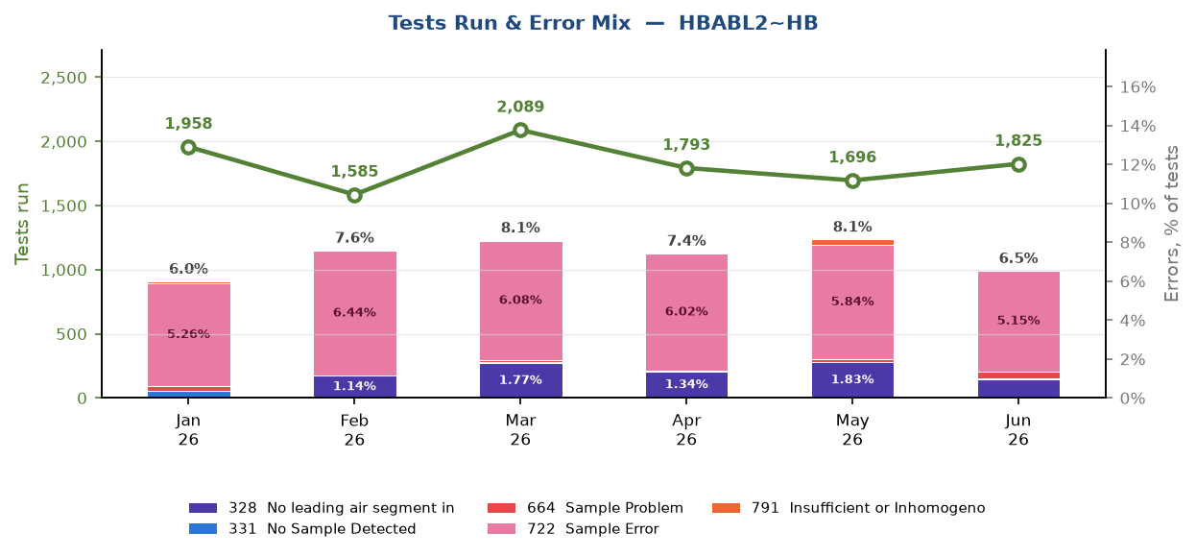
The Tests Run & Error Mix chart
ABL
Green line
Tests run each month — the analyser’s workload
Coloured bars
That month’s errors as % of tests, split by ABL error code — each code named in the legend
Total on top
The month’s overall error rate sits above each stack
Builds itself
A new month is added every time you generate — the chart grows automatically
A real render (analyser ID only — no staff data). Every analyser gets one of these.
Same reading as the i-STAT chart: a dominant colour in the bars names the problem — here, code 722 Sample Error is clearly the one to chase.
Notes:
The ABL twin of the i-STAT chart — this is the original the i-STAT version was modelled on. Workload line above, error-code bars below, legend naming each ABL code. In this real example one code dominates every month, which is exactly the insight the chart exists to surface.

Slide 16
What the report contains (2 of 2)
ABL
4
Operator Error Details by Analyzer
Every operator on each analyser: tests run, a column per ABL error code (328–791) and their error %. ⚠ = flagged (more than 10 tests and over 10%); * = 10 tests or fewer, not assessed.
Operator Tests 353 368 Error %
Farrow, Q. 42 3 1 11.9% ⚠
Bracken, R. 61 1 0 1.6%
Elsmore, T. 6 1 0 * not assessed
5
Error Type Summary
A department-wide count of each ABL error code for the month — the department’s error fingerprint.
353
9
error code counts,
whole department
368
5
791
3
6
Operators Requiring Review
A 12-month lookback: every operator flagged in two or more months, with rate, error types and the month of each flag — the list for competency review.
Farrow, Q. flagged May (12.4%) and September (11.9%)
Nightly, C. flagged June (13.0%) and July (10.8%)
Examples shown with fictional data — layouts match the real Word report.
Notes:
Second half of the ABL report with miniatures: the per-analyser operator tables carry the ⚠ and * symbols (thresholds fixed in the app), the error-code fingerprint, and the 12-month review list.

Slide 17
The monthly routine, end to end
1
Copy this month’s two exports into "Monthly reports" on the drive
2
Launch: plug in → BitLocker password → Start PQ Reports.bat
3
i-STAT: unlock history → drop export → Load Hospitals → Select All → Generate
4
Back to the selection page → open ABL
5
ABL: drop export → Load Analyzers → tick departments → Generate
6
Review the Word reports and the dormant list, then distribute them
7
Close the console window and safely eject the drive
Notes:
The whole routine takes a few minutes plus generation time. Everything stays on the drive; distribution of the Word files is the only step that leaves it.

Slide 18
If something looks wrong
What you see | What it means / what to do
Browser says "refused to connect" | The engines are still starting (first launch can take ~30 s). Wait a moment and refresh — the launcher also opens the page itself when ready.
Console window closes instantly | That PC’s policy blocks USB programs (AppLocker). Use another machine or contact IT.
"History is locked" when generating | Enter the history password on the unlock screen first.
App refuses the export file | Wrong file or changed layout — check you dropped the right monthly export. The app never guesses.
Errors listed after generation | Only the named hospitals failed; the rest are fine. Note the message and re-run that hospital, or ask for support.
A hospital is missing from the list | It has no devices in this month’s export (or only retired ones, which are excluded automatically).
Lock card on a PC that was licensed | EXPIRED: install the renewed licence from the PoC lead. NOT LICENSED: the machine ID has changed (PC reimaged or renamed, motherboard or drive replaced) — send the new ID for a new licence. VERSION: the bundle was updated; a licence for the new version is needed.
Lock page inside an engine (localhost:5757 / 5758) | Same cause. Go back to localhost:5750, install the licence, and the engines unlock straight away — nothing to restart.
Notes:
Most issues are cold-start timing or the wrong input file. Nothing here loses data — histories only update when a generation succeeds.

Slide 19

Quick reference
LAUNCHER
I-STAT REPORTS
PASSWORDS
Start PQ Reports.bat
Reports\iSTAT\<YYYY-MM Month>\
BitLocker (drive) + history (i-STAT and ABL)
SELECTION PAGE
ABL REPORTS
STOP EVERYTHING
localhost:5750
Reports\ABL\<YYYY-MM Month>\
Close the console window
I-STAT APP
EXPORTS LIVE IN
SECURITY DETAILS
localhost:5757
Monthly reports\
SECURITY_README.md on the drive
ABL APP
THIS GUIDE
SUPPORT
localhost:5758
PQ_Report_Generator_User_Guide.pptx
Pathology Queensland PoC team
Pathology Queensland · Point of Care Testing
Notes:
Leave this slide up at the end — it is the one-screen crib sheet for anyone running the reports for the first time.

