Slide 1

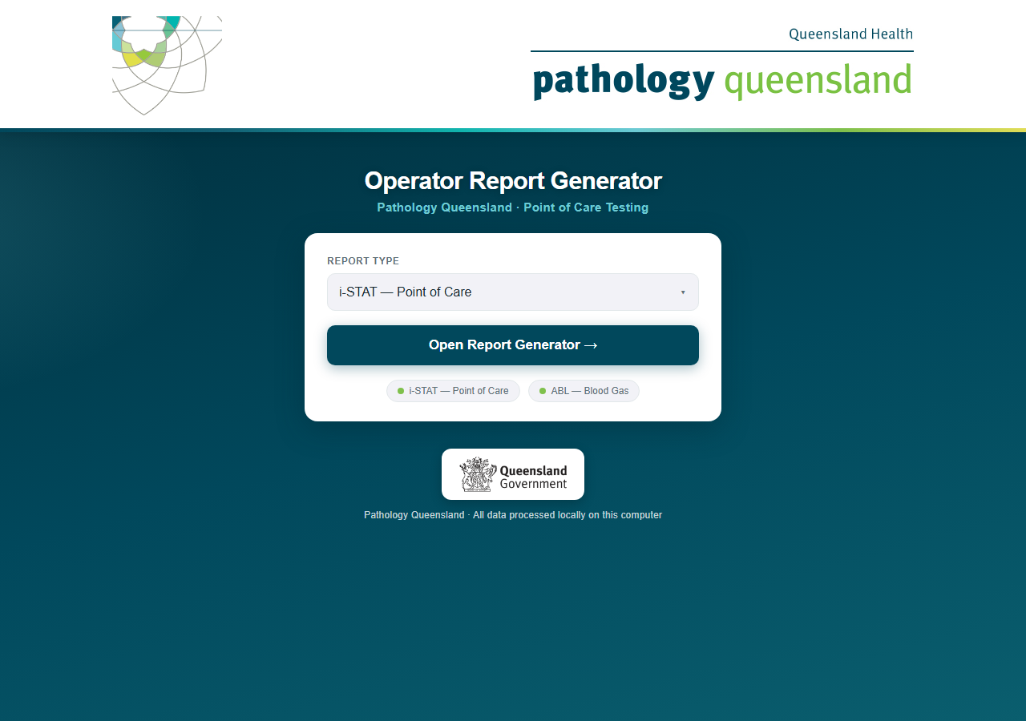
Operator Report Generator
Technical architecture — the i-STAT engine, its dependencies and its security model
A self-contained analytics and document-generation stack on one encrypted drive
Pathology Queensland · Point of Care Testing · September 2026
Conceived, designed and built by Craig MacKenzie · Chemistry Department, Townsville Group Laboratory · Pathology Queensland
Amendments and oversight by Damian Juskiw · Supervising Scientist, Chemical Pathology, Townsville
Notes:
This guide walks through the complete monthly routine: starting the program, generating i-STAT reports, generating ABL reports, and what to do when something looks wrong.

Slide 2
System architecture at a glance
i-STAT
Three loopback-only web services on an embedded runtime, orchestrated from a single launcher, with every byte of state on the drive
Operator
Browser on the host PC — talks to 127.0.0.1 only; nothing is installed
Portal · Flask :5750
Engine selection, licence gate and installer, licence register, same-origin guard; spawns the engines as child processes
Embedded Python 3.13
Portable interpreter and site-packages on the drive; zero host dependencies
Outputs
Reports\iSTAT\YYYY-MM Month
One folder per HHS
Hospital and ward reports · Site Overviews · Area Summaries · Cartridge Stock · Dormant list
~490 Word documents per run
Start PQ Reports.bat
Pins matplotlib’s cache to the drive, starts the portal, opens the browser when ready
i-STAT engine · Flask :5757
3,238-line analytics and rendering engine, 101 functions, 7 HTTP endpoints, background worker thread with a progress API
Encrypted state
Four history stores, AES at rest, 24-month rolling window
ABL engine · Flask :5758
Sister engine for Radiometer blood gas — same encryption, licensing and charting core
Runtime guards
netguard socket interception · licence enforcement before every request
Conceived, designed and built by Craig MacKenzie · Chemistry Department, Townsville Group Laboratory · Pathology Queensland
Amendments and oversight by Damian Juskiw · Supervising Scientist, Chemical Pathology, Townsville

Slide 3
The processing pipeline — eight stages per run
i-STAT
1 Ingest
openpyxl + pandas parse the multi-sheet middleware export: usage, error events, simulator and ceramic sheets, with header-row discovery
2 Normalise
Regex-driven column mapping, device-ID extraction, hospital and HHS prefix parsing, cartridge-type column detection
3 Partition
Per-hospital slices; 24 large sites split per analyser with folder overrides and ward-title rules; error events re-joined by location
4 Analyse
Error rates and performance bands, staff thresholds and recurring flags, the 4-month dormant rule, 12-month cartridge series
5 Chart
matplotlib (Agg backend) renders two charts per analyser on fixed 12-slot axes, capped at the report month, labelled on every segment
6 Assemble
python-docx builds the report at OOXML level: shaded tables, dxa column widths, keep-with-next pagination, 7.2-inch figures
7 Summarise
Site Overviews, Area Summaries with cartridge totals, a Cartridge Stock report per HHS, and the dormant-analyser list
8 Persist
Idempotent monthly upsert into the encrypted histories and the activity ledger; a re-run of a month overwrites, never duplicates
Every hospital runs inside its own fault boundary: an exception in one site is logged and the run continues, so one bad export row never costs the other 158 hospitals their reports.
Conceived, designed and built by Craig MacKenzie · Chemistry Department, Townsville Group Laboratory · Pathology Queensland
Amendments and oversight by Damian Juskiw · Supervising Scientist, Chemical Pathology, Townsville

Slide 4
The dependency stack
i-STAT
Eight components, all open-source or operating-system native, all pinned and carried on the drive — nothing is fetched at run time
Component | Role in the engine | Why it matters
Python 3.13 (embeddable) | Interpreter and standard library, shipped in the python\ folder | No installation, no admin rights, identical behaviour on every licensed PC
Flask ≥ 3.0 | HTTP front end for portal and engines, bound to 127.0.0.1 | A browser UI with a progress API, with no server exposed beyond the PC
pandas ≥ 2.0 | Vectorised analytics over the export: grouping, rates, joins by location | Thousands of rows per sheet processed in milliseconds, not loops
openpyxl ≥ 3.1 | Streams the .xlsx export sheet by sheet | Reads the middleware export directly, values only, no Excel required
python-docx ≥ 1.1 | Generates the Word reports from a branded template at OOXML level | Pixel-controlled tables, pagination and figures in native .docx
matplotlib ≥ 3.8 (Agg) | Headless chart rasterisation for the trend and volume charts | Deterministic charts with no display server and a drive-local font cache
cryptography | PBKDF2-HMAC-SHA256 key derivation, Fernet (AES-128-CBC + HMAC-SHA256), Ed25519 signatures | Encrypted histories and tamper-proof licences from one audited library
Windows native (ctypes, WMI) | Volume serial, system UUID and board serial for the machine fingerprint | Motherboard-bound licensing without any third-party agent
Conceived, designed and built by Craig MacKenzie · Chemistry Department, Townsville Group Laboratory · Pathology Queensland
Amendments and oversight by Damian Juskiw · Supervising Scientist, Chemical Pathology, Townsville

Slide 5
Stateful intelligence — the history layer
i-STAT
Each run is not a snapshot: four encrypted stores give every report a 12-month memory and let the engine recognise patterns a single export cannot show
error_rate_history
staff_error_history
Per analyser, per month: error rate, cartridges run, error-type mix and cartridge counts by type (patient and QC). Feeds the trend charts, the 12-month averages and the ordering guide.
Named operators and their monthly error counts per site. Drives the “This Month” and “Recurring” follow-up logic — consecutive months at the same site are flagged automatically.
error_type_history
device_activity_history
The leading error code each month per analyser, so a repeat (the same top code two months running) is surfaced as a habit rather than a bad month.
Cartridges, simulator runs and ceramic cleans per analyser per month. Four consecutive empty months trigger the dormant rule: no report, no penalty to the site, a line on the review list.
All four stores are AES-encrypted at rest with a key derived from the operator password (600,000 PBKDF2 iterations) and never written to disk; a plaintext sweep on unlock removes any legacy copies.
Conceived, designed and built by Craig MacKenzie · Chemistry Department, Townsville Group Laboratory · Pathology Queensland
Amendments and oversight by Damian Juskiw · Supervising Scientist, Chemical Pathology, Townsville

Slide 6
Defence in depth — six independent controls
i-STAT
1 Whole-drive encryption
2 Loopback-only binding
3 netguard interception
BitLocker To Go on the USB device. Lost drive, unreadable drive. Nothing is ever written to the host PC.
All three services bind to 127.0.0.1. There is no listening socket another machine could reach, even on the same network.
socket.connect, connect_ex and sendto are patched at start-up: any non-loopback destination is refused and written to an audit log. A runtime control, not a policy.
4 Encrypted histories
5 Ed25519 licensing
6 Audit trail
PBKDF2-HMAC-SHA256 (600,000 iterations) derives a Fernet key; AES-128-CBC with HMAC-SHA256 authentication. The password is held in memory only.
Every PC needs a licence signed by the PoC lead’s private key, bound to its motherboard fingerprint, pinned to a bundle version and dated to the QIS cycle.
licence_audit.log and istat_network_audit.log record every launch, licence event and blocked connection; the register lists every copy in circulation.
Conceived, designed and built by Craig MacKenzie · Chemistry Department, Townsville Group Laboratory · Pathology Queensland
Amendments and oversight by Damian Juskiw · Supervising Scientist, Chemical Pathology, Townsville

Slide 7
Licensing cryptography — how a PC is bound
i-STAT
A hardware fingerprint, an asymmetric signature and a dated, version-pinned payload — the LotWarden pattern, issued centrally with a full register
Machine fingerprint
Licence lifecycle
System UUID
SMBIOS, via WMI
Board serial
motherboard, via WMI
Volume serial
system drive, Win32 API
Hostname
socket.gethostname()
Issue
pq_keygen signs a JSON payload (site, machines, seats, expiry, max_version) with the Ed25519 private key — held offline by the PoC lead
Install
The .lic file goes to the drive root or through the selection page; the bundle carries only the public key
SHA-256 of the joined facts
Verify
Every request to either engine passes the licence gate: signature, fingerprint, date and version are checked
XXXX-XXXX-XXXX
first 12 hex digits, shown on the selection page
A copy of the drive on another PC produces a different fingerprint and is refused. The identifiers are read by the operating system, so there is no agent to install and nothing to tamper with.
Expire
LICENSED → EXPIRING (30 days’ notice) → GRACE (30 days) → locked. Each QIS review re-issues against the new bundle version
Conceived, designed and built by Craig MacKenzie · Chemistry Department, Townsville Group Laboratory · Pathology Queensland
Amendments and oversight by Damian Juskiw · Supervising Scientist, Chemical Pathology, Townsville

Slide 8
The document engine
i-STAT
Native Word output, generated at the XML level, so the reports look hand-built and open on any Queensland Health PC
Branded template
OOXML-level layout
Deterministic figures
Every document starts from template.docx: Pathology Queensland header, logos and footer fields. The engine strips the body and rebuilds it, so branding changes are a template edit, not a code change.
Borders, cell shading, dxa column widths, cell padding and keep-with-next are written directly into the document XML — sections never split across pages, tables never orphan a heading.
Charts are rasterised headlessly and embedded at a fixed 7.2-inch width with twelve fixed slots, so a January chart and a December chart line up on the wall.
Five document types
Throughput
Filed for distribution
Hospital and ward reports (six pages), Site Overviews, Area Summaries, Cartridge Stock reports and the dormant list — all from shared helpers and one title block.
About 490 documents in roughly eleven minutes on an ordinary laptop: around 1.3 seconds per document including two charts, with real-time counting on the progress card.
Reports\iSTAT\YYYY-MM Month, one sub-folder per Hospital and Health Service, summaries beside the reports they summarise, dormant list at the top.
Conceived, designed and built by Craig MacKenzie · Chemistry Department, Townsville Group Laboratory · Pathology Queensland
Amendments and oversight by Damian Juskiw · Supervising Scientist, Chemical Pathology, Townsville

Slide 9
Scale and performance
i-STAT
159
490
16
11 min
hospitals in a single export
Word documents per monthly run
HHS folders, each with its own summaries
for a complete statewide run
24
12
600,000
0
large sites reported per ward
months of memory behind every chart and average
PBKDF2 iterations protecting the histories
outbound network connections, by enforcement
What those numbers mean
The work that previously took a scientist most of a week each month — opening the export, filtering by site, charting, pasting into Word, filing — now takes one drop of the file and one click, and produces more than it ever did: per-ward reports, area roll-ups, ordering guides and a retirement list.
Because the engine keeps its own encrypted memory, each run gets better: trends lengthen, recurring operators and repeat error codes surface automatically, and ordering averages settle.
Conceived, designed and built by Craig MacKenzie · Chemistry Department, Townsville Group Laboratory · Pathology Queensland
Amendments and oversight by Damian Juskiw · Supervising Scientist, Chemical Pathology, Townsville

Slide 10
Engineering practice behind it
i-STAT
Version control
Reproducible deployment
Fault isolation and idempotence
Git repository with a whitelist .gitignore: code, templates and documentation are tracked; exports, histories, reports, licences and the private key can never be committed.
Master → staging bundle → USB, every file compared byte for byte after copying; one VERSION file ties the bundle to its licences.
Each hospital runs in its own try/except; a month can be re-run safely because history updates upsert rather than append.
De-identified demo pipeline
Sandboxed testing
Documentation set
A streaming de-identifier replaces every staff identity with a synthetic one so recordings, decks and the landing page never show a real name.
Flask test clients and isolated sandboxes with twelve months of backfilled history validate every change before it reaches the drive.
User guide, security briefing, two manager overviews, this deck, a security README for IT and a licensing runbook for the PoC lead.
Conceived, designed and built by Craig MacKenzie · Chemistry Department, Townsville Group Laboratory · Pathology Queensland
Amendments and oversight by Damian Juskiw · Supervising Scientist, Chemical Pathology, Townsville

Slide 11
Built to be extended
i-STAT
Configuration tables, not code paths: the changes managers most often ask for are single-line edits
Request | What changes | Effort
A new cartridge type from Abbott | One entry in the cartridge order list and the box-size table | Minutes
Split another hospital by ward | One hospital name in the per-device list; ward titles and folder overrides are tables too | Minutes
A new Hospital and Health Service | One entry in the HHS name table; folders and summaries follow automatically | Minutes
A new summary document | Shared title block, table and chart helpers — the Cartridge Stock report was built on them in a day | Days
A new analyser family | The ABL engine reuses the encryption, licensing, charting and summary architecture end to end | Weeks
A new reporting rule (e.g. dormant months) | Named constants at the top of the engine, documented in the user guide | Minutes
The two engines share one security model and one licensing model, so a control added for i-STAT — encrypted histories, the network guard, central licences — reaches the ABL reports in the same release.
Conceived, designed and built by Craig MacKenzie · Chemistry Department, Townsville Group Laboratory · Pathology Queensland
Amendments and oversight by Damian Juskiw · Supervising Scientist, Chemical Pathology, Townsville

Slide 12
In one slide
What it is
What it depends on
What protects it
A portable, self-contained analytics and document-generation platform: an embedded Python runtime, three loopback-only services and an encrypted state layer that turns one monthly export into around 490 branded Word reports, summaries and ordering guides.
Eight pinned, open-source or operating-system-native components — Python, Flask, pandas, openpyxl, python-docx, matplotlib, cryptography and Windows identity APIs — all carried on the drive. No cloud, no installation, no network.
Six independent controls: whole-drive encryption, loopback binding, socket-level network interception, AES-encrypted histories, motherboard-bound Ed25519 licences on the QIS cycle, and audit logs of every launch and every blocked connection.
Conceived, designed and built by Craig MacKenzie · Chemistry Department, Townsville Group Laboratory · Pathology Queensland
Amendments and oversight by Damian Juskiw · Supervising Scientist, Chemical Pathology, Townsville

