Slide 1

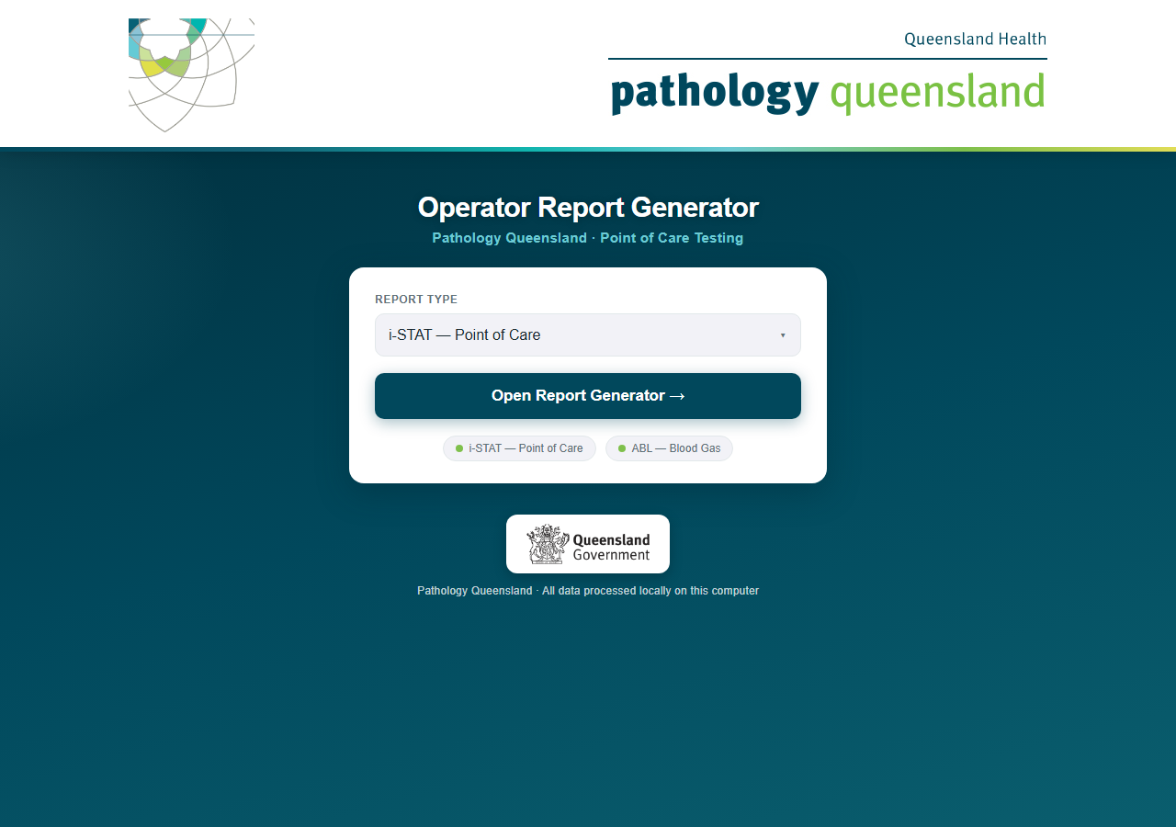
Operator Report Generator
What it does, what it produces — an overview for managers
One drive, one click, every hospital and ward reported
Pathology Queensland · Point of Care Testing · September 2026
Conceived, designed and built by Craig MacKenzie · Chemistry Department, Townsville Group Laboratory · Pathology Queensland
Notes:
This guide walks through the complete monthly routine: starting the program, generating i-STAT reports, generating ABL reports, and what to do when something looks wrong.

Slide 2
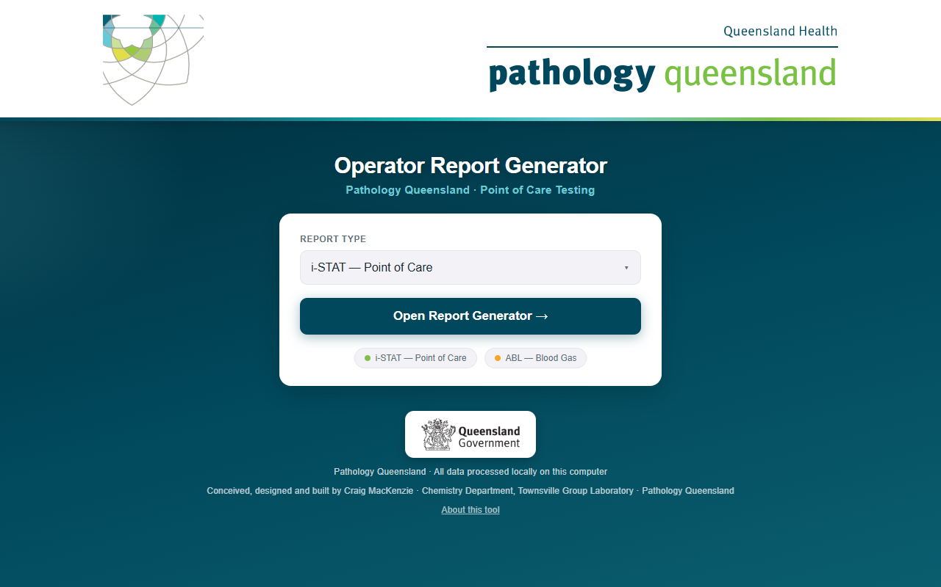
A full run in one minute
VIDEO
Click the picture to play
A real August 2026 run recorded end to end: launch, unlock the encrypted history, drop the export, load the hospitals, generate, results.
Generation for 159 hospitals takes about ten minutes; the video shows it at 30× speed, everything else at real speed.
Every staff name in the demo is synthetic. Hospitals, wards and analyser serials are real.
Conceived, designed and built by Craig MacKenzie · Chemistry Department, Townsville Group Laboratory · Pathology Queensland

Slide 3
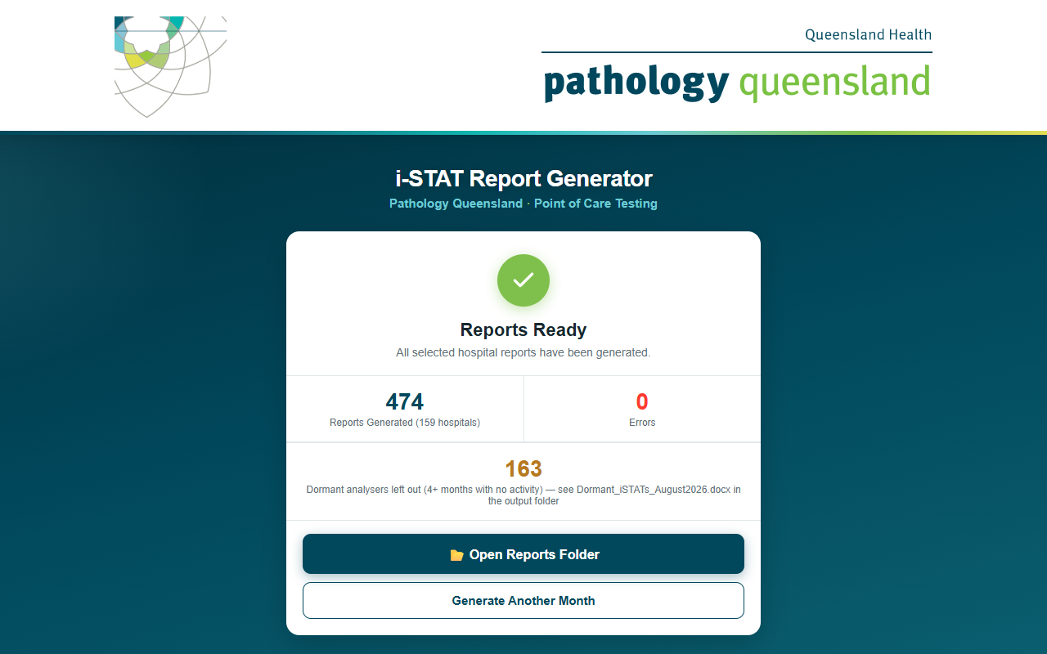
What one run produces
159
474
16
163
0
hospitals in one export
Word documents
HHS folders
dormant analysers listed
network connections, ever
Filed by Hospital and Health Service
CA\ 40 documents
ChildQLD\ 17 documents
Mackay\ 17 documents
NoWe\ 19 documents
ToCa\ 22 documents
WiBa\ 38 documents
CQLD\ 31 documents
DaDo\ 45 documents
MeNo\ 63 documents
SoWe\ 16 documents
Townsv\ 33 documents
CWest\ 17 documents
GoCo\ 25 documents
MeSo\ 39 documents
SuCo\ 25 documents
WeMo\ 26 documents
Dormant_iSTATs_August2026.docx sits at the top level of the month folder — every analyser left out and why.
The results card at the end of a run
Conceived, designed and built by Craig MacKenzie · Chemistry Department, Townsville Group Laboratory · Pathology Queensland

Slide 4
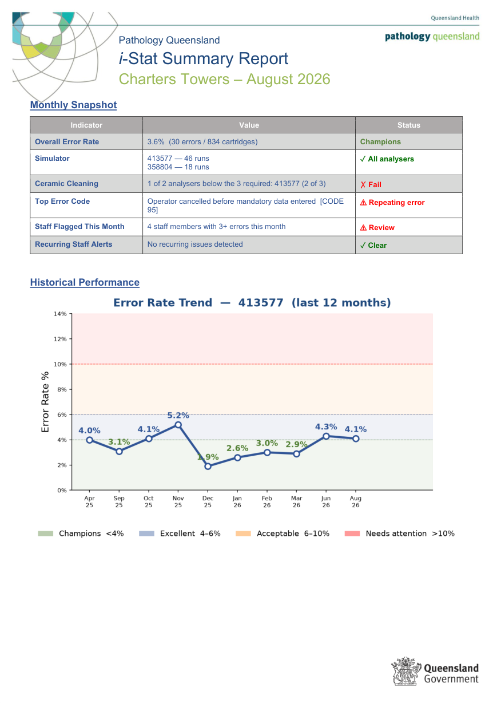
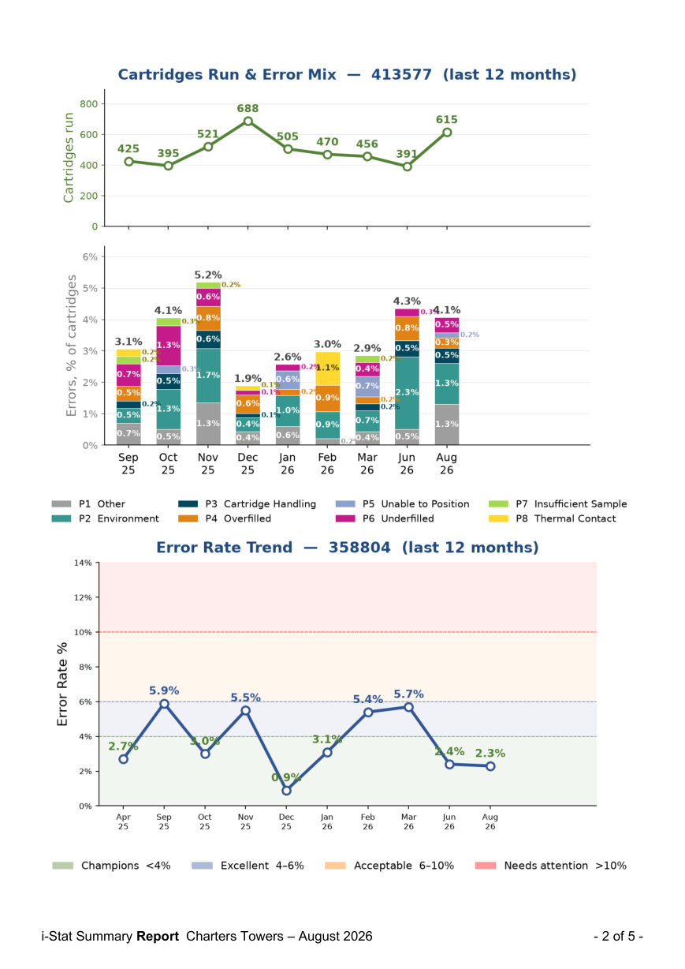
The monthly report — Charters Towers, August 2026
i-STAT
What the site gets each month
A monthly snapshot: error rate, simulator and ceramic checks per analyser, top error, staff flagged this month, recurring alerts.
Two 12-month charts per analyser: the error-rate trend against the performance bands, and cartridges run with the error mix.
Every cartridge error with the staff member, the code and its likely cause, then a follow-up list of staff with three or more errors.
Smaller sites get one report covering all their analysers; the twenty-four largest hospitals get one per ward, plus a site overview.
Page 1: snapshot and 12-month trend
Page 2: cartridges and error mix per analyser
Conceived, designed and built by Craig MacKenzie · Chemistry Department, Townsville Group Laboratory · Pathology Queensland

Slide 5
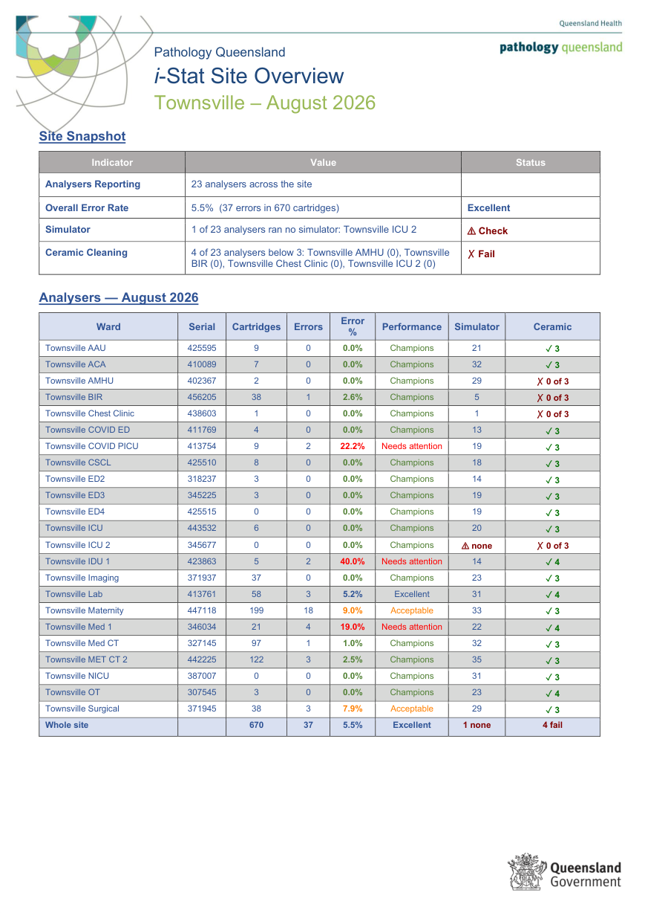
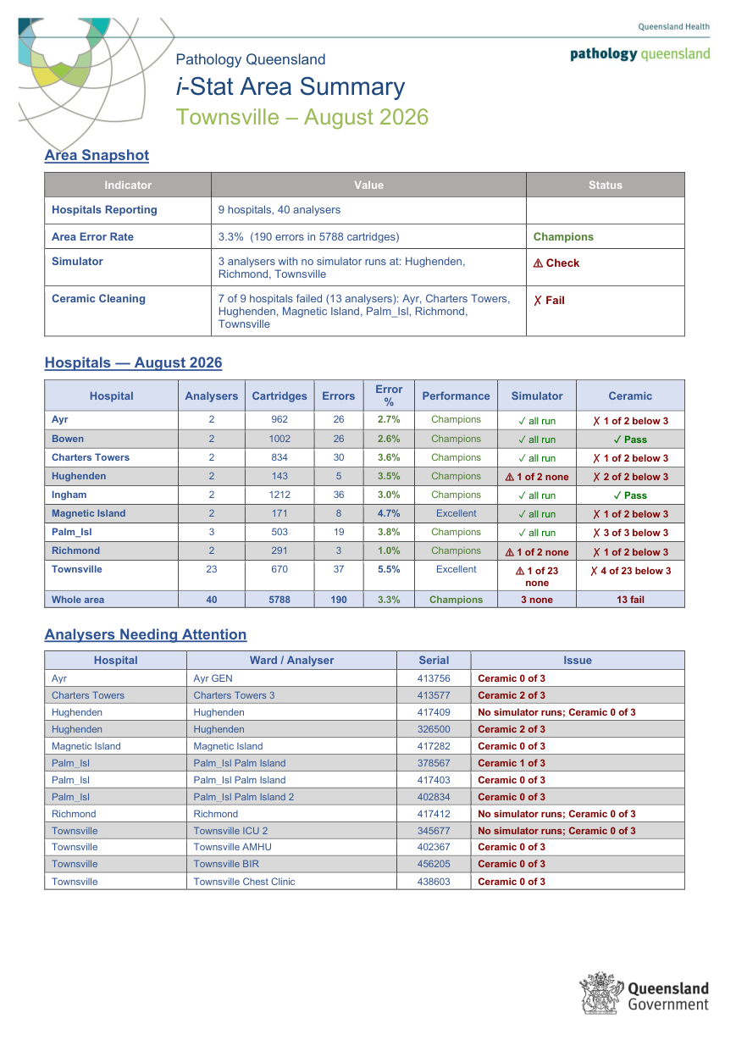
Summaries for site leads and area managers
i-STAT
The whole picture on one page
Site Overview: each ward’s analyser with cartridges, errors, error %, performance band, simulator runs and a ceramic pass or fail, plus a site total.
Area Summary: the same figures per hospital across the HHS, an area total, and a table of every analyser that missed simulators or ceramics.
Both are produced automatically with every run, in the same folder as the reports.
Site Overview — every ward of a large site on one page
Area Summary — every hospital in the HHS
Conceived, designed and built by Craig MacKenzie · Chemistry Department, Townsville Group Laboratory · Pathology Queensland

Slide 6
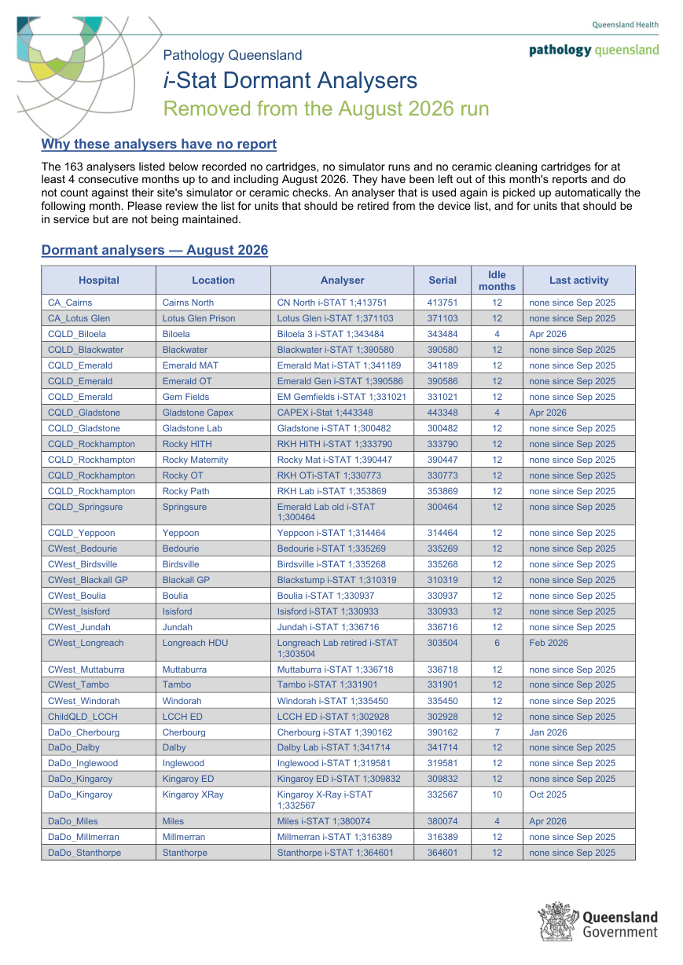
Dormant analysers — found, left out, listed
i-STAT
The four-month rule
An analyser with no cartridges, no simulator runs and no ceramic cleaning for four consecutive months is dormant: it gets no report and no longer counts against its site’s checks.
One or two quiet months change nothing. The reports exist to catch wards skipping simulators, so nothing is removed early.
Any use brings the unit straight back the next month.
Every run writes the list: hospital, location, serial, months idle and last activity. In August 2026, 163 units — mostly old models sitting beside their replacements — a ready-made retirement list.
The dormant-analyser list for August 2026
Conceived, designed and built by Craig MacKenzie · Chemistry Department, Townsville Group Laboratory · Pathology Queensland

Slide 7
How it protects the data
Runs from an encrypted USB drive
Offline by enforcement
Its own Python runtime, no installation, no admin rights, no changes to the PC. BitLocker To Go encrypts the whole drive.
All three servers bind to the local machine only, and a runtime guard blocks and logs any attempt to reach the network. Zero outbound connections, ever.
Named staff data encrypted
Controlled roll-out
The rolling staff and device history is AES-encrypted with a password that is never stored. Reports cannot be generated until it is unlocked.
It runs only on PCs approved by the PoC lead, reviewed on the 12-month QIS cycle, with an audit trail of every launch and every report generated.
Full detail for IT: SECURITY_README.md on the drive and the Security Briefing deck.
Conceived, designed and built by Craig MacKenzie · Chemistry Department, Townsville Group Laboratory · Pathology Queensland

Slide 8
Getting the reports for your site
1. Ask the PoC team
2. Tell us your wards
Reports are generated centrally each month from the middleware exports and distributed by HHS folder.
Large sites get one report per ward. If a ward name or split is wrong, it is a one-line change.
3. Check the dormant list
4. Read the summaries first
Units on it are candidates for retirement, or should be back in service and maintained.
Site Overview for a site lead, Area Summary for an area manager, then the ward reports that need action.
Support: Pathology Queensland Point of Care team · Chemistry Department, Townsville Group Laboratory
Conceived, designed and built by Craig MacKenzie · Chemistry Department, Townsville Group Laboratory · Pathology Queensland

