Slide 1

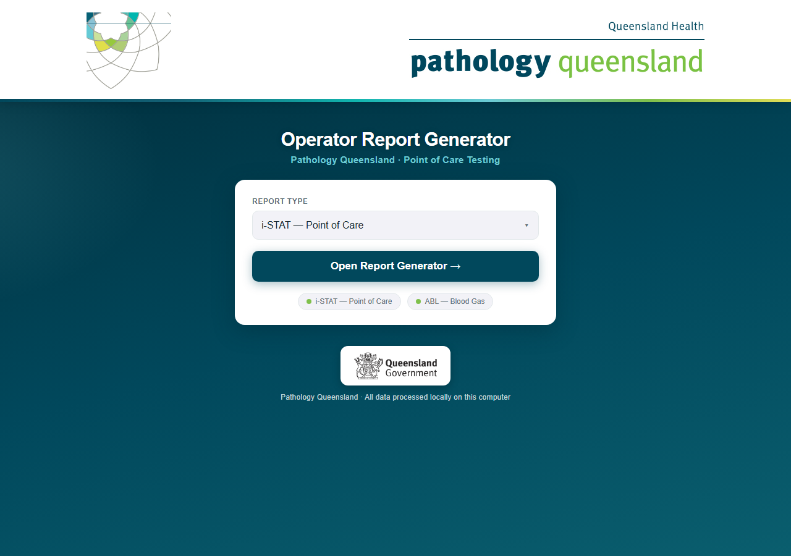
Operator Report Generator
i-STAT reports — an overview for managers
One drive, one click, every hospital and ward reported
Pathology Queensland · Point of Care Testing · September 2026
Conceived, designed and built by Craig MacKenzie · Chemistry Department, Townsville Group Laboratory · Pathology Queensland
Notes:
This guide walks through the complete monthly routine: starting the program, generating i-STAT reports, generating ABL reports, and what to do when something looks wrong.

Slide 2
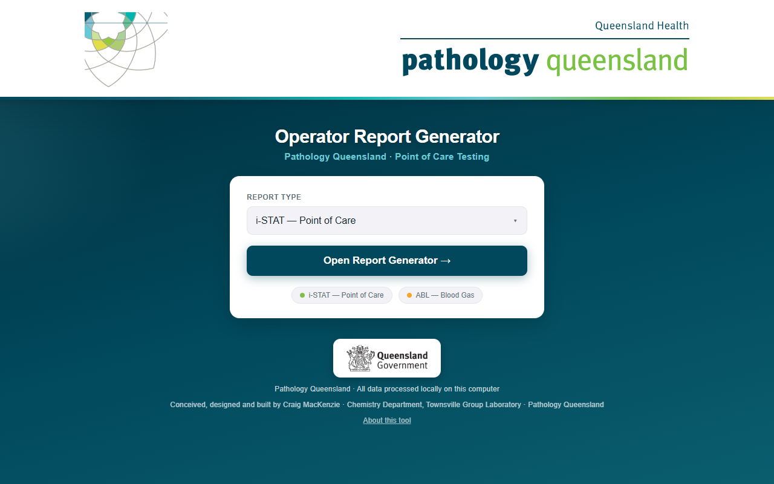
A full run in one minute
VIDEO
Click the picture to play
A real August 2026 run recorded end to end: launch, unlock the encrypted history, drop the export, load the hospitals, generate, results.
Generation for 159 hospitals takes about ten minutes; the video shows it at 30× speed, everything else at real speed.
Every staff name in the demo is synthetic. Hospitals, wards and analyser serials are real.
Conceived, designed and built by Craig MacKenzie · Chemistry Department, Townsville Group Laboratory · Pathology Queensland

Slide 3
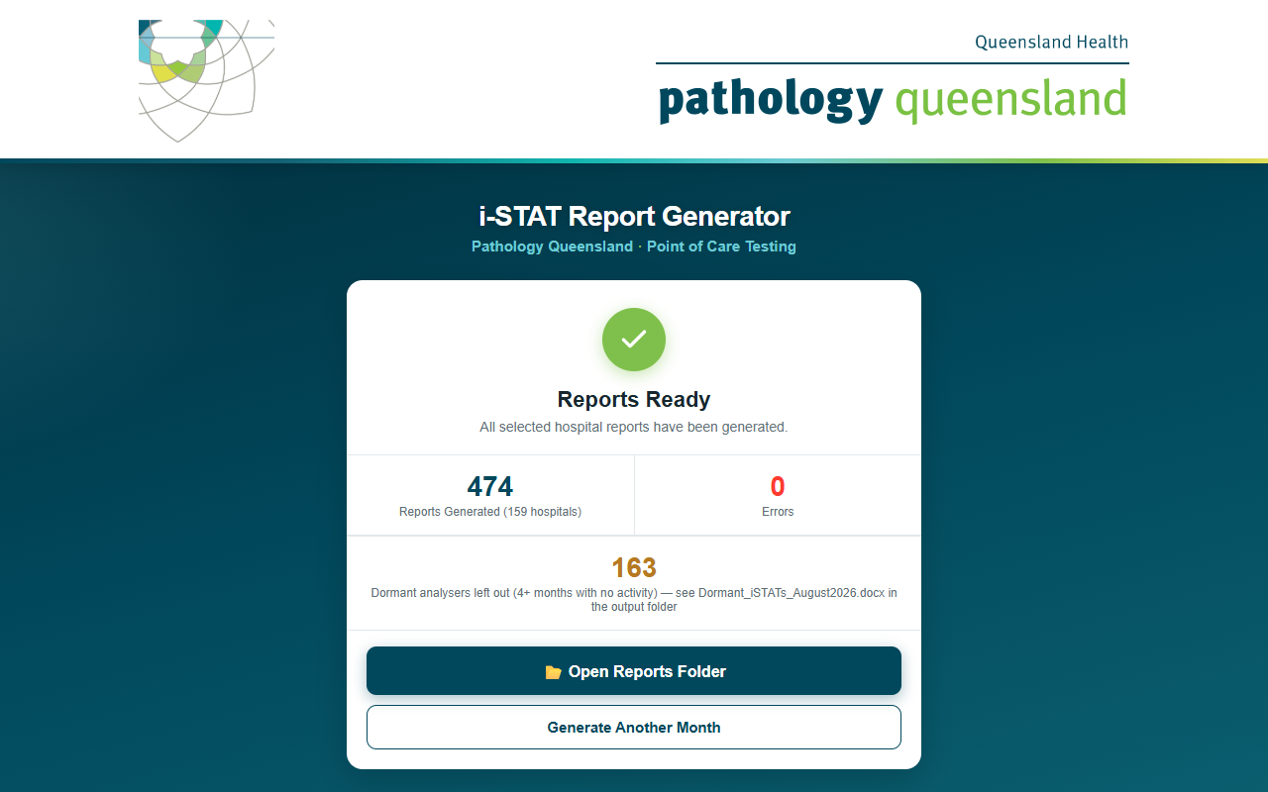
What one run produces
159
474
16
163
0
hospitals in one export
Word documents
HHS folders
dormant analysers listed
network connections, ever
Filed by Hospital and Health Service
CA\ 40 documents
ChildQLD\ 17 documents
Mackay\ 17 documents
NoWe\ 19 documents
ToCa\ 22 documents
WiBa\ 38 documents
CQLD\ 31 documents
DaDo\ 45 documents
MeNo\ 63 documents
SoWe\ 16 documents
Townsv\ 33 documents
CWest\ 17 documents
GoCo\ 25 documents
MeSo\ 39 documents
SuCo\ 25 documents
WeMo\ 26 documents
Dormant_iSTATs_August2026.docx sits at the top level of the month folder — every analyser left out and why.
The results card at the end of a run
Conceived, designed and built by Craig MacKenzie · Chemistry Department, Townsville Group Laboratory · Pathology Queensland

Slide 4
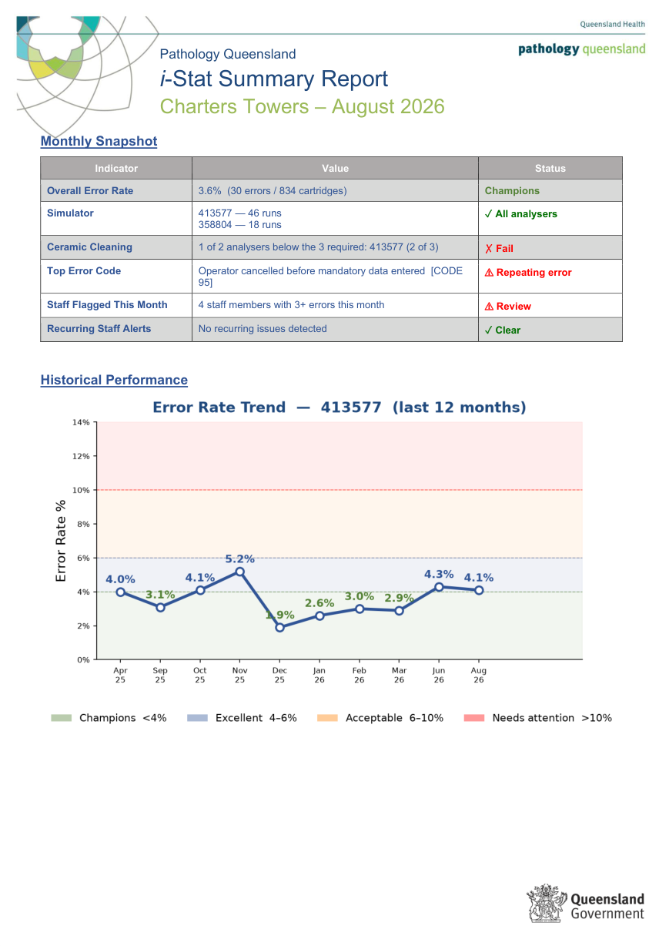
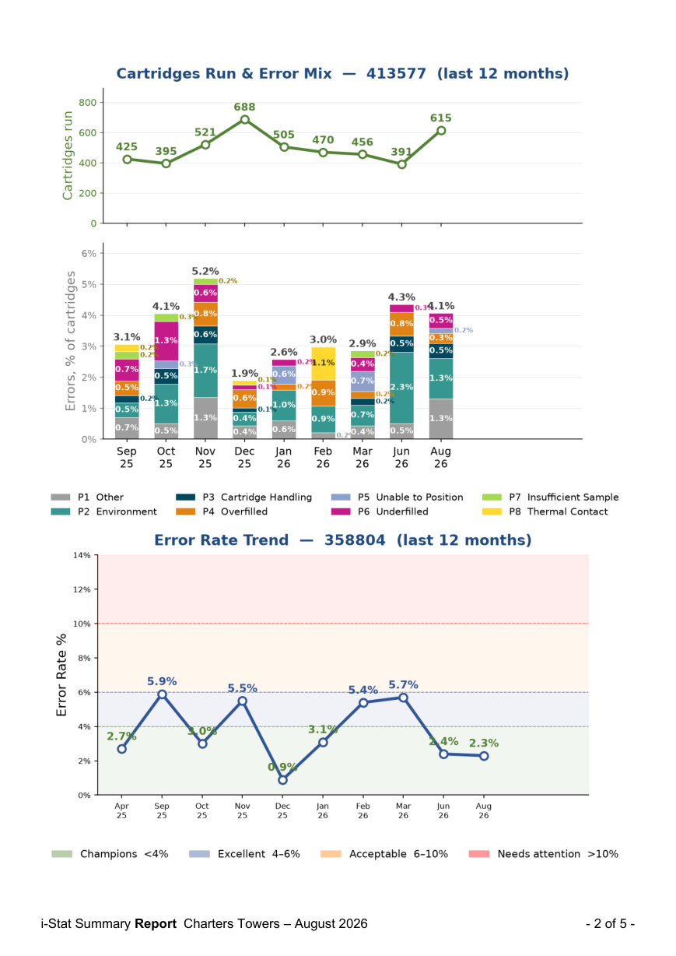
Charters Towers, August 2026 — pages 1–2 of 5
i-STAT
Page 1 — the month at a glance
Monthly Snapshot: overall error rate with its performance band (3.6%, Champions); simulator runs per analyser; ceramic cleaning per analyser (here one of two failed); the top error code, flagged when it repeats from the previous month; staff flagged this month (four with 3+ errors); recurring staff alerts.
Error Rate Trend for the first analyser: twelve months against the colour bands, so a drift is visible before it becomes a problem.
Page 2 — Cartridges Run & Error Mix for the same analyser: workload on top, each month’s errors as a percentage split by category (handling, overfilled, underfilled, sample volume and so on), then the trend chart for the second analyser.
Page 1: snapshot and first trend
Page 2: error mix, second trend
Conceived, designed and built by Craig MacKenzie · Chemistry Department, Townsville Group Laboratory · Pathology Queensland

Slide 5
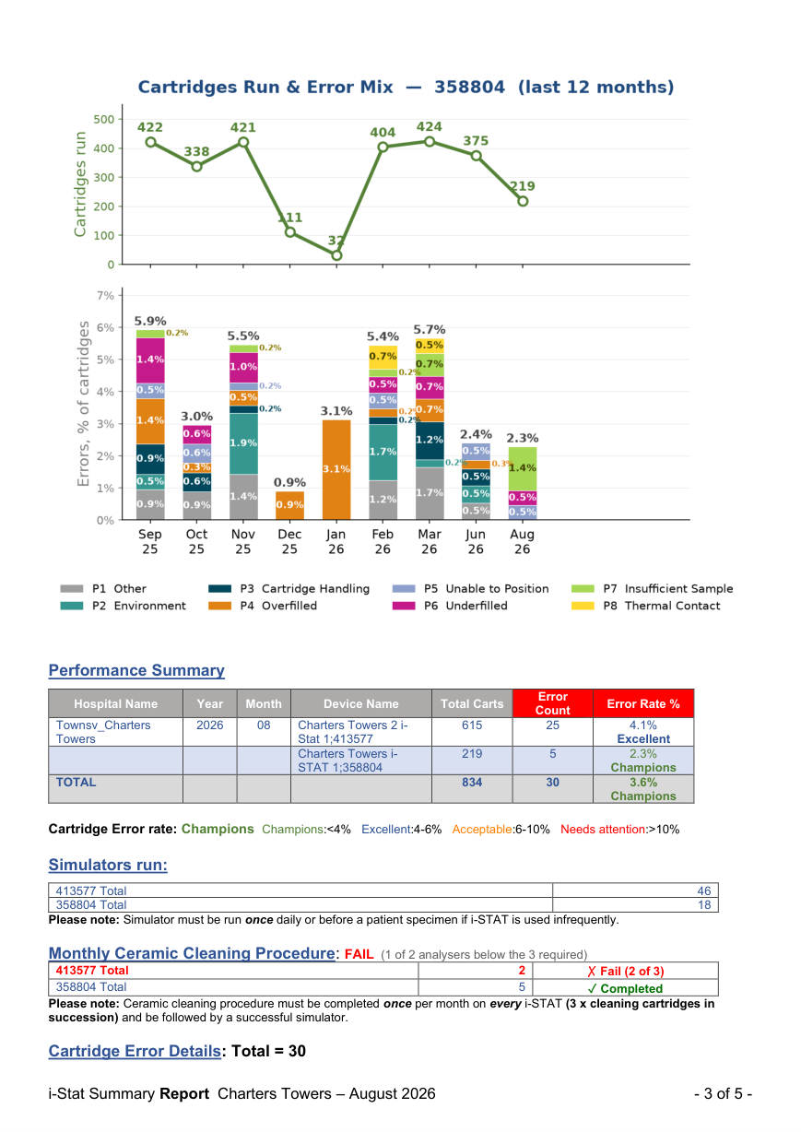
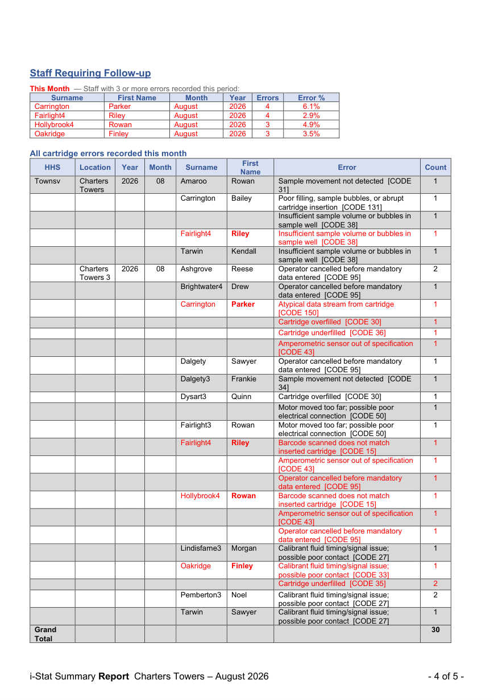
Charters Towers, August 2026 — pages 3–4 of 5
i-STAT
Page 3 — performance and QC compliance
Error mix for the second analyser, then the Performance Summary: cartridges, errors and error rate per analyser with its band, and the site total.
Simulators run per analyser, and the Monthly Ceramic Cleaning check per analyser — FAIL if any analyser is below the three cartridges required.
Page 4 — Staff Requiring Follow-up: this month’s staff with three or more errors, with their error count and personal error rate; a Recurring section appears when someone is flagged in consecutive months.
All cartridge errors recorded this month: every event by location and staff member, the code and its likely cause, flagged staff in red — the evidence behind the follow-up list.
Page 3: performance and QC checks
Page 4: staff follow-up, every error
Conceived, designed and built by Craig MacKenzie · Chemistry Department, Townsville Group Laboratory · Pathology Queensland

Slide 6
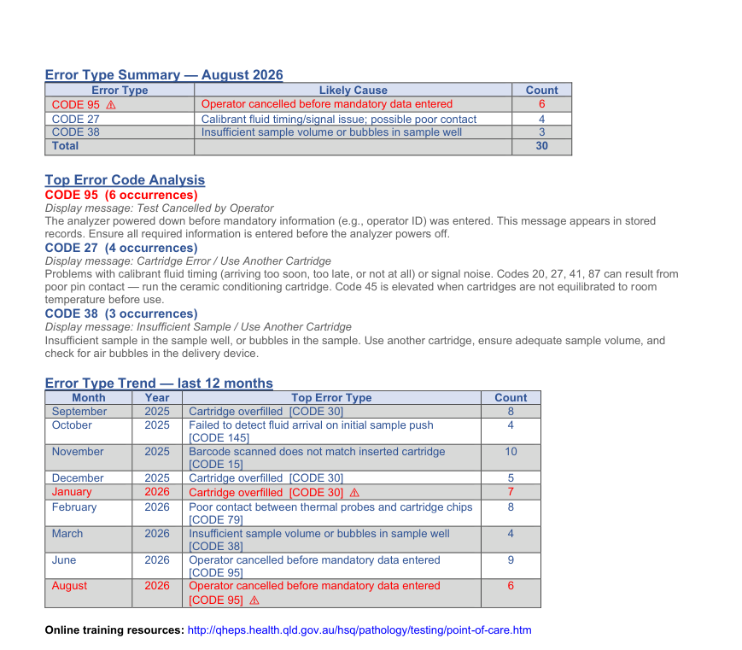
Charters Towers, August 2026 — page 5 of 5
i-STAT
Page 5 — understanding the errors
Error Type Summary: the month’s error codes with their likely cause and count, the top code flagged when it is a repeat.
Top Error Code Analysis: the device message and a plain-English explanation of each leading code — what the operator saw and what to do about it. Here CODE 95 (operator cancelled before mandatory data was entered) leads for the second time.
Error Type Trend: the top error type each month for the last twelve, repeats flagged — the difference between a bad month and a habit.
A link to the online training resources closes every report.
Page 5: error causes and the 12-month pattern
Conceived, designed and built by Craig MacKenzie · Chemistry Department, Townsville Group Laboratory · Pathology Queensland

Slide 7
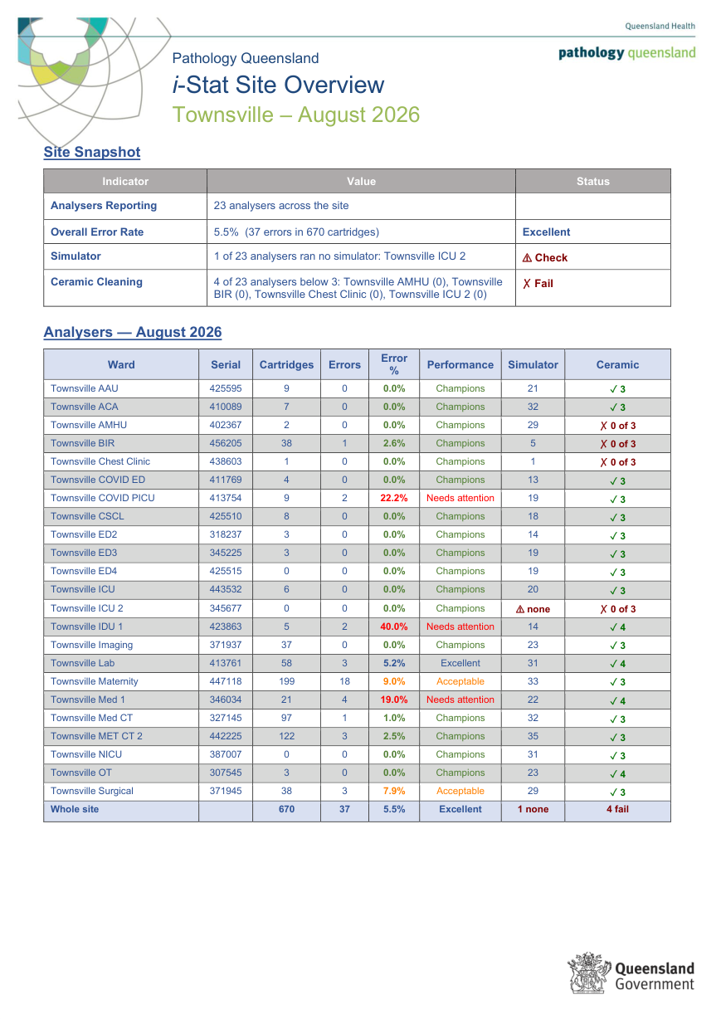
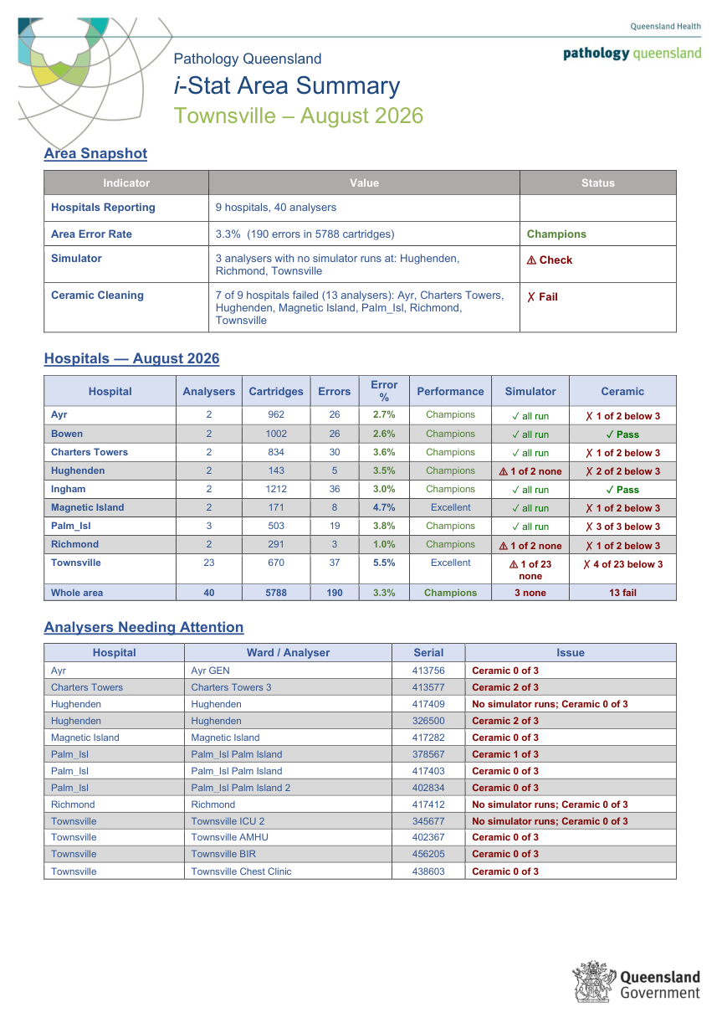
Summaries for site leads and area managers
i-STAT
The whole picture on one page
Site Overview: each ward’s analyser with cartridges, errors, error %, performance band, simulator runs and a ceramic pass or fail, plus a site total.
Area Summary: the same figures per hospital across the HHS, an area total, and a table of every analyser that missed simulators or ceramics.
Both are produced automatically with every run, in the same folder as the reports.
Site Overview — every ward of a large site on one page
Area Summary — every hospital in the HHS
Conceived, designed and built by Craig MacKenzie · Chemistry Department, Townsville Group Laboratory · Pathology Queensland

Slide 8
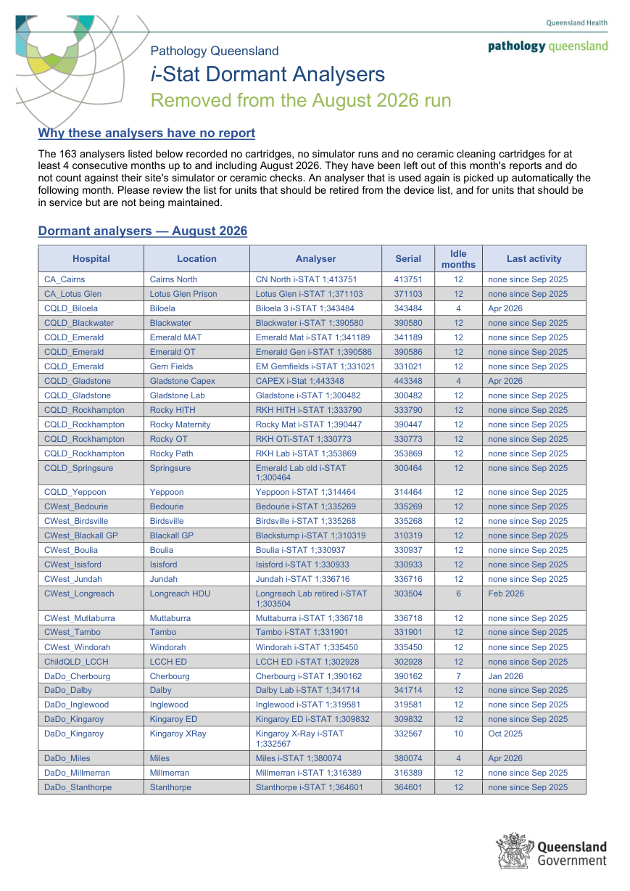
Dormant analysers — found, left out, listed
i-STAT
The four-month rule
An analyser with no cartridges, no simulator runs and no ceramic cleaning for four consecutive months is dormant: it gets no report and no longer counts against its site’s checks.
One or two quiet months change nothing. The reports exist to catch wards skipping simulators, so nothing is removed early.
Any use brings the unit straight back the next month.
Every run writes the list: hospital, location, serial, months idle and last activity. In August 2026, 163 units — mostly old models sitting beside their replacements — a ready-made retirement list.
The dormant-analyser list for August 2026
Conceived, designed and built by Craig MacKenzie · Chemistry Department, Townsville Group Laboratory · Pathology Queensland

Slide 9
How it protects the data
Runs from an encrypted USB drive
Offline by enforcement
Its own Python runtime, no installation, no admin rights, no changes to the PC. BitLocker To Go encrypts the whole drive.
All three servers bind to the local machine only, and a runtime guard blocks and logs any attempt to reach the network. Zero outbound connections, ever.
Named staff data encrypted
Controlled roll-out
The rolling staff and device history is AES-encrypted with a password that is never stored. Reports cannot be generated until it is unlocked.
It runs only on PCs approved by the PoC lead, reviewed on the 12-month QIS cycle, with an audit trail of every launch and every report generated.
Full detail for IT: SECURITY_README.md on the drive and the Security Briefing deck.
Conceived, designed and built by Craig MacKenzie · Chemistry Department, Townsville Group Laboratory · Pathology Queensland

Slide 10
Getting the reports for your site
1. Ask the PoC team
2. Tell us your wards
Reports are generated centrally each month from the middleware exports and distributed by HHS folder.
Large sites get one report per ward. If a ward name or split is wrong, it is a one-line change.
3. Check the dormant list
4. Read the summaries first
Units on it are candidates for retirement, or should be back in service and maintained.
Site Overview for a site lead, Area Summary for an area manager, then the ward reports that need action.
Support: Pathology Queensland Point of Care team · Chemistry Department, Townsville Group Laboratory
Conceived, designed and built by Craig MacKenzie · Chemistry Department, Townsville Group Laboratory · Pathology Queensland

