Slide 1

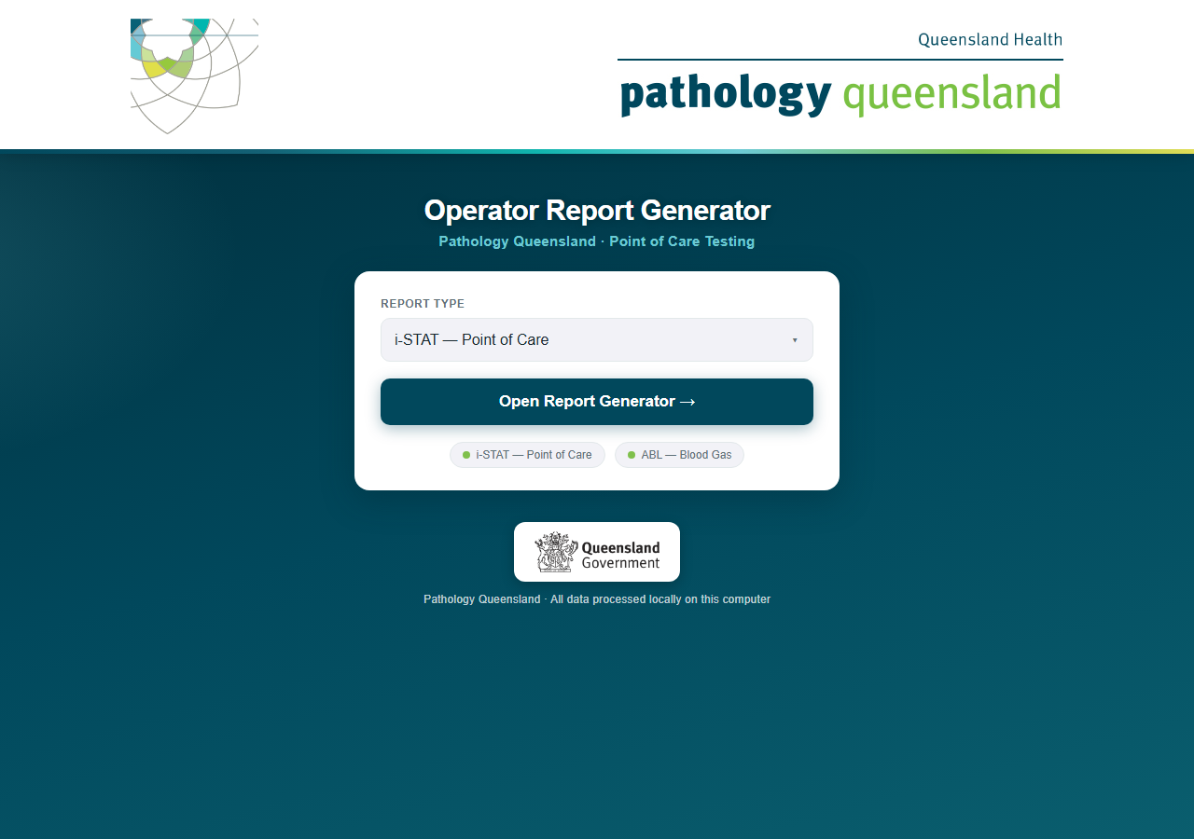
Operator Report Generator
Radiometer ABL blood-gas reports — an overview for managers
One drive, one click, every department reported
Pathology Queensland · Point of Care Testing · September 2026
Conceived, designed and built by Craig MacKenzie · Chemistry Department, Townsville Group Laboratory · Pathology Queensland
Amendments and oversight by Damian Juskiw · Supervising Scientist, Chemical Pathology, Townsville
Notes:
This guide walks through the complete monthly routine: starting the program, generating i-STAT reports, generating ABL reports, and what to do when something looks wrong.

Slide 2
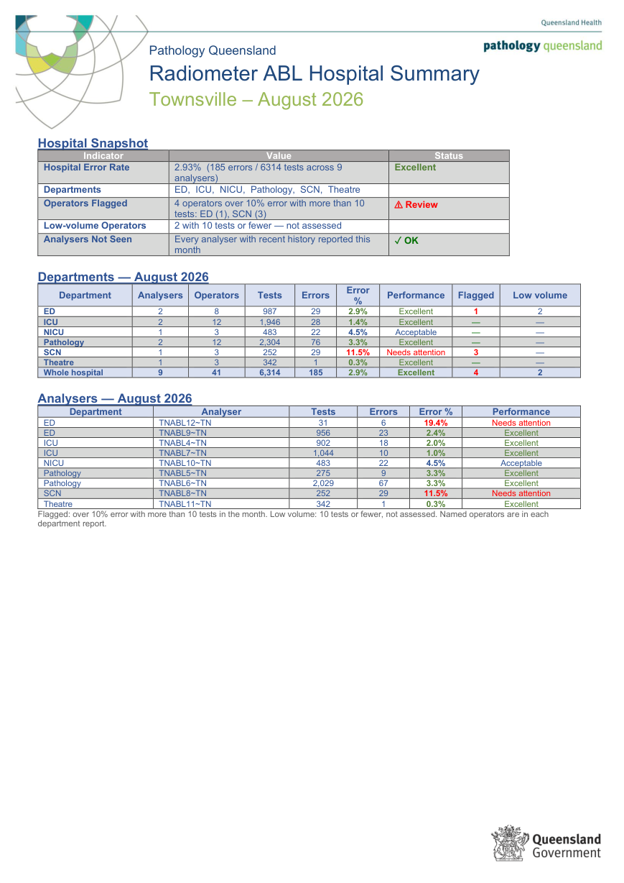
What one run produces
ABL
16
54
16
70
0
hospitals in one export
department reports
hospital summaries
Word documents
network connections, ever
Filed by hospital
Caboolture\ 4 documents
Gympie\ 3 documents
Logan\ 2 documents
Nambour\ 2 documents
Robina\ 4 documents
Townsville\ 7 documents
Cairns\ 2 documents
Hervey_Bay\ 4 documents
Maryborough\ 2 documents
RBWH\ 10 documents
SCUH\ 8 documents
GCUH\ 6 documents
Lady_Cilento\ 5 documents
Mount_Isa\ 4 documents
Redland\ 4 documents
TPCH\ 3 documents
One report per department, and one Hospital Summary per hospital, in that hospital’s folder. Operators with more than 10 tests and over 10% error are flagged; 10 tests or fewer are noted but not assessed.
A Hospital Summary — Townsville, August 2026
Conceived, designed and built by Craig MacKenzie · Chemistry Department, Townsville Group Laboratory · Pathology Queensland
Amendments and oversight by Damian Juskiw · Supervising Scientist, Chemical Pathology, Townsville

Slide 3
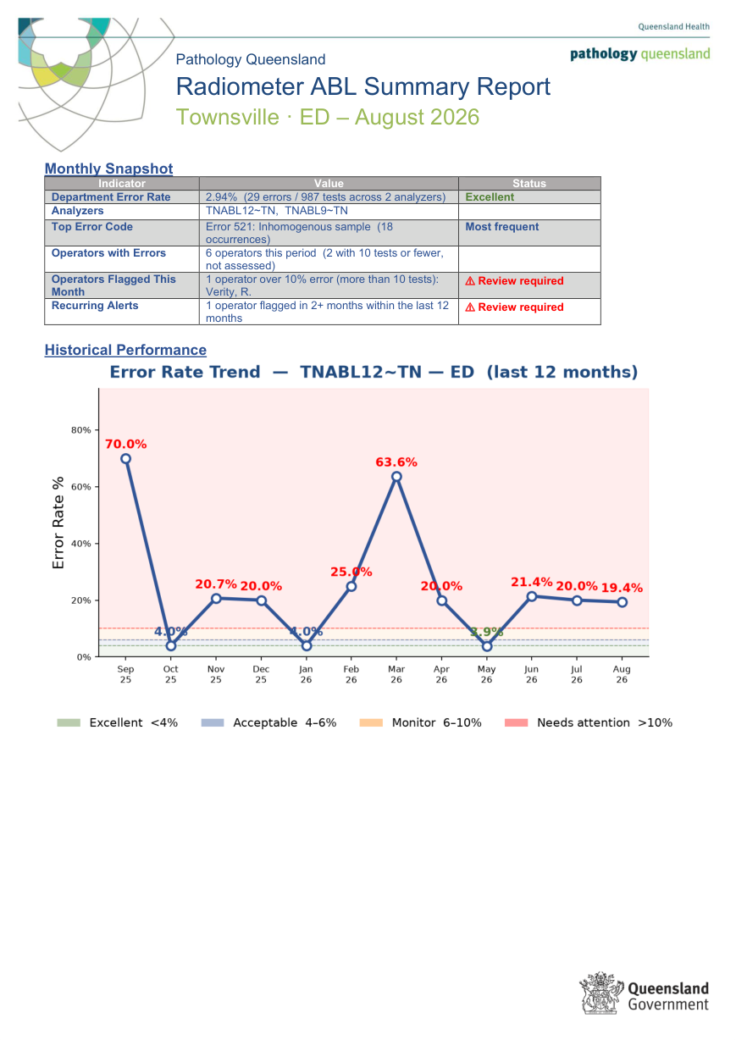
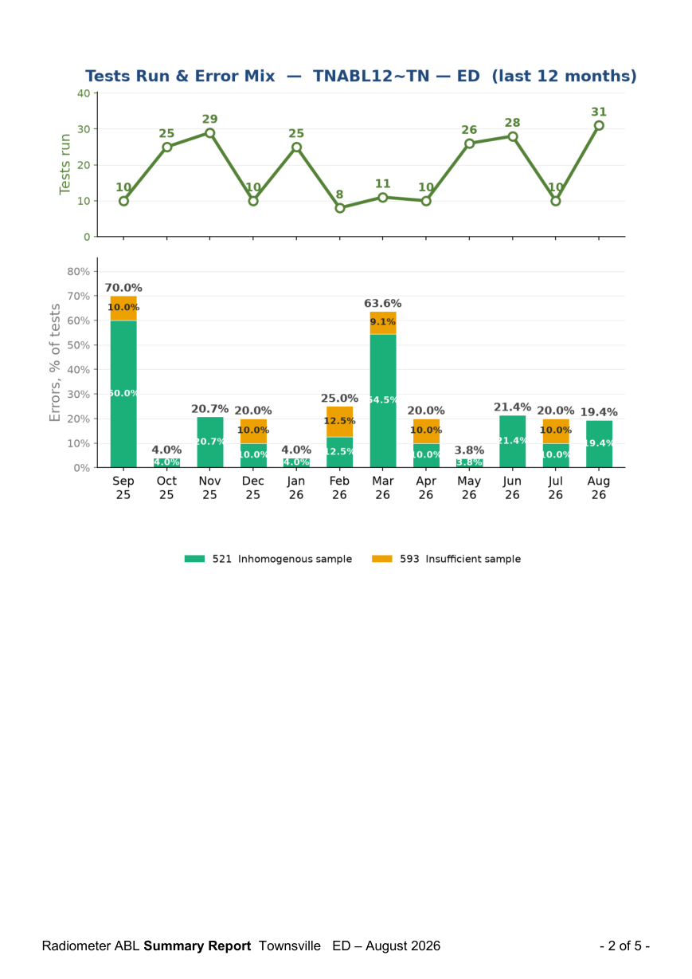
Townsville ED, August 2026 — pages 1–2 of 5
ABL
The department report
One report per hospital department. Page 1 — Monthly Snapshot: department error rate with its band, the analysers covered, the top error code, operators with errors (and how many were too low-volume to assess), operators flagged this month by name, and recurring alerts from the 12-month lookback.
Then the Error Rate Trend for the first analyser against the performance bands.
Page 2 — Tests Run & Error Mix for that analyser: workload on top, each month’s errors as a percentage of tests split by ABL error code, every segment labelled.
Page 1: department snapshot, first analyser trend
Page 2: tests and error mix, first analyser
Conceived, designed and built by Craig MacKenzie · Chemistry Department, Townsville Group Laboratory · Pathology Queensland
Amendments and oversight by Damian Juskiw · Supervising Scientist, Chemical Pathology, Townsville

Slide 4
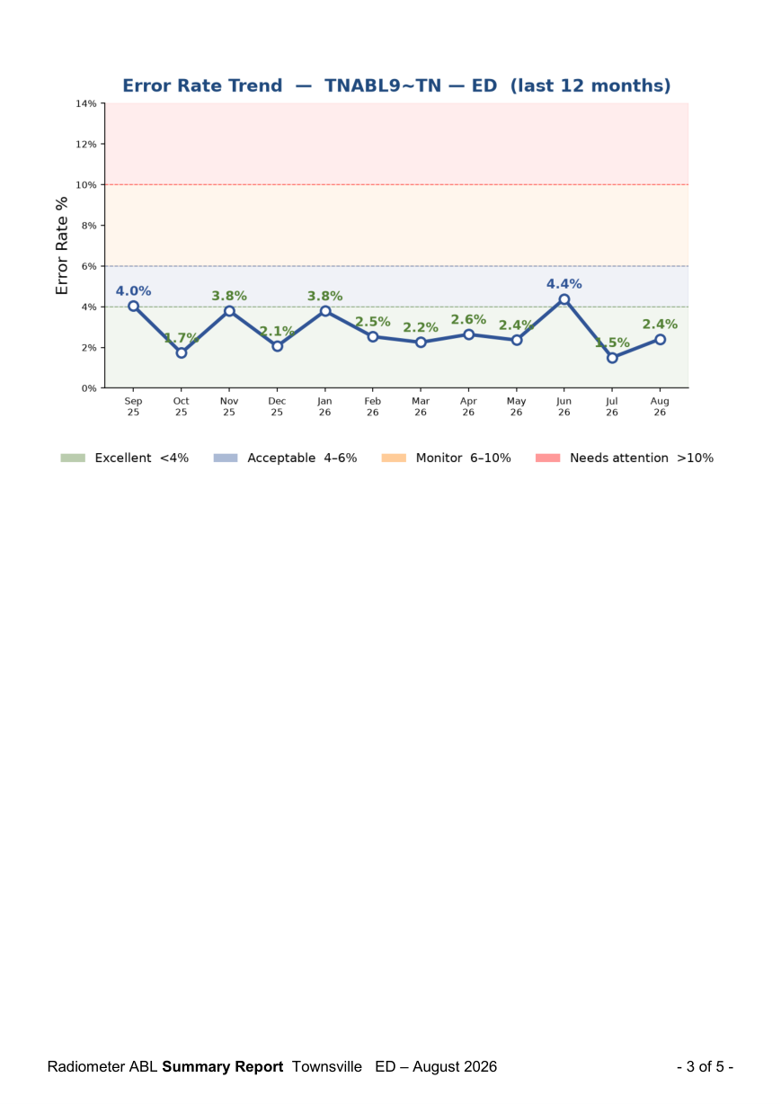
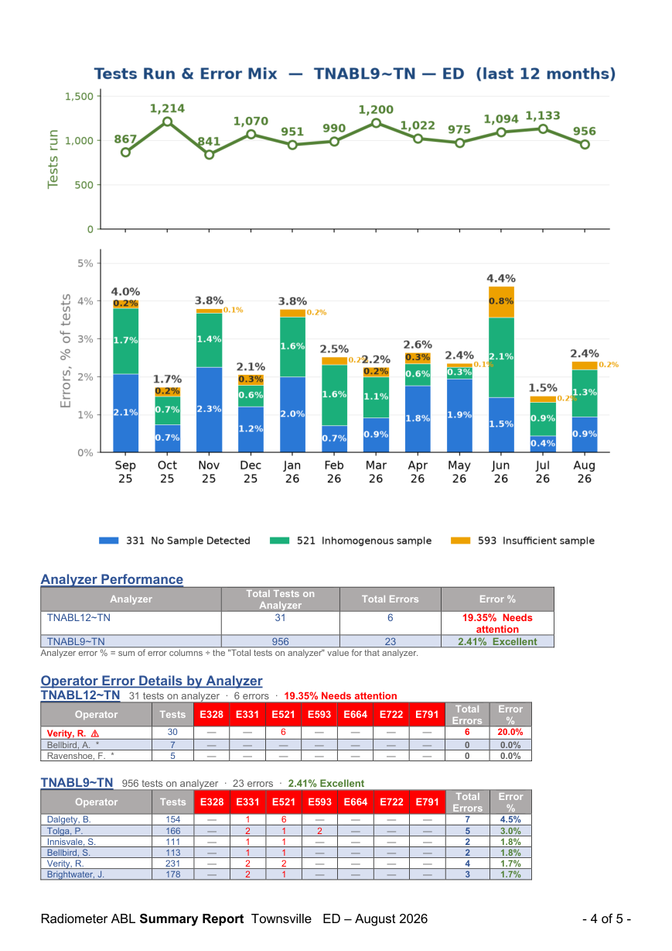
Townsville ED, August 2026 — pages 3–4 of 5
ABL
Per analyser, then per operator
Pages 3–4 repeat both charts for the second analyser, so each instrument’s twelve months are visible on their own.
Analyzer Performance: total tests, total errors and error % per analyser with its band.
Operator Error Details by Analyzer: every operator on each analyser with tests run, a column per ABL error code (328–791), total errors and error %. Flagged operators — over 10% error with more than 10 tests — are in red; low-volume operators are marked and not assessed.
Page 3: second analyser trend
Page 4: error mix, analyser performance, operators
Conceived, designed and built by Craig MacKenzie · Chemistry Department, Townsville Group Laboratory · Pathology Queensland
Amendments and oversight by Damian Juskiw · Supervising Scientist, Chemical Pathology, Townsville

Slide 5
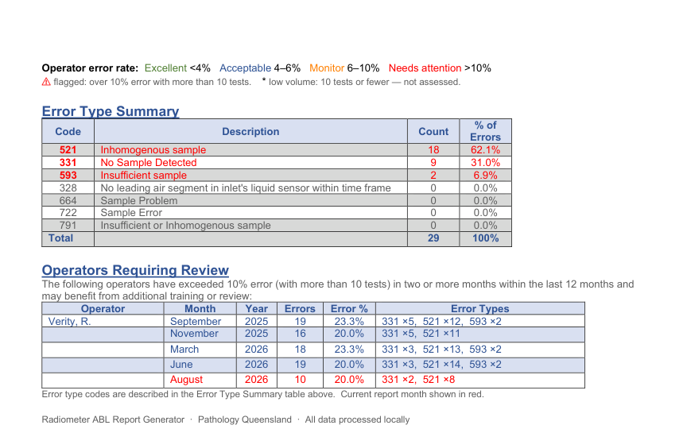
Townsville ED, August 2026 — page 5 of 5
ABL
What the errors were, and who keeps appearing
Error Type Summary: the department’s count of each ABL error code for the month with its share of all errors — the department’s error fingerprint.
Operators Requiring Review: the 12-month lookback — every operator flagged in two or more months, with each month’s error rate and error types. This is the list for a conversation, not a single bad month.
Operator names in the ABL history are encrypted on the drive.
Page 5: error type summary and the 12-month review
Conceived, designed and built by Craig MacKenzie · Chemistry Department, Townsville Group Laboratory · Pathology Queensland
Amendments and oversight by Damian Juskiw · Supervising Scientist, Chemical Pathology, Townsville

Slide 6
The Hospital Summary, August 2026
ABL
The whole hospital on one page
Hospital Snapshot: the hospital’s error rate and band, its departments, how many operators are flagged and in which departments, low-volume operators, and any analyser with recent history that did not report this month.
Departments table: analysers, operators, tests, errors, error % and band, flagged and low-volume counts per department, with a whole-hospital total.
Analysers table: every analyser with its tests, errors, error % and band; an analyser that has gone quiet appears in red with its last active month.
Names stay in the department reports; the summary is for the site lead.
One page per hospital, every department and analyser
Conceived, designed and built by Craig MacKenzie · Chemistry Department, Townsville Group Laboratory · Pathology Queensland
Amendments and oversight by Damian Juskiw · Supervising Scientist, Chemical Pathology, Townsville

Slide 7
How it protects the data
Runs from an encrypted USB drive
Offline by enforcement
Its own Python runtime, no installation, no admin rights, no changes to the PC. BitLocker To Go encrypts the whole drive.
All three servers bind to the local machine only, and a runtime guard blocks and logs any attempt to reach the network. Zero outbound connections, ever.
Named staff data encrypted
Controlled roll-out
The rolling operator and analyser history is AES-encrypted with a password that is never stored. Reports cannot be generated until it is unlocked.
It runs only on PCs approved by the PoC lead, reviewed on the 12-month QIS cycle, with an audit trail of every launch and every report generated.
Full detail for IT: SECURITY_README.md on the drive and the Security Briefing deck.
Conceived, designed and built by Craig MacKenzie · Chemistry Department, Townsville Group Laboratory · Pathology Queensland
Amendments and oversight by Damian Juskiw · Supervising Scientist, Chemical Pathology, Townsville

Slide 8
Getting the reports for your site
1. Ask the PoC team
2. Tell us your departments
Reports are generated centrally each month from the Radiometer operator error export and filed by hospital.
One report per department. If a department name or an analyser’s home is wrong, it is a one-line change.
3. Watch the Hospital Summary
4. Then the department reports
Flagged-operator counts per department, and any analyser that has gone quiet, are on its first page.
Named operators, their error codes and the 12-month review list are in each department’s report.
Support: Pathology Queensland Point of Care team · Chemistry Department, Townsville Group Laboratory
Conceived, designed and built by Craig MacKenzie · Chemistry Department, Townsville Group Laboratory · Pathology Queensland
Amendments and oversight by Damian Juskiw · Supervising Scientist, Chemical Pathology, Townsville

