Slide 1


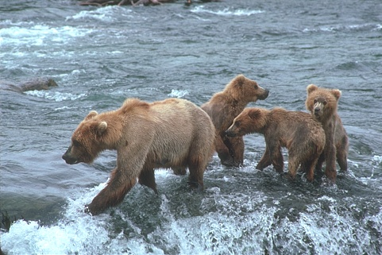
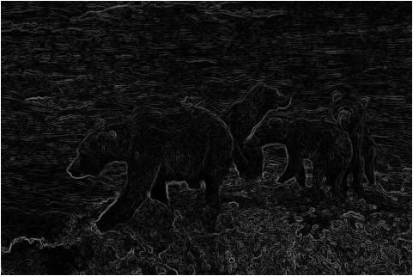
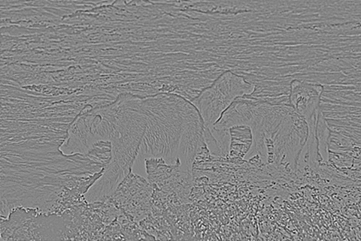
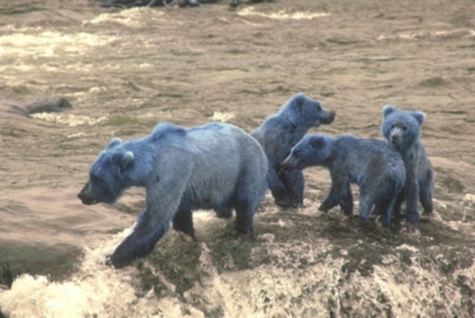
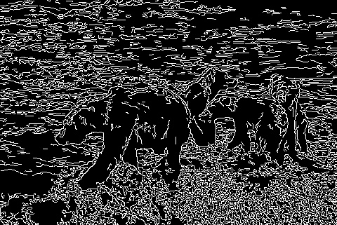
Arbeaez, P., Maire, M., Fowlkes, C., & Malik, J. (2010). Contour Detection and Hierarchical Image Segmentation. IEEE Transactions on Pattern Analysis and Machine Intelligence, 898 - 916.
Validation Study of Image Segmentation Algorithms Southwestern Oklahoma State University
Jacob Miller | Dr. Jeremy Evert | Department of Computer Science and Engineering Technology
Definitions
Methods
Example Segmentations
Image Recognition: A subset of machine learning that classifies images
Machine Learning: A subject in computer science with the goal of teaching computers to learn
Image Segmentation: How a computer divides an image
Algorithm: A mathematical formula, performed in a particular set of steps
Python: A programming language
Programming Libraries: Code that is available for a wide variety of purposes.
Selected articles that offered an approachable segmentation algorithm
Studied three algorithms:
Sobel filter
Laplacian filter
Canny Edge Detector
Implemented algorithms in Python, using a Jupyter Notebook
Measured using scale of accuracy
Original Image
Sobel Filter
Project Effects
Two main benefits:
Prepares researcher to find other avenues of research
Gives newer students in area resources
Laplacian Filter
Gaussian Filter
Sobel: Estimates derivative at each location
Laplacian: Estimates second derivate at each location
Both Sobel and Laplacian are especially susceptible to image noise
Canny Edge: Applies a Gaussian Filter, then a Sobel Filter
Objectives
Introduce machine learning and the research around image segmentation
Increase familiarity with tools and fundamental concepts
Emphasize projects related to current research trajectories for NASA, general robotics applications, and Southwest Research Institute
Make sophisticated code available to fellow undergraduates
Canny Edge Detector
References
Arbelaez, P., Maire, M., Fowlkes, C., & Malik, J. (2010). Contour Detection and Hierarchical Image Segmentation. IEEE Transactions on Pattern Analysis and Machine Intelligence, 898 - 916
Christophe Andrieu, N. D. (2003). An Introduction to MCMC for Machine Learning. Machine Learning, 50, 5-43.
David Martin, C. F. (2001). A Database of Human Segmented Natural Images and its Application to Evaluating Segmentation Algorithms and Measuring Ecological Statistics. Vancouver: IEEE.
Larry Matthies, M. M. (2007). Computer Vision on Mars. International Journal of Computer Vision, Volume 75, Issue 1, 67-92.
P.C.H. Martens, e. a. (2012). Computer Vision for the Solar Dynamics Observatory (SDO). Solar Physics, Volume 275, Issue 1-2, 79-113.
This material is based upon work supported by the National Aeronautics and Space Administration under Grant No.NNX15AK02H issued through NASA Education.
Notes:
1

